Slide 1
Embedding Clinical Trials into Clinical Practice Recommendations Launch
December 15, 2022

Slide 2

WELCOME
Thank you for joining us!
This meeting is being recorded.
All participants are muted upon entry.
Questions will be taken via the chat box.
The presentation and slides will be posted on the CTTI website.
Sally Okun
CTTI Executive Director

Slide 3
Agenda
Time (EST) | Content | Presenter
12:00 PM | Welcome and Introduction to CTTI | Sally Okun (CTTI)
12:05 PM | Opening Comments | Robert M. Califf (FDA)
12:15 PM | Trials in Clinical Practice Project Overview | Matthew Roe (AstraZeneca)
12:30 PM | Stakeholder Perspectives | Sam Bozzette (NIH) Lara Jehi (Cleveland Clinic) Holly Robertson (Medidata) Alandra Weaver (Crohn’s & Colitis)
12:50 PM | Q&A | All Attendees
12:56 PM | Next Steps and Closing Comments | Lindsay Kehoe (CTTI)
1:00 PM | Adjourn

Slide 4
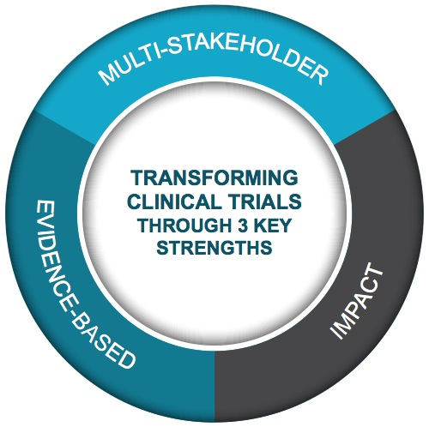
Clinical Trials Transformation Initiative
MISSION
To develop and drive adoption of practices that will increase the quality and efficiency of clinical trials.
VISION
A high-quality clinical trial system that is patient-centered and efficient, enabling reliable and timely access to evidence-based therapeutic prevention and treatment options.
PUBLIC-PRIVATE PARTNERSHIP
Co-founded in 2007 by FDA and Duke University
Active collaboration with +500 individuals and groups
Steering Committee with +80 member organizations
SCOPE
Focus on clinical trials of FDA-regulated medical products, recognizing that clinical trials are international and acting as a collaborative global citizen.
Notes:
Additional content for scope: emphasis on regulatory submission clinical trials because of their unique issues and critical importance

Slide 5

CTTI Recommendations
Our multi-stakeholder teams develop actionable, evidence-based, consensus-driven recommendations designed to:
Accelerate study start-up times & streamline protocols
Enhance the quality of clinical trials without adding undue burden
Leverage new technologies to improve efficiency of clinical trials
Identify streamlined strategies to meet regulatory requirements

Slide 6

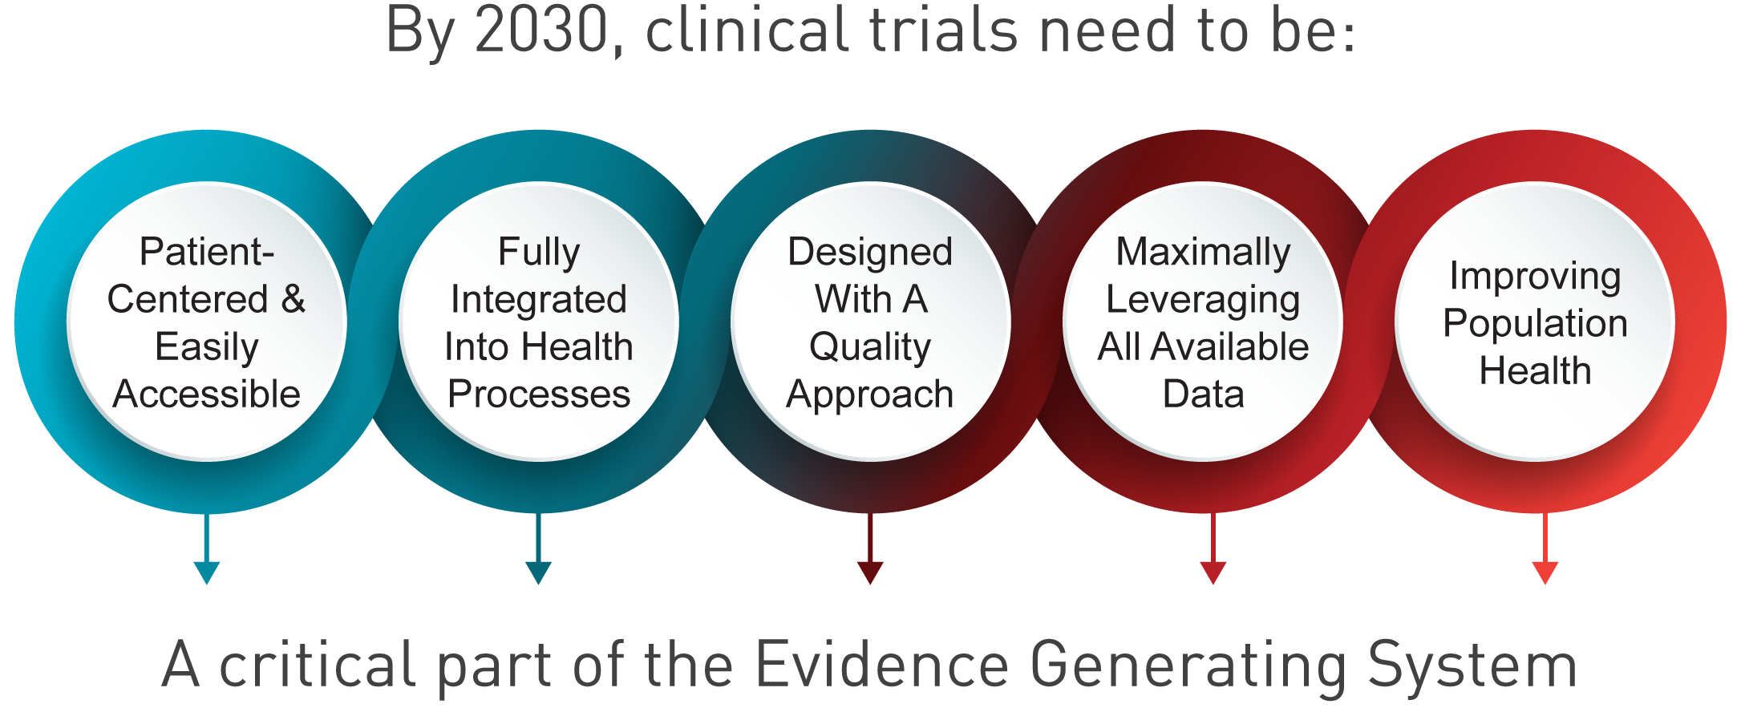

Slide 7

Robert M. Califf
Commissioner,
U.S. Food & Drug Administration

Slide 8

Embedding Clinical Trials into Clinical Practice
Recommendations & Supporting Resources
December 15, 2022
Matthew Roe, VP Head of Early Clinical Development for Cardiovascular, Renal, and Metabolic (CVRM), AstraZeneca, CTTI Team Lead

Slide 9





Integrating Clinical Research & Clinical Practice
Clinical Research
Clinical Practice
Generalizable & Relevant Evidence
+

Slide 10






The Case for Embedding Clinical Trials into Clinical Practice
Patients | Providers | Sponsors & Investigators | Regulators | Payers | Health System Leaders
Research and care are better aligned Less burden to participate in research Greater trial diversity and inclusivity Uses health care data for research to represent more real life experiences | Potential to engage in research with minimal burden Addresses clinically meaningful questions to improve care in a broad population Treatment optionality for patients | Generalizable research populations and evidence Insights into real-world implementation of interventions Potential for increased efficiency & cost savings by reducing duplication of trial & care activities | Sufficiently sized trials with diverse populations Leverages power of randomization & RWD in the context of regulatory decision-making Generalizable evidence | More, diverse data for reimbursement decisions Better understanding of the effectiveness and safety of medical product interventions | A means to innovate and support quality care Potential to attract new patients with research opportunities

Slide 11
Paving the Way for Embedded Trials
NASEM Drug Forum, FDA RWE Framework, NIH Collaboratory, PCORI, Veteran’s Affairs, AHRQ, ACT@POC, COVID-19
Building upon CTTI’s portfolio of multistakeholder projects & recommendations
QUALITY BY DESIGN
Recs that help focus resources on the errors that matter
REGISTRY TRIALS
Recs for assessing & designing registries to meet FDA review expectations
SENTINEL
1st randomized trial using FDA-Catalyst System, IMPACT-Afib
REAL WORLD DATA
Evaluate trial eligibility criteria & enhance recruitment

Slide 12
Trial Elements Amenable to Embedding
Trial Elements
Patient Identification & Eligibility
Intervention
Randomiz-ation
Informed Consent
Evidence Integration
Trial Data Acquisition
Elements integrated into health care delivery
Accessibility to patients at the point of care
Close alignment with clinical workflows
Ability to use clinical care data sources for research purposes
Notes:
Ultimately, what is the trial purpose? What is the question to be answered?

Slide 13
Embedding Clinical Trials into Clinical Practice
Project Overview
Expert Meeting
Purpose: Facilitate the integration of clinical trials intended for, but not limited to, medical product review into clinical practice
Focused on:
  the operations of embedding elements of trials into clinical practice
  randomized trials with U.S. sites, global trials included
Objectives:
  Identify the barriers and potential solutions to incorporating interventional trials into clinical practice
  Identify when integration of clinical trial elements into clinical settings would be feasible and the associated benefits and risks
  Describe the operational approaches to incorporating interventional trials into clinical practice
Multi-Step Stakeholder Review
CTTI Recommendations
Team Discussion & Consensus
Case Examples
Interview Results

Slide 14

CTTI Recommendations
Trial Design/Methodology | Operational | Health Care & Research Culture
Recognize that embedding a trial into clinical practice is not all or nothing Assess whether clinical trial elements should be embedded into clinical practice Verify that data sources are fit for purpose –relevant and reliable Streamline trial design to align with clinical workflows | Ensure site readiness to embed trial elements Minimize participation burden for patients, providers, and research staff Validate the quality of the clinical data for research purposes | Recognize and invest in research activities Promote the basis for and ways to embed trial elements into clinical practice
Recommendations 1-7 are particularly relevant for: sponsors, clinicians interested in conducting research, CROs, funders, health care settings, technology providers, patients/caregivers/patient advocacy groups, payers, and regulatory bodies. |  | Recommendations 8 & 9 are particularly relevant for: health care system leaders, regulatory bodies, funders, patient advocacy groups, and policy makers.

Slide 15
CTTI Recommendations
Trial Design/Methodology | Operational | Health Care & Research Culture
Recognize that embedding a trial into clinical practice is not all or nothing Assess whether clinical trial elements should be embedded into clinical practice Verify that data sources are fit for purpose –relevant and reliable Streamline trial design to align with clinical workflows | Ensure site readiness to embed trial elements Minimize participation burden for patients, providers, and research staff Validate the quality of the clinical data for research purposes | Recognize and invest in research activities Promote the basis for and ways to embed trial elements into clinical practice
Recommendations 1-7 are particularly relevant for: sponsors, clinicians interested in conducting research, CROs, funders, health care settings, technology providers, patients/caregivers/patient advocacy groups, payers, and regulatory bodies. |  | Recommendations 8 & 9 are particularly relevant for: health care system leaders, regulatory bodies, funders, patient advocacy groups, and policy makers.

Slide 16
Trial Design/Methodology Recommendations
Recognize that embedding a trial into clinical practice is not all or nothing
Assess whether clinical trial elements should be embedded into clinical practice
Verify that data sources are fit for purpose – relevant and reliable
Streamline trial design to align with clinical workflows
Key Points
Components or elements of a trial can be embedded into clinical practice and benefits can be gained regardless of the # of elements integrated.
Determine which trial activities and data are essential and whether they align with clinical workflows.
Consult early and often with regulatory authorities on data quality questions.
Validate the reliability of the clinical data through manual and automated data checks.
Develop processes conducive for future trials.
Aim to lessen duplicate efforts already occurring in care.

Slide 17
Operational Recommendations
Key Points
Assess 1) resources and degree of training settings will require, 2) that GCP requirements for clinical staff participating are not compromised, and 3) sites current connections with the local community- help support efforts to engage community clinicians
Communicate across health systems to determine how technology solutions can facilitate changes that meet both research and clinical needs
Train clinical staff to be ready to complete research-related tasks
Provide support staff so that HCPs feel assisted and not overwhelmed
Automate: 1) what can be done before or during clinical care encounters, 2) quality assurance checks of clinical data (compare to a manual check)
Ensure site readiness to embed trial elements
Minimize participation burden for patients, providers, and research staff
Validate the quality of the clinical data for research purposes

Slide 18
Health Care & Research Culture Recommendations
Recognize and invest in research activities
Promote the basis for and ways to embed trial elements into clinical practice
Health Care System Leadership can:
Government and Policy Forums can:
  Prioritize research participation
  Collaborate to build stronger digital and financial infrastructures
  Encourage standardization
  Develop communication plans with sponsors
  Promote the rationale for embedded trials as a means to improve evidence generation
  Encourage regulatory, reimbursement, and policy changes
  Develop standards and acknowledge international opportunities to align
  Support the sharing of learnings
  Recognize that there is shared accountability across organizations to make the required changes

Slide 19
Supporting Resources
Five Case Examples
These reflect, at an individual study level, that embedding trial elements into care is possible
  RECOVERY
  I-SPY
  REMAP-CAP
  VA Diuretic Comparison Project
  TASTE Trial
Tool Coming Soon!
Embedding Considerations Framework
  What: A framework to assess which trial elements to embed into clinical practice
  For Whom: Trials Designers and Health Systems
  When: During the early design planning phase of a study or protocol

Slide 20
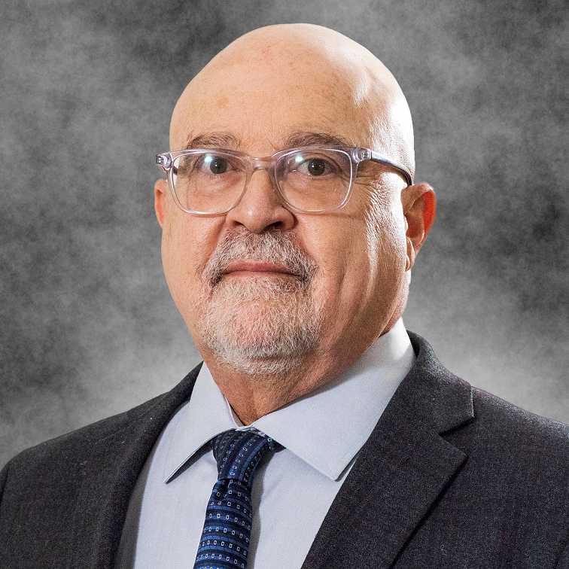



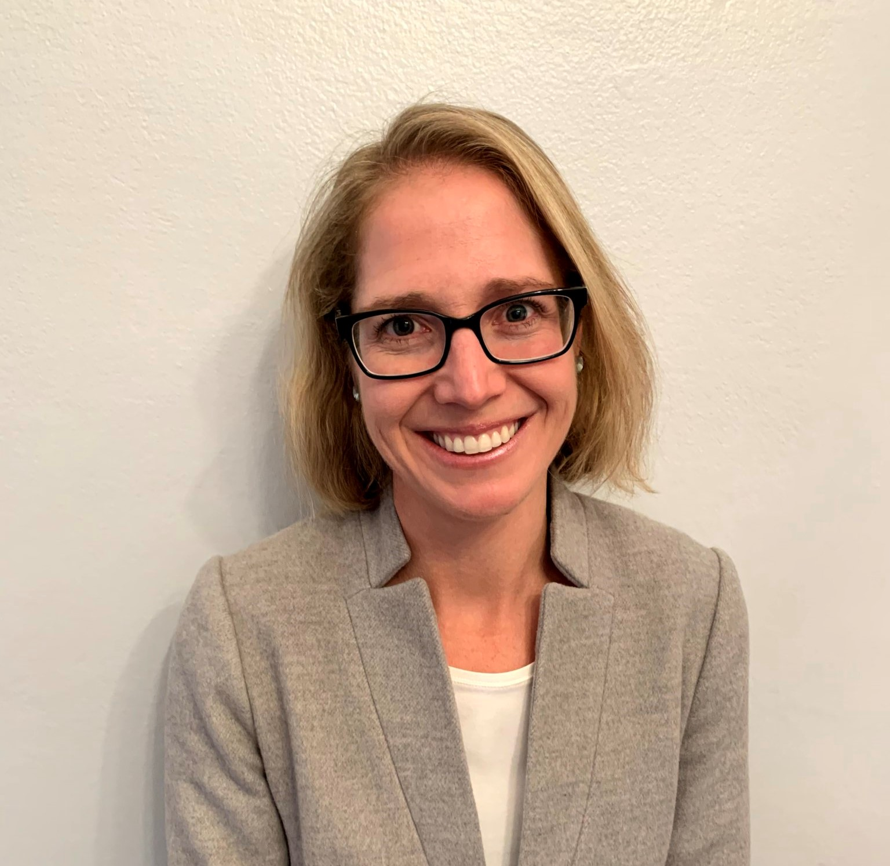
Stakeholder Perspectives
Sam Bozzette
NIH
Lara Jehi
Cleveland Clinic
Holly Robertson
Medidata
Alandra Weaver
Crohn’s & Colitis
Moderator: Lindsay Kehoe, CTTI, Project Manager

Slide 21
Q & A

Slide 22
Next Steps: Dissemination & Implementation
New Tool
Develop out the new Embedding Considerations tool
Manuscript
Summarize in-depth interviews and recommendations
Potential Pilot
Do you have a trial that will be integrated into clinical practice/point of care in the early design phase? Please contact: Lindsay.Kehoe@duke.edu
Q1 2023
Q1-Q2 2023

Slide 23


Download the Recommendations
Learn How Others Implement CTTI Recs
Available Now on the CTTI website:
https://ctti-clinicaltrials.org/our-work/novel-clinical-trial-designs/integrating-clinical-care/
Available Now through the CTTI website:
https://connects.ctti-clinicaltrials.org/case_study_exchange

Slide 24
Thank You
Research Participants
Expert Meeting Attendees
Recommendation Advisory Committee

Slide 25
THANK YOU Trials in Clinical Practice Project Team
Team Leads
Kraig Kinchen (Eli Lilly & Co)
Matthew Roe (AstraZeneca)
Mark Stewart (Friends of Cancer Research)
Executive Committee Champion
John Alexander (Duke)
Social Science Team
Amy Corneli (Duke)
Carrie Dombeck (Duke)
Terry Swezey (Duke)
Writer
Karen Staman (Duke)
Team Members
Sam Bozzette (National Institutes of Health)
Suanna Bruinooge (American Society of Clinical Oncology)
Sabrina Comic-Savic (TrialsPark)
Marie Elena Cordisco (Nuvance Health)
Maureen Dreher* (FDA/OC)
Ryan Ferguson (Department of Veterans Affairs)
Louis Fiore* (Department of Veterans Affairs)
Victoria Gamerman (Boehringer Ingelheim)
Lara Jehi (Cleveland Clinic Coordinating Center for Clinical Research)
Marcy Kravet (EMD Serono)
Nirosha Mahendraratnam Lederer (Aetion)
Greg Licholai (Yale University)
Pablo Morales* (FDA/CDRH)
Nuru Noor (Patient/Caregiver Rep.)
Holly Robertson (Medidata Solutions)
James Riddle (Advarra)
Jeffrey Roberts* (FDA/CBER)
Daniel Rose (Pulmonary Fibrosis Foundation)
Heather Stone (FDA/CDER)
David Thompson* (Open Health)
Alandra Weaver (Crohn’s &Colitis)
Communications Lead
Rae Holliday (CTTI)
Project Manager
Lindsay Kehoe (CTTI)

Slide 26


