Slide 1
Welcome
Once you’ve logged into Webex, please select one of the following audio options:
Call Using Computer
I Will Call In
Please enter the Attendee ID when dialing in
Select the “Call Me” option.
This webinar is being recorded.
All participants are muted upon entry.
Questions can be entered in the chat box during the webinar
Questions will be answered to the best of our ability after the call via CTTI’s best practices document.

Slide 2
Conduct of Clinical Trials during the COVID-19 Pandemic
March 31, 2020
M. Khair ElZarrad, FDA, CDER
Pamela Tenaerts and Sara Calvert, CTTI
Colleen Rouse, Cleveland Clinic
David Borasky, WIRB-Copernicus Group (WCG)
Cindy Geoghegan, Individual Patient Representative/Caregiver
Notes:
NOTE: If your presentation is being recorded, this will be the beginning of the recording, so make it a clean introduction.
EXAMPLE:
Welcome everyone! My name is [insert introducer’s name/title] and it is my pleasure to introduce [insert presentation name].
Today’s presentation is hosted by the Clinical Trials Transformation Initiative, and the speakers today include [insert speaker(s) name/title]
[Insert prepared speaker(s) bios.]

Slide 3
Welcome
For further questions on clinical trial conduct during the COVID-19 pandemic, please email:
Clinicaltrialconduct-COVID19@fda.hhs.gov
Contact information for FDA’s review divisions is as follows:
CDER: https://www.fda.gov/about-fda/center-drug-evaluation-and-research-cder/office-new-drugs
CBER: https://www.fda.gov/about-fda/center-biologics-evaluation-and-research-cber/contacts-center-biologics-evaluation-research-cber
CDRH: https://www.fda.gov/about-fda/cdrh-offices/cdrh-management-directory-organization

Slide 4
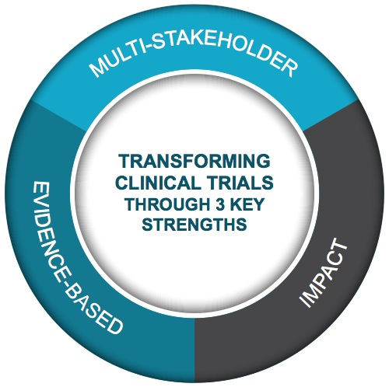
Public-Private Partnership Co-founded by Duke University & FDA
Involves all stakeholders
Approx. 80+ members
Participation of 400+ more orgs
MISSION: To develop and drive adoption of practices that will increase the quality and efficiency of clinical trials

Slide 5
CTTI COVID-19 Activities
Ongoing clinical trials during the pandemic
Survey and webinar today
Considering additional activities to help the clinical trials enterprise right now
COVID-19 trials
Telemedicine
Patient perspective
Considering additional activities to help the enterprise after the immediate crisis is over

Slide 6
Ongoing Clinical Trials
Introduction: Pamela Tenaerts, CTTI
Opening Comments: M. Khair ElZarrad, FDA, CDER
Survey and Best Practices: Sara Calvert, CTTI
Best Practices
From Sites: Colleen Rousse, Cleveland Clinic
From IRBs: David Borasky, WCG
From Participants: Cindy Geoghegan, Patient
Summary & Next Steps: Pamela Tenaerts, CTTI

Slide 7
Safety is Primary Consideration
Safety of trial participants, study staff is most important factor
Avoiding/limiting potential exposures to the virus, avoiding interference with clinical care for COVID-19
Continuing study activities virtually (where feasible), or in-person when benefit is greater than risk
Maintaining compliance with good clinical practice (GCP)
Minimizing risks to trial integrity during the pandemic
Preserving time, invested resources, & effort of participants already enrolled or completed

Slide 8
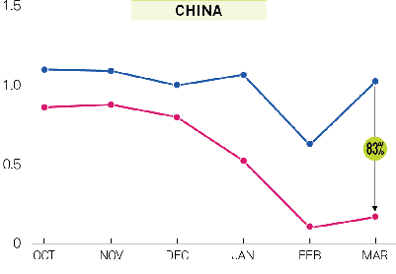
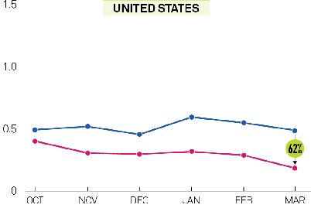
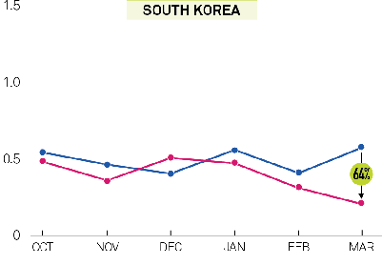
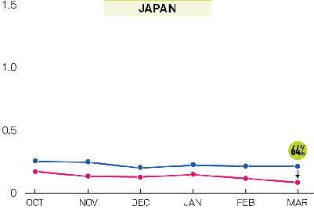
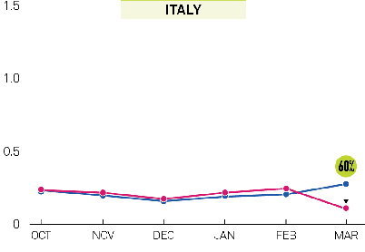
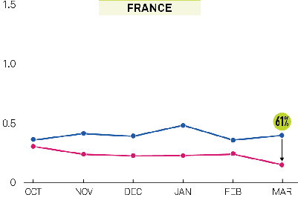
Medidata: Global Impact COVID-19 on Clinical Trials
NEW PATIENTS ADDED PER STUDY SITE
NEW PATIENTS ADDED PER STUDY SITE
China had 83% decrease in new patients entering trials Feb 2020
Similar trends in other affected countries
U.S. decline of 62% in the first half of March
https://www.medidata.com/wp-content/uploads/2020/03/COVID19-Clinical-Trials_20200324-1.pdf

Slide 9

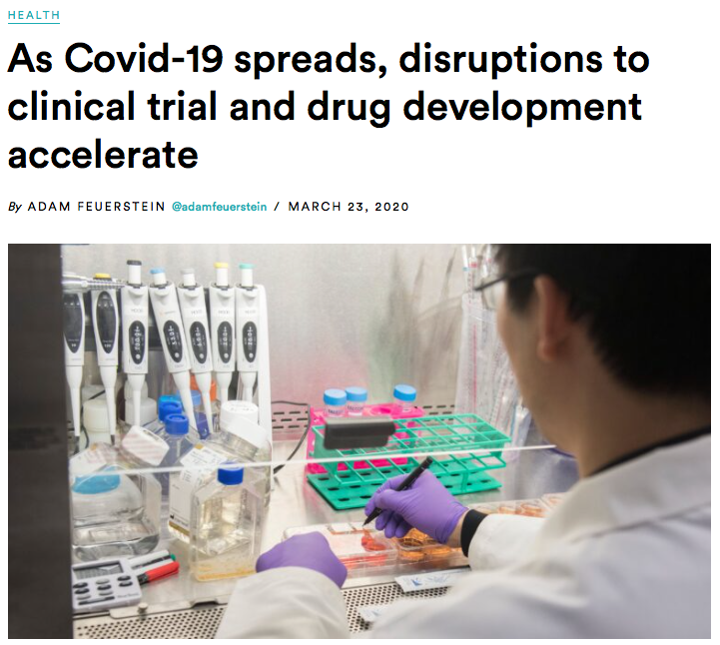
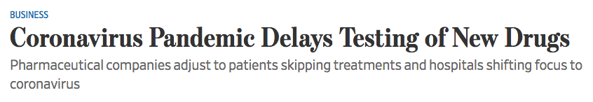
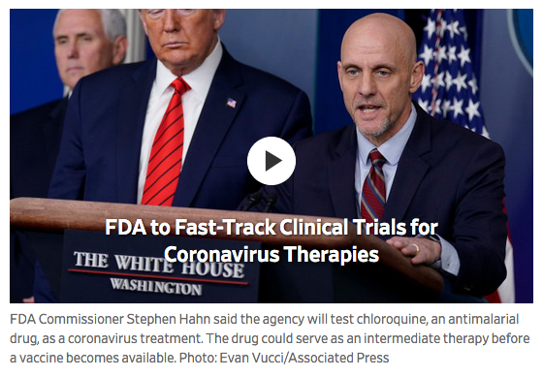

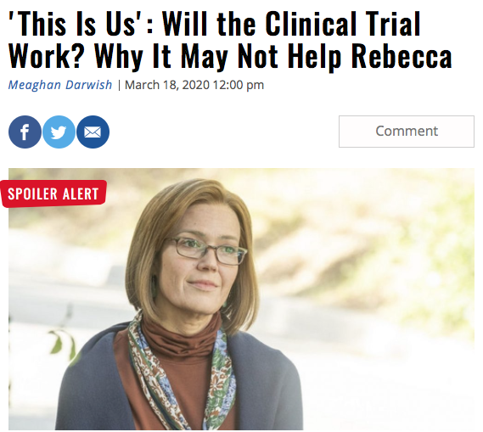

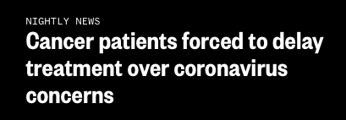
Clinical Trials During Pandemic

Slide 10
Emerging Questions / Confusion about Clinical Trials*
Scientific side:
Delayed startup
Sending study drugs
Short-term outcome measures: losing entire cohort
Ability to re-screen patients
What can be done at a distance with people currently enrolled?
Will funding be extended? Flexibility has been helpful
Will labs be able to administer medications, and what does that mean for patients
Whether therapeutic as well as non-therapeutic trials will be ended
Can natural history studies be done via telemedicine?
Can non-therapeutic trials be done in a safe way?
Concern about loss of clinical trials; how long can you extend primary endpoint assessments without losing entire trial
What level of flexibility will FDA have as visit schedules change?
Are open trials still enrolling patients?
Consistency of care once pandemic has passed
Language used… calling these “non-essential trials”; concern about trials being sidelined
Information on testing kits and approval; untested/unapproved treatments
Application for orphan drug status and pushback from consumer community
*From Patient Engagement Collaborative monthly teleconference, March 26, 2020

Slide 11
CTTI Request for Experiences & Insights, in Context of the New Guidance
Sara Calvert
CTTI

Slide 12
Guidance Documents

Slide 13
FDA Guidance Topics EMA and MHRA Guidance cover similar topics
Assessment of each study focusing on safety
Establish or revise policies & procedures (contingency measures)
Inform patients of status & impact of changes
Pause enrollment, delay visits, extend trials/visit windows
Remote/alternate visits for data collection and safety assessments
Access to investigational medical product (IP or IMP)
Central & remote monitoring programs
Contacting IRB/IEC & FDA with changes
COVID-19 screening procedures
Documenting changes related to COVID-19
Questions & Answers section
EMA also released methodological guidance. FDA also released guidance on use of non-invasive remote monitoring devices for patient monitoring during COVID-19.

Slide 14
CTTI Request for Experiences
CTTI collected feedback from March 23 - 30
Survey distributed via:
Email to CTTI member organizations and public contacts
Posts on Twitter and LinkedIn
Encouraged trade, media, and other organizations to share
In context of the new FDA guidance on the conduct of clinical trials of medical products during the current COVID-19 pandemic,
Do you have any experiences or best practices to share?
What have you tried?
What works well?
What have you thought of doing but have not tried yet?

Slide 15

What best represents your role in the clinical trial ecosystem? (n=53)
Clinical Investigator/ Site, 4
Biotech, 5
Pharma, 11
Patient Group, 9
Device/ Diagnostics, 3
Other, 2
Legal, 1
Technology, 1
CRO, 9
Academia, 5
IRB, 3

Slide 16
Do you have an experience related to any element of the new FDA guidance?
Frequent Responses | Example comments
Conducting risk assessment | Conducting risk-benefit for all studies at organization Approach is county/region specific for global studies
Remote/virtual study visits | Utilizing FaceTime, Zoom, other apps to conduct interviews/questionnaires/assessments Pivoting to telephone visits
Study visits paused/delayed/suspended | Important not to disqualify patients for inability to attend visits during this time Expanding windows for completing study visits
Enrollment hold/pause | Pausing new enrollments in majority of studies Exceptions for life-threating illnesses/potential benefit
Investigational product (IP) directly to patient from site | Shipping self-administered meds to patient home Need site staff or home health willing to travel patients’ homes to administer parenteral meds
Remote monitoring | Those teleworking need to have access to necessary documents If prior experience, increasing amount of risk-based/central monitoring

Slide 17
Best Practices
Keep Participants Informed
Perform Ongoing Risk Assessment
Pause (Most) New Study Starts & Enrollment
Pivot to Remote Study Visits
Switch to Remote Monitoring
Document with COVID-19 Tag
Communicate with IRBs (David Borasky presentation)

Slide 18
1. Keep Participants Informed
“For all clinical trials, however, research staff should keep participants informed about the effects of the coronavirus pandemic on their trial participation. Participants should be informed of necessary changes in protocol and how this may affect the risk associated with study participation. For many randomized trials, communication from research staff is likely to help protect against dropout or nonadherence by reassuring participants that their trial involvement remains important, even during the pandemic.”
From Preserving Clinical Trial Integrity During the Coronavirus Pandemic. JAMA March 25, 2020. doi:10.1001/jama.2020.4689

Slide 19
2. Perform Ongoing Risk Assessment
Follow country, local, & institution rules & restrictions in place due to the virus
Priority is safety of patients & research personnel over data integrity concerns
Telework for study personnel
Which activities can be performed remotely – study visits & monitoring
Avoid interference or burden on clinical care
Screening for COVID-19 symptoms prior to & at visits/when visits resume

Slide 20
3. Pause New Study Starts & Enrollment
New enrollment suspended or paused in many responses
Country & region-specific approach to pauses & restarts
Limited exceptions:
Oncology or other trials where investigational treatment is among limited options
COVID-19 treatment or vaccine trials
Ongoing visits also delayed or conducted with alternative methods unless in-person necessary
Important to collect data by other methods where possible
Allow expanded windows where delay not harmful

Slide 21
Example: Risk Assessment Applied
Study Classification | Actions
Tier 1 High Potential Direct Benefit to Research Participants | Enrollment allowed Convert to virtual visits as much as possible
Tier 2 Moderate Potential Direct Benefit to Research Participants | Pause enrollment Convert to virtual visits as much as possible with likely all visits virtual/phone
Tier 3 Primarily observational, behavioral studies without potential direct benefit | Pause enrollment Convert all visits to virtual/phone
Adapted from March 20 NIH Collaboratory Grand Rounds: https://rethinkingclinicaltrials.org/grand-rounds-hub/

Slide 22
4. Pivot to Remote Study Visits
Use time from paused enrollment to determine activities that can be performed remotely
Utilize available resources: institutions, IRBs, patient groups have resources available & experience
Check for approved telemedicine platforms, programs
Investigate apps, non-invasive physical assessment devices
Questionnaires, adverse events, other questions asked at study visits can be obtained via telephone
Explore alternative distribution of investigational product
Refer immediate safety concerns to PCP or other care provider

Slide 23
5. Switch to Remote Monitoring
Most are postponing all on-site monitoring
Implementation of remote, risk-based monitoring
Prioritization safety assessments & primary outcome measures
Ensure secure methods to allow for access of subject data for remote review
Restricted access accounts in electronic health record, secure file sharing
Staff access while working from home
Document all changes made to monitoring plan

Slide 24
6. Document with COVID-19 Tag
Many IRBs have created COVID-19 specific submission flag or process for amendments, questions, new studies
Add COVID-19 to all documentation - patient & study level
For reports to sponsor, IRB, & FDA when required
Example: One clinical research site proactively created a template for missed assessments
Details any procedures that could not be performed virtually
Plan to perform missed procedures as soon as possible when on-site visits safe
Reported to the sponsor within 48 hours via templated form sent by email to the CRA

Slide 25
Flexibility on Study-by-Study Basis Healy Center for ALS Research Mass General Hospital
Actively engage with IRB
Virtual study activities
Consent via video visit or phone
Safety assessments - adverse events, conmeds, abbreviated exam
Investigating use of home health infusion/nurses
Investigational product infusions
Blood & urine collection for safety & biomarkers
Or use of off-site labs
Staffing adjustments
Rotating staff to minimize those on-site needed to cover study visits
Telework (VPN, EHR, email etc.) for protocol follow-up
Videoconference for staff meetings and check-ins
Delivery of investigational product
FedEx from institution
Investigating home infusion services

Slide 26
Academic Medical Center Practices
Colleen Rouse
Cleveland Clinic

Slide 27
Cleveland Clinic Approach to Trials During COVID-19
Strategy | Implementation
Sponsor Communication | Determine what study changes related to protocol sponsor intends to make Notify sponsor of proposed logistical changes at site level
IRB Notification of Study Changes | Provide specific information about what is changing via amendment after sponsor approval; document in study file Specify that changes were result of COVID-19
Recruitment into Research Studies | Develop recruitment plan based on risk assessment that minimizes patient exposure – both for initial recruitment & subsequent visits Minimal risk recruitment stopped Phone recruitment that requires patient to come in for screening visit stopped
Workforce Adjustment | Divide study team into A and B and adjust on-site work accordingly Work with IT to setup network access (including eMR) from home computers or provide property passes to take laptops home Reminder to be mindful of surroundings, turn off any smart speakers

Slide 28
Cleveland Clinic Approach to Trials During COVID-19
Strategy | Implementation
Study Participant Communication | Discuss how risk has changed & provide proposed study changes Determine subject’s interest/ability in continued participation
Remote/virtual study visits | Utilize ExpressCare online, Skype (or similar virtual conferencing software) for remote study visits.
Send study drug directly to patient from site | Work within state pharmacy board guidelines
Explore alternate options for patients to obtain safety assessments | Utilize less-crowded family health centers or home health for patients to have blood draws, ECGs & imaging away from the hospital
Remote monitoring | Use of Epic Anyconnect feature (or web-based virtual conferencing) to permit remote monitoring with sponsor agreement (limit monitor access to only enrolled subjects) – may require update to contract
DOCUMENT, DOCUMENT, DOCUMENT

Slide 29
IRB Practices
David Borasky
WIRB-Copernicus Group (WCG)

Slide 30
IRB Perspective: Supporting Research
“Ensuring the safety of trial participants is paramount.”
(FDA Guidance on Conduct of Clinical Trials of Medical Products during COVID-19 Pandemic)
Tremendous strain on all
Sites – diversion to clinical care; remote staff; inaccessible participants
IRBs – institutional IRBs may shift staff, members to COVID support; independent IRBs shift to remote work
Sponsors – measures to maintain / salvage studies under circumstances
Goal of IRBs – provide reliable support in order to maintain research that is ethical, valid, compliant

Slide 31
IRB Perspective: Supporting Research
Unprecedented volume of changes to ongoing research
Most common changes
Elimination / reduction in frequency of study visits
Shift from on-site to telemedicine, home healthcare
Collection of labs offsite
Changes to drug delivery – direct ship, delivery by site staff
Other changes that do not require IRB approval
Sponsors – measures to maintain / salvage studies under circumstances

Slide 32
When is IRB Review Required?
Regulations expect prospective review & approval
Regs allow immediate changes when in best interest
Each IRB shall … (a) Follow written procedures for ensuring that changes in approved research, during the period for which IRB approval has already been given, may not be initiated without IRB review and approval except where necessary to eliminate apparent immediate hazards to the human subjects. (21 CFR 56.108(a)(4))
IRBs interpreting in light of COVID-19 context
Check with your IRB to determine timeline for reporting changes to the IRB
IRBs can – & should be – nimble & efficient when managing such changes

Slide 33
Considerations for Informed Consent
Frequent question: Do changes require “re-consent”?
SACHRP – “When there is a need to present participants with new information, IRBs should encourage use of the least burdensome approach for the participant.”
“Re-consent” not a regulatory term
New information can be presented in different formats
Revised consent document
Addendum to consent
Memo or other communication to subjects
Orally by phone or in person

Slide 34
Bottom Line = Documentation
Regulators & IRB know that COVID-19 will necessitate changes to almost all clinical research
Sites & sponsors should create clear documentation of all actions taken to manage ongoing research.

Slide 35
Patient Perspectives
Cindy Geoghegan
Individual Patient Representative/Caregiver

Slide 36
Patient Perspective: Safety of trial participants, study staff is most important
“Safety” to trial participant in context of pandemic
Continuously evaluating; daily prioritizing urgent needs (food, shelter, finances, family)
Fear & anxiety
Baseline fear of living with life-threatening illness can turn to terror
Heightened ”safety” warnings aimed at “high-risk, especially vulnerable”
Preexisting conditions, heart & respiratory ailments, diabetes, elderly
Healthcare shortages – physicians, nurses, supplies
Enforcing of self-isolation and home quarantine in impacted areas; travel restrictions
Worry about added risks to loved ones & caregivers

Slide 37
Patient Perspective: Safety of trial participants, study staff is most important
Sense of urgency –
My disease is progressing as research stalls
Am I “essential”? Is my treatment? Is my trial?
We’ve been waiting for this trial for months, years? How quickly can it resume? What happens to my participation if trial doesn’t resume?
What can I do now?

Slide 38
Patient Communication Essential
It is critical that trial participants are kept informed of changes to the study and monitoring plans that could impact them.
FDA Guidance
Need for plan, process, decision-making
Who informs, when, how?
Resources for consistent, evidence-based information
Essential information at patient-level
Study delays, suspended procedures, clinic closings
Transitions to remote, digital or home-based visits
Support, training necessary for digital tools, monitoring, home collection
Role of patient organizations in reviewing modifications, broader outreach, guidance
Reference: CTTI Recommendations: Technical support (training) for digital tools, home collection (CTTI MCT EPS)

Slide 39
Summary & Next Steps
Pamela Tenaerts
CTTI

Slide 40
Best Practices
Keep Participants Informed
Perform Ongoing Risk Assessment
Pause (Most) New Study Starts & Enrollment
Pivot to Remote Study Visits
Switch to Remote Monitoring
Document with COVID-19 Tag
Communicate with IRBs

Slide 41
Next Steps
Post & communicate recorded webinar & slides
Create best practices document
Submitted questions from today’s webinar will be incorporated
Situation will evolve
Best practices document will be updated and communicated
Additional CTTI efforts will be forthcoming

Slide 42
Additional Resources:
For further questions on clinical trial conduct during the COVID-19 pandemic, email:
Clinicaltrialconduct-COVID19@fda.hhs.gov
Contact information for FDA’s review divisions is as follows:
CDER: https://www.fda.gov/about-fda/center-drug-evaluation-and-research-cder/office-new-drugs
CBER: https://www.fda.gov/about-fda/center-biologics-evaluation-and-research-cber/contacts-center-biologics-evaluation-research-cber
CDRH: https://www.fda.gov/about-fda/cdrh-offices/cdrh-management-directory-organization

Slide 43
Sara.calvert@duke.edu

