Slide 1
Welcome to “Using RWD to Plan Eligibility Criteria and Enhance Recruitment”
Once you’ve logged into WebEx, please select one of the following audio options:
Call Using Computer
I Will Call In
DO NOT SELECT the “Call Me” option.
This webinar is being recorded.
All participants are muted upon entry.
Questions will be taken following the presentation. Please indicate that you have a question by typing in the chat box “To Everyone.”

Slide 2
Using Real-World Data to Plan Eligibility Criteria and Enhance Recruitment
October 17, 2019
Sudha Raman, Duke University
Jack Sheehan, Janssen Scientific Affairs
Notes:
NOTE: If your presentation is being recorded, this will be the beginning of the recording, so make it a clean introduction.
EXAMPLE:
Welcome everyone! My name is [insert introducer’s name/title] and it is my pleasure to introduce [insert presentation name].
Today’s presentation is hosted by the Clinical Trials Transformation Initiative, and the speakers today include [insert speaker(s) name/title]
[Insert prepared speaker(s) bios.]

Slide 3
Disclaimer
The views and opinions expressed in this presentation are those of the individual presenter and do not necessarily reflect the views of the Duke University or Janssen Scientific Affairs.

Slide 4
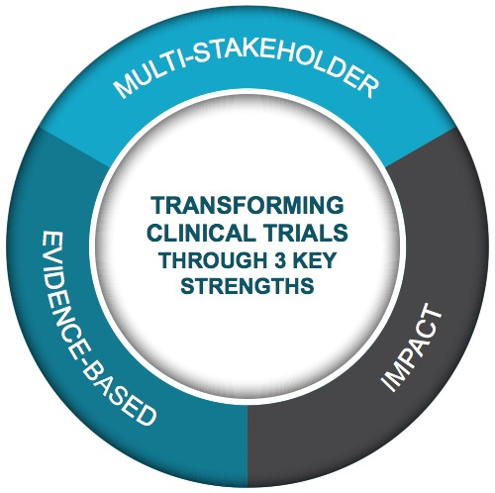
Public-Private Partnership
Co-founded by Duke University & FDA
Involves all stakeholders
Approx. 80+ members
Participation of 400+ more orgs
MISSION: To develop and drive adoption of practices that will increase the quality and efficiency of clinical trials

Slide 5
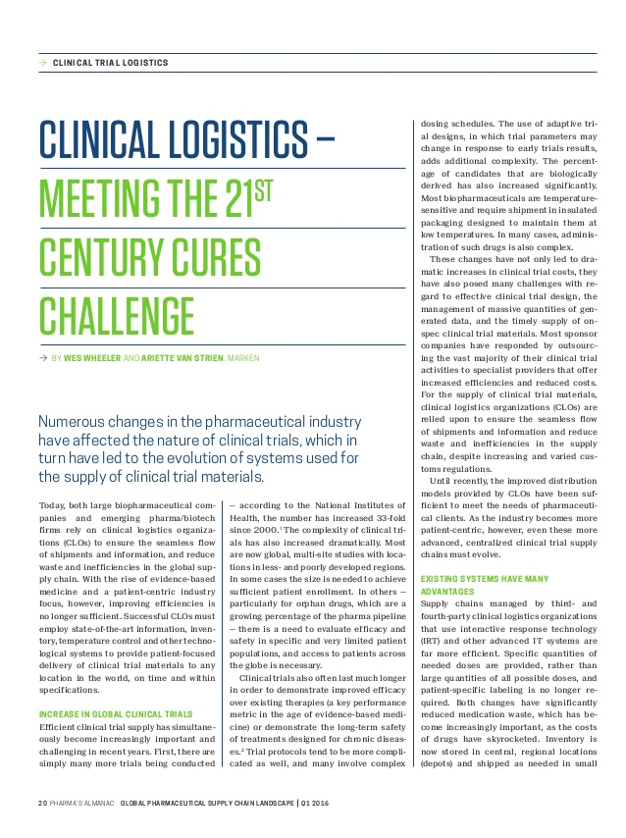
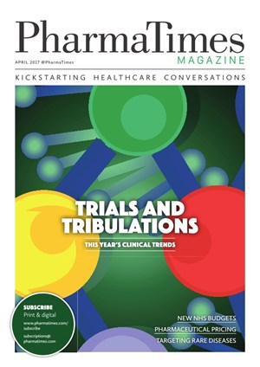
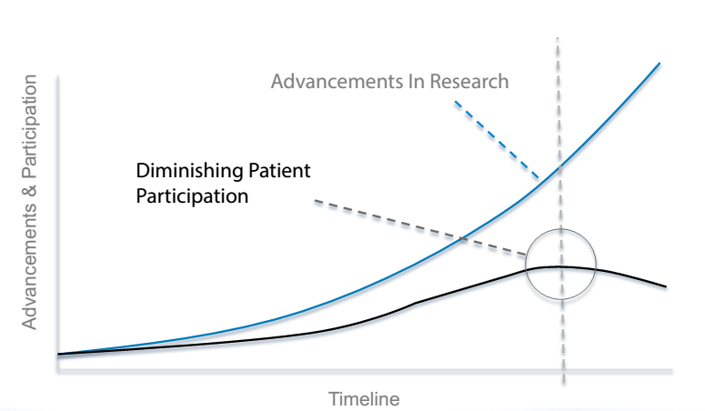
Meeting Recruitment Challenges
Discovery's 'First In Human' Calls Much-Needed Attention To Clinical Trials

Slide 6
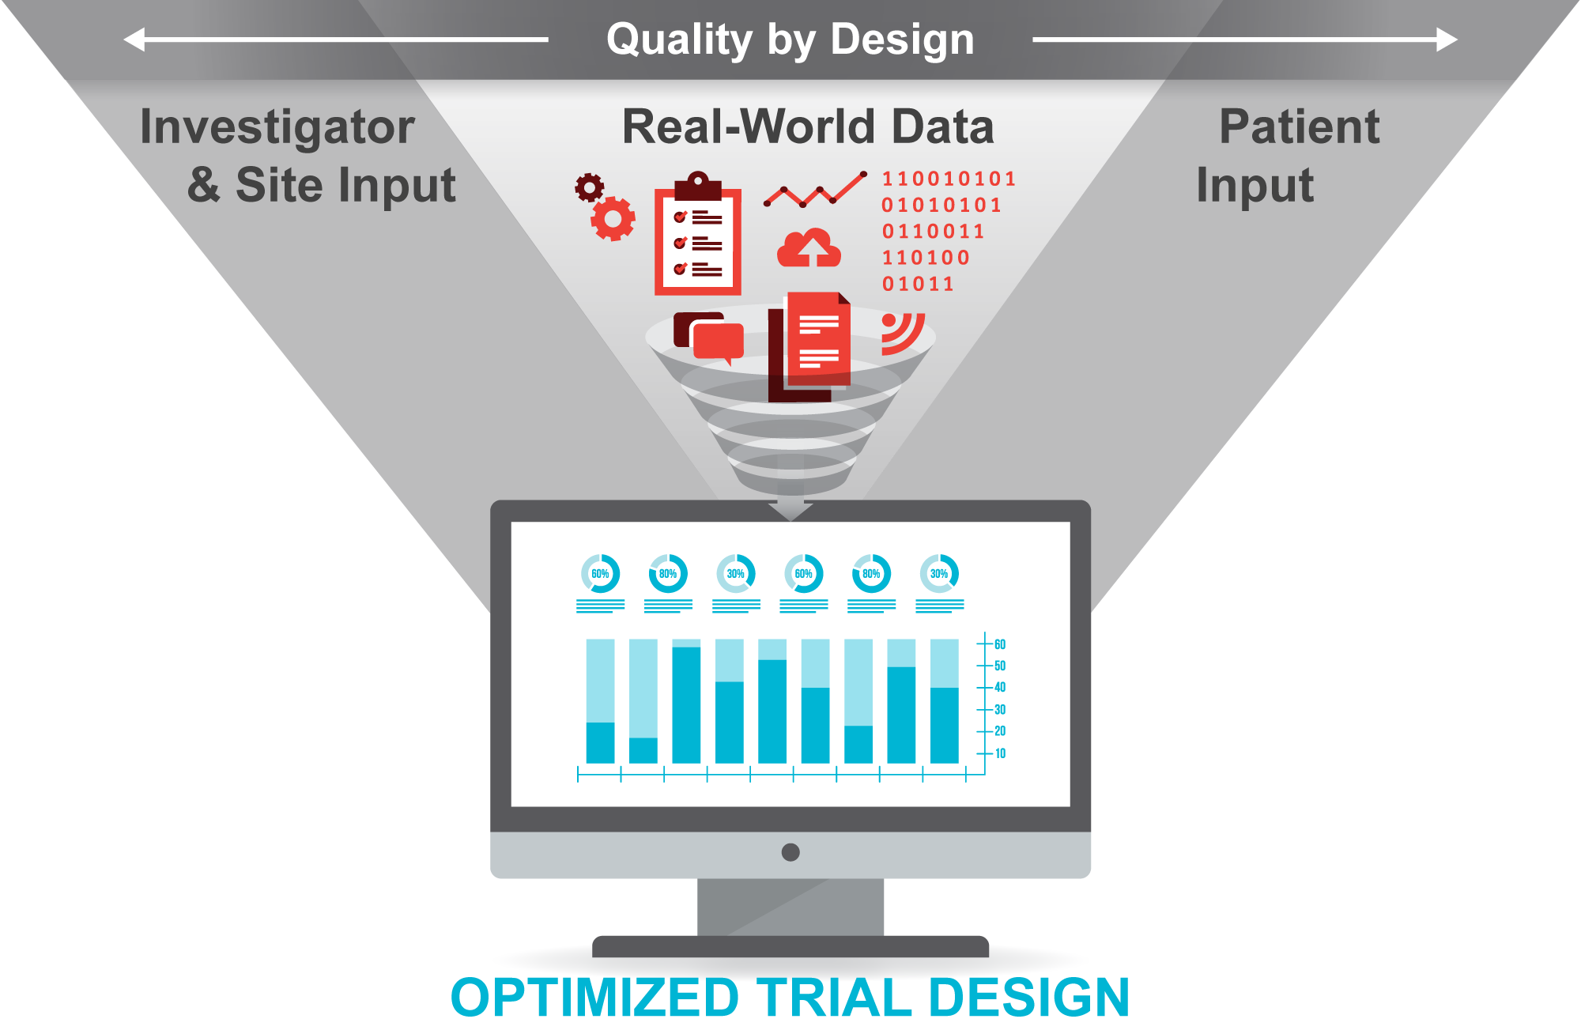

Slide 7
CTTI Real-World Data (RWD) Project Team
Executive Committee Champions: Richard Platt, Harvard Joe Selby, PCORI | Team Members: Naomi Aronson, Blue Cross Blue Shield Barbara Bierer, Harvard William Capra, Genentech* Ken Carson, Flatiron Laura Chu, Genentech* Cathy Critchlow, Amgen Ruthie Davi, Medidata Kristin Dolinski, PhRMA M. Khair ElZarrad, FDA/CDER Ryan Ferguson, Dept of Veterans Affairs Farhan (CJ) Hameed, Pfizer Jerry Heatley, Abbott Ani John, Genentech* Jessie Juusola, Evidation Health David Kronfeld, Medidata* John Laschinger, FDA/CDRH* Sarah Leatherman, Dept of Veterans Affairs Claire Meunier, Evidation Health* Eric Peterson, Duke Estevan Santana, PhRMA David Thompson, Syneos Health Juli Tomaino, FDA/CDER* Guneet Walia, Genentech
Team Leaders: Lesley Curtis, Duke* Scott Evans, Society for Clinical Trials Dianne Paraoan, FDA/CDER Jane Perlmutter, Patient/Caregiver Sudha Raman, Duke Melissa Robb, FDA/CDER* Jack Sheehan, Janssen
CTTI Staff: Zachary Hallinan Gerrit Hamre* Lindsay Kehoe Brian Perry
* Indicates former

Slide 8
Real World Data (RWD) Recommendations
GENERAL PRINCIPLES FOR USING RWD | RECS FOR USING RWD TO PLAN FEASIBLE ELIGIBILITY CRITERIA | RECS FOR USING RWD TO SUPPORT RECRUITMENT | RECS FOR ENHANCING RWD CAPABILITIES FOR THE RESEARCH ENTERPRISE

Slide 9
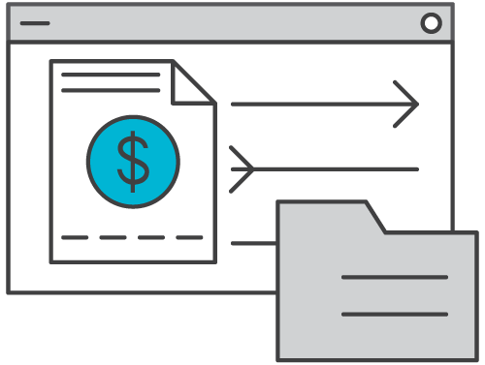
Data Sources
EHR
Data richness / depth
Clinical info
Faster availability
Integration with routine health care
Claims
Fully structured
Widespread availability
Continuum of data capture
COMMON CHALLENGES
Data completeness, data accuracy, & generalizability

Slide 10
GENERAL PRINCIPLES FOR USING RWD | RECS FOR USING RWD TO PLAN FEASIBLE ELIGIBILITY CRITERIA | RECS FOR USING RWD TO SUPPORT RECRUITMENT | RECS FOR ENHANCING RWD CAPABILITIES FOR THE RESEARCH ENTERPRISE
Start early in product lifecycle
Engage patients & sites
Data alone never tell whole story
Build cross-functional teams

Slide 11
Resource: Establishing Use of RWD as Standard Process in Study Planning & Recruitment
Early Stages
Pilot with early phase / feasibility trials
Engage study teams as early as possible
Standard Process
Identify and maintain data sources (consider budgets, priorities, & responsibilities)
Support cross-functional teams
Leadership understanding & support
Demonstrate value (e.g., case studies)

Slide 12
GENERAL PRINCIPLES FOR USING RWD | RECS FOR USING RWD TO PLAN FEASIBLE ELIGIBILITY CRITERIA | RECS FOR USING RWD TO SUPPORT RECRUITMENT | RECS FOR ENHANCING RWD CAPABILITIES FOR THE RESEARCH ENTERPRISE
Evaluate RWD against particular needs of study
Use RWD to test important assumptions
Plan iterative team discussions
Starting early in study design

Slide 13
Tool: Is the Data Fit-for-Purpose?
Important eligibility criteria identifiable?
Directly or via proxy measures
Structured and unstructured data
Data of sufficient relevance & quality?
Acceptability of errors in data
Recency relative to study needs
Analysis cost-effective?
Number of databases
Challenges in pooling data
Generalizability

Slide 14
Tool: Effective RWD-Supported Discussions
Define Fundamental Parameters
Adjust Study Design & Mitigate Risks
Engage Cross-Functional Team
For example…
Clinical
Operations
Informatics
Epidemiology
Patients
Investigators
Including…
Study objectives
Key endpoints
High-level eligibility criteria
Likely operational challenges
Identify and plan for…
Risks associated with non-negotiable eligibility criteria
Impact of changing other proposed eligibility criteria
Outside factors impacting feasibility

Slide 15
Case Study: Using RWD to Expand Eligibility Criteria for Phase III Endocrinology Study
As part of a broader strategic initiative, the sponsor saw:
33%
Increase in
PATIENT ELIGIBILITY
71%
Increase in
ENROLLMENT RATES
2.1 month
Reduction in
RECRUITMENT
TIMELINES
Additional case studies available at https://www.ctti-clinicaltrials.org/our-work/novel-clinical-trial-designs/real-world-data/

Slide 16
GENERAL PRINCIPLES FOR USING RWD | RECS FOR USING RWD TO PLAN FEASIBLE ELIGIBILITY CRITERIA | RECS FOR USING RWD TO SUPPORT RECRUITMENT | RECS FOR ENHANCING RWD CAPABILITIES FOR THE RESEARCH ENTERPRISE
Start with realistic eligibility criteria
Incorporate RWD-supported recruitment whenever feasible
Understand needs of patients & sites

Slide 17
Tool: Evaluating RWD for Recruitment
Granularity
Pathways for contacting patients
Adequate matching
Sufficient recency
Local context
Manual screening

Slide 18
Tool: Planning RWD-Support Recruitment Identify Communication Channels
E.g., email or letter from insurance company or research hospital | E.g., conversation with physician prompted by EHR pop-up
Casts widest possible net Main challenge is finding enough participants Appropriate intermediary not available | Complex eligibility criteria Highly sensitive discussions (e.g., mortality) Narrow window of eligibility Patients have strong connection to care provider

Slide 19
GENERAL PRINCIPLES FOR USING RWD | RECS FOR USING RWD TO PLAN FEASIBLE ELIGIBILITY CRITERIA | RECS FOR USING RWD TO SUPPORT RECRUITMENT | RECS FOR ENHANCING RWD CAPABILITIES FOR THE RESEARCH ENTERPRISE
Data linkage
Global data sets
Technology development
Best practices
Transparency & data usage
Communication channels
Participant diversity

Slide 20
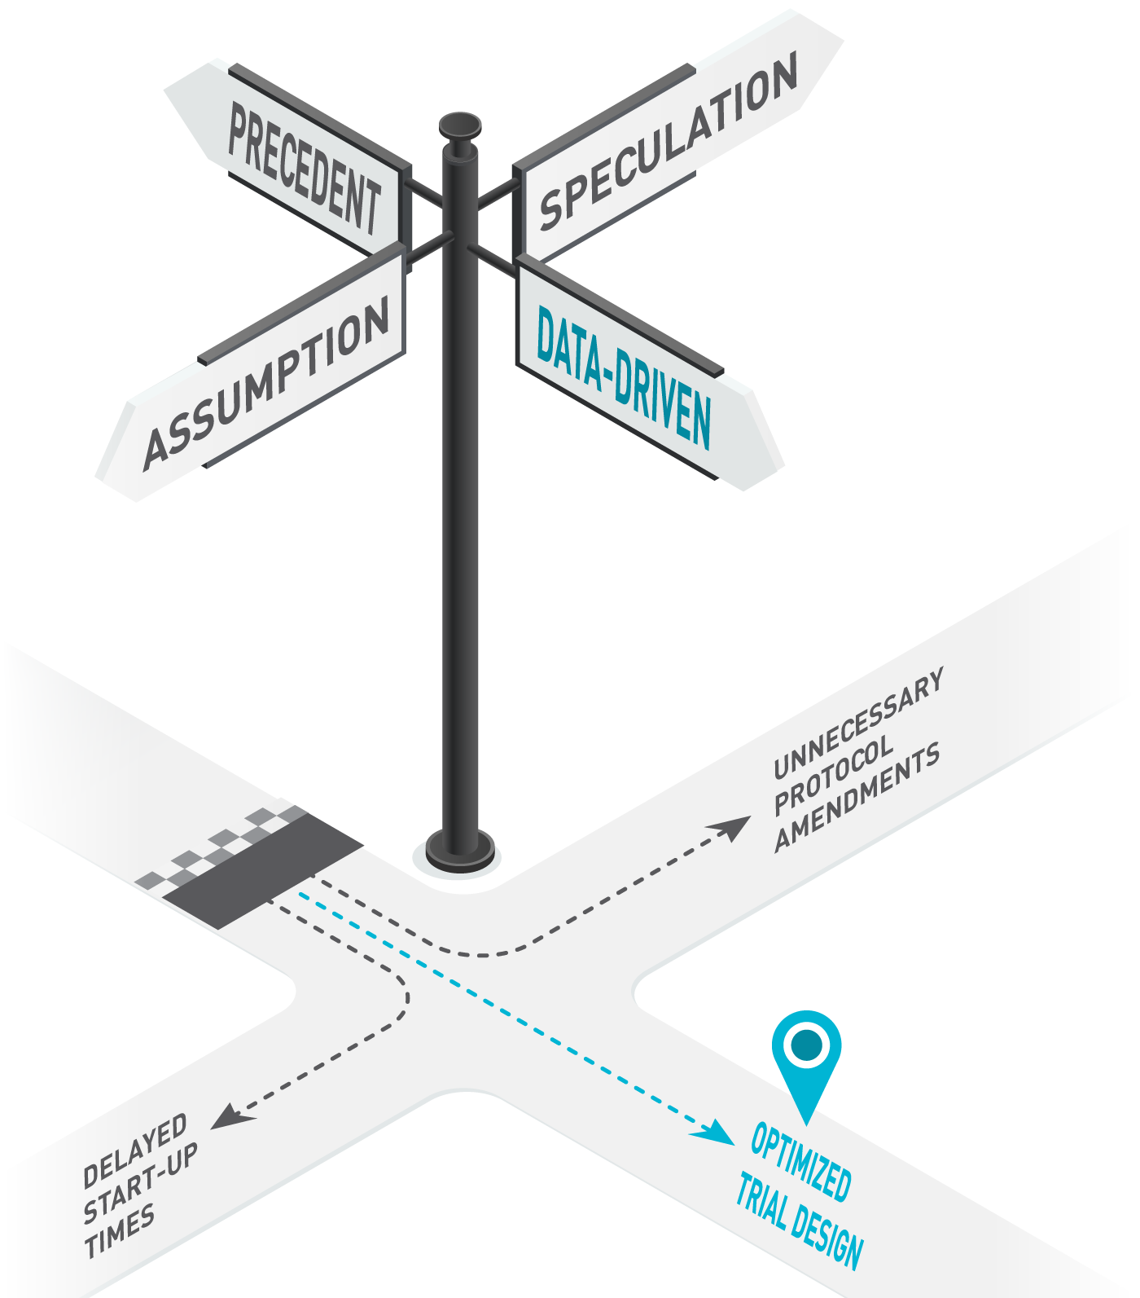
Now Available
Full Recommendations
5 Actionable Tools
Establishing Use of RWD as a Standard Process in Study Planning and Recruitment
Evaluating Whether RWD Is Suitable for Planning Eligibility Criteria and Supporting Recruitment
Effective RWD-Supported Discussions of Eligibility Criteria
Evaluating Feasibility of RWD-Supported Recruitment
Planning RWD-Supported Recruitment Strategies
3 Case Studies
Download at http://www.ctti-clinicaltrials.org/our-work/novel-clinical-trial-designs/real-world-data/

Slide 21
Related CTTI Recommendations
Strategic Recruitment Planning
RWD for Eligibility and Recruitment
Quality by Design (QbD)
Suite of Resources for Planning Successful Clinical Trials
www.ctti-clinicaltrials.org

Slide 22
Thank You!
Experts and stakeholders from across the clinical trials ecosystem, including patients and caregivers, developed these recommendations and resources.
CTTI and the RWD project team would like to extend a special thank you to our Recommendations Advisory Committee:
Maria Ali (The George Institute for Global Health)
Lauren Ariniello (Scripps Translational Science Institute)
Sarah Beeby (Clinithink)
Andrew Bier (Genentech, a member of the Roche Group)
Robert DiCicco (IBM Watson Health)
Angela Dobes (Crohn’s & Colitis Foundation)
Steven Draikiwicz (Sanofi US)
Jan Horsky (Northwell Health)
Marcia Jones (Eli Lilly and Company)
Kristin VanGoor (Biogen)
Ying Wan (Becton, Dickinson and Company)

Slide 23
Webinar recording & slides available at:
https://www.ctti-clinicaltrials.org/webinars

