Slide 1
Welcome to “Recommendations for Strengthening the Investigator Site Community”
Once you’ve logged into WebEx, please select one of the following audio options:
Call Using Computer
I Will Call In
DO NOT SELECT the “Call Me” option.
This webinar is being recorded.
All participants are muted upon entry.
Once you are connected through WebEx, you can use the mute & unmute symbols that appear to the right of your name.
Questions will be taken following the presentation. Please indicate that you have a question by typing in the chat box “To Everyone.”
Notes:
If the webinar is being recorded, wait to introduce yourself and the presentation until the next slide assist with editing.

Slide 2
Recommendations for Strengthening the Investigator Site Community
October 19, 2017

Slide 3
Agenda
Introduction to CTTI
Pamela Tenaerts, CTTI
CTTI Strengthening the Investigator Site Community Project
Rationale, Methods, and Findings
Christine Pierre, Society for Clinical Research Sites
Project Recommendations
Matthew Roe, Duke Clinical Research Institute
Panel Participants

Slide 4
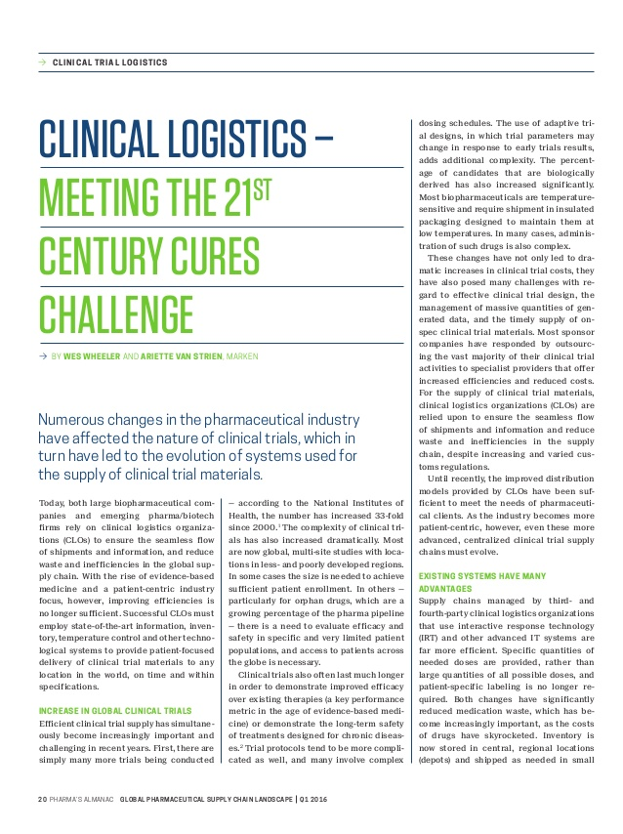
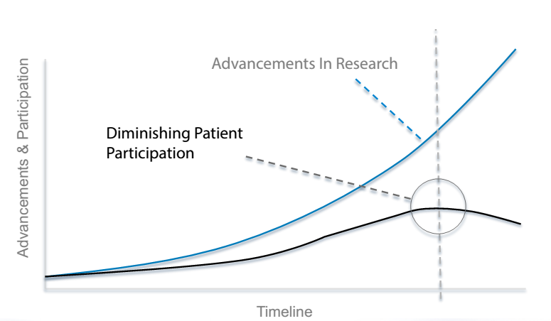

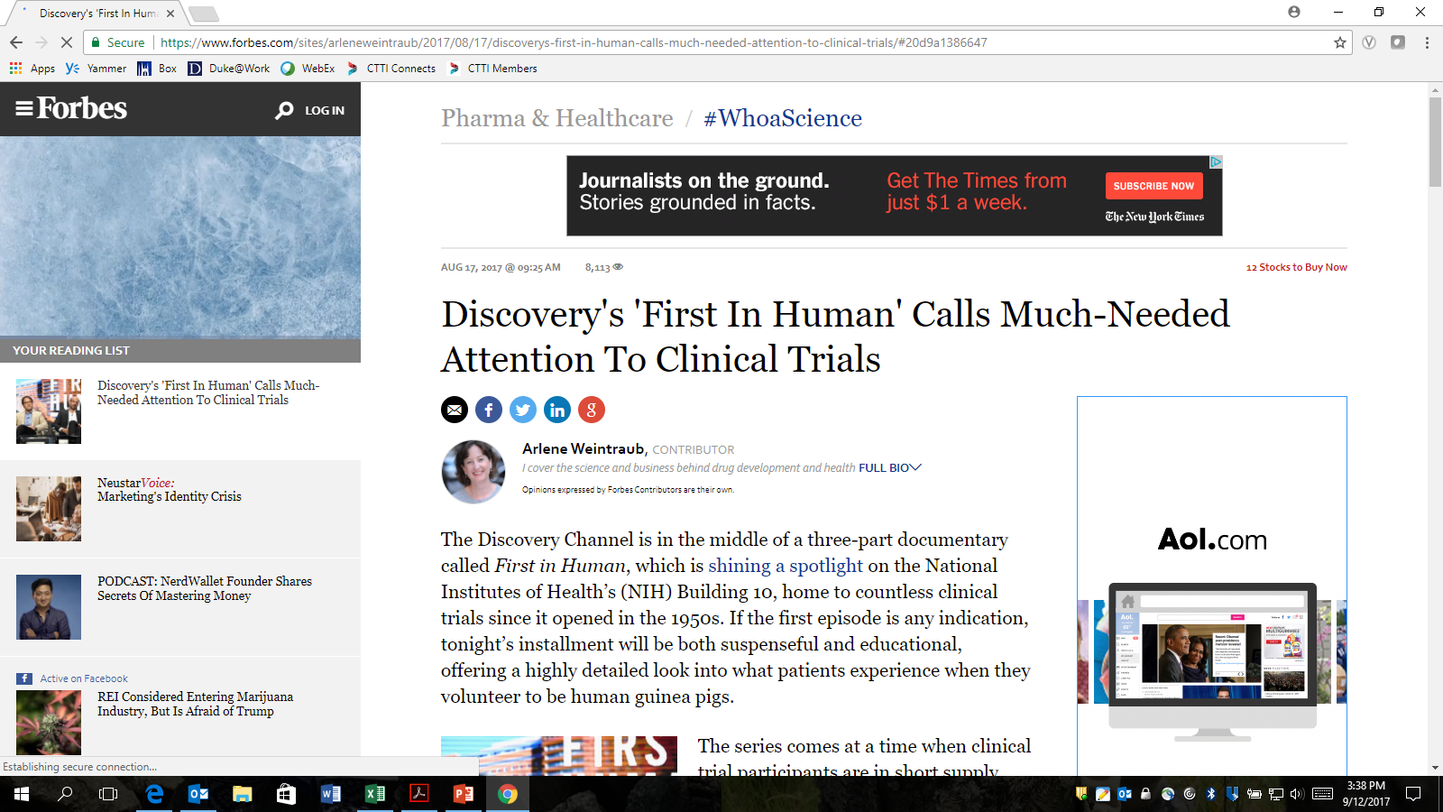
Clinical Trials are in Crisis
Discovery's 'First In Human' Calls Much-Needed Attention To Clinical Trials
Notes:
We all know the increasing difficulty of conducting trials: recruitment is slowing, inclusion and exclusion criteria continue to climb, etc.
In almost all facets of the clinical trials enterprise your work as an investigator has become more challenging over the years, and that’s possibly true of your clinical practice as well.

Slide 5
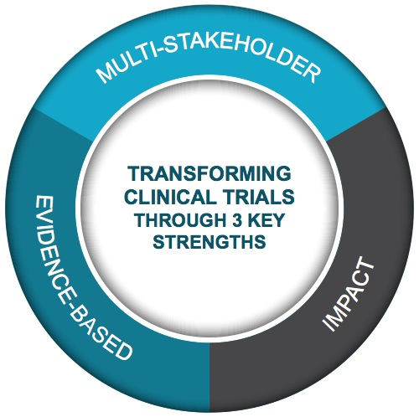
Addressing This Need
MISSION: To develop and drive adoption of practices that will increase the quality and efficiency of clinical trials
CTTI is uniquely positioned to make a significant impact on the clinical trials enterprise
Public-Private Partnership
Co-founded by Duke University & FDA
Involves all stakeholders
80+ members

Slide 6
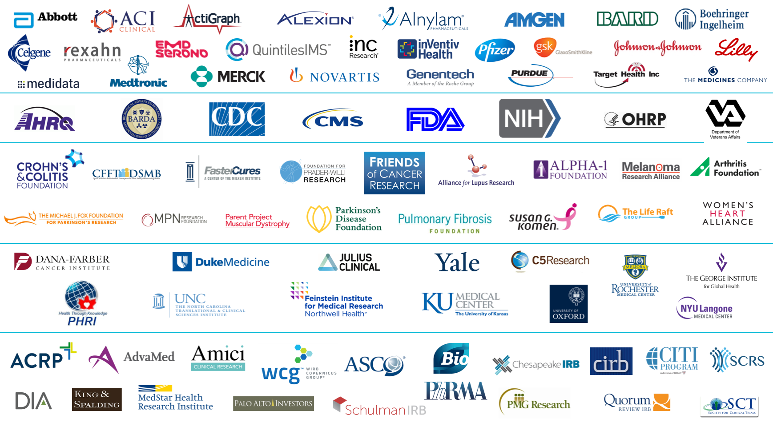
CTTI Membership
*Version: Sept. 26, 2017

Slide 7
CTTI Methodology

Slide 8
Active Project Portfolio
ACTIVE PORTFOLIO September 2017 | Systematic Evidence Generation | Patients as Equal Partners | Efficient & Quality Trials | Public Health Concern | Safe & Ethical Trials
Active Projects | MCT Legal & Regulatory MCT Mobile Devices MCT Stakeholder Perceptions Real World Evidence (new) State of Clinical Trials | Patient Groups & Clinical Trials | Investigator Community Investigator Qualification | ABDD HABP/VABP Studies
Active Collaborations | Sentinel IMPACT-AFib | Patient Engagement Collaborative |  | ABDD PTN

Slide 9
Completed Project Portfolio
COMPLETE PORTFOLIO September 2017 | Systematic Evidence Generation | Patients as Equal Partners | Efficient & Quality Trials | Public Health Concern | Safe & Ethical Trials
Complete Projects | Large Simple Trials MCT Novel Endpoints Registry Trials |  | GCP Training Monitoring Quality by Design Recruitment Site Metrics | ABDD Peds Trials ABDD Streamlining HABP/VABP Trials ABDD Unmet Need Long-Term Opioid Data | Central IRB Central IRB Advancement DMCs Informed Consent IND Safety IND Safety Advancement Pregnancy Testing SAE Reporting
Complete Collaborations | Clinical Trials for Comparative Effectiveness Electronic Healthcare Data | Patient Engagement Survey | Clinical Trials Poll FDA Training Course | Cardiovascular Endpoints

Slide 10
Investigator Community Project Team
Team Leads
Christine Pierre (SCRS)
Matthew Roe (Duke University)
CTTI Project Manager
Gerrit Hamre
Previous CTTI Project Manager
Jane Kolimaga
Pamela Tenaerts
CTTI Lead Social Scientist
Amy Corneli
Team Members
David Ciavarella (C.R. Bard)
Robin Douglas (QuintilesIMS)
Christopher Fordyce (U of British Columbia)
Terri Hinkley (Academy of Medical Surgical Nurses)
John Isidor (CIRB)
Elizabeth Mahon (Janssen)
Kaitlin Malone (Amgen)
Previous Team Members
Stephanie Endy (Feinstein Institute)
Vanessa Jackson (GSK)
Jeffrey Kasher (Eli Lilly and Co.)
William Lawson (U of Texas)
Priscilla Short (CIRB)
Ronnie Todaro (Parkinson’s Disease Foundation)
Notes:
Multi-stakeholder approach – strength of a public/private partnership

Slide 11
CTTI Strengthening the Investigator Site Community Project: Rationale, Methods, and Findings

Slide 12
Project Lifecycle
2015: CTTI membership votes to conduct a project on Site Quality
Key issue identified: Investigator turnover
Assumption: Quality clinical trial execution would be optimized if investigators would continue conducting clinical trials instead of exiting CTE
2015/16: CTTI’s Investigator Community project begins, aims to:
Understand investigators’ challenges
Identify how to keep investigators engaged in research
Create guidelines to help address issues and broaden the pool of qualified investigators
Oct. 7, 2017: The launch of CTTI’s recommendations at SCRS
TODAY: Public webinar to discuss recommendations
2017/18: Drive adoption of CTTI recommendations
Notes:
Introduction to the daunting task of an investigator’s career.
By no means is this an exhaustive list of investigator burden.
Corneli, et al – One and Done Survey
McKinney – The Daunting Career

Slide 13
Project Methods
Surveyed “one and done” investigators to determine reasons for leaving clinical research
Interviewed “active investigators” to identify reasons they have been successful in multiple FDA-regulated trials
Identify challenges experienced or avoided and describe the strategies used to manage and/or prevent these challenges
Discussed findings at expert meeting
Developed recommendations to strengthen and grow the investigator site community

Slide 14
Reasons “One-and-Done” Investigators No Longer Conduct FDA-Regulated Drug Trials
Time to lead trial takes away from other necessary activities
Long work hours
Unpredictable work hours
Trial time makes it difficult to devote time to:
Clinical and non-clinical activities
Activities fostering academic promotion
Too much time required to lead trial
Amount of time to implement trial in general
Time required by investigator to support trial and staff
Amount of time required by staff to support trial
Amount of time required to prepare for trial set up
Burden of data and safety reporting
Amount
Method
Frequency
Dissatisfaction with trial finance
Sponsor/site contract negotiations
Sponsor/site budget negotiations
Final contract
Final site budget
Schedule of site payments
Surprise Finding: 44% of “one and done” investigators wanted to conduct more trials

Slide 15
Reasons Active Investigators have been Successful at Participating in Multiple FDA-Regulated Drug Trials
Sufficient and well-trained staff
Strong commitment and work ethic
Institutional support
Ability to recruit patients
Business knowledge and experience
Strong reputation
Ability to network
Ability to be realistic when selecting protocols/recruitment

Slide 16
CTTI Strengthening the Investigator Site Community Project: Recommendations

Slide 17
Recommendations Overview
Develop site-based research infrastructure and staff
Optimize trial execution and conduct
Improve site budget and contract negotiations
Identify additional trial opportunities for interested investigators

Slide 18
Develop Site-Based Research Infrastructure and Staff
For Investigative Sites | For Sponsors, CROs, and Health Systems/Private Practices
Hire and retain well-trained, experienced research coordinators and other essential staff Provide continuous training for research staff Guide clinical research practice at the site with standard operating procedures (SOPs) and guidelines | Recognize PIs, co-investigators, and research coordinators as key contributors to product development Provide opportunities for investigators and site staff to remain engaged in between trials

Slide 19
Optimize Trial Execution and Conduct
For Investigative Sites | For Sponsors
Determine whether the study protocol is suitable for your site Decline studies that are a poor fit for your site Manage recruitment effectively | Create enrollable study protocols and ensure effective recruitment planning Follow FDA safety reporting requirements
Notes:
Reference CTTI’s Recruitment Project, Quality by Design Project, and IND Safety Reporting Project

Slide 20
Improve Site Budget and Contract Negotiations
For Investigative Sites | For Sponsors and CROs
Review the study protocol and create cost assessments Ensure that staff understand key contract components Plan for and address delayed/outstanding payments Manage site flow concerns | Use master agreements whenever possible Foster transparency about fair market value (FMV) determinations
Notes:
Reference Table 1 of recommendations for numerous, specific examples

Slide 21
Identify Additional Trial Opportunities for Interested Investigators
Make use of investigator/trial match making systems
Contact sponsors and CROs directly

Slide 22
Communications & Driving Adoption
Launch communications: Press release, media outreach, e-mails, website updates, blog, social media and direct engagement with key adopters
Primary Audiences: physicians, medical societies, and trade associations
Secondary Audiences: Sponsors, CROs, and health systems
TODAY – CTTI Public Webinar
Draft manuscript on recommendations for peer reviewed publication
Q1 2018 – SCRS Webinar
Additional conference presentations and webinars throughout 2018
Direct engagement with CTTI members and non-members

Slide 23
Panel Discussion

Slide 24
Communications & Driving Adoption
Launch communications: Press release, media outreach, e-mails, website updates, blog, social media and direct engagement with key adopters
Primary Audiences: physicians, medical societies, and trade associations
Secondary Audiences: Sponsors, CROs, and health systems
TODAY – CTTI Public Webinar
Draft manuscript on recommendations for peer reviewed publication
Q1 2018 – SCRS Webinar
Additional conference presentations and webinars throughout 2018
Direct engagement with CTTI members and non-members

