Slide 1
Welcome: Engaging Racial and Ethnic Minority Patient Populations in COVID-19 Clinical Trials
This webinar is being recorded and will be posted to the CTTI website
All participants are muted upon entry
Questions can be entered in the chat box during the webinar
Questions will be answered to the best of our ability after the call via CTTI’s best practices document

Slide 2
Disclaimer
The views and opinions expressed in this presentation are those of the individual presenter and do not necessarily reflect the views of the Clinical Trials Transformation Initiative.

Slide 3
Engaging Racial and Ethnic Minorities in Covid-19 Clinical Trials
June 18, 2020
Notes:
NOTE: If your presentation is being recorded, this will be the beginning of the recording, so make it a clean introduction.
EXAMPLE:
Welcome everyone! My name is [insert introducer’s name/title] and it is my pleasure to introduce [insert presentation name].
Today’s presentation is hosted by the Clinical Trials Transformation Initiative, and the speakers today include [insert speaker(s) name/title]
[Insert prepared speaker(s) bios.]

Slide 4
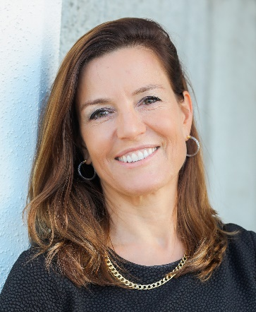

Introduction
Pamela Tenaerts, CTTI
@PamelaTenaerts

Slide 5

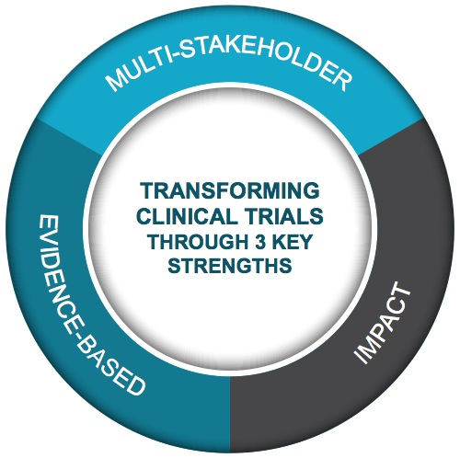
Public-Private Partnership
Co-founded by Duke University & FDA
Involves all stakeholders
Approx. 80+ members
Participation of 500+ more orgs
MISSION: To develop and drive adoption of practices that will increase the quality and efficiency of clinical trials

Slide 6
CTTI’s COVID Related Work
Completed
Conduct of ongoing trials in COVID
Designing high quality COVID treatment trials
Moving to telehealth/virtual visits for ongoing trials
Daily download of COVID clinical trials
During the Pandemic
Engaging minority patients in COVID trials
Master Protocols
Others TBD
After the Pandemic
Lessons learned & maintaining the transformation
Contingency planning
Analysis how clinical trials ecosystem changed due to pandemic
Others TBD

Slide 7
Speakers
Pamela Tenaerts, CTTI
Richard Knight, AAKP
Anand Shah, FDA
Kimberly Fisher, CTTI
Cassandra Smith, Janssen
Christina Brennan, Northwell Health
Fabian Sandoval, ECRI

Slide 8
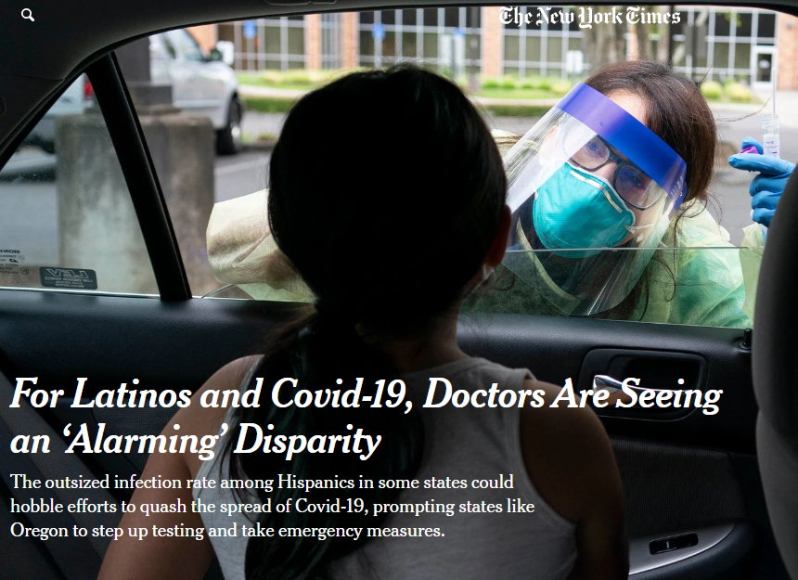
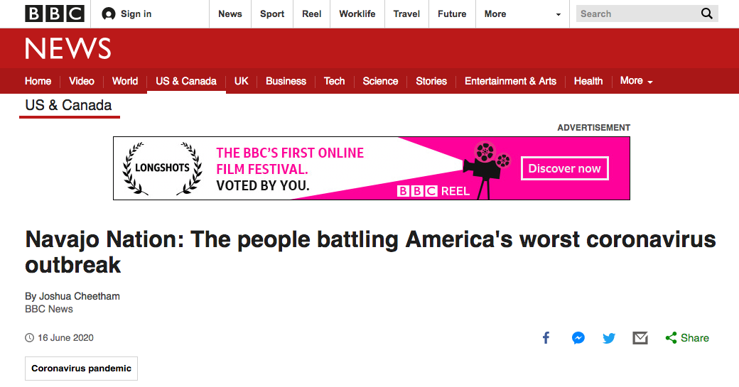
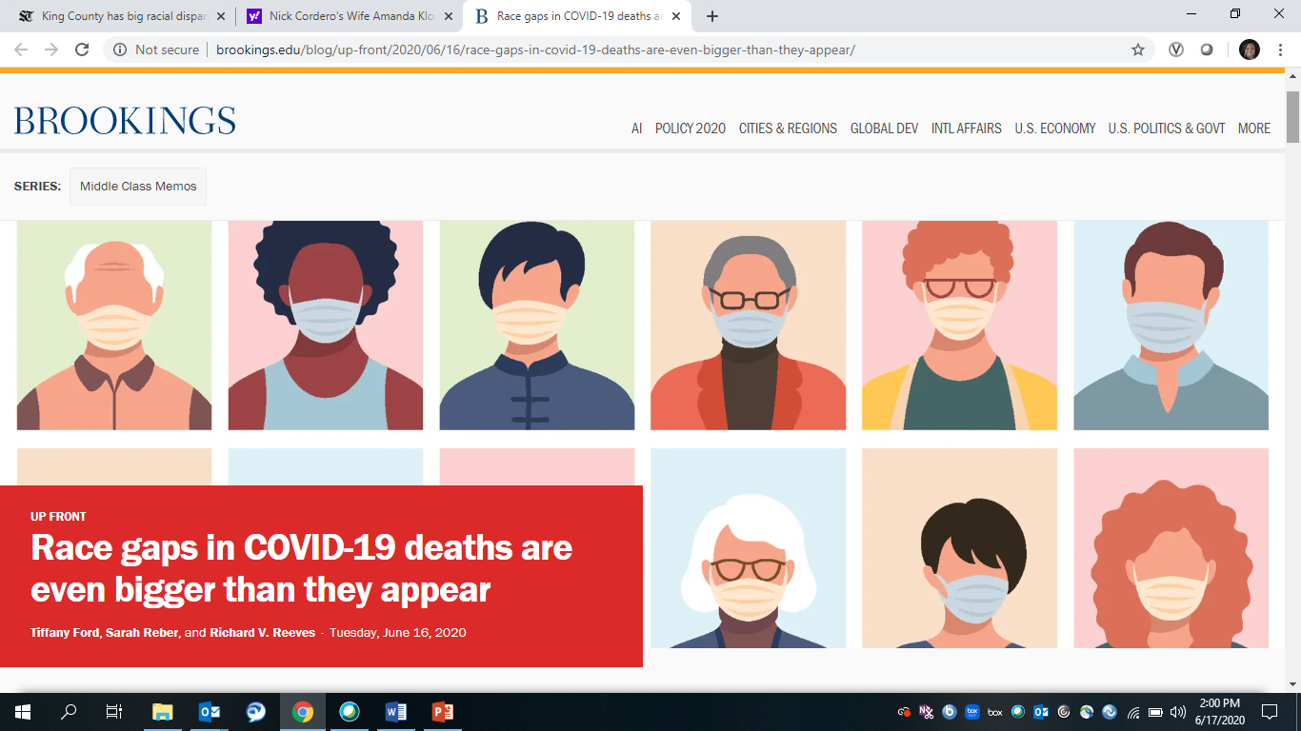
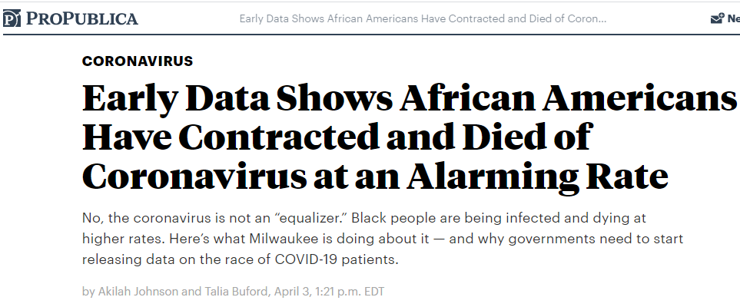
A National Crisis Amplified

Slide 9
The Status Quo is Unacceptable
Scientific & public health consequences
Lack of racial and ethnic diversity in COVID-19 clinical trials will limit our knowledge of the biology of the disease
Limited knowledge of biomedical and social factors that drive racial & ethnic COVID-19 disparities
Inability to explore potential population-level differences in treatment effects and safety
Potential reputational implications
Diminished public trust if readout from trials reveals a lack of diverse patient populations COVID-19 clinical trials

Slide 10
Inequities and Disparities Should Inform COVID-19 Clinical Trial Agenda
Design
Operations
Engage minority patients in the design of COVID-19 clinical trials
Embed clinical trials in sites that are accessible to minority communities
Anticipate and respond to logistical barriers (e.g., childcare, transportation)
Partner with trusted community stakeholders to develop targeted engagement, recruitment, and retention strategies
Inclusion/exclusion criteria

Slide 11
We Need Leadership

Slide 12
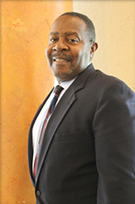
A Patient’s Perspective
Richard Knight, AAKP
@knightra

Slide 13
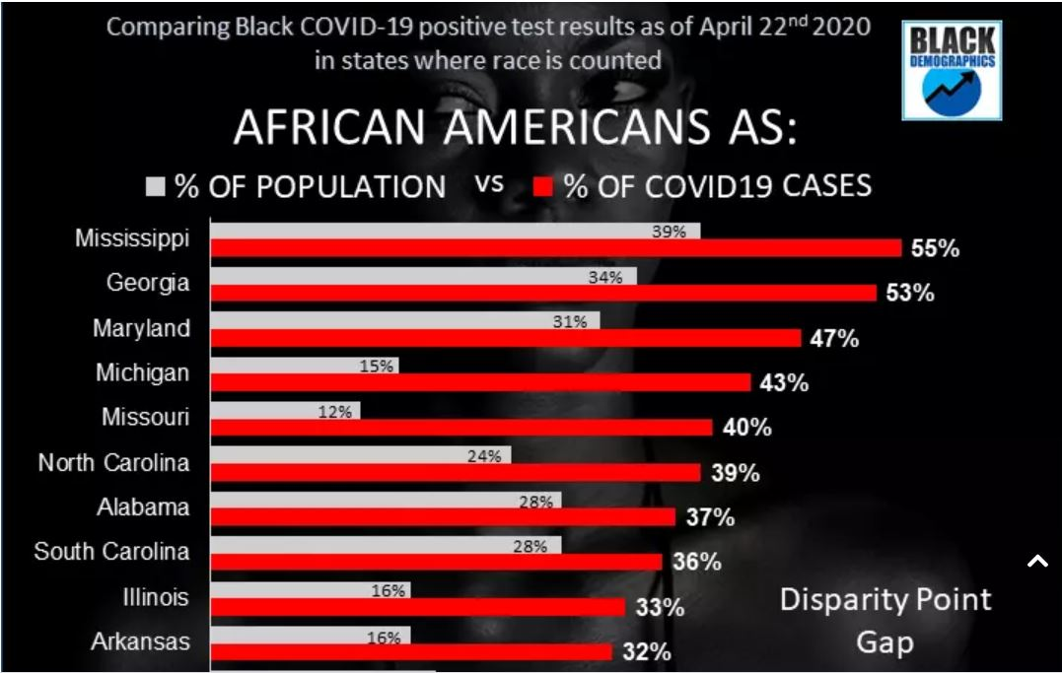
Framing the Crisis – State Level

Slide 14
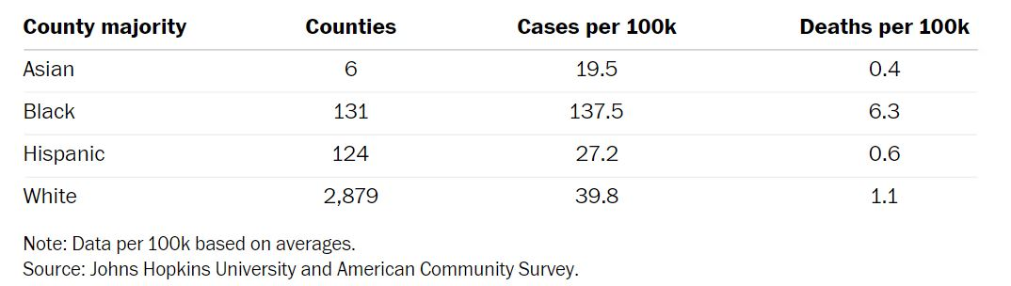
Framing the Crisis – County Level
Compared to majority white counties, counties that are majority-black have
three times the rate of infections
almost six times the rate of deaths

Slide 15
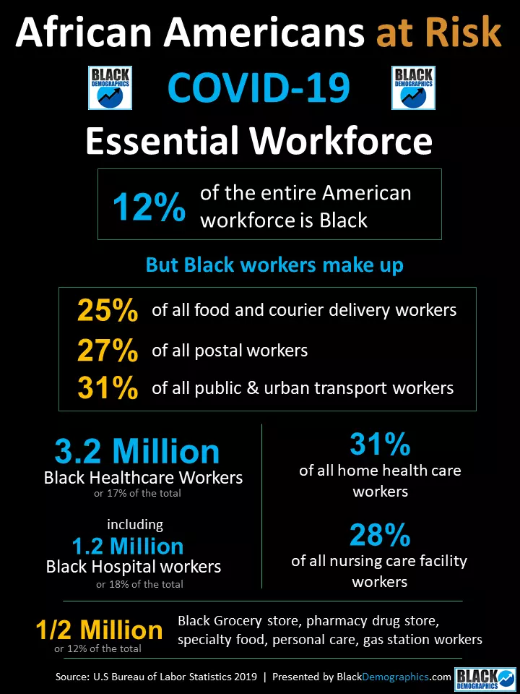
Limited Effectiveness of Social Distancing Measures

Slide 16
Patient Engagement
Meaningful involvement of patients, caregivers, clinicians, and other healthcare stakeholders throughout the entire research process—from planning the study, to conducting the study, and disseminating study results.
The Value of Engagement. Patient-Centered Outcomes Research Institute. 2018 Oct 30. Available from:
https://www.pcori.org/about-us/our-programs/engagement/public-and-patient-engagement/value-engagement

Slide 17
Example Best Practices: Patient Engagement in NIDDK/KUH Studies
KPMP- Kidney Precision Medicine Project
Study funded September 2017
Community Engagement Workgroup
Drafted Informed Consent Document
Championed unique no fault insurance
Patients involved in all Steering Committee meetings
Patients involved in protocol development
Transparency of return of results

Slide 18
Patient Engagement in COVID-19 Clinical Trials
Develop formal mechanisms to engage patients early in the development of COVID-19 clinical trials
Community Advisory Boards (NAACP/NMA)
DSMB/EEP
Focus on patient-centered outcomes
Clarify research costs (full costing)
Increase use of telehealth
Mitigate potential harms by clarification of patient engagement and improving fit - TRUST

Slide 19
Thank You
Rich Knight
240-508-2552
Richardknight.aakp@gmail.com
@knightra
www.aakp.org

Slide 20
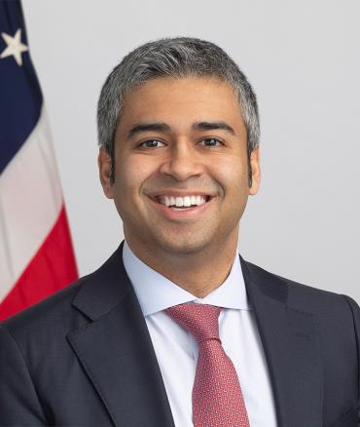
A Regulator’s Perspective
Anand Shah, FDA, OC
@AnandShahFDA

Slide 21
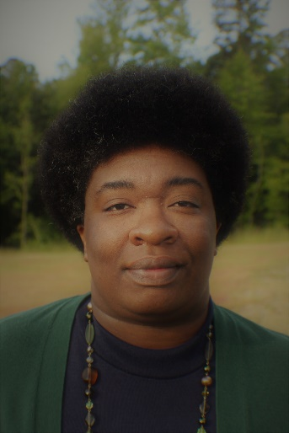
Survey: Engaging Diverse Patient Populations in Clinical Trials
Kimberly Fisher, CTTI

Slide 22
Survey
CTTI collected feedback from May 29th – June 8th
Distribution:
Email to CTTI member organizations & public contacts
Posts on Twitter & LinkedIn
Respondents were asked to describe:
Barriers
Differences across clinical trials that evaluate diagnostic, prophylactic, and treatment options?
Strategies
Recommended best practices

Slide 23

Respondents (53)
Patient Group,
6
Clinical Investigator/ Site, 5
Technology, 3
Biotech,
2
Academia, 17
Pharma, 15
IRB, 3
CRO, 3

Slide 24
Barriers

Slide 25
Barriers
Trust
Engagement
Logistics
Social Distancing
Planning
Partnership
Technology
Language
Leadership

Slide 26
Sponsor & Site Strategies

Slide 27
Sponsor Best Practices
Strategies | Implementation
Partner with racial and ethnic minority communities early | Patient engagement & community design studios Partner with minority-serving organizations to develop targeted recruitment and retention strategies
Develop accessible site networks | Place trials in racially and ethnically diverse cities Engage minority-serving physicians to establish referral partnerships & serve as PIs Allocate additional resources to support sites’ recruitment & retention efforts—translated study documents, transportation, childcare
Commitment & reinforcement from executive leadership | Protect upfront planning efforts to develop effective inclusion strategies Evaluate strategies across trials and course-correct Make a financial commitment

Slide 28
Site Best Practices
Strategies | Implementation
Build trust | Proactively identify and respond to patients concerns (e.g. risk of exposure to COVID-19, safety of IMPs, privacy and confidentiality) Build reciprocal, long-term relations with community stakeholders
Partner with community stakeholders | Co-design effective recruitment and retention strategies Identify patient needs and interests
Provide information | Challenge myths and misinformation about COVID-19 Establish site as a source of trusted information
Hire diverse staff & raise awareness | PIs, research coordinators Research navigators Require training on implicit bias and raise awareness of common barriers

Slide 29
Strategies Are Multi-Level
Patients
Physicians
Sites
Sponsors

Slide 30
All Hands on Deck
Sites
CRO
Sponsors
Physicians
Minority Patients
Community
Orgs.
Patient Groups

Slide 31
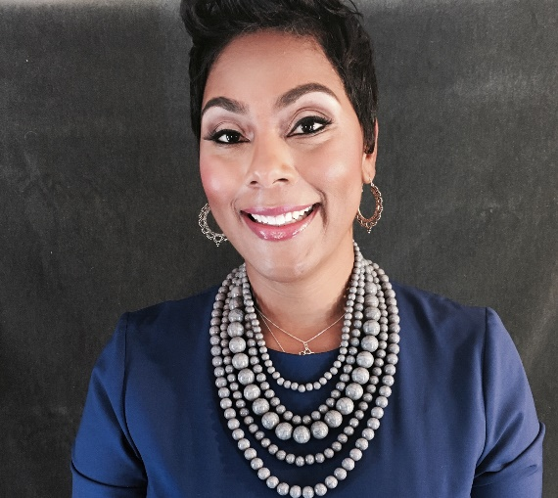
Sponsor Perspective
Cassandra Smith, Janssen

Slide 32
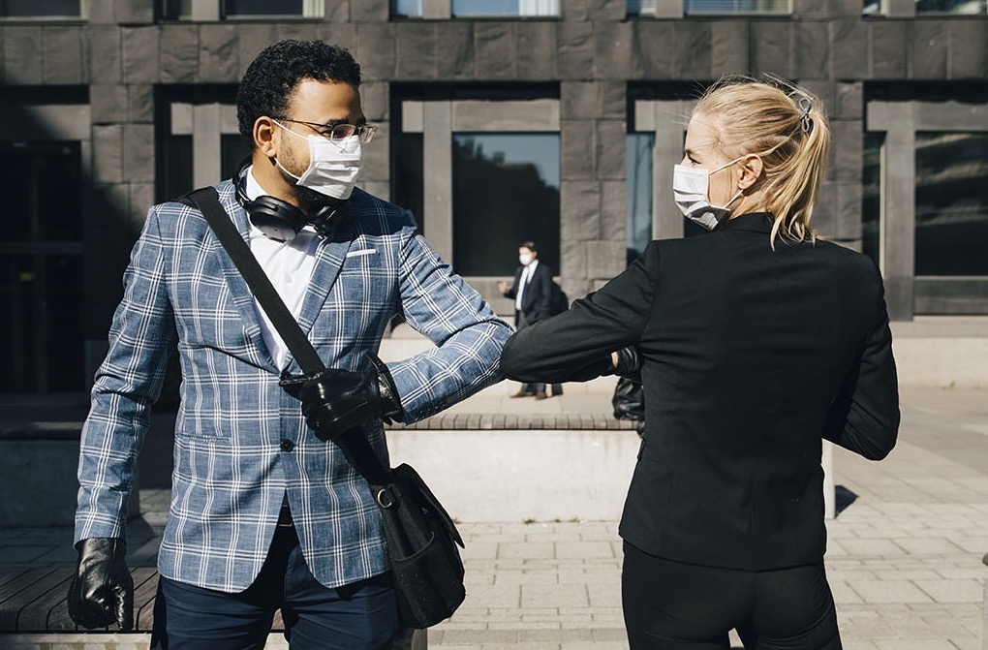
Increasing Minority Engagement in COVID-19 Clinical Trials
Cassandra Smith, Director, Diversity & Inclusion in Clinical Trials
CTTI June Webinar
June 18, 2020
Cassandra Smith
June 18, 2020

Slide 33
Agenda
Situation Analysis
The Approach
Key Takeaways
1
1
2
2
3
3

Slide 34

Situation Analysis
Cassandra Smith
June 18, 2020

Slide 35




We Must Act Now!
As the world awaits news of a safe and effective vaccine for COVID-19, we are all very aware of the importance of clinical research and the race against time to find a medical solution.
This urgency is equally true for every patient who faces a disease for which there is no adequate treatment or prevention.
At Janssen, we are committed to exploring solutions for unmet health needs and focus our efforts on protecting the health and safety of study participants involved in our clinical research.
In these times, what is undeniably clear is that COVID-19 is requiring an unprecedented effort to recruit a diverse participant demographic needed to find an effective treatment that can work for everyone.

Slide 36

The Approach
Cassandra Smith
June 18, 2020

Slide 37



We Must Be Strategic!
Question
Unchallenged
Assumptions
Intentional
Site Selection
Engage,
Engage,
Engage!

Slide 38



Questioning Unchallenged Assumptions
Understand and embrace what’s possible. Balancing time and budgetary pressures with the scientific and public health imperative to engaging racial and ethnic minority patient populations is possible and necessary.
We’re more empowered than we know.
There are a number of sponsor-level strategies that can facilitate greater minority enrollment. Some of these strategies may require an upfront investment, but will reap long-term success in COVID-19 clinical trials and beyond.
Sponsors have a unique opportunity to make us better, together.
Successful strategies require coordination and collaboration across multiple stakeholders. Sponsors are uniquely positioned to drive this.

Slide 39




Intentional Site Selection
Meet patients where they are.
Ensure that trial sites are located in underrepresented and underserved communities and accessible to diverse populations.
Reflect the communities being served.
Look for diverse, culturally competent clinical research teams, especially staff who have patient-facing roles.
Bridge to local leadership.
Engage trial sites that have connections to local businesses and other stakeholders to facilitate greater engagement between trial sites and communities.
Connect with community HCPs.
Encourage trial sites to connect with other HCPs, especially those with established relationships with minority communities, to serve as referral partners.

Slide 40



Engage, Engage, Engage!
Identify trusted voices.
Work with community organizations to disseminate information and build trust in clinical research.
Disrupt misinformation.
Provide education using a data-driven analysis of the specific myths and sources of misinformation and proactively prepare to disrupt misconceptions.
Build relationships through partnerships.
Work closely with communities to address unmet patient needs by listening, learning, adjusting (as possible), and truly partnering.

Slide 41
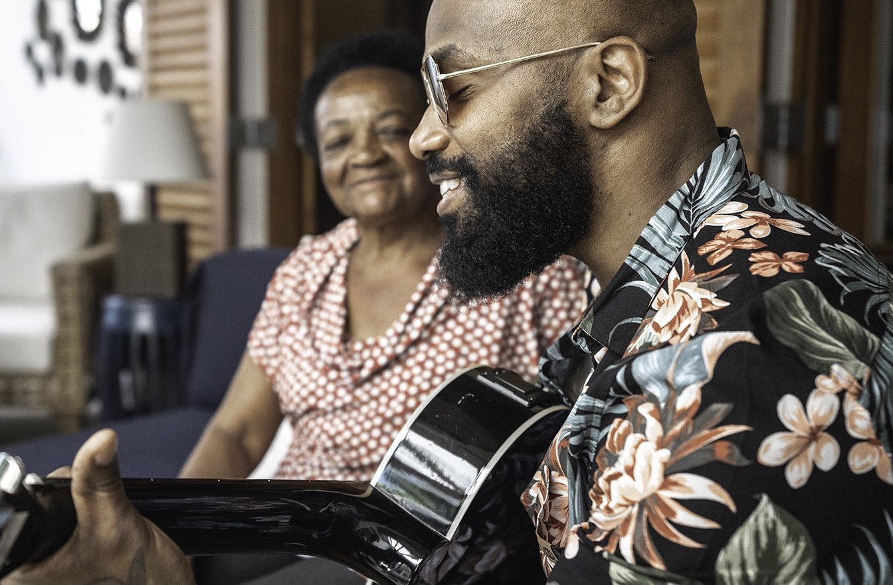
Key Takeaways
June 18, 2020

Slide 42



We must strengthen diversity & inclusion in COVID-19 clinical trials, and beyond, by meeting the unique needs of all patients!
Apply strategic operational practices to engage and increase racial and ethnic minorities in COVID-19 clinical trials
Continue to grow, innovate and advance global health, through thoughtful investments of time and resources to achieve long-term gains beyond COVID-19
Leverage our unique role as leaders to facilitate collaboration across multiple stakeholders to reduce barriers preventing diversity in clinical trials

Slide 43

Thank You!
Cassandra R. Smith
Director, Diversity & Inclusion in Clinical Trials
Janssen
CSmith52@its.jnj.com
June 18, 2020

Slide 44
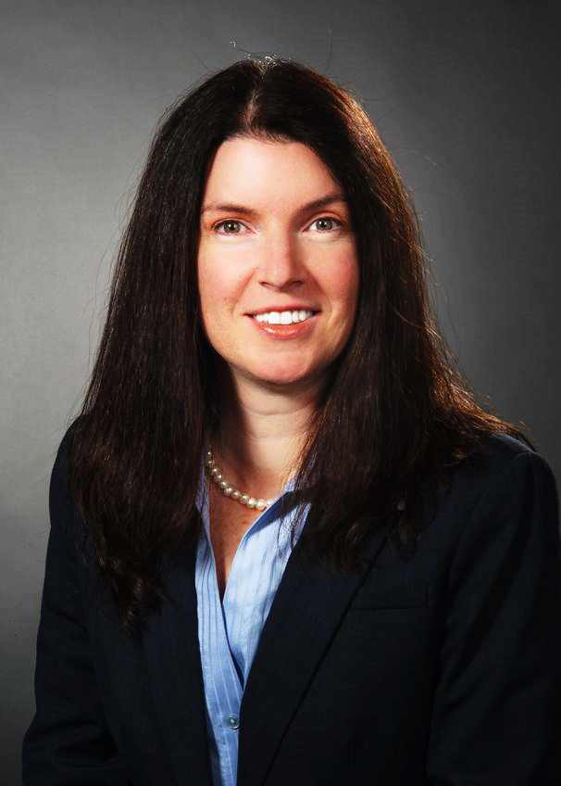
A Health System’s Perspective
Christina Brennan, Northwell Health
@DrCBrennan

Slide 45
Focus on diversity inclusion for in-patient trials during COVID-19 and beyond

Slide 46
Northwell Health, NY
23 hospitals
800+ ambulatory sites
72,000 + employees
NYS – Epicenter of the pandemic
Northwell – Epicenter of the Epicenter
Discharged over 11,000 patients

Slide 47
Solutions oriented framework
Selecting the right trial and sponsor
Feasible and practical ways for diverse enrollment
Measures to monitor your success

Slide 48
Selecting the right trial and sponsor
Sites
Responsibility to be selective in the right trial and sponsor that they want to partner with
Resources
Focus on the availability of resources to the site
Translation services
Transportation
Patient stipend
Community target engagement

Slide 49
Practical solutions to address barriers
Informed consent
Language barriers
Surrogate consents
Remote
Limited access to technology
Community
Engagement
Trust

Slide 50
Measures to monitor your success
Proactively analyze your data
Geography
Race
Preferred language
Ethnicity

Slide 51
The Northwell Health Experience The Epicenter of the Pandemic
The importance of practically engaging diverse patients quickly in the most ethnically diverse urban area in the world
Number of trials | Number of Facilities | Number of enrollment | Preferred language | Geography
7 | 13 | 1,100 | 17 different language consents | In diverse urban areas

Slide 52
Race & Ethnicity

Slide 53
Key Takeaways
Sites have a responsibility to be selective and critical in thinking about sponsors and trials they want to partner with
Select and conduct clinical trials that have inclusiveness strategies
Ask the right questions to get the right resources needed to recruit a diverse patient population
Be proactive and measure your success through collection of data and analyze
Demand diversity

Slide 54
Thank you
Christina Brennan, MD, MBA
cbrennan@northwell.edu

Slide 55
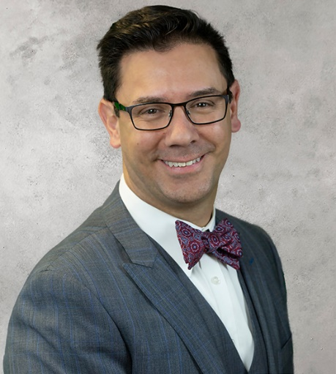
A Community Research Site’s perspective
Fabian Sandoval, Emerson Clinical Research Institute
@DrFabian202

Slide 56


Out-Patient Setting Strategies: Importance of building robust community partnerships
Fabian Sandoval, md

Slide 57
Emerson clinical research institute
Commitment to serving racial and ethnic patient populations
Diversifying clinical trials
Community clinic
Centrally located in D.C. metro area
Location accessible to African American and Latino communities disproportionately impacted by COVID-19
Active partnerships with major community stakeholders
Consulates
Community-based organizations

Slide 58

Must start Building the trust now
Traditional outreach mechanisms that require face-to-face contact are not available
Engage in innovative strategies to build relationships and trust with racial and ethnic minority communities
Social media outreach: use Facebook, Twitter, Instagram to post quick educational/outreach videos related to COVID-19 and clinical trials
ECRI example: posting a tip of the day video, engage interns who are more technically savvy
Use patient databases to develop targeted outreach efforts based on patient demographics
Make the site welcoming and accessible to patients:
Community stakeholders need to understand how the site operates. Host tours, explain what research is available and how patients are enrolled into studies
Make sure that site hours and scheduling practices facilitate patients ability to navigate logistical barriers related to work and caretaking responsibilities

Slide 59
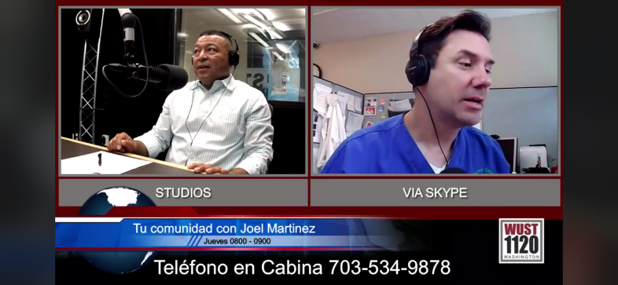


Must start budding the trust now
A robust plan outreach plan to grow the community trust & partnerships
Radio show
Television show
www.TuSaludTuFamilia.com

Slide 60
Key takeaways
Effective site-level community engagement strategies require consistency and willingness to adapt traditional engagement strategies to our pandemic environment
Engagement strategies should be proactive and respond directly to needs and interests expressed by community stakeholders
Sites can play an important role in establishing themselves as a trusted source of timely, accurate information related to COVID-19 and other diseases

Slide 61
Thank You
Fabian Sandoval, MD
CEO & Research Director
Emerson Clinical Research Institutes
Fabian@ecrinstitute.com

Slide 62
Summary
Pamela Tenaerts, CTTI
@PamelaTenaerts

Slide 63
Summary
Sponsors:
Need executive leadership that promotes diversity
Have sites in minority geographic areas
Make diversity and engaging with minority communities a priority for your sites
Reduce recruitment of minority barriers for sites
Sites
Be a trusted source of information
Be a trusted minority partner
Measure your minority enrollment metrics

Slide 64
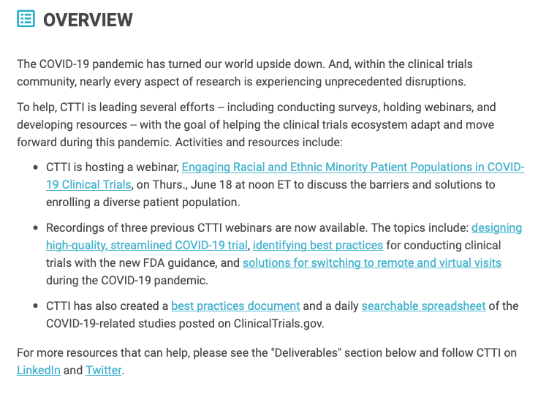
Next steps
Will be included in COVID trials best practices document
https://www.ctti-clinicaltrials.org/our-work/quality/covid-19/

