Slide 1
State of U.S. COVID-19
Treatment Clinical Trials
April 15, 2021
Deborah Zarin, Multi-Regional Clinical Trials Center of Brigham and Women's Hospital and Harvard University
Robert Califf, Verily and Google Health
Harlan Krumholz, Yale School of Medicine
Leanne Madre, CTTI Acting Executive Director

Slide 2
Welcome
This webinar is being recorded and will be posted to the CTTI website.
All participants are muted upon entry.
Questions can be entered in the chat box during the webinar.
There will be a “Question & Answer” session at the end of the webinar.
Questions can be entered in the chat box to all panelists and attendees throughout the webinar

Slide 3

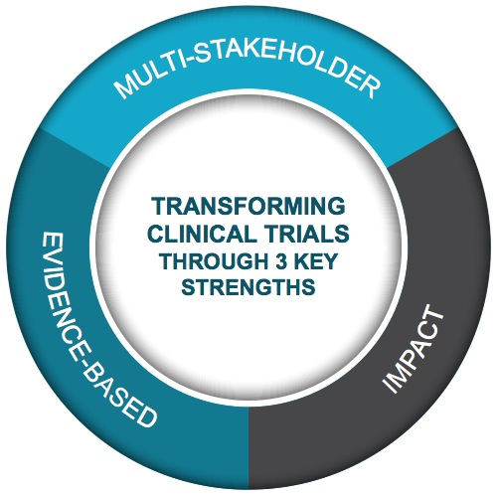
Multi-stakeholder,
public-private partnership
co-founded by Duke University & FDA
Participation of 500+ more orgs and + 80 member organizations
MISSION: To develop and drive adoption of practices that will increase the quality and efficiency of clinical trials

Slide 4
Agenda
Welcome | Leanne Madre
Methods & Overview: COVID-19 Trials in ClinicalTrials.gov | Deborah Zarin
Results: State of U.S. COVID-19 Treatment Trials | Robert Califf
Commentary | Harlan Krumholz
Panel Discussion | Moderator – Leanne Madre Panelists – Robert Califf, Harlan Krumholz, Deborah Zarin

Slide 5
COVID-19 Trials in ClinicalTrials.gov

Slide 6
Recent COVID-19 Research Enterprise Analyses

Slide 7
Key Findings of These Analyses of the
COVID-19 Research Enterprise
Large number of initiated trials
Heterogeneity of key design features
Many studies with insufficient power to provide meaningful results
Slow production and dissemination of results, impeding the key goal of producing actionable data
Lack of coordinated system for assessing the need for each new trial
Enrollment of small percentages of COVID patients

Slide 8
Heterogeneity of Study Design
232 trials with 351 unique Primary Outcome Measures (as of 6/20)
53 had “COVID Ordinal Scale” as Primary Outcome Measure
  14 unique scales (35 trials) could be characterized
  6 scales (18 trials) could not be characterized
Overlap in clinical states, ranging from “no dx”, “out of hospital with COVID” to “death”
# discreet states (scores) ranged from 3 to 11
Directionality varied: e.g., death was scored as 1, 5, 6, 7, 8 or 10, depending on the specific scale

Slide 9
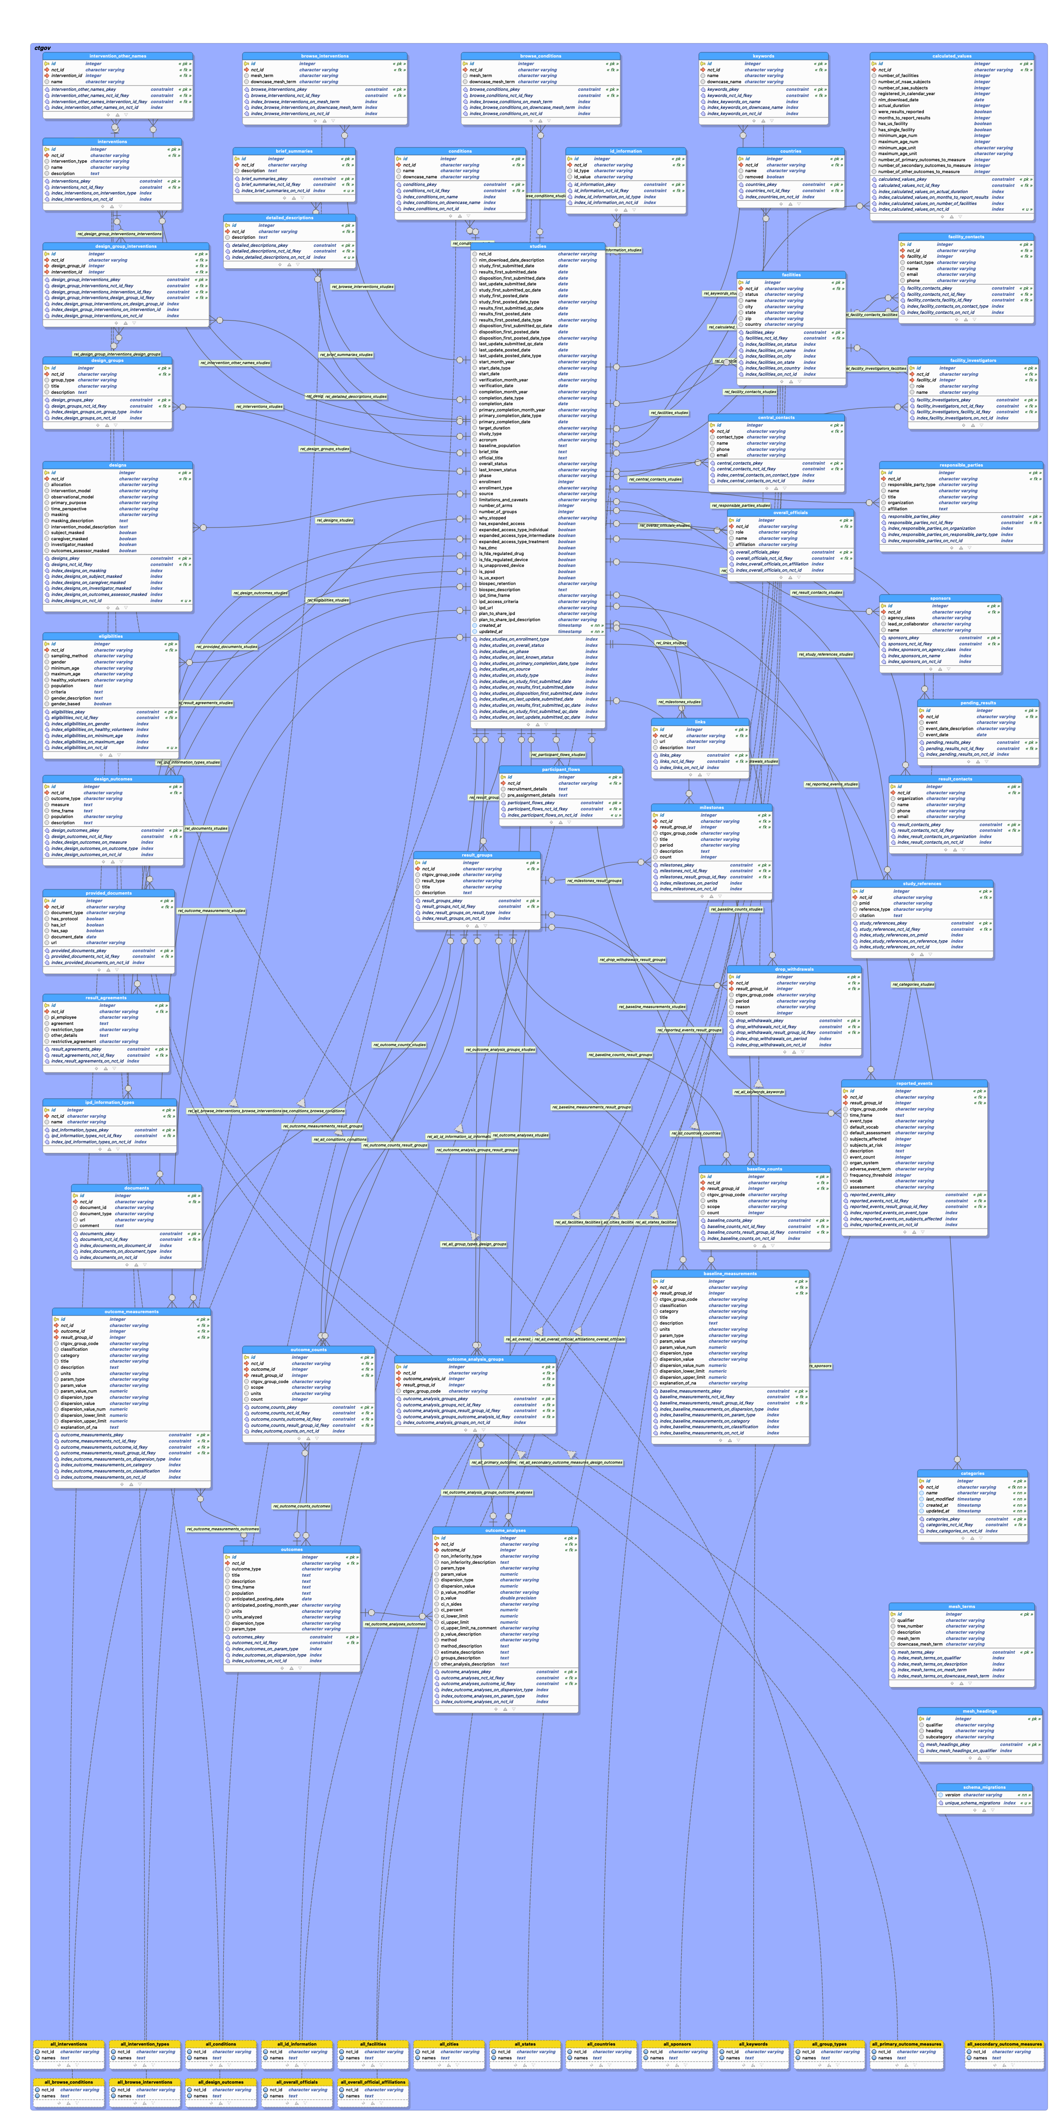
Search Strategy
Searched ClinicalTrials.gov data for interventional studies started on or before December 31, 2020
Primary search conducted on February 1, 2021
Results search updated on April 12, 2021
ClinicalTrials.gov data accessed using AACT
AACT Database Schema

Slide 10
Sample Definition
Interventional studies of COVID-19
At least one site in U.S.
Start date on or before December 31, 2020
Primary Purpose of Treatment or Prevention
Drug, biological, or device intervention type
Vaccine studies excluded

Slide 11
Additional Methods
Funder derived from ClinicalTrials.gov sponsor/collaborator
End State – ClinicalTrials.gov study status of:
  “completed”
  “suspended”
  or “terminated”
Results search:
COVID-19 Studies with results and reviewed indexed publications
NCT ID Search for studies with “end state” and “active, not recruiting”
  ClinicalTrials.gov
  PubMed
  medRxiv
Manual results search for all “master protocol” studies (any status)
Reviewed other published COVID trial reviews
Notes:
Expand what funder means

Slide 12
U.S. COVID-19 Trial Cohort
4,610
COVID-19 Studies
4080 Exclusion Criteria Applied
530
Interventional Studies
80 Excluded - Manual Review
450 Final Cohort:
Purpose: Treatment or prevention of COVID-19
>=1 site in United States
Start date on or before 12/31/20
At least 1 Drug/Biological/Combo Intervention
Not COVID-19 Vaccine
Not withdrawn

Slide 13
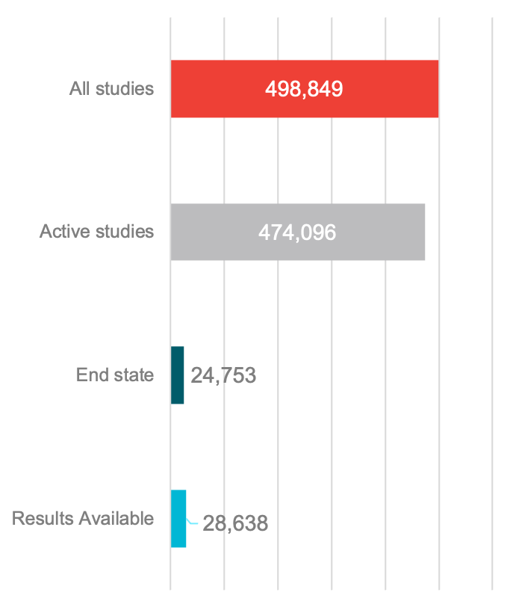
Results Availability & Participants
450 Final Cohort
389 Active
61 Reached
End State
44 Results Available
21 Results with
End State
23 Active
With Results
Studies
Participants (Planned or Actual)

Slide 14
Results by Study Quarter Started
 | <= Q1 | Q2 | Q3 | Q4 | Total
Studies started | 30 | 203 | 116 | 101 | 450
Active | 20 | 160 | 108 | 101 | 389
Reached end state | 10 | 43 | 8 | 0 | 61
Any results available* | 11 | 29 | 3 | 1 | 44
Location of Results | All studies, N=450
ClinicalTrials.gov | 11/450 (2.4%)
Peer-reviewed publication | 31/450 (6.9%)
Results posted on medRxiv | 18/450 (4.0%)
Any results available* | 44/450 (9.8%)

Slide 15
Promise & Challenges of
Trial Registration System
Widespread practice of trial registration has allowed for real-time monitoring of the COVID research response
  Research community
  Mainstream media
  Others
COVID data dashboard should be an essential tool for making decisions about new research studies

Slide 16
Promise & Challenges of
Trial Registration System
Meta-researchers have been critiquing the trial enterprise, but system in general lacks mechanisms for responding to such information
Vigilance regarding data quality is always essential
Challenges arise when interpreting data for:
  Master protocol studies
  Studies that ”evolve” or combine with other studies
ClinicalTrials.gov is a communal resource that requires care and nurturing by all members of the research ecosystem

Slide 17
Results

Slide 18
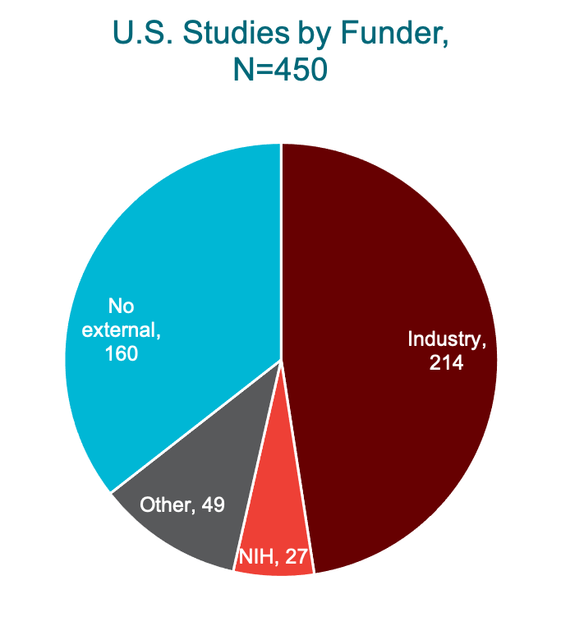
U.S. Studies: Start Date & Funder

Slide 19
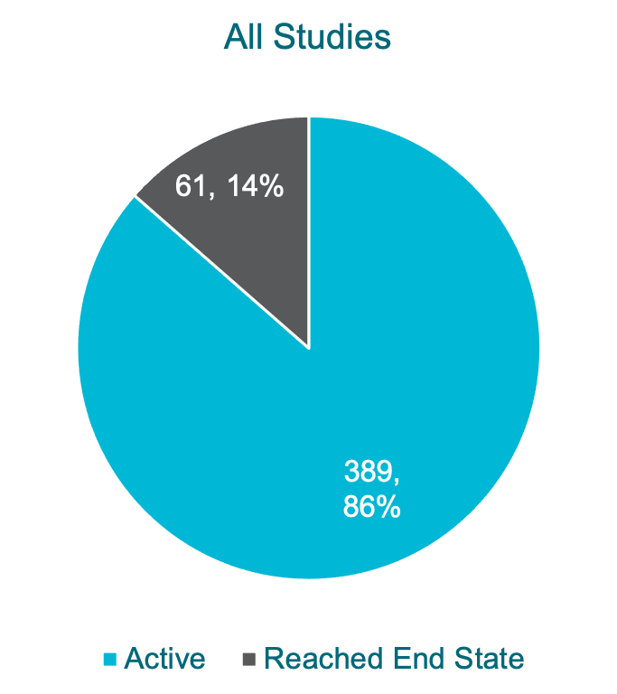
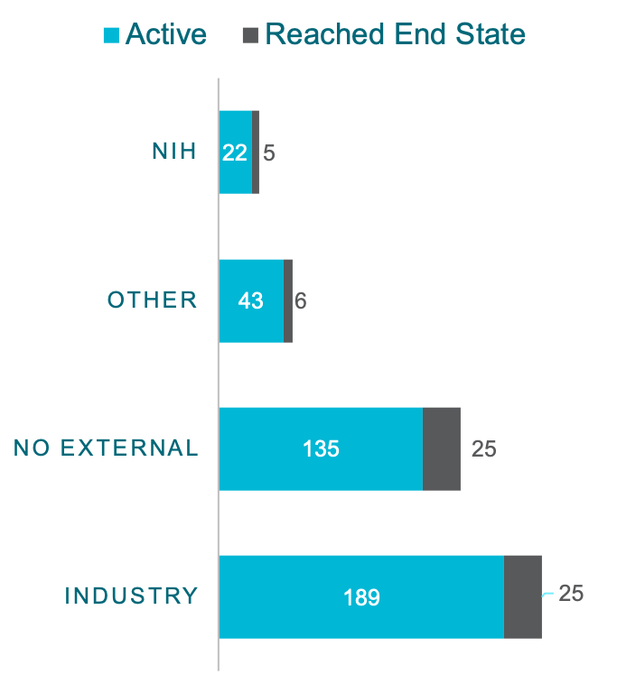
U.S. Studies:
Recruitment Status as of 2/1/21

Slide 20
U.S. Studies: Number of Study Sites
 |  | Funder
 | All studies N=450 | Industry N=214 | NIH N=27 | No external N=160 | Other N=49
Multi-site study, n/N (%) | 230/450 (51.1%) | 147/214 (68.7%) | 22/27 (81.5%) | 36/160 (22.5%) | 25/49 (51.0%)
Number of study sites
N | 450 | 214 | 27 | 160 | 49
Mean +/- SD | 11.87 +/- 25.01 | 17.90 +/- 31.66 | 29.11 +/- 26.97 | 1.78 +/- 2.93 | 9.02 +/- 17.50
Median (Q1, Q3) | 2.00 (1.00, 10.00) | 5.00 (1.00, 17.00) | 25.00 (2.00, 51.00) | 1.00 (1.00, 1.00) | 2.00 (1.00, 8.00)
A little more than half of all studies were multi-site
Less than a quarter with no external funder had more than one site

Slide 21
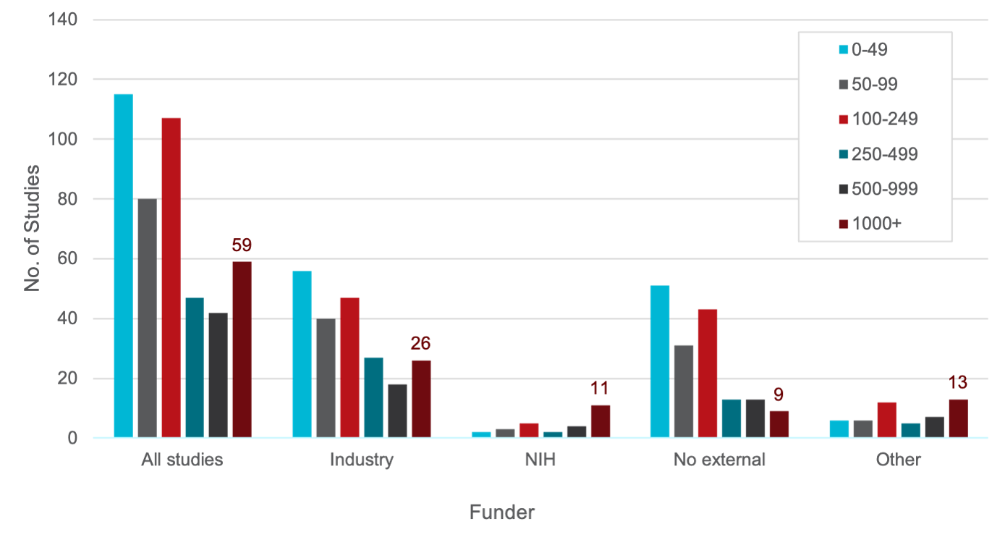
Study Size

Slide 22
Study Size by Quarter

Slide 23
U.S. Studies Design Features
 | n/N (%) | % of All Studies N=450
Number of arms
One | 48/449 (10.7%)
Two | 305/449 (67.9%) | 89% > 2 arms
Three or more | 96/449 (21.4%) | 89% > 2 arms
Randomized (for studies with >1 arms) | 377/401 (94.0%) | 84%
Number of parties masked (for randomized studies with >1 arm)
No masking | 75/377 (19.9%)
1 party masked | 15/377 (4.0%)
2 parties masked | 96/377 (25.5%)
>2 parties masked | 191/377 (50.7%)
DMC appointed (for randomized studies & >1 arm)
Yes | 283/377 (75.1%) | 63%
No | 55/377 (14.6%)
Unknown | 39/377 (10.3%)
Notes:
Doesn’t deal with observational

Slide 24
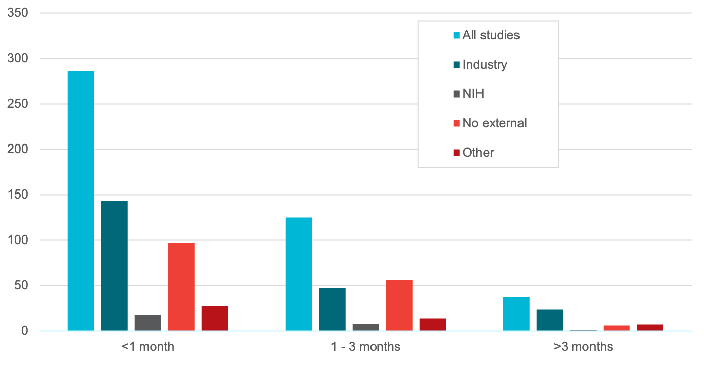
Primary Outcome Time Frame

Slide 25
Intervention Types
 |  | Funder type
 | All studies N=450 | Industry N=214 | NIH N=27 | No external N=160 | Other N=49
Drug | 368/450 (81.8%) | 179/214 (83.6%) | 21/27 (77.8%) | 126/160 (78.8%) | 42/49 (85.7%)
Device | 4/450 (0.9%) | 1/214 (0.5%) | 0/27 (0.0%) | 2/160 (1.3%) | 1/49 (2.0%)
Biological or vaccine* | 87/450 (19.3%) | 38/214 (17.8%) | 9/27 (33.3%) | 34/160 (21.3%) | 6/49 (12.2%)
All Other | 115/450 (25.6%) | 51/214 (23.8%) | 11/27 (40.7%) | 39/160 (24.4%) | 14/49 (28.6%)

Slide 26
 |  | Funder type
Intervention Sub-type | All studies N=450 | Industry N=214 | NIH N=27 | No external N=160 | Other N=49
Immunomodulators | 159 (35.3%) | 107 (50.0%) | 12 (44.4%) | 8 (16.3%) | 32/ (20.0%)
Other | 112 (24.9%) | 26 (12.1%) | 2 (7.4%) | 33 (67.3%) | 51 (31.9%)
Antivirals | 103 (22.9%) | 33 (15.4%) | 12 (44.4%) | 19 (38.8%) | 39 (24.4%)
Neutralizing antibody therapy | 52 (11.6%) | 7 (3.3%) | 5 (18.5%) | 5 (10.2%) | 35 (21.9%)
Antithrombotic therapy | 29 (6.4%) | 10 (4.7%) | 2 (7.4%) | 3 (6.1%) | 14 (8.8%)
Cell and gene therapy | 25 (5.6%) | 18 (8.4%) | 2 (7.4%) | 1 (2.0%) | 4 (2.5%)
SARS-CoV-2 Neutralizing Antibodies | 19 (4.2%) | 17 (7.9%) | 2 (7.4%) | 0 | 0
Steroids | 8 (1.8%) | 3 (1.4%) | 1 (3.7%) | 3 (6.1%) | 1/160 (0.6%)
Vaccine (Non-COVID-19 Vaccine) | 2 (0.4%) | 2 (0.9%) | 0 | 0 | 0

Slide 27
Frequent Interventions

Slide 28
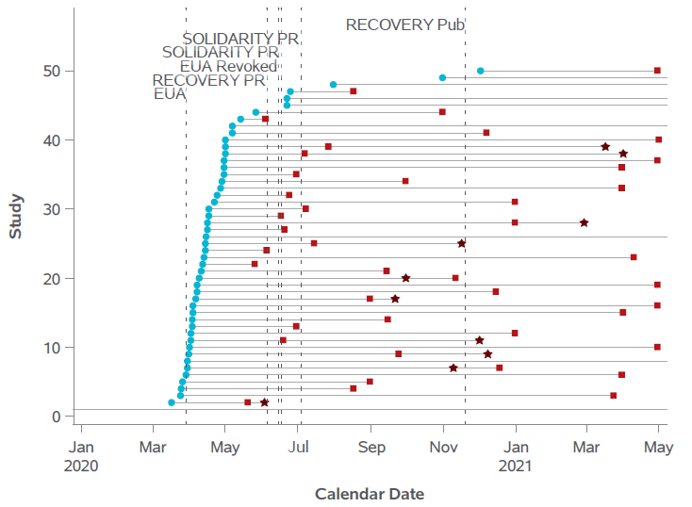
Hydroxychloroquine/Chloroquine
Start Date
Primary
Completion
Date*
First Results
Available
*Anticipated or actual. PR= Press Release, Pub=Publication

Slide 29
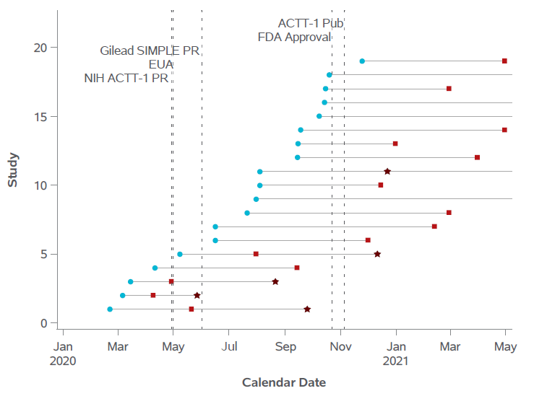
Remdesivir
Start Date
Primary
Completion
Date*
First Results
Available
*Anticipated or actual. PR= Press Release, Pub=Publication

Slide 30
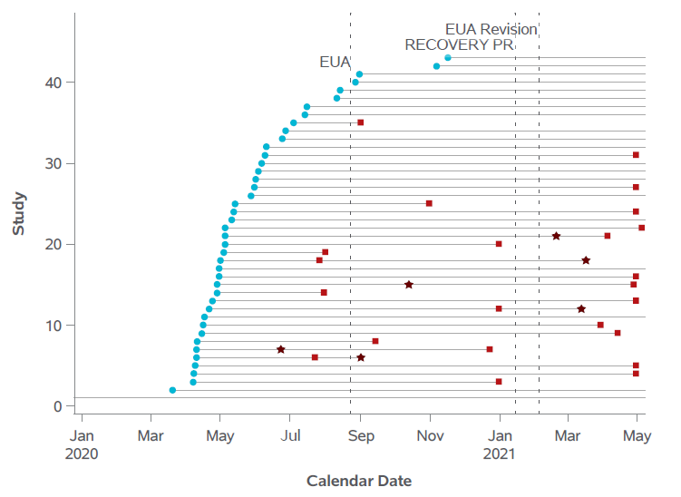
Convalescent Plasma
Start Date
Primary
Completion
Date*
First Results
Available
*Anticipated or actual. PR= Press Release, Pub=Publication

Slide 31
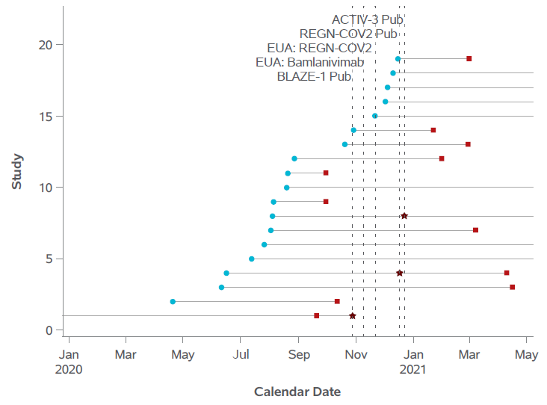
SARS-CoV-2 Targeted Neutralizing Antibodies
Start Date
Primary
Completion
Date
First Results
Available
*Anticipated or actual. PR= Press Release, Pub=Publication

Slide 32
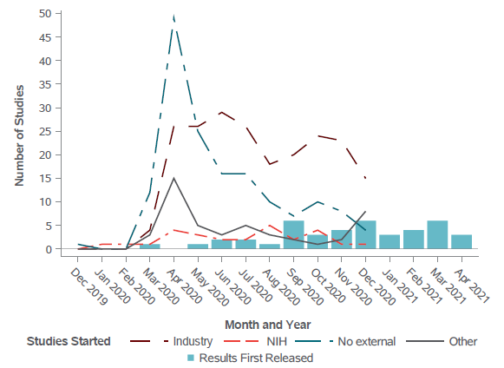
Timing of Results Availability

Slide 33
U.S. Trials & U.K. Recovery Platform
U.S. Trials (as of 12/31/20)
U.S. Confirmed COVID-19 Cases | Total Potential Participants in Studies with >1 U.S. Site | Participants in U.S. Studies with Results as of 4/12/21
20,026,890 | 498,849 (2.5%) | ~29,000 (0.1%)
Highlights: SARS COV2 Targeted Antibodies: NIH ACTIV, Regeneron, Lilly REMAP-CAP, ACTIV-4a, ATTACC, trials pooled anticoagulation study results*
RECOVERY Trial (as of 1/4/21) Hospital Only
U.K. Confirmed COVID-19 Cases | Enrolled Participants
2,708,592 | 24,000 (0.9%)
Major Results: Dexamethasone Azithromycin Hydroxychloroquine Lopinavir-Ritonavir Convalescent Plasma Tocilizumab Some with same-day press release & preprint
Notes:
Azith & Toci same day pre-print and press release. Dexa within 6 days.

Slide 34
Conclusions
ClinicalTrials.gov provides a resource to better understand the clinical trials enterprise (CTE).
The volunteerism of patients, clinicians, and researchers is amazing.
The U.S. CTE is fragmented with many small trials and fewer large trials that define balance of benefits and risks of treatments.
Multiple trials appear to be addressing the same questions.
Actual enrollment lags far behind anticipated enrollment.
Many trials either do not have results reported or will never be completed.
Many trials have no apparent source of funding.
What would happen if high-priority trials that provided definitive evidence of which treatments are effective had priority for enrollment?

Slide 35
Commentary

Slide 36
Panel & Discussion:
Lessons Learned

