Slide 1
CTTI Master Protocol Expert Meeting
April 21, 2020
Notes:
NOTE: If your presentation is being recorded, this will be the beginning of the recording, so make it a clean introduction.
EXAMPLE:
Welcome everyone! My name is [insert introducer’s name/title] and it is my pleasure to introduce [insert presentation name].
Today’s presentation is hosted by the Clinical Trials Transformation Initiative, and the speakers today include [insert speaker(s) name/title]
[Insert prepared speaker(s) bios.]

Slide 2
Welcome
Once you’ve logged into Zoom, please select one of the following options:
Join with Computer Audio
Join with Phone
Dial call-in number
Enter Meeting ID followed by #
Enter Participant ID followed by #
The webinar is being recorded
All participants are muted on entry. Please stay muted unless called on by the moderator
Unless you are a presenter we ask that you keep your video off
Type questions in the chat box to the host
The moderator will call on you to unmute yourself and ask your question
Please introduce yourself and the organization you represent
We will answer as many questions as possible in the allotted time

Slide 3

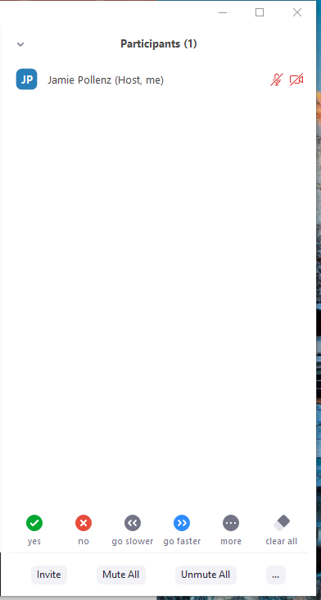

Participant List
Chat Box
Use to mute and unmute yourself during meeting
Click to expand participant list
Click to open chat box

Slide 4
Day 2 Overview
Kim Fisher, CTTI

Slide 5
Day 2 Objectives
Apply CTTI tools to the development of real-world master protocols that are at the pre-planning and planning stages of study development
Identify necessary revisions to CTTI tools to make them more responsive to the unique design and operational challenges identified in diverse therapeutic areas.

Slide 6
Day 2 Overview
Case study presentations
Early Childhood Stunting Multi-Arm, Multi-Stage Adaptive Platform
PTSD Adaptive Platform Trial
Next Steps
Feedback

Slide 7
An Adaptive Platform Trial for the Evaluation of Multi-Component Interventions for Optimal Child Linear Growth for sub-Saharan Africa
Jay Park
Cytel Inc

Slide 8
Presentation Overview
Study overview
Business and operational plan overview
Challenges with stakeholder engagement

Slide 9
Introduction
Increase mortality and morbidity
Development deficits
Hampered educational and professional attainment
Productivity and economic loss
Greater susceptibility to infections
Between 1990 and 2015, we have made a remarkable progress towards the MDGs of reducing childhood morbidity and mortality
However, childhood stunting (low height-for-age) continues to be a critical public health issue particularly in LMICs
Childhood stunting can have immediate and long-lasting consequences
Lifetime cost of
childhood stunting
Acronyms: MDGs – Millennium Development Goals;
LMICs – Low- and middle-income countries
*Adapted from McGovern ME et al. A review of the evidence linking child stunting to economic outcomes. International journal of epidemiology. 2017 Aug 1;46(4):1171-91.

Slide 10
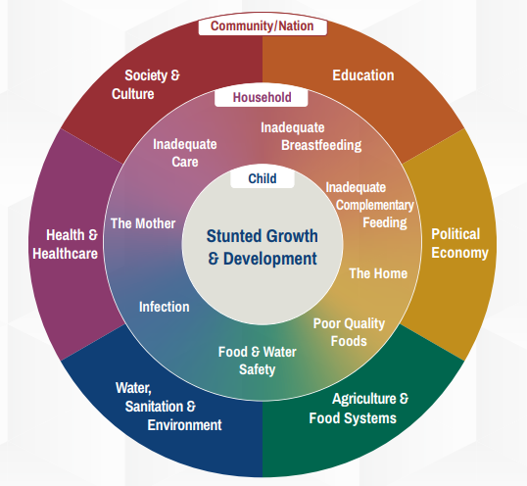
What Causes Early Stunting in Children?
Determinants of stunting are multi-faceted
Genetic, household, and other broad socioeconomic factors all have an intertwined role behind poor linear growth
As a shorter-term goal, it is critical to address micro- and macronutrient deficiencies and improve infection control, hygiene practices, and parental education
In the long-term goals, economic and other broader factors should be considered
WHO’s Conceptual Framework – Childhood Stunting: Context, Causes and Consequences

Slide 11
Current Evidence Base for Childhood Stunting
In addition to questionable methodological quality, there is a paucity of information on the benefits of combining interventions
The majority of clinical trials have only focused on a single intervention domain, such as micronutrients
Given multifaceted determinants of poor linear growth, there is a need to investigate multi-component intervention packages
Park JJH et al., JAMA 2019; 2(7)e197871

Slide 12








Conceptual Framework
Determinants of growth are multi-factorial
There are differing growth needs at different life stages
Early growth affects adolescence and adulthood
Start optimizing growth early
Adolescence and adult outcomes will feedback and affect the next generation
Preconception
Pregnancy
EBF (0-6mo)
Early CFP (6-12mo)
Adolescence &
adulthood
Conception
Birth
6m
1 year
birthday
Acronyms: Exclusive breastfeeding (EBF); Complementary feeding period (CFP)

Slide 13
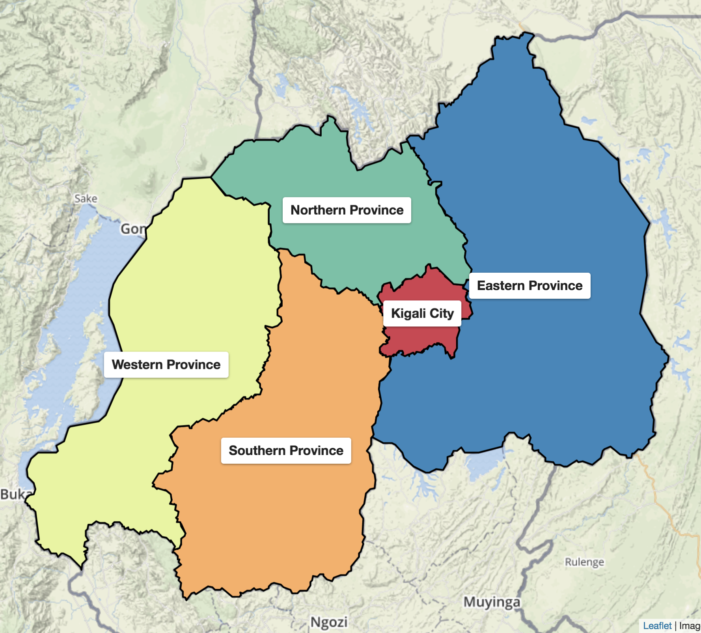
Rwanda
A densely populated country in East Africa ~ 12.2 million people
Urban-rural disparities exist between its capital city (Kigali City) and the outside regions
High national stunting prevalence of 38% in children <5yrs
Stunting has been identified as a national priority in 2018
Current national goal: Cut stunting prevalence by 50% by 2025

Slide 14
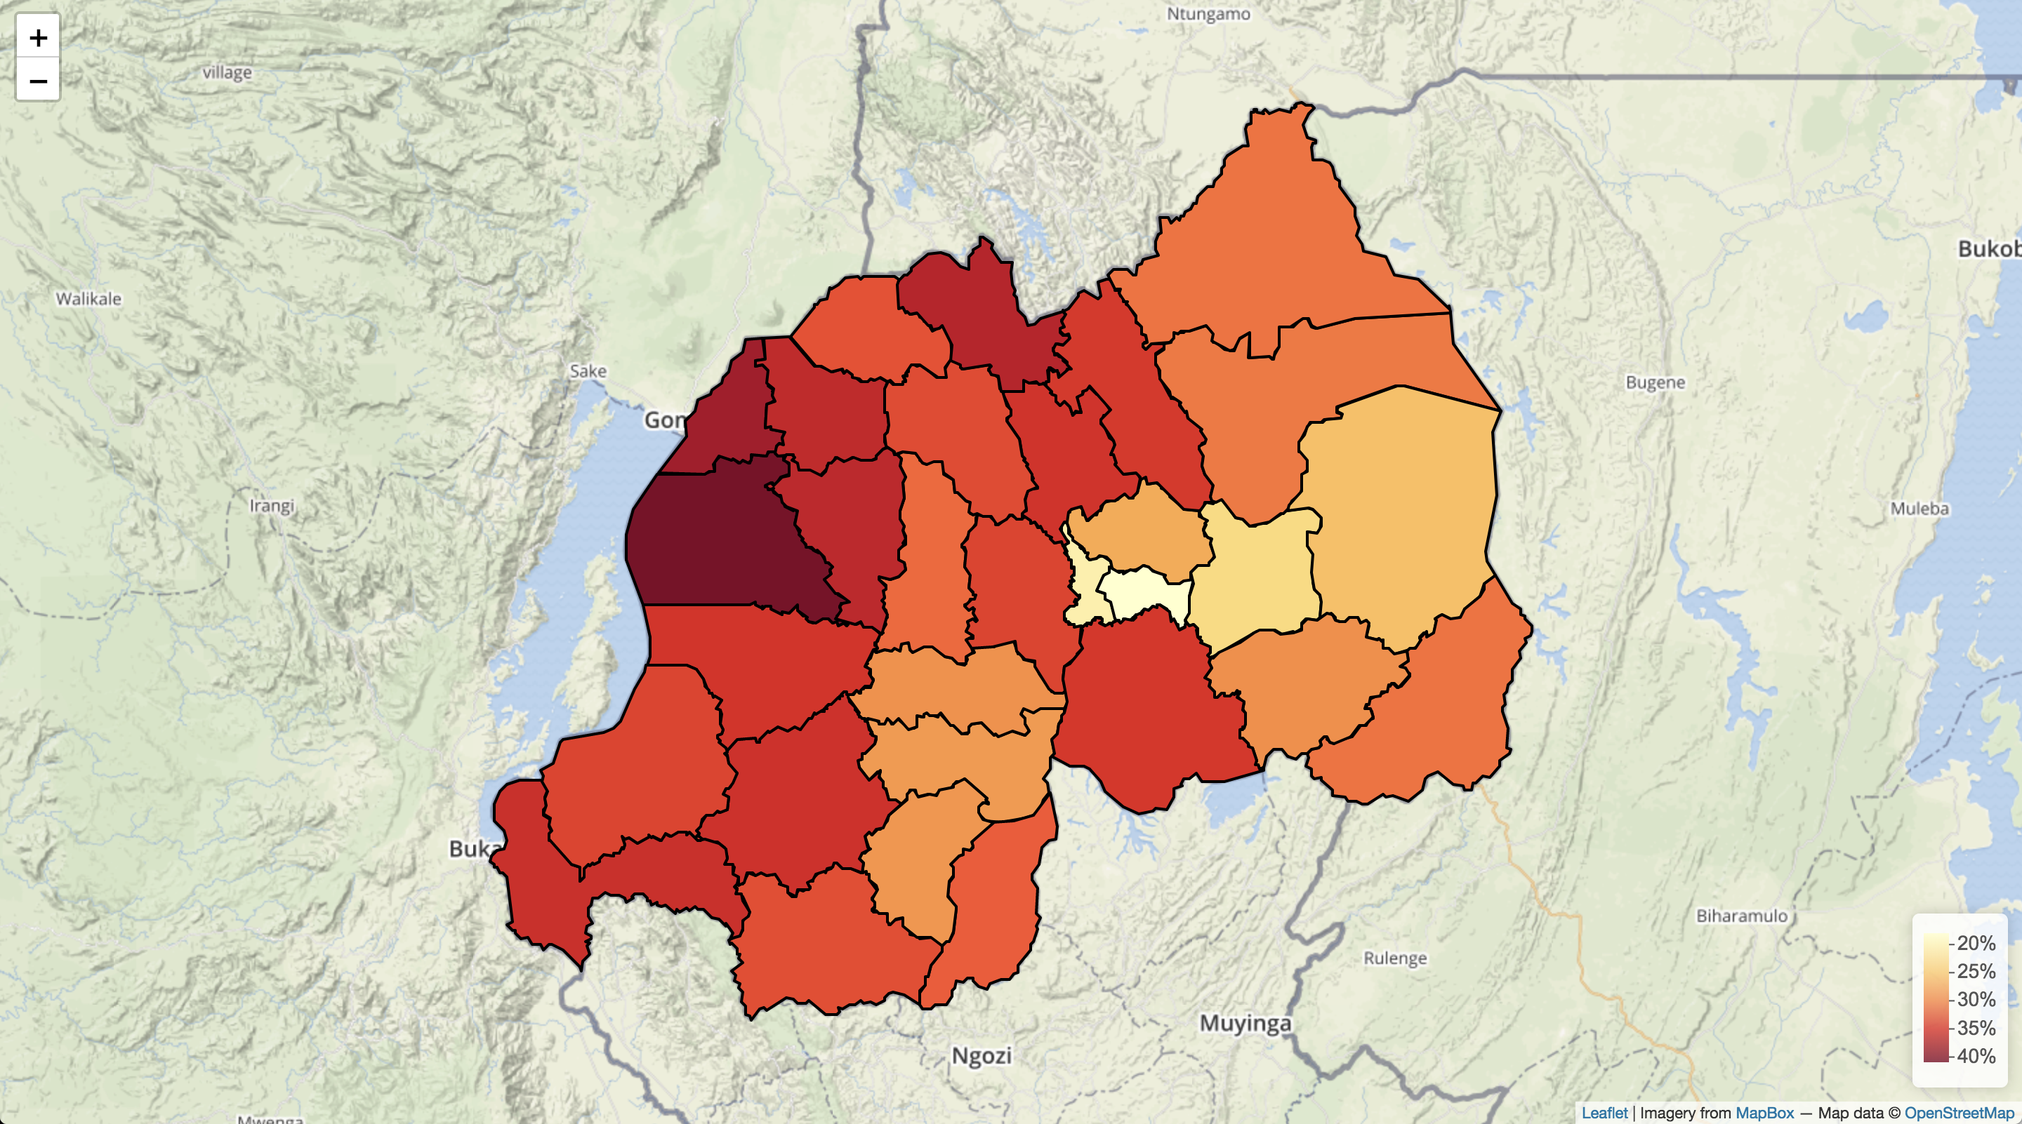
Status of Children in Rwanda
2018/19 stunting estimates for 6-24 months
National breastfeeding campaign already implemented in Rwanda
Stunting peaks when complementary food becomes necessary as breast milk alone is no longer enough to meet the nutritional needs
The complementary feeding period (6 to 18-24 months of age) has been identified a critical period for child development
Rutsiro
40.8% (N = 12,553)

Slide 15
Status of Children in Rwanda - Continued
The Government wishes to revise their national policy to tackle stunting
Adopt packaged multi-component interventions that are effective, scalable, and sustainable interventions
Strengthen the existing infrastructure and capacity for research and health delivery
Adopt inter-sectoral collaborations
There was a particular key desire for the health ministries to collaborate with the agriculture ministry

Slide 16
Intervention Strategies
Build on local standard-of-care with macronutrients and infection control strategies
Prioritize interventions that can be locally produced – to enhance the local agriculture
For imported goods, test affordable interventions that can realistically be scaled at the national level
Utilize delivery strategies that can be incorporated within the existing programs (e.g. RapidSMS)

Slide 17
Intervention Strategies - Continued
Arm number | Standard of care | Micronutrient supplements | Macronutrient supplements | Nutritional infectious control | Other infection control
1 (Control) | Yes | Multiple micronutrient powders (MNP) | -- | -- | --
2 | Yes | MNP | Corn soy blended (CSB)++ | -- | --
3 | Yes | MNP | CSB++ | Probiotics | --
4 | Yes | MNP | CSB++ | Probiotics | Azithromycin
5 | Yes | MNP | Eggs | -- | --
6 | Yes | MNP | Eggs | Probiotics | --
7 | Yes | MNP | Eggs | Probiotics | Azithromycin
All children enrolled in to the trial will receive standard-of-care according to the Rwanda’s National guideline
*MNP distribution is part of the National guideline

Slide 18
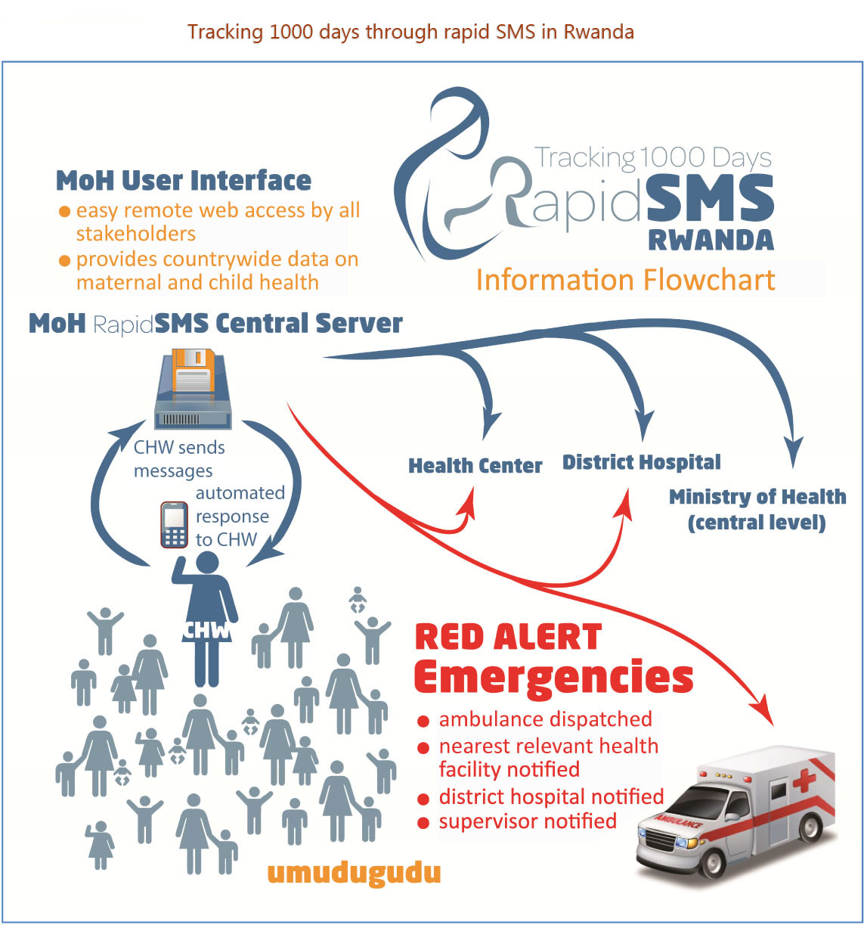
RapidSMS Program: Community Healthcare Worker Network
RapidSMS is a national community healthcare worker program that collects important data on the first 1,000 days of life (pregnancy to 2 years of age)
Community healthcare workers across the country are equipped with a mobile phone and sends the data through text messages

Slide 19
Methodology Overview
Overall goal:
To determine the most optimal and scalable intervention package that can be provided to children during the complementary feeding period in Rwanda
Primary objective:
To determine the intervention packages during the complementary feeding period that can reduce stunting at 12 months of age

Slide 20
The Need for Innovation and Efficiency in Global Health
In almost all areas of global health, single modality intervention approaches dominate along with one-off clinical trials (non-master protocols) with conventional fixed trial design approaches
Still to this day, clinical trials are still getting funded and being conducted to evaluate a single vitamin supplement
Linear growth similar to other problems is complicated. There is a need to combine different intervention modalities and test them as a package
The number of possible combinations can become large and infeasible to test with conventional approaches. There is a need for innovation and efficiency in global health

Slide 21
Business and Operations Plan Overview

Slide 22
Master Protocol Project Business & Operations Plan
Value proposition
High-level design overview (will present first)
Operational capacity building

Slide 23
High-Level Design Overview
Adaptive
platform trial
Cost effectiveness analysis
Budget impact analysis
Qualitative analyses
Assess the value for money
Determine affordability
Identify implementation challenges
Construct a research ecosystem where multiple interventions can be evaluated
Conduct economic analyses alongside the trial to determine value for money and estimate the cost of scale-up
Qualitative analyses also done to improve future implementation

Slide 24
High-Level Design Overview – continued
Rwanda stunting platform trial
Type of master protocol | Adaptive multi-arm, multi-stage platform trial with complementary economic and qualitative analyses
Objectives | To determine the most optimal and scalable intervention packages that can be adopted into the national policy Construct a research ecosystem that can be leveraged to future scale efforts
Primary endpoint | Stunting at 12-14 months of age
Study population | Children in 6-8 months of age living in Rwanda
Arms | 4 groups simultaneously at once (initially)
Control arm description | The standard-of-care according to the Rwanda’s National guideline
Special safety considerations | Minimal

Slide 25
High-Level Design Overview - Continued
Features | Details | Purpose/Benefits (why do this?)
Pragmatic design | Open-label with 4 groups evaluated at once | Feasibility reasons
Sample size | Maximum 600 children per arm | To allow for sufficient power
Recruitment plan | Recruit 800 children per cycle (200 per arm) | Economic reasons – not committing too many children at once Feasibility and operational reasons – allow for time to solve unanticipated problems between cycles
Interim analysis plans | Futility assessment done at end of each cycle | To cut losses with interventions with little-to-no promise of success

Slide 26
Trial Schema
Cycle 1
Cycle 2
Cycle 3
Recruitment
6 month follow-up
Recruitment
6 month follow-up
Recruitment
6 month follow-up
Arm 1: Control
Arm 1: Control
Arm 1: Control
Arm 2: CSB
Arm 3: CSB + Probiotics
Arm 3: CSB + Probiotics
Arm 4: CSB + Probiotics + Azithro
Arm 4: CSB + Probiotics + Azithro
Arm 4: CSB + Probiotics + Azithro
Arm 5: Eggs + Probiotics + Azithro
Arm 5: Eggs + Probiotics + Azithro
Arm 6: Eggs + Probiotics
800 children recruited each cycle

Slide 27
High-level Design Overview - Continued
Features | Details | Purpose/Benefits (why do this?)
Shared control arm | Pairwise comparison against the control | Reduce sample size and resources
Borrowing of past control data | Empirical Bayesian borrowing method to incorporate past control data for new arms | Reduce sample size, resources, and time
Ability to change control | If at the end, one of the interventions shown to be superior – leave it up to the Government to continue testing other interventions | Align with the overall goal which is to help with national scale

Slide 28
Scientific Criteria for Adding New Arms
Summary of Criteria
Phase I testing completed or limited safety concern
Clear social and biological rationale or known effectiveness for linear growth
Plausible mechanisms for improved growth
Sufficient availability of the intervention in Rwanda
Relative ease of scalability and sustainability
Local stakeholder enthusiasm

Slide 29
Value Proposition
Scientific and participant benefit/rationale
Evident in the government mandate to end stunting
Attempted to minimize parental concerns of their children being randomized to the control group by using the national guideline as the standard-of-care
In addition to using a common control, planned for an analytical method to incorporate past control data for the comparison of new interventions being added later

Slide 30
Value Proposition - Continued
Operational rationale/feasibility
The existing systems such as RapidSMS leveraged into the trial evaluation
Qualitative analyses to explore challenges of caregivers and community health workers and areas of improvements
Cycles of recruitment planned to allow for unanticipated problems and challenges to be solved

Slide 31
Value Proposition - Continued
Economic rationale
Prioritized interventions that can be produced locally to boost the local agriculture economy
Complementary economic analyses planned to assess the value for money and affordability
Recognized that conducting this trial can strengthen the local research capacity and infrastructure for future clinical trials – a case study for Rwandan capacity

Slide 32
Operational Challenges and Capacity Building Efforts
Challenges | Solutions
Community health workers | Additional training needed Provide feedback and engagement throughout the project
Intervention distribution | Centralized distribution of packaged interventions Provide drug interventions at clinical follow-up time by the health care providers
Biological specimens | Biobanking to allow for biomarker analysis
Data collection and firewall of information | Recruitment done in cycles Prioritize collection of height for adaptations

Slide 33
Challenges with Stakeholder Engagement
Priorities between international content experts and funders with local stakeholders
The local stakeholders wanted to conduct research to set local guidelines and policies as the main priority
Generating evidence for international guidelines was a secondary priority
Funding challenges for non-pharmaceutical research
Funding challenges for “non-priority” African countries

Slide 34
Feedback on CTTI Tools
Better capture unique operational, design, and stakeholder challenges for building robust master protocol study infrastructures in LMIC settings
We need to think about master protocol studies as being vehicles to build a broad and integrated global public health infrastructure to respond to a wide range of public health emergencies
Engage health authorities and regulators in LMICs to discuss unique need for cost-effective technical assistance and capacity building needs
Pressure test existing tools against these unique needs

Slide 35
Conclusion
Doing it the first time is always hard. We experienced many skeptics and skepticism
Value proposition of master protocols for the local stakeholders is clear, given that local contextual considerations are made with proper local stakeholder engagement
The current funding scheme in global health is undoubtedly difficult, especially for non-pharmaceutical research, to conduct master protocols
Improving capacity and infrastructure in these countries is necessary for global public health response to current and future threats

Slide 36
Q /A

Slide 37
Questions for the Audience
What are your perceived benefits and challenges of assessing non-pharmaceutical interventions within the context of a single platform trial?
What are your perceived institutional and infrastructure challenges of conducting clinical trials in LMICs?

Slide 38
Questions for the Audience - Continued
3. What ways could IMP developers and funders develop capacity and infrastructure for the conduct of master protocol studies in LMICs?
How do you perceive the value of such efforts?
4. What ways could the research community from high-income countries better engage with the research communities from LMICs to build a more robust global clinical trials ecosystem?

Slide 39

Posttraumatic Stress Disorder Adaptive Platform Trial (APT)
Kimberly A. del Carmen, Ph.D.
Product Manager
kimberly.a.delcarmen.civ@mail.mil
Elyse R. Katz, Ph.D.
Sr. Product Management Support, Contractor
elyse.r.katz.ctr@mail.mil
21 April 2020

Slide 40
Disclaimer
The views expressed in this brief are those of the authors and do not necessarily reflect the official policy of the Department of Army, Department of Defense, or the U.S. Government.

Slide 41
Background
United States Army Medical Materiel Development Activity (USAMMDA) aka “Advanced Development”
Warfighter Brain Health (WBH) Project Management Office (PMO)
Mission: To develop and deliver brain health medical solutions, across the continuum of care, that aid in the detection, prevention, and treatment of neurotrauma and psychological health disorders in our US Service Members.
Posttraumatic Stress Disorder Drug Treatment Program
Requirement: to develop alternative drugs for the treatment of military-service related PTSD
Program Activities:
Conduct market research
Conduct Phase 2 and Phase 3 drug treatment studies
Conduct enabling studies to de-risk Phase 2 and Phase 3 PTSD treatment development efforts by increasing the probability of technical and regulatory success.

Slide 42
Background and Rationale
for PTSD APT
Current State of PTSD Drug Development:
More than 130 clinical trials conducted with at least 48 drug/drug combinations, encompassing 30+ mechanisms of action since 1987, with little to no return on investment
Only two Food and Drug Administration (FDA)-approved drugs for the treatment of Post Traumatic Stress Disorder (PTSD), approved 18+ years ago
Substantial heterogeneity in clinical presentation and biological underpinnings of PTSD
Multiple uncoordinated efforts within and between government agencies, academic centers, pharmaceutical companies, non-profits, etc. to develop new treatments for PTSD
Recommendations for a different approach to PTSD drug treatment trials:
2017 DOD analysis of clinical trial results and landscape:
Mitigate the failure to detect a clinical benefit due to enrolling a heterogeneous sample by using patient enrichment biomarkers, and thus increase the likelihood of success of future trials
2017 PTSD Expert Meeting:
Identify biological subtypes of PTSD and utilize those subtypes in future clinical trial designs
Due to the complexity of PTSD and the multiple stakeholders (academia, industry, government, non-profits and advocacy groups) involved in addressing the treatment of the disorder and related conditions, private/public partnerships are needed

Slide 43
APT Status: Planning
Currently in the planning stage: Infrastructure build is ongoing
September, 2018 APT to test drug treatments for PTSD awarded to Cohen Veterans Bioscience (CVB)
Governance structure is in place (e.g., Joint Steering Committee, Working Groups)
Approval of drug selection process is pending
Master Protocol Synopsis is under development
Statistical modeling is ongoing

Slide 44
PTSD APT Objectives
Establish clinical trial infrastructure and conduct an adaptive platform trial to comparatively test the efficacy & safety of a minimum of 2 candidate pharmacotherapeutics for the treatment of individuals with PTSD including military cohorts, against a placebo control in a well‐powered Ph2 study.
~700K Service Members and Veterans with PTSD Diagnosis¹
Anticipated sample size is approximately 150 patients per arm
Additional arms may be added pending funding availability
Primary outcome at trial launch will be based on symptom improvement measured on the Clinician-Administered PTSD Scale (CAPS) at 12 weeks
Collect and assay biomarker (BM) data to identify and validate treatment response BMs
In Vitro Diagnostic (IVD) companion diagnostic device will be developed though appropriate FDA approval pathway
¹ Institute of Medicine, 2014

Slide 45
Key Challenge: Visibility of other efforts to inform our path forward
Protocol Design Challenges
Key factors influencing selection and incorporation of APT design elements
Identification and validation of treatment-response biomarkers within the APT construct
Response adaptive randomization
Translation of DOD-required primary endpoint into effect size/power calculations, trial simulations
Project Simulation Tool should include key design criteria, factors for deciding to employ design elements, and impact to simulations/trial scenarios
High-level Roadmap Tool should include specific deliverables and roadblocks about biomarker discovery and validation
Best Practices for Vendor Selection
Is there standard language that can be included in RFIs/RFPs to assist sponsors in assessing vendor experience and expertise in supporting Master Protocols?
In particular statistical modeling, CRO, trial support vendors, regulatory affairs
Vendor Selection Tool should include considerations or suggestions for how to solicit and evaluate proposals to support Master Protocols
“Real-world” results of Master Protocols
Which studies have read out, have they met their goals, was it more efficient or successful than traditional trials?
Annotated bibliography/Central database of MP results needed, funding needed to analyze success of MPs to support value statements and future investment

Slide 46
Best Practices for Master Protocols
Identified gaps for standardization and articulation of best practices and CTTI tools to address gaps
Data Sharing
Suggest development of a tool to help sponsors navigate considerations for the development of data sharing policies that include multiple stakeholders
Governance and Oversight
High-level Roadmap
Business Plan Template
Intervention selection
Suggest development of a tool to help sponsors understand implications for intervention selection, e.g. different routes of administration, types of interventions (drug, device, combinations, other)
Business Plan Template
Regulatory interaction
FDA Engagement Tool
High-level Roadmap
Operational conduct
Vendor Assessment Tool
Protocol Development Map
Site Selection Tool

Slide 47
Next Steps and Closing Comments
Kim Fisher, CTTI

Slide 48
Next Steps
Incorporate feedback into draft tools & develop additional complimentary resources
Explore additional opportunities to host COVID-19 discussion forums
Explore developing additional tools that respond to our current pandemic environment
Continue to develop forums for early adopters to connect with more experienced experts

Slide 49
Meeting Feedback
What worked well?
What could be improved?
What would you like to see next?

