Slide 1
CTTI Master Protocol Expert Meeting
April 20, 2020

Slide 2
Welcome
Once you’ve logged into Zoom, please select one of the following options:
  Join with Computer Audio
  Join with Phone
    Dial call-in number
    Enter Meeting ID followed by #
    Enter Participant ID followed by #
The webinar is being recorded
All participants are muted on entry. Please stay muted unless called on by the moderator
Unless you are a presenter we ask that you keep your video off
Type questions in the chat box to the host
  The moderator will call on you to unmute yourself and ask your question
  Please introduce yourself and the organization you represent
  We will answer as many questions as possible in the allotted time

Slide 3

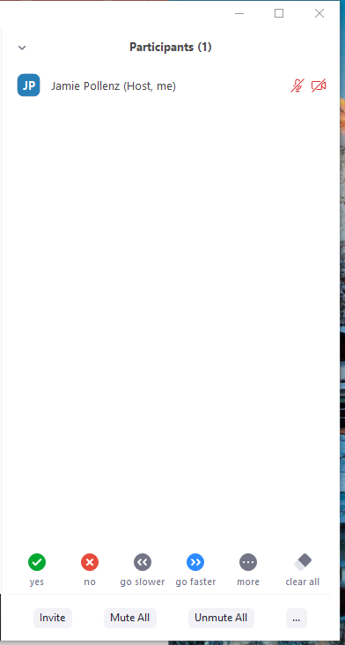
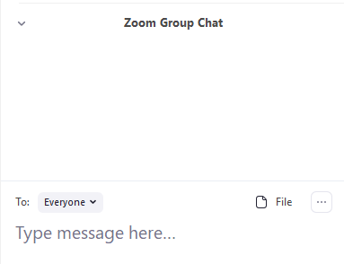
Participant List
Chat Box
Use to mute and unmute yourself during meeting
Click to expand participant list
Click to open chat box

Slide 4
Introduction to CTTI
Pamela Tenaerts, CTTI

Slide 5

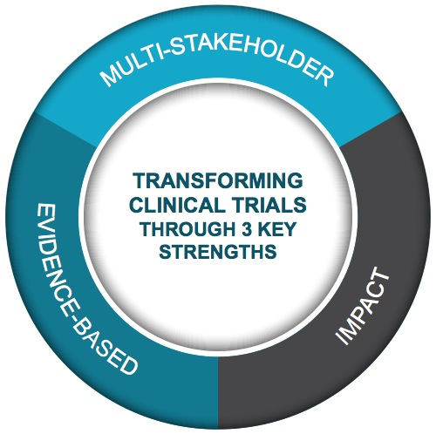
Public-Private Partnership
Co-founded by Duke University & FDA
Involves all stakeholders
Approx. 80+ members
Participation of 400+ more orgs
MISSION: To develop and drive adoption of practices that will increase the quality and efficiency of clinical trials

Slide 6
Multi-Stakeholder Collaboration
Clinical
Investigators
Better
Streamlined
Fit for purpose
Clinical Trials
Government & Regulatory Agencies
Patients, Caregivers & Patient
Advocacy Groups
Everyone is an equal partner at the table
Industry (pharma, bio, device, CRO, & tech)
Academia
IRBs
Trade &
Professional Orgs

Slide 7
Project Team
Team Leads | Team Members
Daniel Millar (Janssen R&D) Abby Bronson (Edgewise Therapeutics) Marianne Chase (Massachusetts General Hospital) Nicholas Richardson (FDA) Shenghui Tang (FDA) | Sabrina Paganoni (Massachusetts General Hospital) Jane Perlmutter (Patient Advocate) Dionne Price (FDA) Paulina Selaru (Pfizer) Paul Bycott (Pfizer) Antonio Valkas (EMD Serono) Kert Viele (Berry Consultants) Karen Dimick (Genetech) Greg Licholai (Yale) Sharon Love (UCL) Sumithra Mandrekar (Mayo) Debra Michaels (DIA) Nicholas Kenny (Syneos) Barbara LeStage (Patient Advocate) Roger Lewis (UCLA, Berry Consultants | Michelle Detry (Berry Consultants) Angie Botto-van Bemden (Patient Advocate) Gene Vinson (Syneos) Alain Vuong (GSK) Kirsty Wydenbach (MHRA) Louis Brown (UCL) Amy Burd (LLS) Emma Healy (Novartis) Ritesh Jain (EMD Serono)
 |  | CTTI Staff
 |  | Kim Fisher (Project Manager) Laura Shannon (Communications Manager)

Slide 8
Meeting & Project Overview
Kim Fisher, CTTI

Slide 9
Expert Meeting Objectives
Refine CTTI tools to support the development of emerging master protocol studies in diverse therapeutic areas
Identify specific capacity building efforts to support cross-institutional collaboration in response to COVID-19 and other major public health threats

Slide 10
Project Overview

Slide 11
Purpose
Provide diverse stakeholders with a roadmap for the successful design and implementation of master protocols

Slide 12
Objectives
Compare and contrast the distinct design and operational features of basket, umbrella, and platform studies.
Identify emerging best practices for the design and conduct of master protocol studies.

Slide 13
VeloCTTI Project Methodology
Convene experts
Describe an issue related to a novel, time-sensitive topic
Share emerging best practices
Identify specific challenges and potential solutions

Slide 14
Expert Meeting Series
Identify and clarify how various stakeholders experience challenges related to the design and implementation of master protocol studies
Develop creative forums to share emerging best practices

Slide 15

How Can We Strengthen the Landscape?
Demystify
the Process
Create Forums for Discussion
Strengthen the Landscape
Provide Educational Programs
Drive Knowledge Sharing

Slide 16

Tool Development Process
Priortiize
ROADBLOCKS
Develop
TOOLS
Identify Potential
STRATEGIES

Slide 17
Tool Development Timeline
October
November
December
January
February
March
April
May
June
October – November | December – April | May – June
Tools prioritized and refined | Structure defined, content developed, request feedback on drafts | Tools finalized and prepared for public release

Slide 18
High-Level Roadmap: Study Development Deliverables & Challenges

Slide 19



Study Development Process
Pre-Planning
Planning
Execution

Slide 20
Challenges and Problem-Solving Approaches
Pre-Planning
Planning
Execution

Slide 21
Deliverables
& Roadblocks
DESIGN
Rationale
Pre-Planning
Feasibility
Prove value
MULTI-STAKEHOLDER ENGAGEMENT
OPERATIONS

Slide 22
Deliverables
& Roadblocks
DESIGN
Reach consensus
Planning
Integrate, centralize processes
Education
MULTI-STAKEHOLDER ENGAGEMENT
OPERATIONS

Slide 23
Deliverables
& Roadblocks
DESIGN
Fidelity,
change
Execution
Centralization,
flexibility,
communication
Cultivate,
maintain
MULTI-STAKEHOLDER ENGAGEMENT
OPERATIONS

Slide 24
Draft Business Plan Template
Daniel Millar, Janssen R&D
Abby Bronson, Edgewise Therapeutics

Slide 25
Deliverables
& Roadblocks
DESIGN
Rationale
Pre-Planning
Feasibility
Prove value
MULTI-STAKEHOLDER ENGAGEMENT
OPERATIONS

Slide 26
Business Plan Template Overview
Patient
Benefit
Patient Benefit
Scientific Rationale
ARTICULATE THE
VALUE PROPISITION
Operational Feasibility
Economic Rationale

Slide 27
Key Success Factors
DESIGN | Innovative features that respond to unmet patient, scientific, and economic needs
OPERATIONAL CAPACITY | Creation of robust, long-term infrastructure to support long-term innovation
STAKEHOLDER ENGAGEMENT | Respond to engagement barriers Address collaboration across distinct and competing stakeholder groups
GOVERNANCE & DECISION MAKING | Describe sponsor qualifications Detail governance structure that will facilitate decision making and collaboration

Slide 28
Tool Strengths & Content Development Needs: Perspective from Duchenne Platform Trial
Abby Bronson, Edgewise Therapeutics

Slide 29
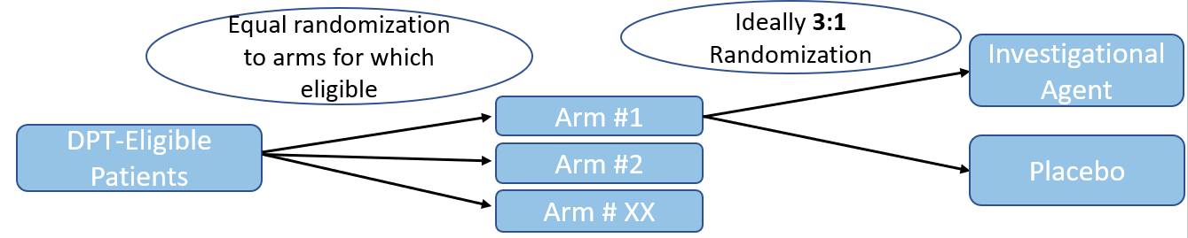
Adaptive Platform Trial for Duchenne Muscular Dystrophy (APT-DMD)
Phase 2, Phase 3, Phase 2/3 and post-approval trials
Age > 4
Standard Suite of Endpoints
Interim Analyses and Safety Monitoring across Platform and Within Arms
Efficiencies gained from polling placebo data across arm

Slide 30



It Takes a Village
Stakeholder Engagement
Identify champions
Understand concerns
Communications
Where will funding come from?
Governance
Who will legally own the Master IND?
How to embed stakeholder input?
Site network
Evaluate existing resources
What operational and data systems can be leveraged
Protocol
Identify expertise needed
Who needs to engage?
Develop Milestones
  Parent Project Muscular Dystrophy (PPMD) drug development forum, community engagement,
  Critical Path Institute (C-Path) Duchenne Regulatory Science Consortium
  Berry Consultants: Design, statistics, analysis planning
  I-ACT for Children: Master Protocol, Roadmap, Consortium Development

Slide 31
Business Plan Template Strengths
Starts with the “Why” – the Value Proposition
  The four components lay the foundation for everything that comes after.
  Focus on the patient benefits
Emphasizes importance of stakeholder engagement and gaining consensus
For Patient Advocacy Organizations, provides framework for understanding unique aspects of master protocols
  Governance
  Protocol Design

Slide 32
Business Plan Template Content Development Needs
Funding, Budgeting and Timeline
  More details on resource requirements to set expectations
Stakeholder Engagement Timing
  Bring All Stakeholders together early and often
“Call-outs” of real life successes of a particular strategy
  i.e. increasing patient engagement, IRB engagement

Slide 33
Master Protocol Trial Simulation:
Components & Communications Considerations
Michelle Detry, Berry Consultants, LLC

Slide 34
Deliverables
& Roadblocks
DESIGN
Rationale
Pre-Planning
Feasibility
Prove value
MULTI-STAKEHOLDER ENGAGEMENT
OPERATIONS

Slide 35
Deliverables
& Roadblocks
DESIGN
Reach consensus
Planning
Integrate, centralize processes
Education
MULTI-STAKEHOLDER ENGAGEMENT
OPERATIONS

Slide 36
Simulation Components
KEY MODULES
Interim Analyses Module
Definition of Plausible Scenarios
Virtual Patient Generator
Final Analyses Module
Module to Summarize Operating
Characteristics
Regulators

Slide 37
Communicated Simulated Trial Findings: Respond to Stakeholders’ Needs
Key Stakeholders | Needs
FUNDERS | Succinct summary of how simulation trial results justify the proposed design approach
REGULATORS | Demonstrate how key aspects of the trial will work (pre-trial) Demonstrate that the type 1 error risk protection was really maintained (post-trial) Demonstrate that the trial operating characteristics were not impacted adversely (post-trial)
IRBs | Risk benefit balance for individual subjects and how the risk benefit balance might change over time Patient burden, ethics and informed consent High-level trial performance characteristics
SITES | Operational implications of the design Patient-centered considerations
Patients | Vetting of design to include perspectives of all key stakeholders

Slide 38
Organize the Presentation of Simulated Trial Results
Describe how the simulation framework was developed
Examine individual trial trajectories
Summary of trial characteristics for a single scenario
Summary of trial characteristics across multiple scenarios

Slide 39
Tool Feedback
Strengths:
  Demonstrates role/benefits of simulation in multiple stages of master protocol design development and uses in interactions with multiple stakeholders
  Highlights benefits of simulated single example trials
Content Development Needs:
  Expand stakeholders to include communication with patients/patient advocacy groups and industry sponsors
  Consider providing examples for presentation of simulated trial results
  Make clear simulations are used in an iterative process in design creation, not just once and done

Slide 40
Protocol Development Map & Vendor Assessment Tool
Marianne Chase, Massachusetts General Hospital

Slide 41
Deliverables
& Roadblocks
DESIGN
Reach consensus
Planning
Integrate, centralize processes
Education
MULTI-STAKEHOLDER ENGAGEMENT
OPERATIONS

Slide 42
Protocol Development Map
Illustrates key consensus-building deliverables:
Establish high-level objectives, secure buy-in
Develop protocol synopsis, and study schedule of activities
Draft the master protocol document and complete cross-functional review

Slide 43
Achieving Consensus
Medical Writer
Data Management
IMP Developers
Patients
Safety Experts
Clinical Operations
Regulators
Clinical Scientists

Slide 44
Unique Aspects of Consensus Building
Reaching consensus takes more time and resources
More stakeholders are required to participate in protocol content development earlier in the process
Consensus building deliverables are not linear; they are iterative and cyclical across the life of a master protocol study
Efficiency is gained over time through preserving content of the master protocol document and allowing for flexibility in sub-protocols
Maintaining the content of the master protocol document should be a guiding principal of the consensus building process

Slide 45
Protocol Development Process is Integral to Vendor Network Development
PROTOCAL
DEVELOPEMENT
Protocol
Development
Vendor
Network
VENDOR NETWORK DEVELOPMENT

Slide 46
Vendor Assessment Tool
Key Descriptive Elements
Unique aspects of vendors’ role
Key assessment factors
Training and capacity building needs
Central
Lab
Safety
Management
CRO
Patients
Central
EKG
EDC
& Data Management
Single
IRB

Slide 47
What makes vendor selection unique in master protocol studies?
Master protocol studies iteratively cycle across pre-planning, planning, and execution stages of study development as
  Vendors will require training and education on the operational implications of the innovative design features of master protocol studies.
Variability in workflow and budgeting will require vendors to nimbly scale-up and scale-down their services to adjust to changing needs within the study
  Standard business practices may need to adjust to better respond to the complex, changing needs
Flexibility will be required to handle what may be a greater volume of work overall

Slide 48
Tool Strengths & Content Development Needs: Perspective from ALS Adaptive Platform Trial

Slide 49

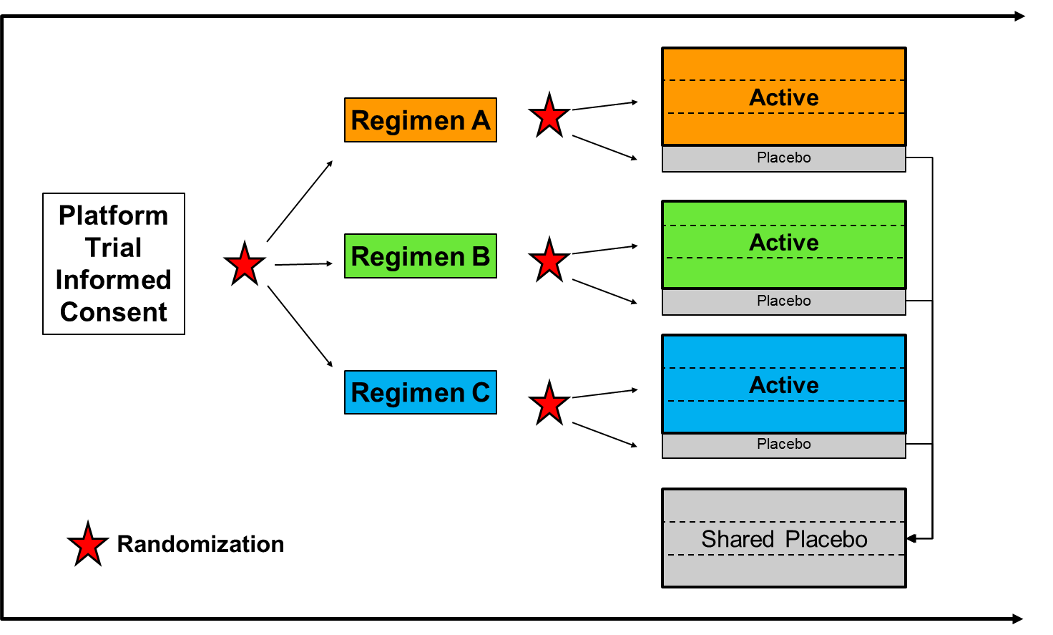

HEALEY ALS Platform Trial: Leveraging Innovative Trial Design to Accelerate Drug Development in ALS
Industry
Partners
Sites
Patients
Foundations
FDA

Slide 50
Strengths of tools
Protocol Development Tool
  Provides a roadmap of steps that are critical to the process and recommendations for stakeholder input at each stage
Vendor Assessment Tool
  Provides description of what is unique about vendor engagement for a Master Protocol

Slide 51
Additional Content Development
Tools developed from the perspective of an academic/ non-profit group designing a Master Protocol
There may be a unique set of challenges for an individual company that is developing a Master Protocol to test multiple drugs within their company
Development companion resources, such as educational tools for various stakeholders

Slide 52
Large Group Discussion

Slide 53
Large Group Discussion Questions
How well do CTTI’s tools address early adopters’ needs?
Are there critical challenges in the pre-planning and planning stages of a master protocol study’s development that CTTI’s tools do not address?
How should the clinical trials research community facilitate future opportunities for early adopters to collaborate and problem-solve with more experienced master protocol experts?

Slide 54
Transition Break (5 min.)

Slide 55
COVID-19 Panel Discussion
Moderator: Daniel Millar, Janssen R&D

Slide 56
Panel Objectives
Describe master protocol studies that are being conducted in response to COVID-19
Identify study-level and enterprise-level resources that are needed to support the efficient use of master protocol studies to develop treatments for COVID-19

Slide 57
Panelists
Louis Dron, Cytel
Tom Fleming, University of Washington
Nicholas Richardson, FDA
Kirsty Wydenbach, MHRA
Christopher Butler, University of Oxford

Slide 58
A Global Interventional Trial Tracker for COVID-19
Louis Dron
Cytel Inc
www.covid-trials.org

Slide 59
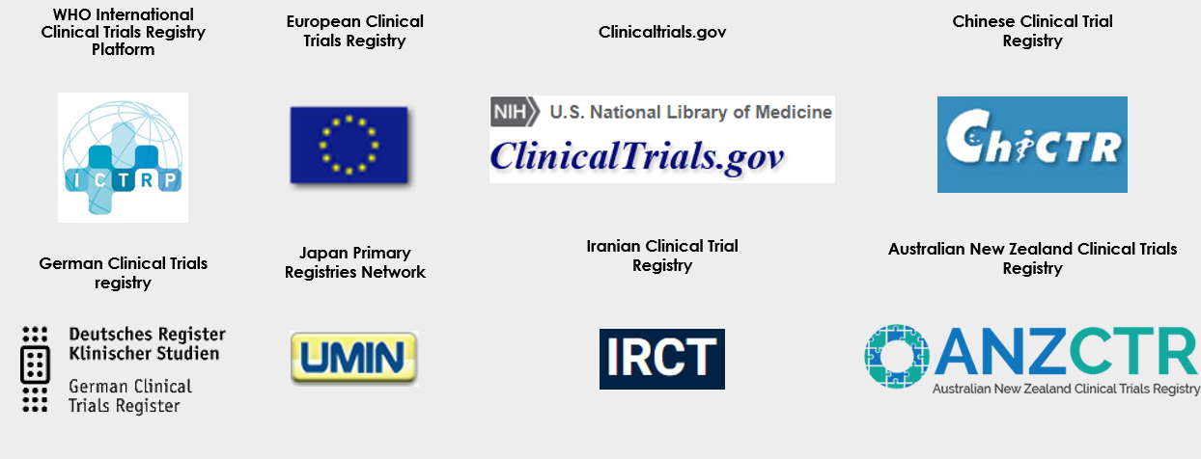
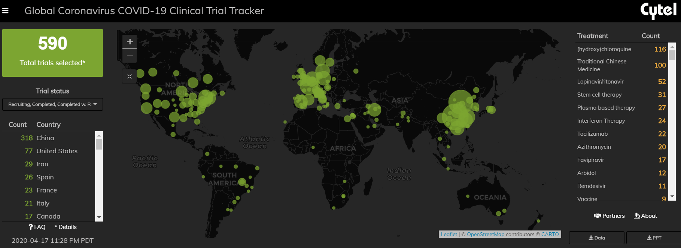
Global tracker: www.covid-trials.org
Global data
sources
Visualization

Slide 60
A fragmented landscape
>50% of these trials are investigating one intervention only (2-arm trials) with sample size <100 participants.
Certain treatments are particularly often investigated and repeated.
For example, chloroquine or hydroxychloroquine features as a treatment in 118 separate trials.

Slide 61
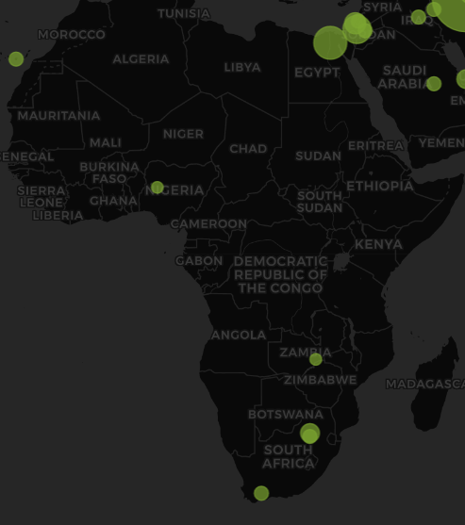
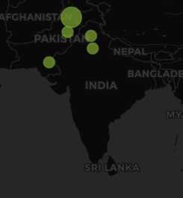
Geographical Spread of registered COVID-19 trials

Slide 62
Examples of registered master protocols in COVID-19
Trial name (ID) | Master protocol category | Therapeutic area(s) (listed as of mid-April) | Countries | Patient context
ACOVACT (NCT04351724) | Basket trial | RAS blockade, antiviral, immune modulation | Austria | Outpatients, renal impaired critically ill (separate sub studies)
PRINCIPLE (ISRCTN86534580) | Platform trial | Hydroxychloroquine | United Kingdom | High risk patients, primary care
REMAP-CAP (REMAP-COVID) (NCT02735707) | Platform trial (sub-platform) | Antiviral, immune modulation, macrolide, corticosteroid | Thirteen countries | Critically Ill
SOLIDARITY (ISRCTN83971151) | Platform trial with umbrella component* | Vaccine, antiviral, immune modulation | Thirteen countries, five continents | Multiple planned
U-DEPLOY (NCT04331665 – single sub trial registration) | Umbrella trial | Cellular products, immune modulation | Canada | Critically ill, non-critically ill
*Design description not taken from study investigators
Note this is not intended to be an exhaustive list of master protocols in COVID-19. It is intended to demonstrate several efforts identified through routine surveillance of clinical trial registries as of April 19, 2020

Slide 63
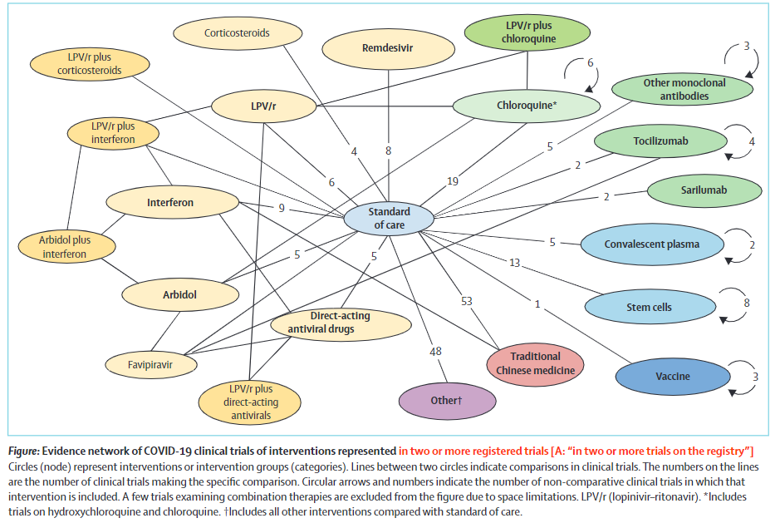
Global policy and health implications
Thorlund et al., 2020. the Lancet – In press
Evidence synthesis through meta-analysis will be difficult.
Collective allocation of resources and efforts at the global scale through master protocol framework would be much better.

Slide 64
Thank you!
www.covid-trials.org

Slide 65
CTTI Master Protocol Expert Meeting
WHO CORE Protocols for COVID-19…
Enlightened by Learnings from EVD in DRC
April 20, 2020
Thomas R. Fleming, Ph.D.
Professor of Biostatistics
University of Washington

Slide 66
Addressing Public Health Emergencies
WHO R&D Working Group
2014-2016: Ebola Outbreak in Liberia, Guinea, & Sierra Leonne
  Need for randomized trials in public health emergencies…NAM & WHO
  PREVAIL II RCT: ZMapp vs oSOC…71 of targeted 200 patients…
2016-2018: WHO R&D Working Group
  Establishing principles/infrastructure in advance of public health emergencies
2018-2019: Ebola Outbreak in DRC
  WHO Monitored Emerg’cy Use of Unregis’d & Investigat’l Interven (MEURI)
  PALM RCT : mAb114; REGN-EB3; Remdesivir; ZMapp
  WHO MEURI & PALM RCT engaged ½ of 3000 patients in DRC outbreak
  “These efforts have created a paradigm to develop infrastructure to deliver compassionate care while efficiently and effectively attaining evidence needed to reliably assess benefits and risks of interventions to treat and prevent diseases in public health emergencies” WHO MEURI DMC, 8/16/2019
2020-on: SARS-CoV-2 & COVID-19 Pandemic
Ebola, ZIKA, Lassa, Chikungunya
Nipah, SARS & MERS CoV
NEJM 4/2/2020: “Creating a Framework for Conducting Randomized Clinical Trials during Disease Outbreaks” The CORE Protocol

Slide 67
The CORE Protocol
Reference: “Creating a Framework for Conducting
Randomized Clinical Trials during Disease Outbreaks”
N Engl J Med 382; 14; 1366-1368. April 2, 2020
(WHO R & D Working Group)
Natalie E. Dean, Pierre-Stéphane Gsell, Ron Brookmeyer, Forrest W. Crawford, Christl A. Donnelly, Susan S. Ellenberg, Thomas R. Fleming, M. Elizabeth Halloran, Peter Horby, Thomas Jaki, Philip R. Krause, Ira M. Longini, Sabue Mulangu, Jean-Jacques Muyembe-Tamfum, Martha C. Nason, Peter G. Smith, Rui Wang, Ana Maria Henao Restrepo, Victor De Gruttola
“At the end of an outbreak, the release of promising but inconclusive results from partially completed trials may support the belief that confirmatory trials comparing the investigational agents against the previously accepted placebo or standard-of-care comparator could no longer be conducted.”

Slide 68
“Creating a Framework for Conducting Randomized Clinical Trials during Disease Outbreaks” NEJM 4/2/2020
  “A new approach to clinical trials is needed to enable reliable evaluations of vaccines and treatments for outbreak pathogens…We propose a ‘Core-protocol’ concept that allows a clinical trial to extend across multiple infectious disease outbreaks…
  New investigational agents may be added to the protocol over time as they become available or may be removed as deemed appropriate, using a platform trial approach, as described previously, (see Woodcock, LaVange NEJM 2017; 377: 62-70).
  Core protocols are rapidly being developed by the WHO for trials assessing the efficacy of therapies and vaccines that are being developed to combat the Covid-19 pandemic.”

Slide 69
Addressing the COVID-19 Pandemic
2020-onward: SARS-CoV-2 & COVID-19 Pandemic
  Developing WHO “Solidarity” CORE Protocol for Therapeutics
    In Hospitalized Patients
  Developing WHO CORE Protocol for Vaccines
  Developing Protocols for Therapeutics in PrEP, PEP, Early Dx & Adv Disease
    In PrEP, such as in Healthcare Workers
    In PEP, such as in Household Contacts
    In Early Diagnosis
    In Hospitalized Patients with Severe Illness…
    preventing ventilator use & death
Endpt: Ordinal scale
vs. Mortality
Adaptively adding & deleting
candidate regimens
Endpt: Virologically confirmed COVID-19 disease…Severe disease? H_{o} for VE?...What about disinhibition?
Endpt: infection vs sev dis, death?
Supply ⇒ Lowest effective dose?
Endpt: hospitalization vs sev disease
How to efficiently proceed from
Phase 2 to Phase 3?
(using immuno-suppressive agents)

Slide 70


Response to COVID-19: FDA Perspective
Nicholas Richardson DO, MPH
Pediatric Oncologist
FDA

Slide 71

Current Status
Numerous industry-led and investigator initiated trials/proposals
Expanded access
Repurposed treatments
  Pre-clinical rationale/evidence
  Clinical evidence
Proof-of-concept to large Phase 2 /3 trials
Heterogenous endpoints
Statistical considerations

Slide 72
General Approach
Rapid review
Recommend/encourage randomized, double-blind, placebo-controlled trials
Encourage clinical trial participation versus expanded access
Trial design considerations
  Study population (severity classification)
  Endpoints
Statistical considerations
  Safety assessment (rapid enrollment)
  Interim futility analysis

Slide 73

Leveraging Master Protocols
Clinical Trials
- Coordinated
- Scientifically Rigorous
- Efficiency
Patient Access
- Safe & Effective Treatments
COVID-19 Patients

Slide 75
Leveraging Master Protocol Studies to Combat COVID-19 - MHRA
Dr Kirsty Wydenbach
Senior Clinical Assessor / Deputy Unit Manager CTU

Slide 76
Agree with the general points from FDA
Master protocol approach is fully supported by MHRA as well as UK Chief Medical Officer
  There is a new review process for all COVID19 trials in parallel to MHRA and Ethics review: https://www.nihr.ac.uk/covid-19/
  The National Priority list includes multiple master protocol trials
Also aligned with EMA: strongly recommended that a more coordinated approach across the EU is pursued and that efforts are put in place to prioritise larger multi-country randomised clinical trials (RCTs) that have the potential to generate confirmatory evidence https://www.ema.europa.eu/en/documents/other/call-pool-eu-research-resources-large-scale-multi-centre-multi-arm-clinical-trials-against-covid-19_en.pdf

Slide 77
Key has been a rolling review and advice
Draft protocols have usually been reviewed by email ahead of the submission.
A rolling review of documentation has allowed for a swift, but rigorous, process
New arms are discussed informally before submission so issues are addressed early
Advice meetings also help for wider aspects such as manufacturing capabilities, supply issues and any possible regulatory flexibilities

Slide 78
Examples
RECOVERY
  Started with 3 arms
  2 further arms already added via amendment
  Supported via government so able to set up sites quickly and recruit >4800 patients in less than 4 weeks
Academia/pharma consortium
  2 master protocols
    One for FIH/phase 1 and 2, including input from a review team for promising entities
    A second for phase 2/3 that can follow the previous trial, feed into other trials, or be independent

Slide 79
© Crown copyright
About copyright
All material created by the MHRA, including materials featured within these MHRA presentation
notes and delegate pack, is subject to Crown copyright protection. We control the copyright to our
work (which includes all information, database rights, logos and visual images), under a delegation
of authority from the Controller of Her Majesty’s Stationery Office (HMSO).
The MHRA authorises you to make one free copy, by downloading to printer or to electronic,
magnetic or optical storage media, of these presentations for the purposes of private research,
study and reference. Any other copy or use of Crown copyright materials featured on this site, in any
form or medium is subject to the prior approval of the MHRA.
Further information, including an application form for requests to reproduce our material can be
found at www.mhra.gov.uk/crowncopyright
Material from other organisations
The permission to reproduce Crown copyright protected material does not extend to any material in
this pack which is subject to a separate licence or is the copyright of a third party. Authorisation to
reproduce such material must be obtained from the copyright holders concerned.

Slide 80

How can we learn well in a pandemic?
Derek C. Angus, MD, MPH
Section Editor, Caring for the Critically Ill, JAMA

Slide 81
Best learning tool is the RCT, but 3 key challenges
Randomization is very uncomfortable
  Physician feels responsible for patient outcomes, consequences are immediate
  Physician feels less responsible for research, consequences are remote
RCTs are very cumbersome
  Slow to start
  Intrusive to execute
No/limited coordination within the global clinical research enterprise
  94 registered trials of HCQ!

Slide 82
3 solutions from the clinical research enterprise
Make randomization more comfortable
  Multiple arms, only one is control
  Adaptive randomization, preferentially assign to best therapy over time
Make entry into clinical trials ‘1-stop shopping’
  Simplify interface between clinical practice and clinical research
  Use master protocols with standard entry criteria, outcomes, etc.
  Essentially, combine trials/study questions
Sacrifice ‘sacred cows’ of research
  Don’t let perfection be the enemy of the good
  Ex. placebo probably overrated in a pandemic; added rigor not worth the burden

Slide 83
REMAP-CAP Executive Summary
A global adaptive platform trial
Designed to determine best treatment for severe pneumonia
  Randomizes multiple interventions simultaneously, nested within domains
  Uses a multifactorial Bayesian inference model
  Uses response-adaptive randomization
Assesses both interpandemic AND pandemic forms of pneumonia
  Pre-set rules to switch into pandemic mode
Entered pandemic mode (termed ‘REMAP-COVID’) in February 2020

Slide 84
REMAP-COVID
Expanded to all hospitalized patients with COVID-19, in 2 strata
  Moderate (hospitalized but not severe)
  Severe (requiring ICU care for respiratory failure or shock)
1º endpoint: ICU-free days
  Death worst outcome, followed by number of ICU-Free days through 21 days
  Modeled with cumulative logistic proportional odds model
2º endpoints: mortality, WHO ordinal scale, safety
$$\log\left(\frac{π_{y}}{1−π_{y}}\right)=\left[Site\right]+\left[Time\right]+\left[Age\right]+\sum_{i=1}^{k}{\left[Intervention\right]+\sum{\left[IxI Interactions\right]}}$$

Slide 85
REMAP-COVID domains/interventions
Current COVID19-specific domains
  Antiviral agents (HCQ, kaletra, HCQ/kaletra combo)
  Concurrent macrolide (azithromycin)
  Corticosteroids (3 doses)
  Targeted innate immune modulation (IL1ra, IL6ra, IFNbeta, others)
Additional funded domains about to launch
  Coagulation modulation (heparin, possibly dipyridamole)
  Convalescent serum/antibody therapy
  High dose vitamin C
  Simvastatin
Once these 8 domains all running, there are 2,560 separate regimens (recipes) …
  Plus, more under development
    ACE2 modulation (3 subdomains for binding and downstream activation)
    Ventilation

Slide 86
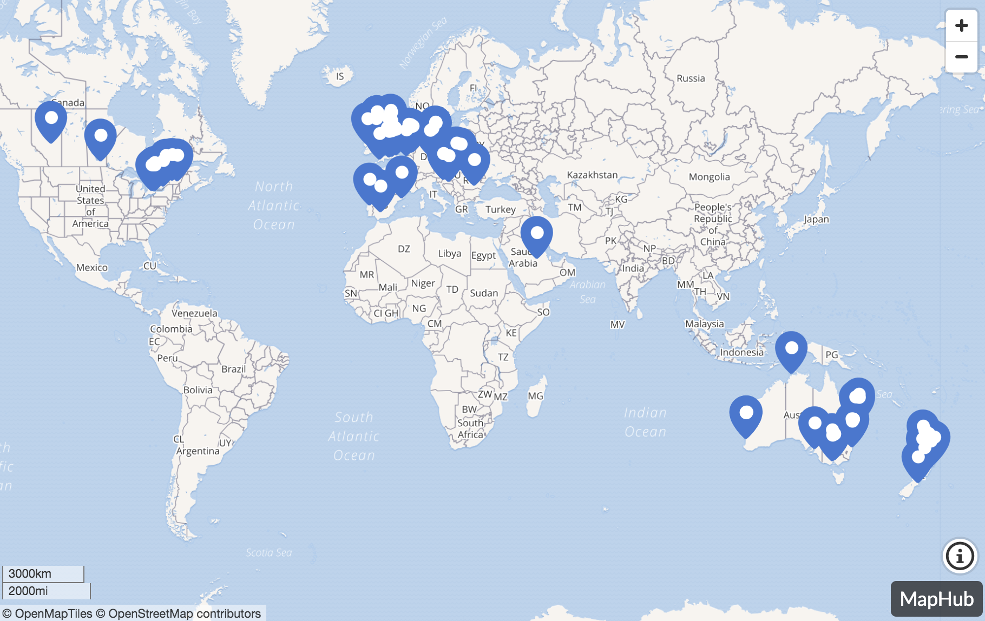
REMAP-CAP/COVID is global
A federation of several highly successful clinical trial networks and coordinating centers
  >100 sites and 13 countries ‘live’
  New COVID-specific grants from EU, the Netherlands
  France, Germany, UK, Ireland, Canada, Australia and NZ
Scaling up rapidly across the world
  Funded to expand to >200 sites this month
  Adding sites in Middle East and South America
  Discussions for further expansion in Asia (e.g., Japan) and Africa
Advantage – global positioning allows capture of patients across the globe

Slide 87
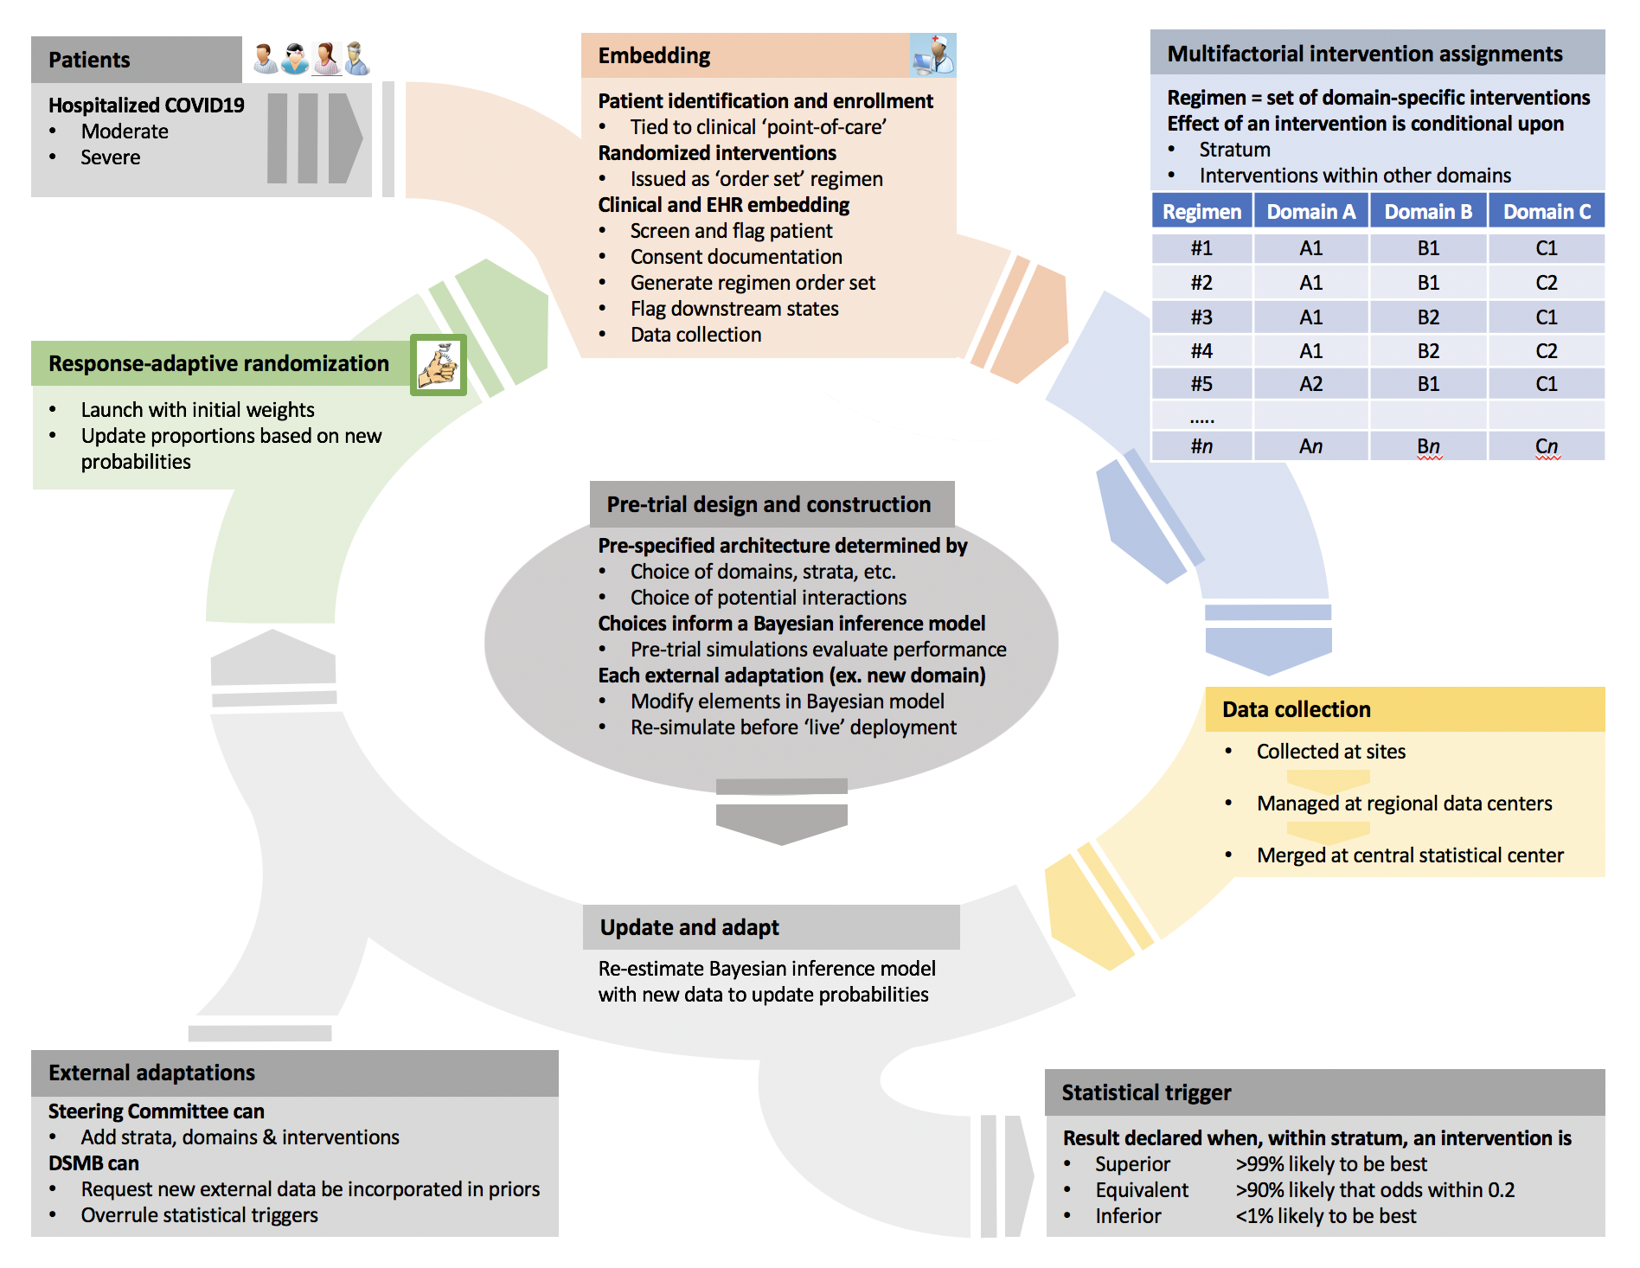
REMAP-COVID design
Regimens, domains and interventions
Many domains can be added
~4 interventions can be tested within any given domain @ one time (but more serially)
Interventions can be tested as a ‘nest’
(e.g., all IL-6/TNF blocking agents versus none)
A priori consideration regarding potential interactions
Each domain starts with ‘usual care’ control
If usual care inferior, it can be dropped
(e.g., if ‘any’ IL6/TNF blocker superior to ‘none’)
Design and Updates
Overall model can have custom specifications for individual agents and domains
RAR can be weekly
New agents added simply as protocol amendments
Data
Support US sites with either standard eCRF portal or E.H.R. embedding tools
Individual interventions/domains can have added data modules for FDA safety requirements
Trial is GCP, CTIMP-certified, and discussed with FDA (IND for entire core protocol pending)

Slide 88
Simulations and power
For ‘head-to-head’ within stratum with no interactions
  ~400 per group for moderate (OR: 1.5) treatment effect

Slide 89
Conclusions
This pandemic forces us to do 2 things simultaneously
  Do
  Learn
These activities are intertwined: we must ‘Learn While Doing’
Unfortunately, ‘practice’ traditionally separated from ‘research’
  The two enterprises must lean in to each other
  Use ‘learning designs’ that accommodate ‘doing’ at the same time
Global adaptive platform trials have potential as LWD instruments

Slide 90
Master Protocols: Developing Sustainable Coalitions for Transformation
Panel Discussion: Leveraging Master Protocol Studies to
Combat COVID-19
Chris Butler
Professor of Primary Care
Professorial Fellow, Trinity College
Clinical Director, Primary Care Clinical Trials Unit
Nuffield Department of Primary Health Care Sciences
20.04.220

Slide 91
Platform Randomised trial of INterventions against COVID-19 In older peoPLE (PRINCIPLE)
Almost all trials of COVID-19 hospital based
Most people are man aged in the community
No studies of early intervention
Might be a bit of a ‘heavy lift’ for hydroxychloroquine and some other drugs to make a big difference in very sick people, but nevertheless make a difference in early intervention.
Many possible interventions were being considered, and the list would undoubtedly change in the face of emerging findings.
Asked to lead a study on 11/3 (while sick with COVID-Like-Illness).
First draft of protocol 15/3
Ethics approved 24/3, CTA 24/3
First patient in 2/4

Slide 92
PICO
Participants: Patients ≥50-64 years with comorbidities detailed below, and aged ≥65 with or without comorbidity presenting within 7 days since onset of symptoms with a new continuous cough and/or high temperature during time of prevalent COVID-19 infections; current t modelling = 3000 for two way comparison
Interventions: Usual care plus Hydroxycloroquine now, others to be added.
Comparisons: usual care without study drug. Usual care plus azithromycin to be added in next, with ?more to come
Outcomes:
Primary: Hospital admission or mortality related to suspected COVID-19 within 28 days
Secondary: Daily symptoms diary; Day feels recovered; Contacts with health services; WHO-5 Well Being Index; viral shedding (if swabs available)

Slide 93
Why master protocol
If hydroxychloroquine becomes standard of routine care because of emerging data elsewhere or in trial, other comparisons can be compared to HCQ, or to existing controls.
Allows for adding in and dropping arms.
May need HCQ plus antibiotic arm vs HCQ alone
Are other agents as good as HCQ (supply issues, those who cant take HCQ)

Slide 94
Large Group Discussion

Slide 95
Large Group Discussion
Questions from the audience for the panelists
What study-level and enterprise-level resources do you think are needed to facilitate greater coloration and coordination across organizations that are developing COVID-19 clinical trials?
  How do you think CTTI can help?

Slide 96
Day 2 Overview

Slide 97
Day 2 Objectives
Apply CTTI tools to the development of real-world master protocol that are at the pre-planning and planning stages of study development
Identify necessary revisions to CTTI tools to make them more responsive to the unique design and operational challenges identified in diverse therapeutic areas.

