Slide 1
Welcome: Designing High-Quality COVID-19 Treatment Trials
This webinar is being recorded and will be posted to the CTTI website
All participants are muted upon entry
Questions can be entered in the chat box during the webinar
Questions will be answered to the best of our ability after the call via CTTI’s best practices document

Slide 2
Disclaimer
The views and opinions expressed in this presentation are those of the individual presenter and do not necessarily reflect the views of the Clinical Trials Transformation Initiative.

Slide 3
Designing High-Quality COVID-19 Treatment Trials
April 23, 2020

Slide 4
Presenters
Pamela Tenaerts, CTTI
Janet Woodcock, FDA
Fergus Sweeney, EMA
Ann Meeker O’Connell, Vertex Pharmaceuticals
Ed Cox, Regeneron Pharmaceuticals, Inc.
Karlin Schroeder, Parkinson’s Foundation
Martin Landray, University of Oxford
John Marshall, WHO, University of Toronto

Slide 5

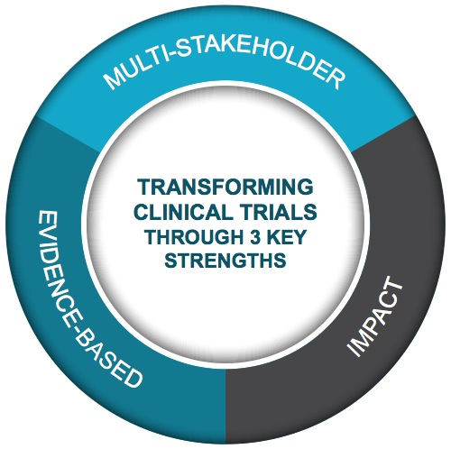
Public-Private Partnership
Co-founded by Duke University & FDA
Involves all stakeholders
Approx. 80+ members
Participation of 500+ more orgs
MISSION: To develop and drive adoption of practices that will increase the quality and efficiency of clinical trials

Slide 6
Completed
Today
Conducting ongoing trials
Webinar
Best practices document
Designing high quality COVID-19 treatment trials
CTTI’s
COVID
Work
Daily COVID-19 trials download CT.gov
Telehealth
Master protocols
Lessons learned
How to sustain transformation
Contingency planning
During Pandemic
After Pandemic

Slide 7
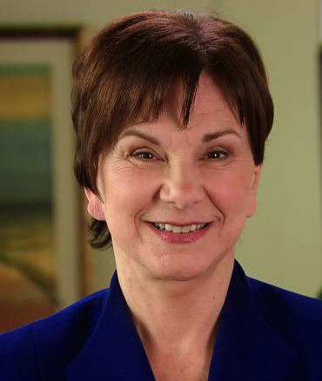
Current State of COVID-19 Treatment Trials: US Perspective
Janet Woodcock
FDA, CDER

Slide 8
Keynote: Dr. Janet Woodcock
FDA CDER’s objective is twofold:
Keep drug supply up to help care for patients who are already sick, and
Oversee potential developmental programs for all phases of COVID-19, from pre-exposure prophylaxis to treatment of patients on ventilators.
We’ve received 950 inquiries for drug proposals.
This is an overwhelming amount in a short period of time. CDER and CBER have 72 active clinical trials and another 211 developmental programs in the planning stages. It’s a massive effort.

Slide 9
Keynote: Dr. Janet Woodcock, cont’d
Based on these numbers, there is an urgent need for master protocols, especially for repurposed agents that may not need a lot of early work. We want to pick out more promising agents and move forward in more sensitive evaluations.
CDER is looking for high-quality master protocols to study all states of COVID-19. We’ll put out guidance on our early thoughts on protocols, design, patient populations, etc.

Slide 10
Keynote: Dr. Janet Woodcock, cont’d
We need better clinical trial infrastructure in place that can rapidly launch protocols and begin accruing patients. We want to minimize doing any extra steps, minimize contact between people, rethink ways to collect informed consent, run trial data off e-health records, etc.
Trials must be done during the pandemic if we’re going to make progress. This comes down fundamentally to meticulous planning, quality by design, integrating data collection efforts into the ordinary work flow & determining what constitutes an objective for future trials.

Slide 11

Current State of COVID-19 Treatment Trials: EU Perspective
Fergus Sweeney
EMA

Slide 12

Focusing on What Matters: A Quality by Design Perspective
Ann Meeker O’Connell
Vertex Pharmaceuticals

Slide 13




General Principles for Optimal Trial Design
Select the best design feasible to address the scientific question(s)
Avoid or reduce opportunity for issues that might have a material impact on either the wellbeing and safety of study participants or the reliability of the results that would inform the care for future patients
Consider the health Rigorously evaluated Leverage insights Explore care context in which study design to verify from investigators, opportunities to trial will be conducted that planned activities HCP. and patients on simplify data and data collection general relevance of collection and are essential. endpoints and reporting
feasibility Streamline trial
design wherever feasible

Slide 14
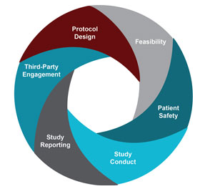
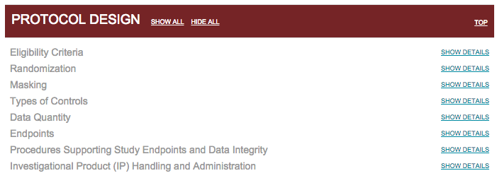
Optimizing trial design efficiently
“…criteria should be used to evaluate the best design for the question addressed by the trial, an approach known as quality by design.”
Rodriguez F, Califf RM, and Harrington RA. JAMA Cardiol. 2019;4(11): 1129-1130.
http://www.ctti-clinicaltrials.org/our-work/quality/qbd-quality-by-design-toolkit/

Slide 15
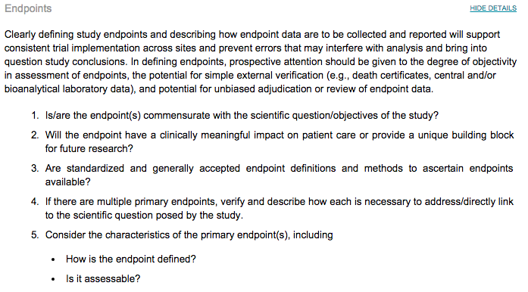
Outcome Measures
Opportunities for COVID trials:
Re-confirm need for volume of secondary endpoints, balancing feasibility and burden with scientific value
Standardize endpoint definition and measurement where feasible to enhance consistency in measurement across sites and comparability across-trials

Slide 16

Clinical Trials for Emerging Infectious Diseases: Lessons Learned & Implications for COVID-19
Ed Cox
Regeneron Pharmaceuticals, Inc.

Slide 17
Disclosures and Disclaimer Statement
Edward Cox, MD MPH is an employee of Regeneron Pharmaceuticals, Inc. Regeneron Pharmaceuticals, Inc. is engaged in product development for COVID-19.
The opinions expressed in this talk are those of the presenter and do not necessarily represent the opinions of the presenter’s employer, Regeneron Pharmaceuticals, Inc.

Slide 18
Shared Goal
The rapid identification of safe and effective medical therapies that can treat or prevent COVID-19 disease
Consistent with this goal:
We want to avoid using large quantities of investigational drugs in a manner that does not allow us to learn and understand whether the drug provided – benefit – had no effect – or harm

Slide 19
Reliable Scientific Methodologies
Basic scientific foundational principles remain constant
We need to rely on sound science to rapidly identify therapies that can help
Benefits – Risks – Seriousness of the condition – Unmet Need – Levels of Uncertainty - need to be weighed appropriately given the circumstances
This concept has been in practice in the medical science and regulation for years
Scientifically sound approaches with greater uncertainty are likely to be more interpretable than methodologically weak approaches even in the setting of large amounts of data

Slide 20
Peramivir EUA – Lessons Learned
During the 2009 H1N1 influenza pandemic, it was considered infeasible to establish a multisite clinical study for an investigational therapy during a public health emergency.
Peramivir, an intravenously administered influenza antiviral drug under clinical development, was made available in the United States under Emergency Use Authorization (EUA) to treat certain hospitalized patients. Demand was brisk — nearly 1300 seriously ill patients received the drug.
Unfortunately, no reliable data on effectiveness were derived from this use. Some analyses suggested that mortality was increased among patients receiving peramivir, although that finding could have represented channeling bias (if patients receiving peramivir were already “sicker” in ways that could not be readily measured).
A subsequent randomized clinical trial did not demonstrate either benefit or increased mortality associated with peramivir in patients hospitalized with influenza.
Demand for this investigational drug drove its use under EUA, but any imperative to get demonstrably effective products to people in need as quickly as possible was not fulfilled.
This experience showed that a reasonable expectation of benefit doesn’t always pan out, data derived from uncontrolled use may not be interpretable, and use outside of a properly designed clinical trial can delay product assessment.
.
Borio L, Cox E, Lurie N. NEJM 373:11; 993-5. 2015

Slide 21
COVID-19 Factors Impacting Outcomes
Pathogen - COVID-19 can cause disease that is asymptomatic, mild, severe disease, critical, and fatal
Host response – appears to play an important role and we have only a limited understanding of host response in this disease
Tissue repair/recovery
Underlying host health status
Medical Care – healthcare system under significant strain in some locations
Degree of strain may vary by geography and time
Necessary Infection control and isolation procedures

Slide 22
Use the Correct Tool for the Disease & Question Being Tested
Serious acute infectious diseases can have a considerable degree of variability in outcomes
COVID-19 has a wide range of disease severity from asymptomatic to fatal
Prognostic factors include factors we can measure and factors that we don’t understand and cannot measure
A concurrent control group generated by randomization is an excellent method for generating two groups likely to be comparable on measured and unmeasured prognostic factors so that we can reliably assess the effect of an intervention

Slide 23
Use the Correct Tool for the Disease & Question Being Tested cont.
In an infectious disease with a wide range of outcomes, which is straining the healthcare system, and the degree of strain may change over time, by region, it seems particularly important to have a concurrent control group generated by randomization with which to make reliable comparisons
ICH E-10: It is well documented that untreated historical-control groups tend to have worse outcomes than an apparently similarly chosen control group in a randomized study, possibly reflecting a selection bias.
://www.ema.europa.eu/en/documents/scientific-guideline/ich-e-10-choice-control-group-clinical-trials-step-5_en.pdfICH E-10 https

Slide 24
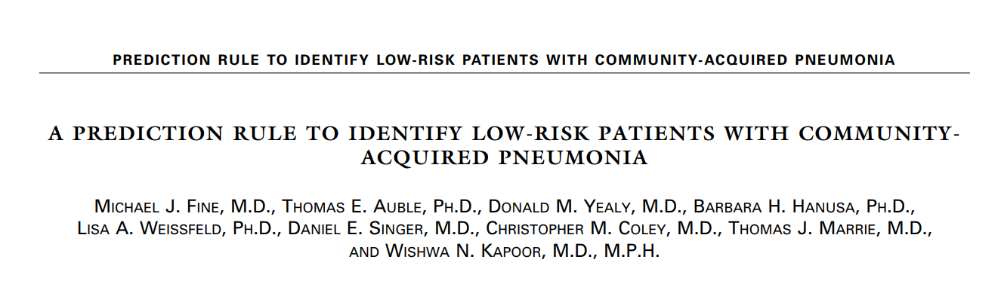
N Engl J Med 1997;336:243-50

Slide 25
Port Score Development
Analyzed 14,199 adult inpatients with community-acquired pneumonia to derive a prediction rule for risk of death
The rule was validated with data on 38,039 inpatients and with data on 2287 inpatients and outpatients
Candidate predictor variables were identified using a two-step logistic regression approach from among a range of demographic variables, coexisting illness, physical exam findings, and laboratory findings
The prediction rule assigns points based on age and the presence of coexisting disease, abnormal physical findings and abnormal laboratory findings at presentation
Fine MJ, et al. N Engl J Med. 1997 Jan 23;336(4):243-50.

Slide 26
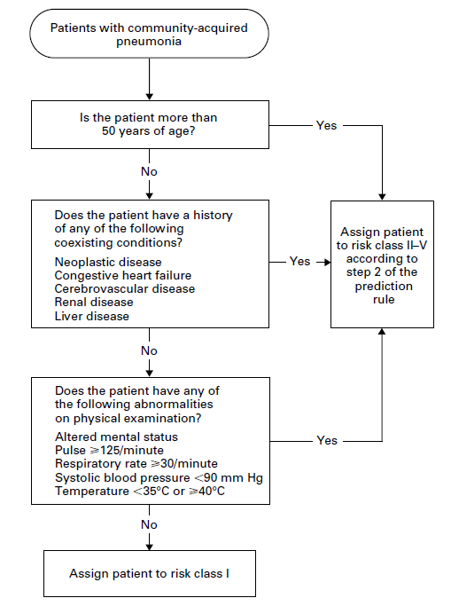
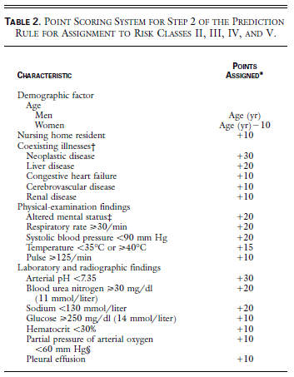

Slide 27
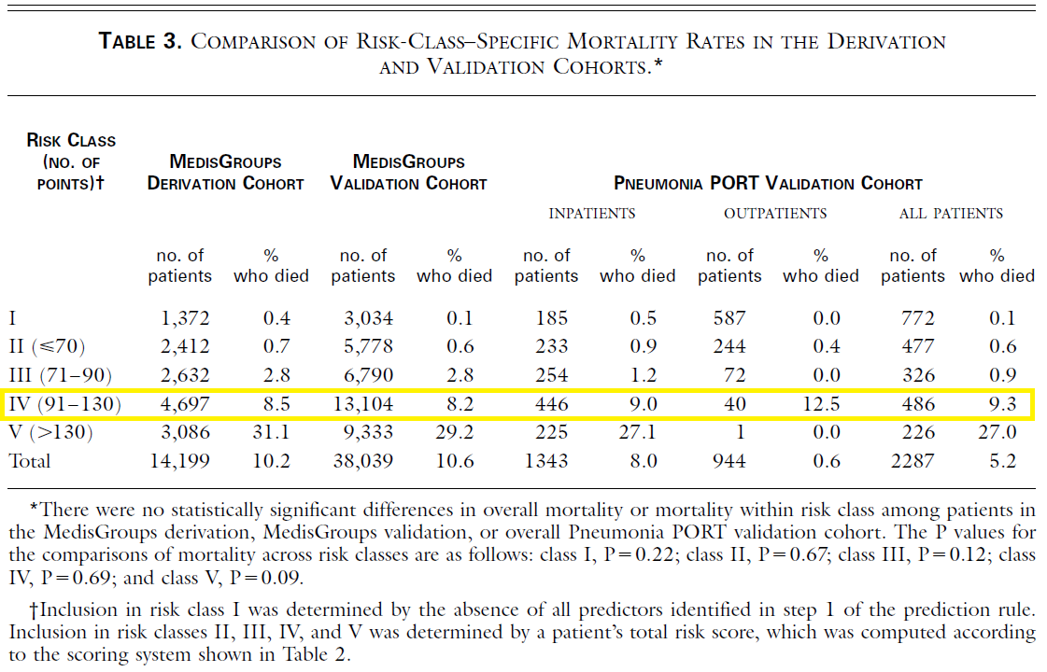
8.5% 8.2% 9.0% 12.5 % 9.3%

Slide 28
CABP Clinical Trials and Mortality Rates
PORT Class | Trial 1
 | Drug A | Drug B
IV | 1/45 (2.2%) | 2/40 (5.0%)
Avg. 3.5%

Slide 29
CABP Clinical Trials and Mortality Rates
Mortality by PORT Risk Class CABP
PORT Class | Trial 1 |  | Trial 2
 | Drug A | Drug B | Drug A | Drug B
IV | 1/45 (2.2%) | 2/40 (5.0%) | 3/110 (2.7%) | 6/107 (5.6%)
Avg. 4.0%

Slide 30
CABP Clinical Trials and Mortality Rates
Mortality by PORT Risk Class CABP
PORT Class | Trial 1 |  | Trial 2
 | Drug A | Drug B | Drug A | Drug B
IV | 1/45 (2.2%) | 2/40 (5.0%) | 3/110 (2.7%) | 6/107 (5.6%)
PORT Class | Trial 3
 | Drug C | Drug D
IV | 6/217 (2.8%) | 7/218 (3.2%)
Avg. 3.4%

Slide 31
Some Possible Explanations Why Patients in Clinical Trials Have Better Outcomes
Patient selection
HCPs first decide if a patient is a trial candidate
Protocol inclusion / exclusion criteria
Enrollment procedures and consent
There may be unmeasured co-variates that are impacting patient outcomes
There are limits as to how well you can predict comparability of patient groups based on measured characteristics
You generally won’t know when you are being misled by an unmeasured co-variate
The analytic methods utilized may provide false comfort in those circumstances when you are unknowingly being misled b/c of the “allure of precision”
Human nature is to accept results that we expect or prefer and work vigorously to explain away results that we do not prefer/expect even when both types of results are the product of methodologically weak approaches

Slide 32
PORT Score Example - Insights
The example using PORT score is a relatively unique opportunity to gain insights into the limits of well-designed prediction rules in certain settings
One might ask…
“Yes, but isn’t this just a rare example of a strange occurrence?”
Another might ask…
“How often does a study design allow one to see (or not see) such occurrences if / when they are present?”
Underscores the importance of a concurrent control group generated by randomization for making valid comparisons

Slide 33
CONTROL GROUP

Slide 34
Why Utilize a Supportive Care Control Arm?
Therapies to date have not demonstrated clinical benefit
Provide best available supportive care for all – this should provide benefit for all
Trial comparing two putative active drugs – without a supportive care control arm – possible outcomes
If two putative active agents look the same can’t discern if both are beneficial, ineffective, or harmful
If one putative active agent looks better than the other
One may be helpful • Both beneficial, but one more so
One may be harmful • Both harmful, but one less so

Slide 35
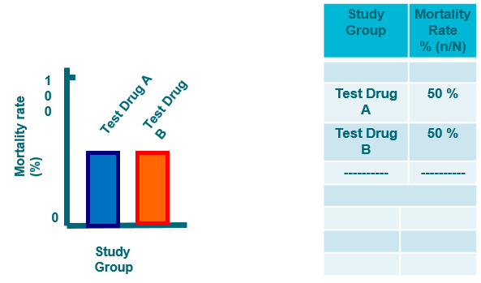
Role of a Supportive Care Control Arm

Slide 36
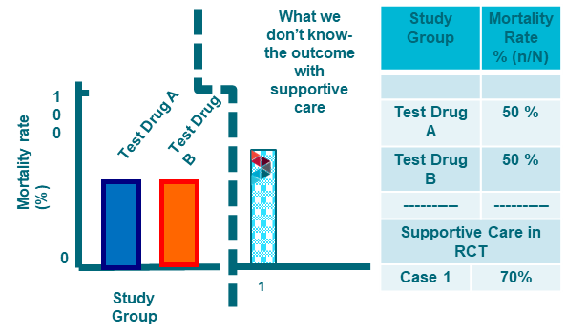
Role of a Supportive Care Control Arm

Slide 37
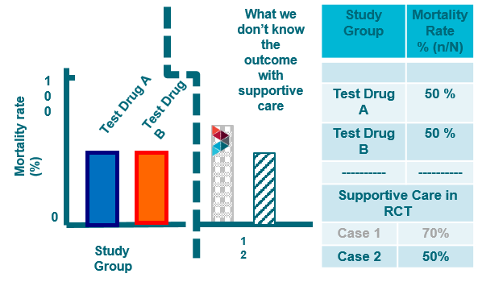
Role of a Supportive Care Control Arm

Slide 38
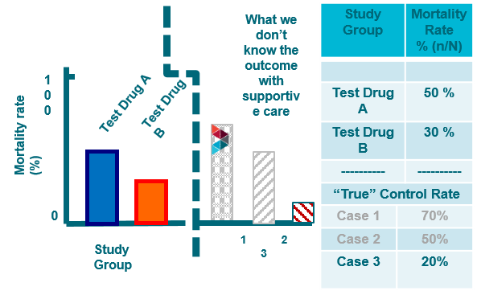
Role of a Supportive Care Control Arm

Slide 39
Importance of Well-Controlled Trials
Well-controlled scientifically sound clinical trials have brought important advances to medicine
Landmark trials in infectious disease
Well-controlled trials appropriate for the disease being studied
Have a large impact on medical practice
Provide a foundation for future advances
Streptomycin Treatment of Pulmonary Tuberculosis. Br Med J 1948;2:769-
The Efficacy of Azidothymidine (AZT) in the Treatment of Patients with AIDS and AIDS-Related Complex. NEJM 1987;317:185-91
A Randomized, Controlled Trial of Ebola Virus Disease Therapeutics. NEJM 2019; 381:2293-2303

Slide 40
Trials
Observational data – gather natural history data as soon as possible
Phase 1, as needed
Quick to phase 2 / phase 3 RCTs
Rapidly evaluate dose - pharmacodynamic endpoints
Might use sentinel cohorts, adaptive designs
Ph2 may also help identify endpoints for ph3
Gather information to plan ph3 & rapidly move ph2->ph3
Get to a clinical endpoint in ph3 – “feels, functions, or survives”
you ought to be able to explain the benefit that the endpoint demonstrates in lay language

Slide 41
Endpoints
Endpoints for phase 3 trials
Show a clinical benefit - feels, functions, or survive
Depends on the population enrolled in the trial
Some of the endpoints that have been considered/used
Prevent disease
Decrease need for hospitalization
Decrease hospital duration
Decrease need for mechanical ventilation
Decrease mortality
Ordinal scale endpoints
Time to clinical resolution

Slide 42
Lessons Learned from Ebola & Others
Post Ebola 2014 – clear recognition of the importance of well-controlled trials for evaluating therapies for emerging infectious diseases
Focus on key procedures for the trial in the setting of strained resources
Provisions to protect patient safety – safety monitoring - IDMC / DSMB
Provisions to protect healthcare worker safety
Avoid “nice to know” non-essential study procedures
Investigator enthusiasm and enrollment rates for the trial
Enthusiasm for the compound(s) being tested may speed enrollment
Trials that focus on key procedures may attain greater acceptance
Trials that involve extensive “nice to know” non-essential procedures may enroll more slowly or not be accepted by investigators

Slide 43
Some Closing Thoughts - 1
Now is the time to
Work together to have a positive impact on the COVID-19 pandemic
Utilize reliable scientific methodologies to provide reliable answers rapidly
Use the right clinical trial “tool” that has the capacity to reliably identify therapies that can help patients
randomized controlled trials are a reliable tool for studying a therapy for treatment of a serious acute infectious disease
Let our hope fuel our efforts for good science to get answers that will benefit patients

Slide 44
Some Closing Thoughts - 2
Avoid concluding efficacy before the trial has started. If we conclude efficacy for a drug before it has been shown, it can be difficult to perform a proper trial or to make good decisions along the way
Well-controlled, high quality, clinical trials are essential to guide quality patient care
Developing a new drug & doing well-controlled clinical trials has never been easy – But it is essential
We must focus on how we can rapidly and reliably identify the therapies that will help patients, friends, relatives, people near and far,.. all of us

Slide 45
Selected References
National Academies of Sciences, Engineering, and Medicine. 2017. Integrating clinical research into epidemic response: The Ebola experience. Washington, DC: The National Academies Press. doi: https://doi.org/10.17226/24739.
Adarsh Bhimraj*, Rebecca L. Morgan**, Amy Hirsch Shumaker et al. Infectious Diseases Society of America Guidelines on the Treatment and Management of Patients with COVID-19. Published by IDSA, 4/11/2020. https://www.idsociety.org/practice-guideline/covid-19-guideline-treatment-and-management/
Streptomycin Treatment of Pulmonary Tuberculosis. Br Med J 1948;2:769-
The Efficacy of Azidothymidine (AZT) in the Treatment of Patients with AIDS and AIDS-Related Complex. NEJM 1987;317:185-91
A Randomized, Controlled Trial of Ebola Virus Disease Therapeutics. NEJM 2019; 381:2293-2303
A Randomized, Controlled Trial of ZMapp for Ebola Virus Infection. NEJM 2016;375:1448-1456.
Borio L, Cox E, Lurie N. Combating Emerging Threats — Accelerating the Availability of Medical Therapies. NEJM. 2015. 373:993-995.
Cox E, Borio L, Temple R. Evaluating Ebola Therapies — The Case for RCTs. NEJM. 2014. 371; 2350-2351

Slide 46

Focusing on What Matters to Study Participants
Karlin Schroeder, MA
Parkinson's Foundation

Slide 47
What Is Patient Engagement in Research?
Meaningful inclusion of a representative group of patients as partners in designing and implementing research
Inclusion early and often and at each step of the research process
Equal decision makers bringing lived expertise to add to the scientific expertise
Notes:
Patients want the same thing all the stakeholders want in the research enterprise - safe, well designed studies that are done efficiently and effectively

Slide 48





How Patient Engagement Improves Research
More research that better addresses community needs and priorities.
Better-defined endpoints that reflect meaningful change for patients.
Patient reported outcomes that accurately capture lived experience.
Less protocol amendments.
Reduced study burden, faster recruitment and better retention
New therapies getting to the market more
efficiently and effectively.
Notes:
Increasingly, studies are demonstrating the impact of patient engagement. Evidence is showing that patient engagement shortens study timelines and saves money.

Slide 49
Patient Engagement Across the Clinical Trial Continuum: Highlighted Trial Design Opportunities
Financial support for research
Natural history data
Input on relevance of research to patients
Access to translational tools
Help defining eligibility criteria
Input on meaningful endpoints & PROs
Advocacy for policy & funding issues†
Education to patient community†
Support to sponsors around key regulatory meetings
Support preparing submissions for newborn screening for rare diseases
Informing regulators on benefit-risk†
Public testimony at regulatory meetings†
Discovery &
Pre-Clinical‡
Phase
1 - 3
Regulatory Review
Post-
Approval
Benefit-risk & patient-preference studies
Protocol design & study feasibility input
Study recruitment & retention strategy input
Increased awareness about trials
Participant feedback on trial experience
Input on informed consent content & processes
Peer advocates for participants†
Clinical trial networks†
Data Safety Monitoring Board members†
Phase 1-3 activities and…
Support interpreting & disseminating study results
Collaboration on post-marketing studies & surveillance initiatives
Support developing access strategy & preparing for value or health technology review
Updated 2018; adapted from Parkinson’s Foundation materials | †Patient group activities typically undertaken independently or with partners other than sponsors | ‡Includes early planning for trials
Notes:
For patient engagement to be optimal, patients should be included early and often in the research process and at each steps. Here are places where patients can engage. Those bolded are places that are particularly relevant to this discussion. I will go into details on these in a moment.

Slide 50
Patient Engagement in COVID Research
Virtual small group discussion or hospitalization exit interviews
Endpoints that are most important
Time to remission
Medical complications due to hospitalization
Neurological outcomes
Best fit measurement tools for PROs
How many tools are too many?
What is feasible to fill out in an ER or ICU?
Digital versus paper?
Notes:
Here are some examples of how patient engagement can done on a smaller, yet still impactful, scale, when time is of the essences and resources may be limited.
Mixed methodology approaches are optimal.

Slide 51
Patient Engagement in COVID Research
Patient surveys
Risk/benefit
Hydroxychloroquine versus a new drug
Placebo or comparator
Virtual workshop – development of informed consent form
Proper health literacy and numeracy level
Reasonable length
Pictures versus words
Cultural competency
Disseminating information about clinical trials to the community.
Notes:
Mixed methodology approaches are optimal.

Slide 52
Example of Patient Engagement
Designing and Developing a Study Protocol
Parkinson's Foundation Research Advocates reviewed a study protocol in a working group with a research team.
Identified the most impactful non-motor symptom endpoints for people living with Parkinson’s disease.
Clarified how people with Parkinson’s disease are defining these symptoms.
Changed PRO tools to accurately capture the lived PD experience.
Notes:
Many patient organizations, both umbrella organizations and disease specific groups, work on patient engagement in research and are here to help guide projects and offer support and resources.

Slide 53

Randomised Evaluation of COVID-19 Therapy: the RECOVERY trial
Martin Landray
University of Oxford
On behalf of the RECOVERY trial investigators

Slide 54
Randomised Evaluation of COVID-19 Therapy: the RECOVERY trial
Martin Landray
University of Oxford, UK
on behalf of the RECOVERY trial investigators
www.recoverytrial.net

Slide 55
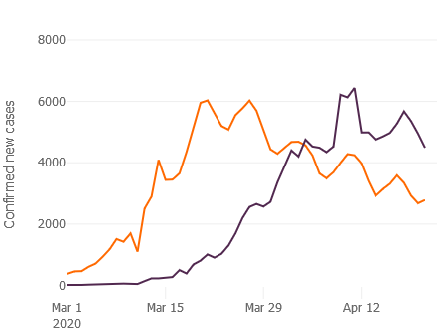
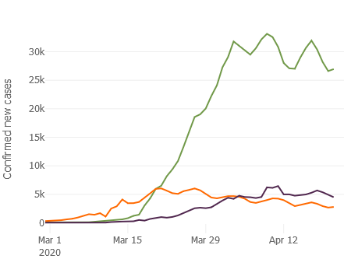
Background
Emerging pandemic caused by a new virus
For most people, self-limiting viral illness
For hospitalised patients, 10-20% mortality
For ventilated patients, 40-50% mortality
Daily confirmed new cases
USA
UK
Italy

Slide 56
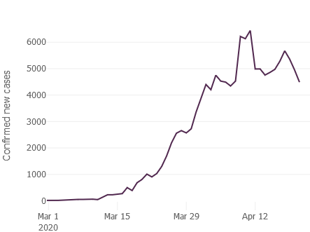
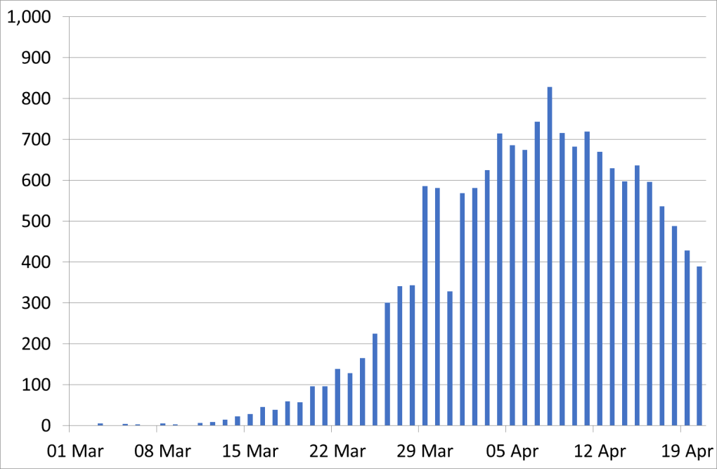
Background
Unprecedented clinical challenge
Overstretched health service (availability of beds, staff, and ventilators)
Huge time pressures and personal stress for frontline medical staff
Large numbers of unwell, anxious, and often elderly patients
UK New Cases
UK Deaths

Slide 57
Background
Unprecedented clinical challenge
Overstretched health service (availability of beds, staff, and ventilators)
Huge time pressures and personal stress for frontline medical staff
Large numbers of unwell, anxious, and often elderly patients
Huge therapeutic uncertainty
Many candidates
Many opinions (from many sources)
No reliable data (uncontrolled case series, inconclusive randomized trials)

Slide 58
Background
Addressing the therapeutic challenge
Unlikely to be a single “big win”
Moderate benefits plausible
Moderate effects are worthwhile
- There were ~15,000 deaths from COVID-19 in the US last week
- Reducing mortality by one-fifth would “save” ~3,000 lives

Slide 59
Background
Differentiating moderate benefits from no benefit (or harm) requires:
RANDOMIZATION
Comparison vs. CONTROL group not receiving the drug
LARGE numbers
For example:
90% power @2P=0.01 |  | Mortality
 |  | 20% | 30%
Proportional risk reduction | 20% | 5,600 | 3,300
 | 30% | 2,400 | 1,400

Slide 60
Quality by Design
Three key principles:
Obtain robust results that can rapidly impact care
Consider well-being of patients
Consider well-being of staff
Focus only on what matters
Leave orthodoxy, habits, and traditional practices behind
Communicate and collaborate
Transparency (with research, medical, patient, public, media, etc)

Slide 61

RECOVERY trial design
No additional treatment
ELIGIBLE PATIENTS
Age ≥18 years
Admitted to hospital
Proven or suspected SARS-CoV-2 infection
OUTCOMES
Primary: all-cause death
Secondary:
Duration of hospitalisation
Need for ventilation
Need for renal replacement therapy
Lopinavir-ritonavir
400/100 mg bd PO for 10 days
R
Dexamethasone
6 mg od PO/IV for 10 days
Hydroxychloroquine
See protocol for dosing
Azithromycin
500 mg od PO/IV for 10 days

Slide 62
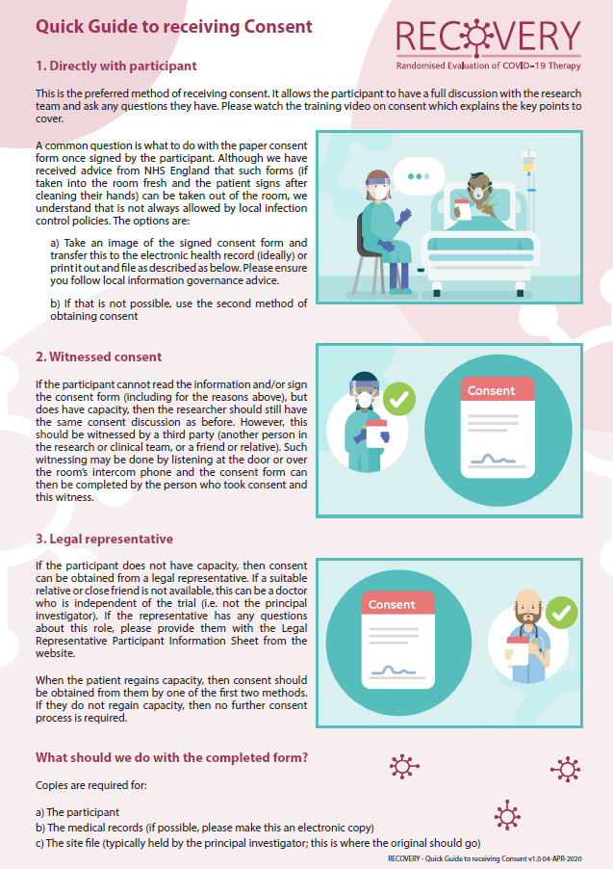
Informed consent
Simple 2 page consent form
Option for witnessed consent
if participant cannot read or sign for themselves
If infection control procedures do not allow ICF out of the ‘red zone’
Option for legal representative
if patient lacks capacity

Slide 63
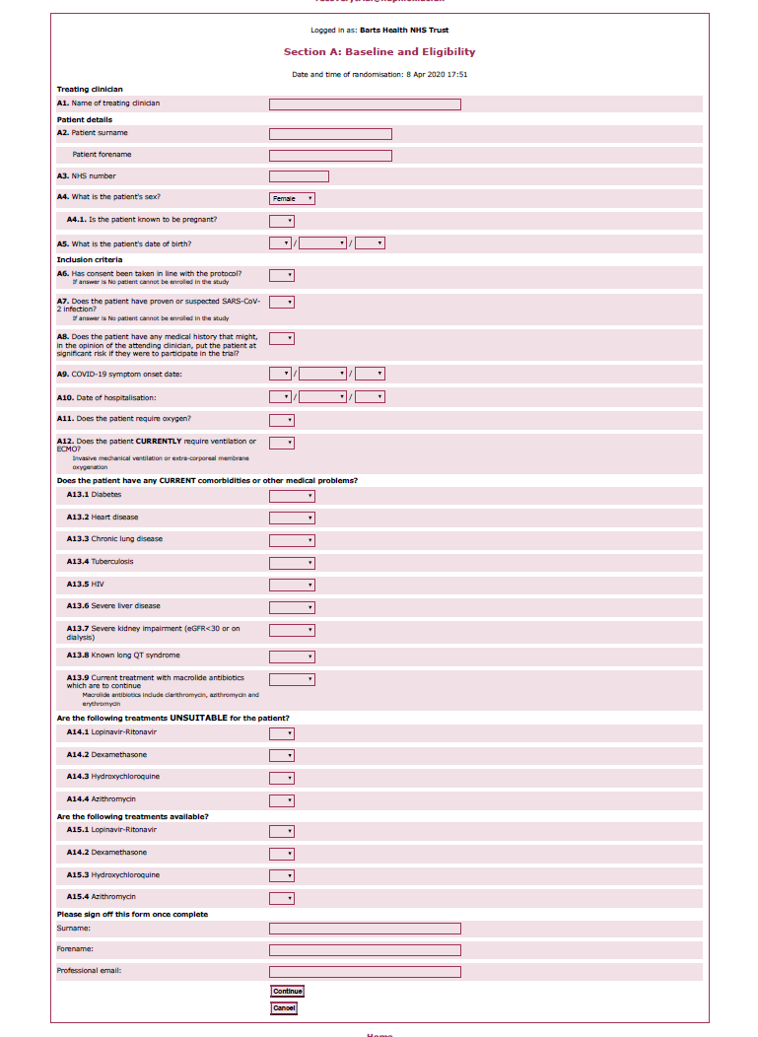
Data collection
Randomisation Form
Patient details
Inclusion criteria
Key co-morbidities
Any treatments for which the patient is not suitable
Any treatments not available in hospital pharmacy
Follow-up Form
Which treatments did the patient receive
COVID-19 test result
Vital status
Discharge date
Use of ventilation

Slide 64
Follow-up
Simple on-line form completed by research nurses
Linkage to national data sources
Vital status, death certificate
Coded hospital episode statistics (diagnoses, procedures)
Intensive Care audit data
SARS-CoV-2 PCR laboratory results
Primary care
National outpatient prescribing data
Permission to follow-up via record linkage for up to 10 years

Slide 65
RECOVERY second randomisation
No additional treatment
SECOND RANDOMISATION ELIGIBILITY CRITERIA
R
Tocilizumab
OUTCOMES
Mortality at 28 days
Need for ventilation; admission duration
Control
Lopinavir-ritonavir
400/100 mg bd PO for 10 days
R
Tocilizumab
Control
Tocilizumab
Dexamethasone
6 mg od PO/IV for 10 days
R
Tocilizumab
vs
Control
Control
Hydroxychloroquine
See protocol for dosing
R
Tocilizumab
Control
Azithromycin
500 mg od PO/IV for 10 days
R
Tocilizumab
Control

Slide 66
Sticking to the principles of Good Clinical Practice
“Each individual involved in conducting a trial should be qualified by education, training, and experience to perform his or her respective task(s).” (ICH E6(R2) section 2.8).
At each hospital, a lead investigator will be responsible for trial activities but much of the work will be carried out by medical staff attending patients with COVID-19 within the hospital and by hospital research nurses, medical students and other staff with appropriate education, training, and experience.
The tasks that they are required to perform under this protocol are similar to those that they perform in the other aspects of their roles as NHS staff.
No additional training in GCP is required. All study materials, including protocol and related documents, will be available online and there will be a 24 hour telephone service, supported by medical staff and trained coordinating centre research staff.

Slide 67
A coordinated approach
Coordinated, collaborative approvals
- Single regulatory agency (MHRA)
Single Ethics Committee (IRB) covers the whole country
Common contract
Prioritisation of resources
- Chief Medical Officer: clinical trial enrolment is part of delivering clinical care
- National Institute for Health Research Clinical Research Network: mobilised research nurses at every hospital
- Department of Health: procured & supplied treatment
- NHS Digital: access to linked national health data from multiple sources

Slide 68
Progress: Set-up
Taking the front-foot
10th March | First draft protocol
13th March | Joint regulatory & ethics (IRB) submission
16th March | Regulatory approval. Chief Medical Officer letter to all hospitals.
17th March | IRB committee meeting
18th March | IRB approval received in writing
19th March | First Patient Enrolled (1st protocol +9 days)
3rd April | 1000 patients enrolled (FPE + 15 days)
UK New Cases

Slide 69
Recruitment
6,900 randomised at 170 hospital
typically ~300 per day

Slide 70

Candidate Core Outcome Measure Set for COVID-19 Trials
John Marshall
WHO, University of Toronto

Slide 71

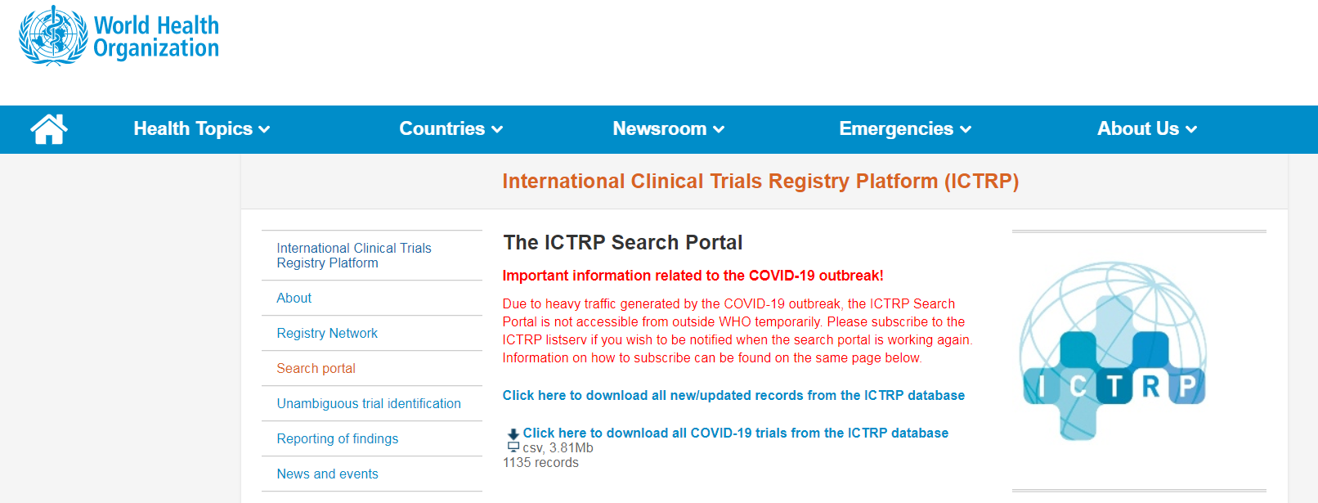
1135 Registered Clinical Studies

Slide 72

Similar questions
Similar interventions
Different study metrics

Slide 73
How can we pool and compare data across trials?
Similar questions
Similar interventions
Different study metrics

Slide 74

Core Outcome Measures in Effectiveness Trials
www.comet-initiative.org
Twitter: @COMETinitiative
Email: info@comet-initiative.org

Slide 75


Geneva, February 11, 12
2020

Slide 76
Common Minimal Outcomes Set
Simple, readily measured elements
Relevant across a spectrum of disease severity
Inclusive of clinical priorities
Applicable in resource-limited settings

Slide 77
Primary Outcomes in COVID-19 Trials
Viral burden 148
Mortality 118
Duration of Hospital/ICU Stay 32
Symptoms 45
Progression/Resolution 175
Lung injury/function 101
Other measures 117
Imaging findings 76
Biomarkers 73
Depression, anxiety 63
Co-infection, other organ injury 15

Slide 78
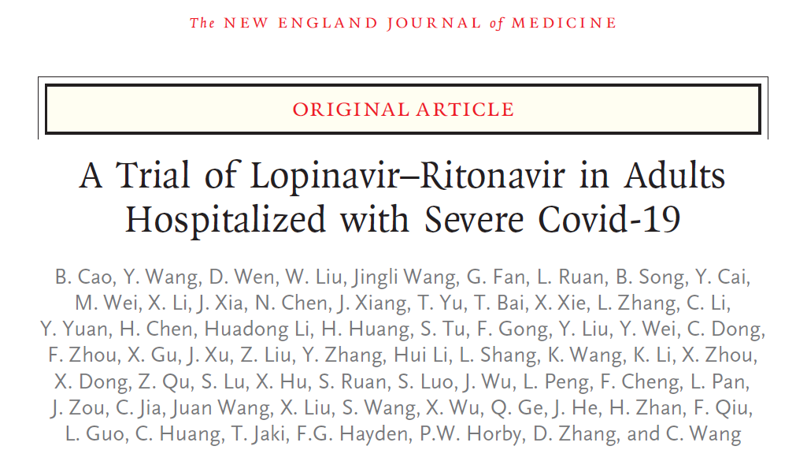
Not hospitalized; normal activities
Not hospitalized, but limited
Hospitalized; no oxygen support
Hospitalized; on oxygen
Hospitalized; on high flow oxygen or NIV
Hospitalized; ventilated or on ECMO
Dead
- Lancet Respir Med 7:941, 2019

Slide 79
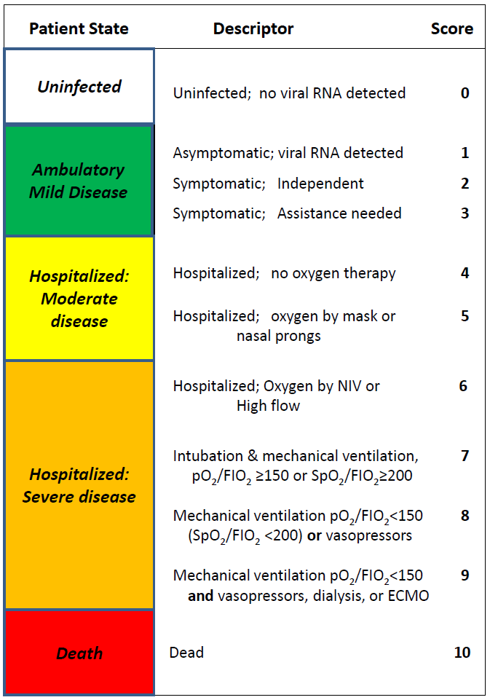
WHO Common Minimal Outcome Measure Set
Viral burden
Mortality at hospital discharge or 60 days
Clinical progression scale

Slide 80

Summary & Next Steps
Pamela Tenaerts
CTTI

Slide 81

Everything should be made
As simple as possible,
But not simpler
Albert Einstein

Slide 82
Designing High-Quality COVID-19 Treatment Trials
Quality does not slow you down
Focus on what matters
Need large randomized clinical trials
Streamline as much as possible
Pay attention to endpoints AND stage of disease
Add a control group/supportive care
Communicate and Collaborate (master protocols/endpoints/share data & knowledge/transparency)

Slide 83
Next Steps
Post & communicate recorded webinar & slides
Create best practices document
Submitted questions/comments from today’s webinar will be incorporated
Situation will evolve
Best practices document will be updated and communicated
Additional CTTI efforts will be forthcoming

Slide 84
zachary.hallinan@duke.edu

