Slide 1
Welcome
Once you’ve logged into WebEx, please select one of the following audio options:
  Call Using Computer
  I Will Call In
  DO NOT SELECT the “Call Me” option.
This webinar is being recorded.
All participants are muted upon entry.
Questions will be taken following the presentation. Please indicate that you have a question by typing in the chat box to the “Host.”

Slide 2
Embracing the Value of Patient Engagement
February 27, 2020
Joseph DiMasi, Tufts Center for the Study of Drug Development
Jaye Bea Smalley, formerly of Celgene
Notes:
NOTE: If your presentation is being recorded, this will be the beginning of the recording, so make it a clean introduction.
EXAMPLE:
Welcome everyone! My name is [insert introducer’s name/title] and it is my pleasure to introduce [insert presentation name].
Today’s presentation is hosted by the Clinical Trials Transformation Initiative, and the speakers today include [insert speaker(s) name/title]
[Insert prepared speaker(s) bios.]

Slide 3
Disclaimer
The views and opinions expressed in this presentation are those of the individual presenter and do not necessarily reflect the views of the Clinical Trials Transformation Initiative or Tufts University.

Slide 4
Brief Agenda
Time | Topic | Presenter
12:05 p.m. | Introduction: Patient Groups & Clinical Trials | Zachary Hallinan
12:10 p.m. | Quantifying the Impact of Patient Engagement: A Modeling Approach | Joseph DiMasi
12:25 p.m. | Identifying High-Value Patient Engagement Opportunities | Jaye Bea Smalley
12:40 p.m. | Discussion and Q&A
Please indicate that you have a question by typing in the chat box “To Host.”

Slide 5
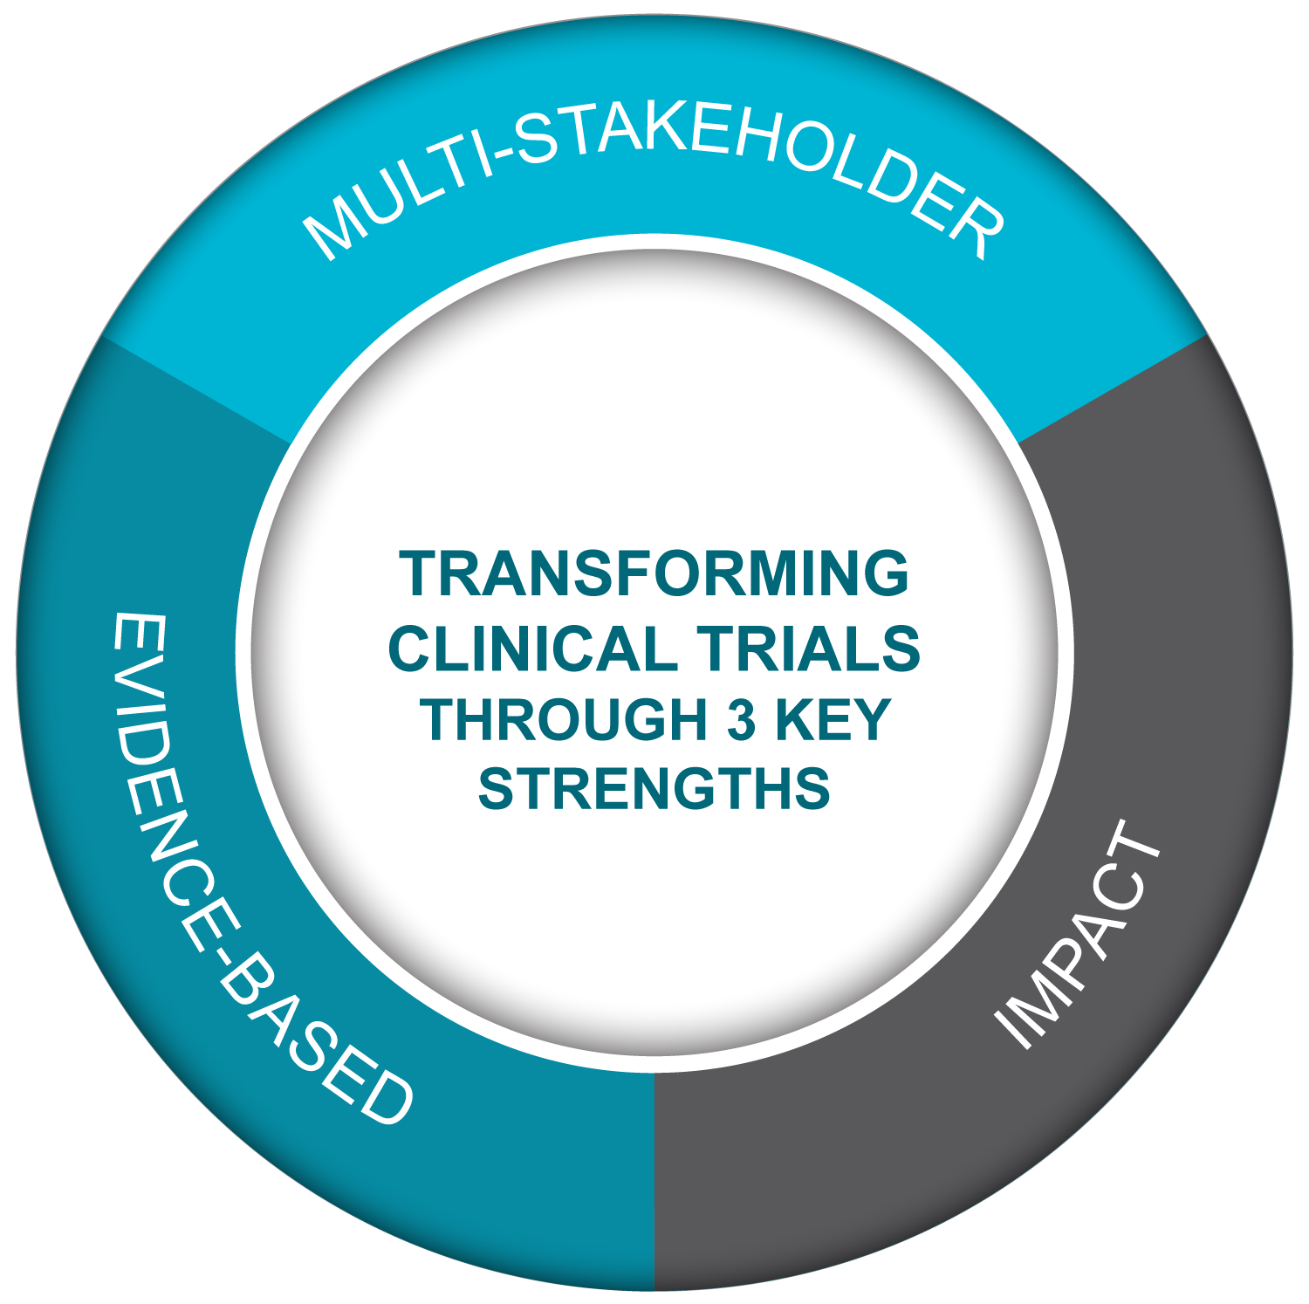

CTTI Strengths
Public-Private Partnership
Co-founded by Duke University & FDA
Involves all stakeholders
80+ members
MISSION: To develop and drive adoption of practices that will increase the quality and efficiency of clinical trials

Slide 6
Patient Engagement at CTTI
Normed (no question) inclusion of patients as equal partners into every aspect of clinical trial (reform)
  Full integration into the Steering Committee
  Individual patients reimbursed for time on CTTI activities incl. projects
Patient/caregivers on project teams have played critical role in shaping many projects
Co-founded Patient Engagement Collaborative with FDA
Almost all CTTI recommendations advocate for involving all stakeholders and particularly patients in the process, including our Quality by Design work which is included in ICH E8 renovation

Slide 7
Clinical Trials Stakeholders
Clinical
Investigators
CDRH/CBER 2019 draft guidance: “FDA believes medical device clinical investigations prospectively designed with input from patient advisors may help to address common challenges.”
ICH E8(R1) 2019 draft: “Clinical study design is best informed by input from a broad range of stakeholders, including patients and treating physicians.”
Better
Streamlined
Fit for purpose
Clinical Trials
Government & Regulatory Agencies
Patients, Caregivers & Patient
Advocacy Groups
Equal Partners
Industry (pharma, bio, device, CRO, & tech)
Academia
IRBs
Trade &
Professional Orgs

Slide 8
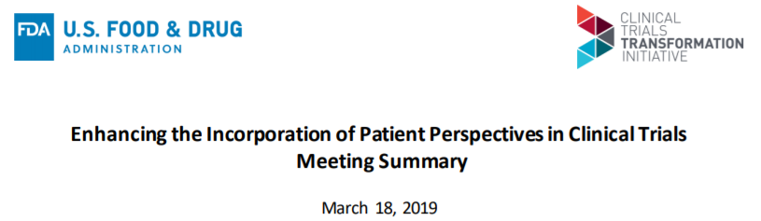
Donna Cryer*, President and CEO of the Global Liver Institute, delivered the keynote presentation challenging attendees to reflect on what she considers a broken system in which barriers to patient engagement are still numerous despite years of collective effort.
https://www.ctti-clinicaltrials.org/enhancing-the-incorporation-of-patient-perspectives-in-clinical-trials/
*Member of CTTI Executive Committee

Slide 9
MODIFIABLE BARRIERS TO COLLABORATION
Unsure of how to identify/ engage w/ PGs
Mismatched expectations between trial teams & PGs
Providing PGs
w/ only a token seat at the table
Internal resistance, lack of buy-in
Perceived difficulty of overcoming legal barriers to collaboration
Lack of engagement best practices & infrastructure
Lack of demonstrated value
Lack of sophistication of PGs
Excluding PGs from early stages of trial planning & design
Lack of funding

Slide 10
CTTI Resources Developed for Engaging Patient Groups in Clinical Trials
Identifying Best Practices | Describing Value & Impact
Recommendations: Effective Engagement with Patient Groups Around Clinical Trials Implementation resources Patient Group Organizational Expertise and Assets Evaluation Assessment of Patient Group Internal Aspects Assessment of Patient Group External Relationships | Economic model to quantify the financial value of patient engagement Online prioritization tool for identifying high-value engagement opportunities
All resources freely available at
https://www.ctti-clinicaltrials.org/our-work/patient-engagement/patients-groups-clinical-trials/

Slide 11
CTTI Resources Developed for Engaging Patient Groups in Clinical Trials
Identifying Best Practices | Describing Value & Impact
Recommendations: Effective Engagement with Patient Groups Around Clinical Trials Implementation resources Patient Group Organizational Expertise and Assets Evaluation Assessment of Patient Group Internal Aspects Assessment of Patient Group External Relationships | Economic model to quantify the financial value of patient engagement Online prioritization tool for identifying high-value engagement opportunities
All resources freely available at
https://www.ctti-clinicaltrials.org/our-work/patient-engagement/patients-groups-clinical-trials/

Slide 12
Patient Groups & Clinical Trials Project Team
(2014 – 2019)†
Linda Brennan (CFF)*
Richard Klein (FDA)*
David Leventhal (Pfizer)*
Jaye Bea Smalley (Celgene)*
Sophia Smith (Duke)*
Amy Abernathy (Duke)
Ronald Bartek (FARA)
Joel Beetsch (Celgene)
Patricia Cornet (BMS)
Joe DiMasi (Tufts)
Eric Eisenstein (Duke)
Ken Getz (Tufts)
Michele Goldberg (J&J)
Matthew Harker (Duke)
Sharon Hesterlee (Bamboo Therapeutics)
Bennett Levitan (J&J)
Jim Kremidas (ACRP)
Paulo Moreira
(EMD Serono)
Bray Patrick-Lake (Duke)
Steve Roberds (Tuberous Sclerosis Alliance)
Jamie Roberts (Duke)
Al Roy (Lupus Research Alliance)
Wendy Selig (WSCollaborative)
Jeff Sherman (DIA)
James Valentine
(Hyman, Phelps & McNamara)
Scott Weir
(University of Kansas)
CTTI:
Zachary Hallinan (PM)
Amy Corneli (Social Science)
Rae Holliday (Comms)
Laura Shannon (Comms)
*Project team leader | † Affiliations indicated as primary at time of project participation

Slide 13
Quantifying the Impact of Patient Engagement: A Modeling Approach

Slide 14
Prospective Modeling Overview
Apply a commonly used and widely accepted method for modeling financial value based on project development cost, time and risk
Base cases: Typical phase II and III oncology
development programs
What-if scenarios to test model:
  Assumed avoidance of one protocol amendment
  Assumed 3 month faster enrollment
  (due to more feasible and convenient participation)
All data used to populate model based on published benchmark
and source data
Assessing the Financial Value of Patient Engagement: A Quantitative Approach from CTTI’s Patient Groups and Clinical Trials Project. Therapeutic Innovation and Regulatory Science 2018;52(2):220-229

Slide 15
Development Program Value Drivers
Revenue
Cost
Time
Financial benefits accruing from project success
Out-of-pocket & opportunity cost
When costs, revenue, & risks occur
*Note: ‘Strategic’ and intangible values not included

Slide 16
Risk Factors Impacting Value
Scientific & technical risks driving whether to advance development
  Efficacy, safety, competitors, comparative effectiveness and economics
Regulatory risk driving approval and launch
Operational risk driving timely, efficient and compliant development activity
Resource risk driving the accuracy of capacity and resource allocation
Forecasting risk driving accuracy of predicted development
performance and investment
Patient quality of life, satisfaction, receptivity influencing
development decisions

Slide 17
Modeling Value and Impact
Circles represent studies or other key milestones/risks
Probabilities assigned based on scientific, operating &
regulatory risk
Each development path has an associated cost or reward
expressed as cash flow in net present value terms
Succeed
Treatment launched
Succeed
Regulatory Approval
Succeed
Fail
Phase 3
Failures Resulting in
Termination
Fail
Phase 2
Fail

Slide 18
Adjusting Value for All Expected
Risk Outcomes
Prob
NPV
($millions)
NPV for technical & regulatory success
Succeed
22%
400
90%
Succeed
60%
Regulatory Approval
Succeed
Fail
2%
-45
NPV for regulatory failure
Phase 3
10%
40%
Fail
Phase 2
16%
-40
NPV’s for technical failures
40%
Fail
60%
-3
60%
eNPV = “Expected Net Present Value”
= NPV adjusted for risk
= 0.22 x 400 – 0.02 x 45 – 0.16 x 40 – 0.60 x 3 = $77 MM

Slide 19
Patient Engagement Assumptions
$50,000 - $100,000 patient engagement initiative investment required
Improved Protocol Feasibility Resulting in One Amendment Avoided
  Phase 2 and 3 amendments cost $141,000 and $535,000
  to implement respectively
  70% of protocols have at least one amendment; 22% of amendments
  are due to recruitment difficulty or site execution difficulty
  A single amendment adds 3 months of time to implement
Improved Protocol Feasibility Resulting in More Convenient Participation
  ICF easier to understand
  Eligibility criteria simplified
  Participation burden for patients reduced
  Arbitrary 3 months of study cycle time saved

Slide 20
Modeling Results
Avoid One Amendment
Improve Convenience
 | Phase II | Phase III |  | Phase II | Phase III
eNPV Impact on $100,000 Invested | +$3.8 million | +$15.0 million |  | +$30.1 million | +$57.0 million
For engagement activities resulting in avoiding an amendment and/or an improved patient trial experience, the benefits in eNPV vastly outweigh the resources spent on engagement.

Slide 21
Expansion of an eNPV Value Framework for Evaluating Patient Engagement Methods

Slide 22
Overview
Primary AIM – to expand on initial eNPV modeling & establish a resource for researchers and companies to assist them in constructing models for a wide variety of scenarios
Expanded list of variables and inputs
Useful references for gathering benchmark & case study data to populate eNPV models & guide model assumptions
Authored by Joseph DiMasi (Tufts) & Kenneth Getz (Tufts) in collaboration with Bennett Levitan (Janssen)

Slide 23
Drivers and Parameters
Value drivers:
  Cycle time
  Direct cost
  Success rates
  Commercialization
Expanded benchmarks for additional therapeutic areas
Parameters:
  Drug development cost, cycle time, risk
  Regulatory approval times
  Sales & market expense
  Effective patent life
  Effective corporate tax rate & cost of capital
  Public & patient attitudes & experience in clinical trials
  Patient centric approaches – cost & impact

Slide 24
Resources
Economic Model Development & Market
  14 primary sources cited
Public and patient attitudes & experience
in clinical trials
  28 primary sources cited
Patient centric approaches – cost & impact
  70 case examples referenced

Slide 25
Conclusions
Pilot study published & well-received
Resources identified that can be used to expand the analytical framework to other disease categories & additional patient engagement methods
Could be expanded by researchers, internally as a tool by sponsors, or as a collaborative online tool

Slide 26
Identifying High-Value Patient Engagement Opportunities

Slide 27
Patient Group Engagement Across the Clinical Trial Continuum*
Patient groups have potential to enhance the quality & efficiency of clinical trials by providing:
Financial support for research
Natural history data
Input on relevance of research to patients
Access to translational tools
Help defining eligibility criteria
Input on meaningful endpoints & PROs
Advocacy for policy & funding issues†
Education to patient community†
Support to sponsors around key regulatory meetings
Support preparing submissions for newborn screening for rare diseases
Informing regulators on benefit-risk†
Public testimony at regulatory meetings†
Discovery &
Pre-Clinical‡
Phase
1 - 3
Regulatory Review
Post-
Approval
Benefit-risk & patient-preference studies
Protocol design & study feasibility input
Study recruitment & retention strategy input
Increased awareness about trials
Participant feedback on trial experience
Input on informed consent content & processes
Peer advocates for participants†
Clinical trial networks†
Data Safety Monitoring Board members†
Phase 1-3 activities and…
Support interpreting & disseminating study results
Collaboration on post-marketing studies & surveillance initiatives
Support developing access strategy & preparing for value or health technology review
*Updated 2018; adapted from Parkinson’s Foundation materials | †Patient group activities typically undertaken independently or with partners other than sponsors | ‡Includes early planning for trials

Slide 28


How Sponsors & Patient Groups Define Value
When evaluating potential BENEFITS consider:
When evaluating potential INVESTMENTS and RISKS:
Scope of impact of the activity on your patient population/org/co
Amount of financial
resources needed
Necessity of patient group involvement to conduct the
activity
Level of staff time &
expertise required across
the lifespan of the activity
Necessity of the activity to advance medical product development
Amount of additional
organizational commitment needed
given existing infrastructure
Ease of accomplishing the activity in the short-term
Amount of direct patient
involvement & potential
patient burden
Reputational benefits
Reputational risks
Based on semi-structured interviews conducted with representatives of sponsors (n=14) and patient groups (n=14) to understand how each characterizes “investments” and “benefits” of engagement

Slide 29
How Sponsors and Patient Groups Define Value
When evaluating potential BENEFITS consider:
When evaluating potential INVESTMENTS and RISKS:
Scope of impact of the activity on your patient population/org/co
Amount of financial
resources needed
Necessity of patient group involvement to conduct the
activity
Level of staff time &
expertise required across
the lifespan of the activity
Necessity of the activity to advance medical product development
Amount of additional
organizational commitment needed
given existing infrastructure
Ease of accomplishing the activity in the short-term
Amount of direct patient
involvement & potential
patient burden
Reputational benefits
Reputational risks
Based on semi-structured interviews conducted with representatives of sponsors (n=14) and patient groups (n=14) to understand how each characterizes “investments” and “benefits” of engagement

Slide 30
Web-Based Tool for Identifying High-Value Engagement Opportunities
Provides a simple, straightforward process for sponsors & patient groups to identify opportunities to work together
 |  | INVESTMENT
 |  | High | Low
BENEFIT | High | High Benefit High Investment | High Benefit Low Investment
 | Low | Low Benefit High Investment | Low Benefit Low Investment
Step 1: Identify engagement opportunities
Step 2: Evaluate investments & benefits
Step 3: Visualize & discuss mutually beneficial activities
BEST
WORST
Tool is freely available at https://prioritizationtool.ctti-clinicaltrials.org/

Slide 31
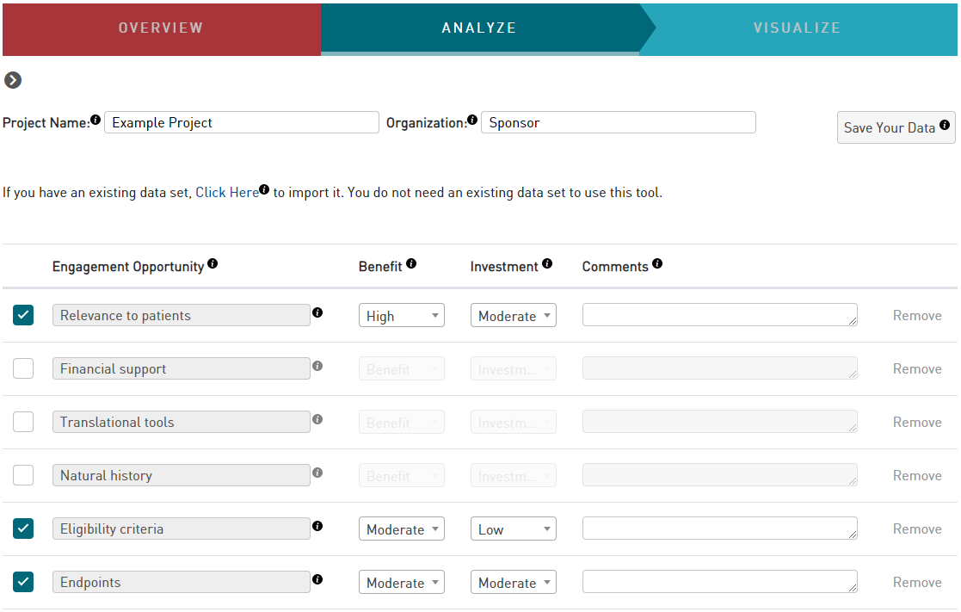
Identifying & Evaluating Engagement Opportunities

Slide 32
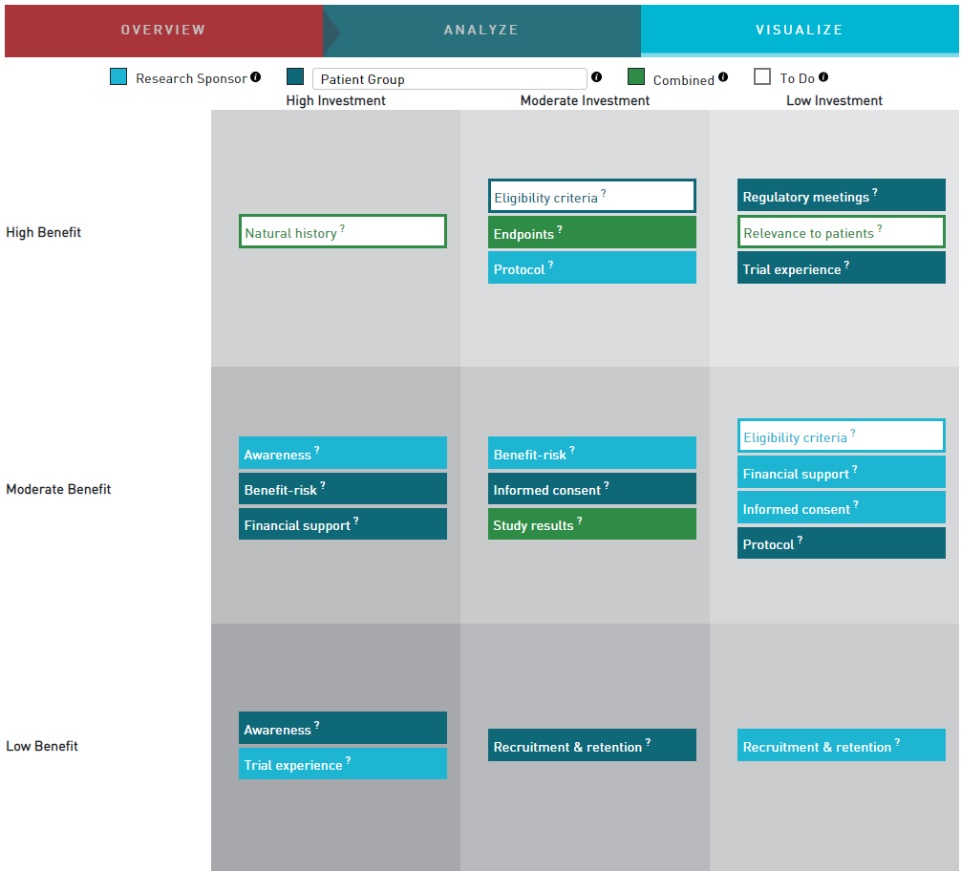
Visualizing & Discussing Engagement Opportunities

Slide 33
Finding the Best Approach
Economic Impact
Qualitative Evaluation

Slide 34
Recommendations for Sponsors
Establish ongoing relationships with patient groups & communicate openly with them on a regular basis.
Ensure that patient groups are essential partners throughout the research & development process and not “token” voices.
For consistency, establish guiding principles & clear lines of communication to facilitate a fit-for-purpose process for collaborating with patient groups.
Integrate into your ongoing research & portfolio planning an assessment of patient group expertise & assets and value to your program.
Match patient group expertise & assets to the specific needs & phases of your research & development programs.
Measure the impact of patient group engagement on cycle time & other metrics.

Slide 35
Recommendations for Patient Groups
Proactively identify, engage, & bring the patient voice to stakeholders relevant to your research & development interests.
Promote your value as an essential partner by maximizing & articulating your expertise & assets.
Deliver your expertise & assets to research sponsors throughout the entire research & development lifecycle.
Patient groups should select sponsors who have a product or development program with significant promise for their constituents & who are committed to engaging in a meaningful way.
Manage real or perceived conflicts of interest by establishing policies that require full disclosure, transparency, & accountability.

Slide 36
CTTI Patient Engagement Resources
Economic Model:
https://www.ctti-clinicaltrials.org/sites/www.ctti-clinicaltrials.org/files/new_ctti_resource_26feb2020_final.pdf
Prioritization Web Tool:
https://prioritizationtool.ctti-clinicaltrials.org/
Recommendations: Realizing the Value of Effective Patient Group Engagement
https://www.ctti-clinicaltrials.org/our-work/patient-engagement/patients-groups-clinical-trials/
Quality by Design (QbD)
Mobile Clinical Trials
Patient Engagement Collaborative
Additional Resources for Engaging Patients in Clinical Trials

Slide 37
Webinar recording & slides available at:
https://www.ctti-clinicaltrials.org/webinars/

