Slide 1
PRECISION ONCOLOGY NETWORK
Mika Newton, CEO
FALL 2019

Slide 2

For Advanced Cancer Patients, Getting the Best Care Is a Nightmare
No one knows the optimal way to treat any cancer,
many patients can’t get or pay for the drugs they need
and treatment outcomes vary widely
Each year thousands die unnecessarily

Slide 4




xCures: A perpetual trial that continuously learns from all patients, all physicians, all therapies, all the time through Creating value an AI-based precision oncology platform that finds novel treatment options, facilitates access, and coordinates across patients to maximize learning. (NCT03793088)
KOLs/VTBs
Rx
CT
CT
Rx
A Common Platform Across Clinical Trials
Physicians/ Health Networks
AI Dynamically Allocates Patients and Drugs to Optimize Outcomes
Rx
Service Providers
Rx
CT
Insights Shared Across Ecosystem
Rx
Pharma
Rx
Rx
Rx
Rx
Rx
Rx
Rx
Rx
Faster, cheaper development of drugs and tests
Payers pay only for what works
Patients get the best outcomes
Payers
Rx

Slide 5

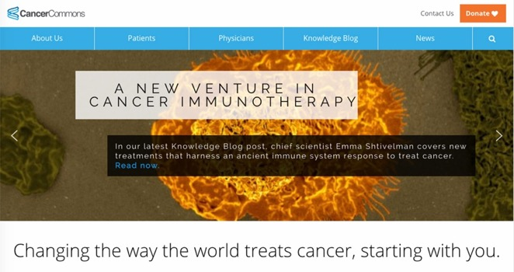
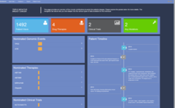



ASK Cancer Commons
RESPECTED NON-PROFIT
Network of world-class physicians and researchers
4,000+ patients who have benefitted from ASK virtual tumor boards
Multiple peer reviewed publications
American Cancer Society collaborator
4000 patients, 40+ countries
Case
Referral
Patient
and
Physician
Cancer
Network
Partner
Virtual
Tumor
Board
Ranked
Options for Care
Make
Decision
Capture Outcome
Notes:
VTB Service but not scalable.

Slide 6







Cancer Commons + xCures
Globally coordinate treatment plans across patients
Case
Referral
Patient
and
Physician
Cancer
Network
Partner
Virtual
Tumor
Board
Ranked
Options for Care
Make
Decision
Capture Outcome
Initial Options
Knowledge Base (options, rationales and outcomes)

Slide 7


xCures Platform: Options, Access and Outcomes
LEARNING FROM ALL PATIENTS. ALL PHYSICIANS. ALL THERAPIES. ALL THE TIME.
SUPPORTING VIRTUAL TUMOR BOARDS
SERVICING PATIENTS
C
O
Trial enrollment
Expanded access
Reimbursement for approved drugs
OPTIONS
ACCESS
Knowledge sharing
Decision support
Treatment planning
O
R
D
I
N
A
OUTCOMES
T
E
TRACKING REAL WORLD EVIDENCE
Master protocol
Data registries

Slide 8



Value for All Stakeholders
Consults with VTB experts; Access to top drugs; Superior Outcomes
PATIENTS
Faster, cheaper trials → approvals, label expansions, compendia listings, Early signals. Salvage drugs abandoned for business reasons.
PHARMA
Improved outcomes. Patient referrals and retention. Access to novel treatments. Knowledge sharing with peers.
PROVIDERS
Clinical data. Outcomes data. Rapid Investigator Initiated Studies.
RESEARCHERS
Optimize care, defray costs by moving patients into research, and pay only when drugs works. Trusted data for claims adjudication.
PAYERS
Notes:
Started with patients, but get that right, and create Value across the board. (and owning the patients = owning oncology).
Put patient value at center of the system and creates all kinds of new value.
Change the economics, making some things feasilble.
Have a side fund, trade insider information. Spin off Virtual Biotechs if warranted (CollabRx business model).
We create value across ecosystem, all aligned with patient. (by aligning with pt, we can create value across the ecosystem).
If we see signals, lots of ways to monetize. Selll successes to pharma and failures to the payers. (and comparative effectiveness to investors).
Publish papers -> compendia listings.

