Slide 1
Introduction to CTTI
Annemarie Forrest

Slide 2

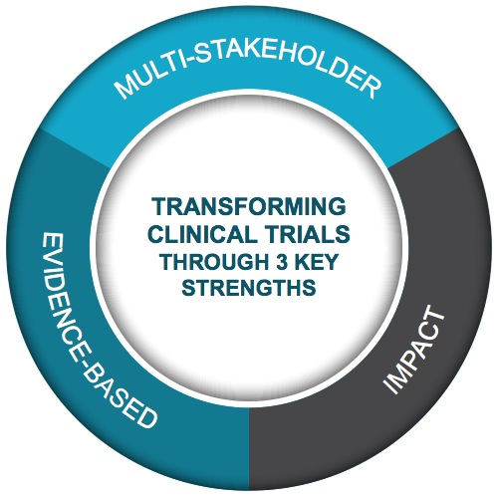
Public-Private Partnership
Co-founded by Duke University & FDA
Involves all stakeholders
Approx. 80+ members
Participation of 400+ more orgs
MISSION: To develop and drive adoption of practices that will increase the quality and efficiency of clinical trials

Slide 3
Multi-Stakeholder Collaboration
Clinical Investigators
Better
Streamlined
Fit for purpose
Clinical Trials
Government & Regulatory Agencies
Patients, Caregivers & Patient Advocacy Groups
Everyone is an equal partner at the table
Industry (pharma, bio, device, CRO, & tech)
Academia
IRBs
Trade &
Professional Orgs

Slide 4

CTTI Membership
*Version: August 06, 2019

Slide 5
CTTI Activities
Quality | Patient Engagement | Investigators & Sites
Quality by Design Informing ICH E6 Renovation Diversity Analysis of ClinicalTrials.gov Recruitment Planning for Pregnancy Testing State of Clinical Trials Report Monitoring | Patient Groups & Clinical Trials Patient Engagement Collaborative | Investigator Community Investigator Qualification Site Metrics
Mobile Clinical Trials | Novel Clinical Trial Designs | Ethics & Human Research Protection
Novel Endpoints Mobile Technologies Decentralized Clinical Trials Engaging Patients and Sites | Real-World Data Registry Trials Master Protocols Antibacterial Drug Development Large Simple Trials Using FDA Sentinel for Trials | Single IRB Data Monitoring Committees Informed Consent Safety Reporting
Notes:
We focus our work on 6 critical areas of clinical trials—areas that represent the biggest challenges and opportunities for improvement.
-----------------------------------------------------
Noel’s notes to help guide review process: (delete after reviewing)
I went ahead and reverted this one back to the normal slide layout (with the footer and logo). Feel free to use either version!

Slide 6
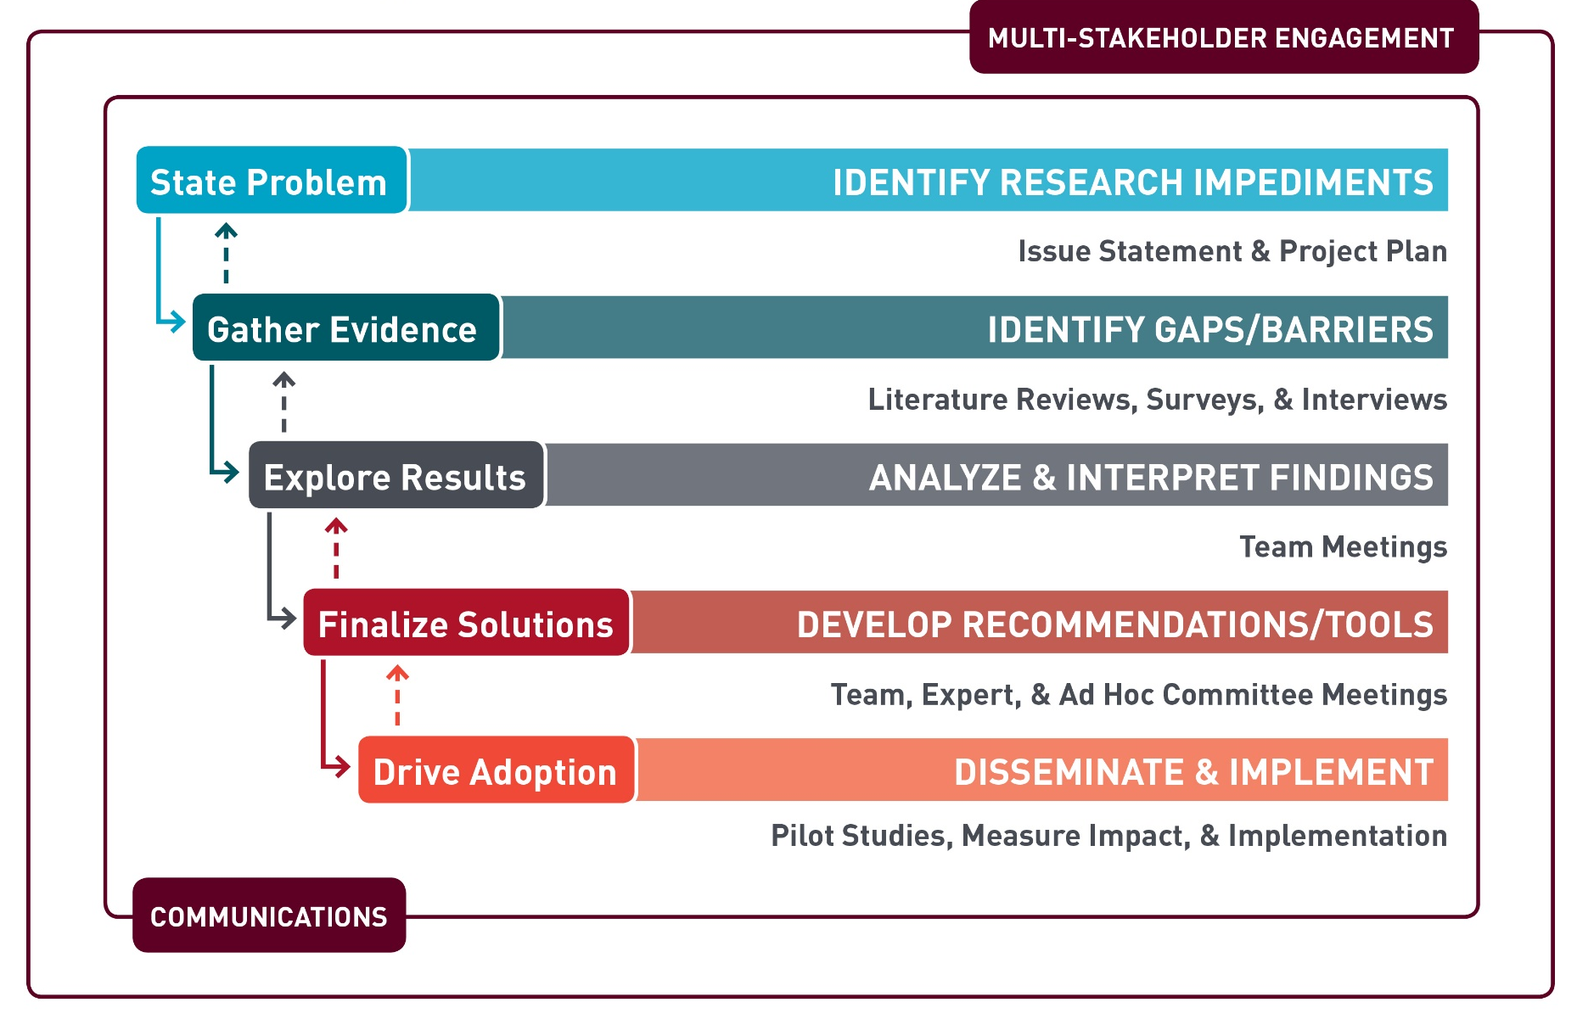
CTTI Methodology

Slide 7
CTTI Recommendations and Resources
Quality | Patient Engagement | Investigators & Sites
Create better protocols with Quality by Design (QbD) Move Recruitment planning upstream Create Pregnancy Testing plans for improved clinical trials | Involve Patient Groups as equal partners | Strengthen the Investigator Site Community Improve Investigator Qualification & reduce GCP Training inefficiencies
Mobile Clinical Trials | Novel Clinical Trial Designs | Ethics & Human Research Protection
Pathways for developing Novel Endpoints and running trials using Mobile Technologies Overcome Decentralized Clinical Trials hurdles Engaging Sites and Patients when incorporating mobile technologies | Use Registries to conduct more efficient clinical trials Streamline Antibacterial Pediatric and HABP/VABP Studies | Improve ethics review process via use of Single IRB Organize DMCs to ensure patients’ safety Perform higher quality Informed Consent process Develop a better IND Safety Reporting system

Slide 8
Notes:
Please consider connecting with us on any of these social platforms!

