Slide 1
Study Execution Breakout Session 2
October 23, 2019
Rajeshwari Sridhara, FDA, CDER

Slide 2
Breakout Session Ground Rules
Listen actively and respectfully
Give everyone the opportunity to share their ideas
Recognize that there will be disagreement:
To maximize the benefit of collaborating, you need to diverge before you converge
Team members with minority perspectives should be given the opportunity to speak up
Criticize ideas, not people

Slide 3
Session 2 Objectives
Review prioritized roadblocks and potential strategies
Translate strategies into potential tools
Complete a high-level outline for 2–3 tools

Slide 4
Execution Breakout Session 3 Report Out

Slide 5
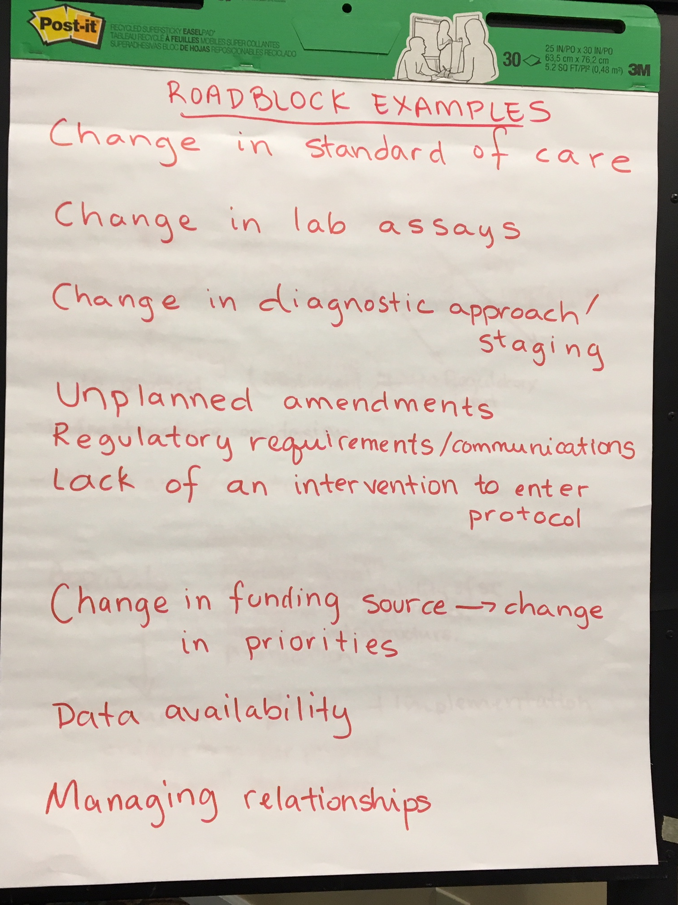

Slide 6
Strategy
Study Conduct & Operations
External Events
Decision-Making Body
Advisory Bodies
Approvals & Oversight
Communications & Implementation

Slide 7
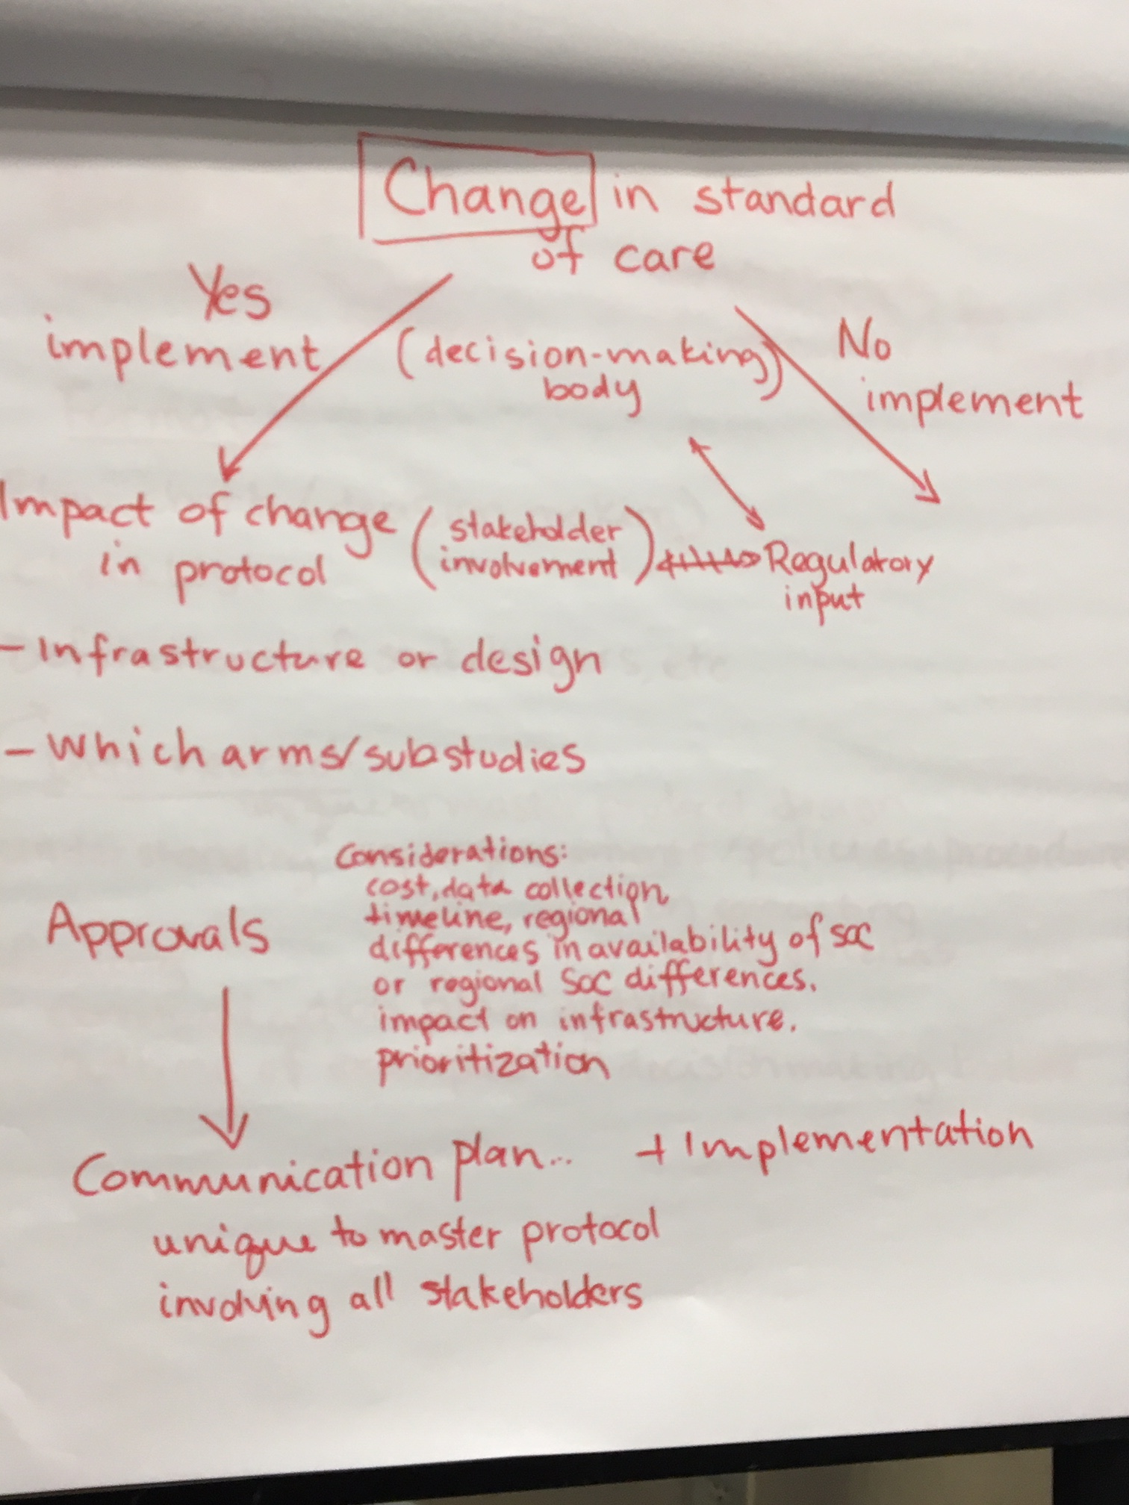

Slide 8
