Slide 1

Institute for Advanced Clinical Trials for Children
Edward Connor, MD, MBE, FAAP
Chairman and Interim Chief Medical Officer
I-ACT for Children
An independent 501(c)3 public-private collaboration launched in 2017 to advance innovative medicines/device development and labeling to improve child health
Addressing the challenges and opportunities in pediatric clinical trials of new medicines/devices
Focus on innovation, efficiency, quality, child-health impact
Early and continuous cross-stakeholder stakeholder engagement, including patients/parents
Scope:
Strategy/Planning including innovative trial design, feasibility, pediatric program development
Infrastructure/Trials Execution – 60 pediatric centers, international reach, multidisciplinary experts
Best Practices – trial readiness, harmonized processes, points of contact
Thought Leadership – moving the field forward
Funded by membership, FDA U18 grant, donations/philanthropy

Slide 2

Institute for Advanced Clinical Trials for Children
Platform trials represent an important alternative to traditional product development for children and a high priority for I-ACT for Children
Increasing interest by regulators, biopharmaceutical companies, foundations, networks, etc.
Key success factors:
Program that is “ready for prime time” (pipeline, natural history, endpoints, feasibility, etc.)
Diverse stakeholder engagement and credible stakeholder value proposition
Committed leadership and governance
An entity to serve as master protocol “sponsor” and regulatory interface
Trial network and infrastructure with regulatory-grade trials expertise and capabilities
Seed funding and sustainability plan
“Two types of innovation are hallmarks of master protocols: the use of a trial network with infrastructure in place to streamline trial logistics, improve data quality, and facilitate data collection and sharing; and the use of a common protocol that incorporates innovative statistics“
Janet Woodcock, Lisa LaVange, NEJM

Slide 3


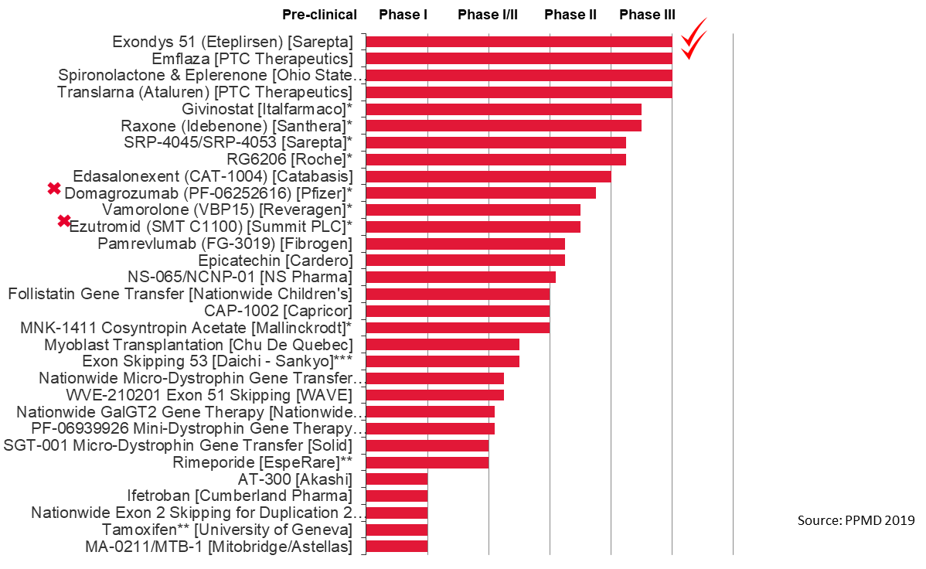
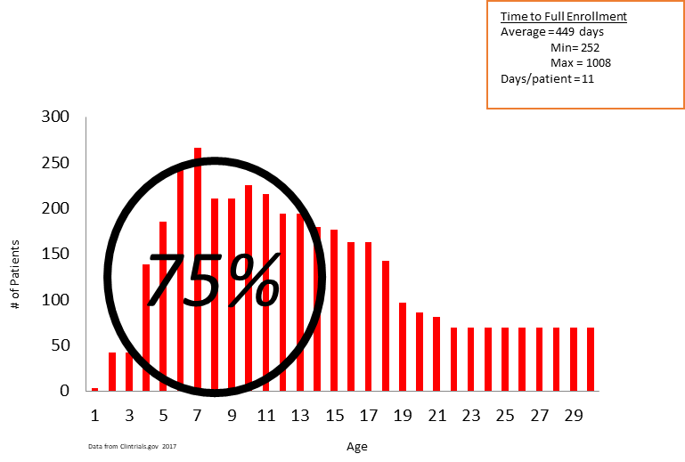
Duchenne Platform Trial
Concept:
Parent Project Muscular Dystrophy (PPMD) drug development forum
Critical Path Institute (C-Path) Duchenne Regulatory Science Consortium
Berry Consultants: design, statistics, analysis planning
I-ACT for Children: master protocol, roadmap, stakeholders meeting, consortium
Patients Needed by Age (N=3885) 41 studies, Ph 2+,

Slide 4
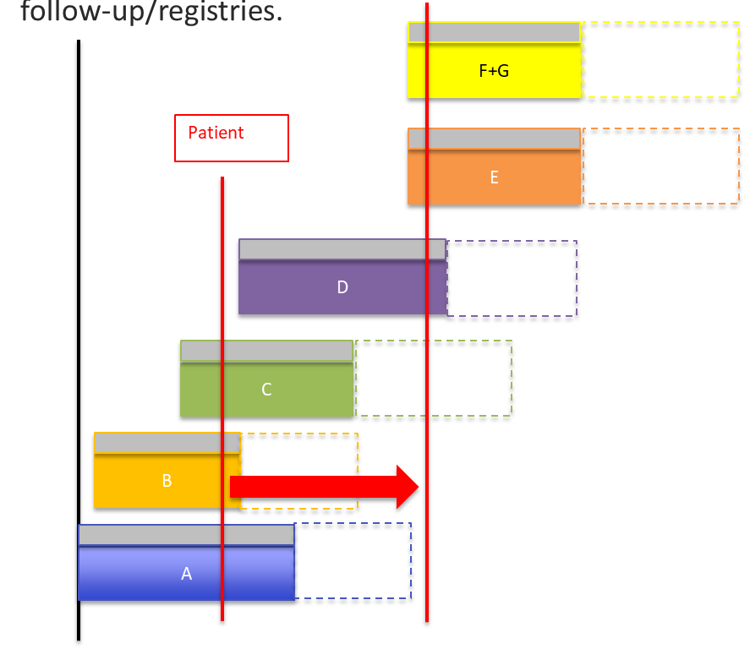
Platform Trial: DMD
Standard patient experience
Standard suite of endpoints
Savings in sample size
Limited placebo exposure
Adaptive
Wider patient inclusion
Standard futility analyses
Decrease time to “decision”
Trial ready sites
Centralized processes
Coordinated regulatory interface

Slide 5




I-ACT for Children: Platform Trial Catalyst
Concept: Idea and initial feasibility (ready for prime time?)
Consortium: Key stakeholders produce essential elements
Master Protocol
Business Plan
Operations Plan
Platform Trial Implementation
“Corporation”: Entity created to implement trial and hold IND

Slide 6

Summary
Platform trials represent an important innovative trial design methodology in the pediatric product development toolkit.
Platform strategy includes scientific, organizational, and financial elements
Plan for registrational use upfront
Don’t start something you can’t finish… Sustainability is essential.

