Slide 1
Master Protocol Expert Meeting
October 22, 2019
Notes:
NOTE: If your presentation is being recorded, this will be the beginning of the recording, so make it a clean introduction.
EXAMPLE:
Welcome everyone! My name is [insert introducer’s name/title] and it is my pleasure to introduce [insert presentation name].
Today’s presentation is hosted by the Clinical Trials Transformation Initiative, and the speakers today include [insert speaker(s) name/title]
[Insert prepared speaker(s) bios.]

Slide 2
Introduction to CTTI
Annemarie Forrest

Slide 3

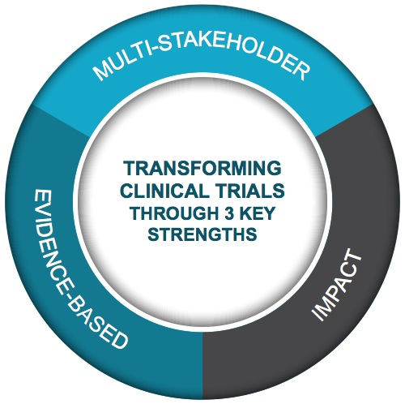
Public-Private Partnership
Co-founded by Duke University & FDA
Involves all stakeholders
Approx. 80+ members
Participation of 400+ more orgs
MISSION: To develop and drive adoption of practices that will increase the quality and efficiency of clinical trials

Slide 4
Multi-Stakeholder Collaboration
Clinical
Investigators
Better
Streamlined
Fit for purpose
Clinical Trials
Government & Regulatory Agencies
Patients, Caregivers & Patient
Advocacy Groups
Everyone is an equal partner at the table
Industry (pharma, bio, device, CRO, & tech)
Academia
IRBs
Trade &
Professional Orgs

Slide 5
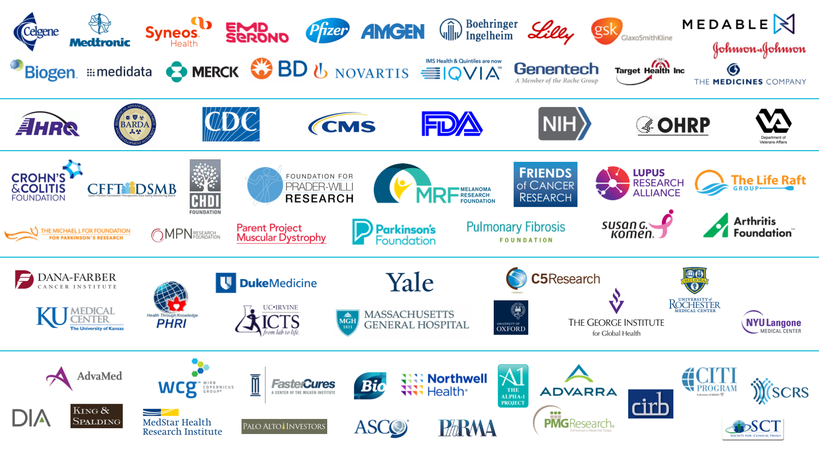
CTTI Membership
*Version: August 06, 2019

Slide 6
CTTI Activities
Quality | Patient Engagement | Investigators & Sites
Quality by Design Informing ICH E6 Renovation Diversity Analysis of ClinicalTrials.gov Recruitment Planning for Pregnancy Testing State of Clinical Trials Report Monitoring | Patient Groups & Clinical Trials Patient Engagement Collaborative | Investigator Community Investigator Qualification Site Metrics
Mobile Clinical Trials | Novel Clinical Trial Designs | Ethics & Human Research Protection
Novel Endpoints Mobile Technologies Decentralized Clinical Trials Engaging Patients and Sites | Real-World Data Registry Trials Master Protocols Antibacterial Drug Development Large Simple Trials Using FDA Sentinel for Trials | Single IRB Data Monitoring Committees Informed Consent Safety Reporting
Notes:
We focus our work on 6 critical areas of clinical trials—areas that represent the biggest challenges and opportunities for improvement.
-----------------------------------------------------
Noel’s notes to help guide review process: (delete after reviewing)
I went ahead and reverted this one back to the normal slide layout (with the footer and logo). Feel free to use either version!

Slide 7
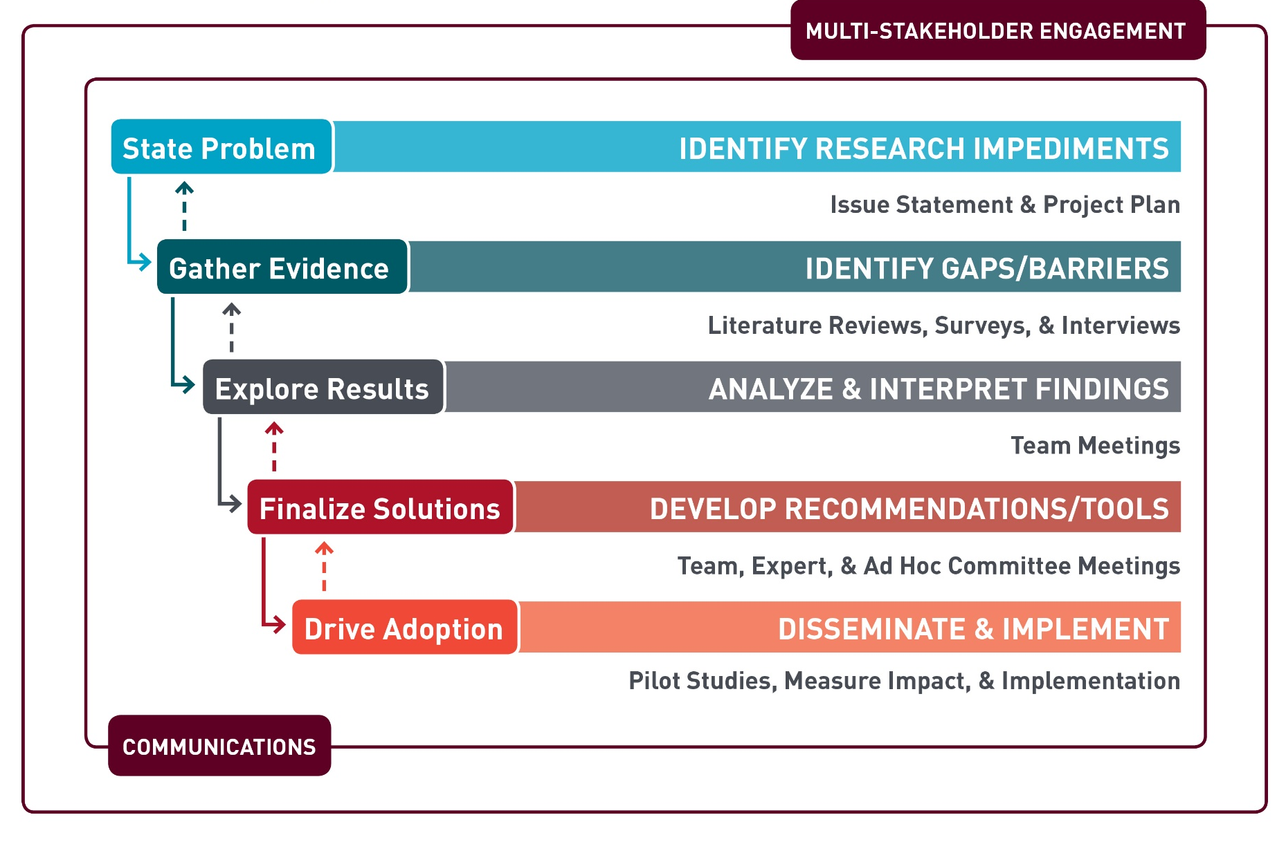
CTTI Methodology

Slide 8
CTTI Recommendations and Resources
Quality | Patient Engagement | Investigators & Sites
Create better protocols with Quality by Design (QbD) Move Recruitment planning upstream Create Pregnancy Testing plans for improved clinical trials | Involve Patient Groups as equal partners | Strengthen the Investigator Site Community Improve Investigator Qualification & reduce GCP Training inefficiencies
Mobile Clinical Trials | Novel Clinical Trial Designs | Ethics & Human Research Protection
Pathways for developing Novel Endpoints and running trials using Mobile Technologies Overcome Decentralized Clinical Trials hurdles Engaging Sites and Patients when incorporating mobile technologies | Use Registries to conduct more efficient clinical trials Streamline Antibacterial Pediatric and HABP/VABP Studies | Improve ethics review process via use of Single IRB Organize DMCs to ensure patients’ safety Perform higher quality Informed Consent process Develop a better IND Safety Reporting system

Slide 9
CTTI Master Protocol Project Overview
10.22.2019
Kimberly Fisher, MA
Notes:
NOTE: If your presentation is being recorded, this will be the beginning of the recording, so make it a clean introduction.
EXAMPLE:
Welcome everyone! My name is [insert introducer’s name/title] and it is my pleasure to introduce [insert presentation name].
Today’s presentation is hosted by the Clinical Trials Transformation Initiative, and the speakers today include [insert speaker(s) name/title]
[Insert prepared speaker(s) bios.]

Slide 10
Project Overview

Slide 11
Purpose
Provide diverse stakeholders with a roadmap for the successful design and implementation of master protocols

Slide 12
Objectives
Compare and contrast the distinct design and operational features of basket, umbrella, and platform trials.
Identify emerging best practices for the design and conduct of master protocol studies.

Slide 13
Project Methods
Expert meeting series:
  Identify and clarify how various stakeholders experience challenges related to the design and implementation of master protocol studies
  Prioritize, develop, and refine tool/resources
  Develop creative forums to share emerging best practices

Slide 14
CTTI Methodology

Slide 15
VeloCTTI Project Methodology
Convene experts
Describe an issue related to a novel, time-sensitive topic
Share emerging best practices
Identify specific challenges and potential solutions

Slide 16
Expert Meeting Series

Slide 17
Expert Meeting 1 Objectives
Map the pre-planning, planning, and execution processes of a master protocol trial.
Strategize solutions to common roadblocks related to the pre-planning, planning, and execution of a master protocol study.
Identify and prioritize the creation of tools to support the adoption of emerging best practices outlined by CTTI’s roadmap.

Slide 18
How do we measure our project’s success?
Creation of tools/resources that…
  Clearly articulate the rationale for using master protocol studies
  Are responsive to the needs of diverse stakeholders
  Help stakeholders develop creative solutions to common challenges
Expert meeting series that…
  Helps the team understand how diverse stakeholders experience common challenges
  Efficiently collects feedback from stakeholders to create and refine tools
Notes:
When I think about our metrics of success, I think of the following:
The creation of tools that really help diverse stakeholders—stakeholders who are diverse in terms of experience and stakeholder type—understand the rationale, or why, of master protocols, responsive to how stakeeholders experience the different challenges, and really help guide people through solution-oriented thinking.
Expert meeting that help us understand how different stakeholders experience the challenges we choose to prioritize and effectively engage stakeholders in creating and refining tools,..

Slide 19
CTTI Master Protocol Landscape Review: Opportunities, Gaps, & Future Horizons
October 22, 2019
Nicholas Richardson
FDA, CDER
Notes:
NOTE: If your presentation is being recorded, this will be the beginning of the recording, so make it a clean introduction.
EXAMPLE:
Welcome everyone! My name is [insert introducer’s name/title] and it is my pleasure to introduce [insert presentation name].
Today’s presentation is hosted by the Clinical Trials Transformation Initiative, and the speakers today include [insert speaker(s) name/title]
[Insert prepared speaker(s) bios.]

Slide 20
Presentation Objectives
Review CTTI’s high-level landscape review
Describe key roadblocks in the pre-planning, planning, and execution phases when developing a master protocol
Explain how our meeting activities will help outline potential strategies to address gaps in the landscape

Slide 21
Landscape Characteristics

Slide 22
Impetus for Innovation:
How Can We Serve Patients Better?
Precision
Medicine
Evolution
of RCTs
Learning
Health System
Advances in genomic science
Computational advances
Demand for targeted therapies
Time
Cost
Limited flexibility to explore complex problems
Patients demand better care
Advances in health information technology
Demand for continuous improvement
How can we serve patients better?
Notes:
Increasing interest and enthusiasm for the master protocol approach is a result of three contemporaneous developments in the clinical trials research community, that collectively led to demands for trials that were able to answer better questions and generate better answers to speed the development of innovative treatment options for patients:

Slide 23
Landscape Strengths
Strong patient leadership
Shift from trials that are product focused to trials that are disease focused and/or biomarker driven
Enhanced multi-stakeholder collaboration & coordination
Ability to facilitate the development of innovative, targeted medical products through robust study infrastructures
Notes:
Accelerate the overall progress, but still creates an upfront investment…more answers over the long haul doesn’t mean the first answer is quicker
Also discuss the economic realities
Really draw out what is the best use in patient leadership

Slide 24
Landscape Limitations
Common master protocol terms (e.g., platform, umbrella, and basket) are used inconsistently
Limited expertise in master protocol design and implementation (outside of oncology & drug dev)
Education & awareness needs to include all stakeholders — patient and provider community, study sites, sponsors, etc.
Public resources & tools that outline basic design, operational, & regulatory processes are needed

Slide 25

How Can We Strengthen the Landscape?
Demystify
the Process
Create Forums for Discussion
Strengthen the Landscape
Provide Educational Programs
Drive Knowledge Sharing
Notes:
Demystify the design, implementation, and regulatory process of trials that utilize complex, innovative statistical methods
Create forums for potential early adopters to connect with experts who have significant master protocol design and implementation experience
Ongoing educational outreach efforts to secure interest and buy-in across diverse therapeutic areas

Slide 26
Nomenclature

Slide 27
Nomenclature Development Needs
Standardization of terms used to describe master protocol subtypes
Terms that are responsive to the heterogeneity of disease
Expansion of terms to include:
  Diseases outside of oncology
  Unique design, operational, & regulatory
  considerations specific to biomarker development
  and/or medical devices
Notes:
Give concrete examples of specific terms that need to be translated to disease areas…look at biomarkers…pull examples from FDA draft guidance that may not automatically compute…

Slide 28
General Terminology
Master Protocols: “…a protocol designed with multiple substudies—which may have different objectives and involves coordinated efforts to evaluate one or more investigational drugs in one or more disease subtypes within the overall trial structure”
Multiple diseases, one intervention:
  Basket: trial that tests a single investigational drug in different disease populations
One disease, multiple interventions:
  Umbrella: trial that evaluates multiple investigational products in a single disease population
  Platform: trial that evaluates multiple investigational products in a single disease population in a perpetual manner
Multiple diseases, multiple interventions
Notes:
Challenge here is what does single disease mean? How do we define disease? How do we define patient populations?
Roger: Platform trials evaluate multiple investigational products in a heterogeneous disease area…

Slide 29
Basket, Umbrella, & Platform Trials
Subtype | General Characteristics | Innovation | Challenges | Example
Basket | Usually exploratory, early phase trials | Disease-agnostic Ability to test efficacy across multiple disease types | Histology has proven to be predictive of response Feasibility challenges related to rare diseases Ability to explore interrelationship b/w baskets as the trial progresses | VE Basket Trial (BRAF V600 mutation)
Umbrella | Can be exploratory or confirmatory, capacity to utilize Phase II/III seamless design | Prospectively planned interim analyses & adaptations | Feasibility related to arms characterized by rare patient subpopulations Changes in standard of care | ALCHEMIST, LUNG-MAP
Platform | Can be exploratory or confirmatory, capacity to utilize Phase II/III seamless design | Prospectively planned interim analyses & adaptations Trials designed to run continuously | Feasibility related to arms characterized by rare patient subpopulations Changes in standard of care | I-SPY 2

Slide 30
Shared Innovative Design Features
Focus on a disease or biomarker — patient-centric
  Design of trial can be created before investigational medical
  product is identified
  Biomarker-driven
Broader eligibility
  Lower screen failure rate
  More likely to be assigned to active drugs
Flexibility to explore multiple hypotheses
  Can explore different drugs, combinations, & patient populations
  Greater flexibility to amend the study as data accrues to the trial

Slide 31
Shared Innovative Operational Features
Enhanced collaboration
Highly centralized operational infrastructure
  Integrated data management systems
  Common screening platform
Robust study governance structure
  Centralized decision making

Slide 32

Integrating Innovation Across
Design and Operations
Design
Innovation
(Flexibility)
Operational
Innovation
(Centralization)
Optimal
Innovation

Slide 33
Study Development Challenges

Slide 34



Study Development Process
Pre-Planning
Planning
Execution
Notes:
Can include feedback loops around challenges and problem-solving approaches to get to the point of the cyclical, iterative nature of design

Slide 35
Challenges and Problem-Solving Approaches
Pre-Planning
Planning
Execution

Slide 36
Draft Roadmap Structure
Major Sections
Design
Operations
Multi-
Stakeholder Engagement
Design
Operations
Multi-
Stakeholder Engagement
Design
Operations
Multi-
Stakeholder Engagement
Deliverables, Roadblocks Problem Solving Approaches:

Slide 37
Deliverables
& Roadblocks
DESIGN
Rationale
Pre-Planning
Feasibility
Prove value
MULTI-STAKEHOLDER ENGAGEMENT
OPERATIONS

Slide 38
Deliverables
& Roadblocks
DESIGN
Reach consensus
Planning
Integrate, centralize processes
Education
MULTI-STAKEHOLDER ENGAGEMENT
OPERATIONS

Slide 39
Deliverables
& Roadblocks
DESIGN
Fidelity,
change
Execution
Centralization,
flexibility,
communication
Cultivate,
maintain
MULTI-STAKEHOLDER ENGAGEMENT
OPERATIONS

Slide 40
Meeting Activities:
Identify Strategies & Develop Tools

Slide 41
Guiding Questions
Where do we need to go?
1
How do we get there?
2
What can this CTTI
project do to help?
3

Slide 42

Breakout Session Brainstorm Goals
Priortiize
ROADBLOCKS
Day 2
Brainstorm
TOOLS
Day 1
Identify Potential
STRATEGIES

Slide 43
Multi-Stakeholder, Cross-Institutional Strategies for Change
Daniel Millar, MBA
Sr. Director, Strategic Business Transformation, Quantitative Sciences
Janssen R&D, LLC.

Slide 44
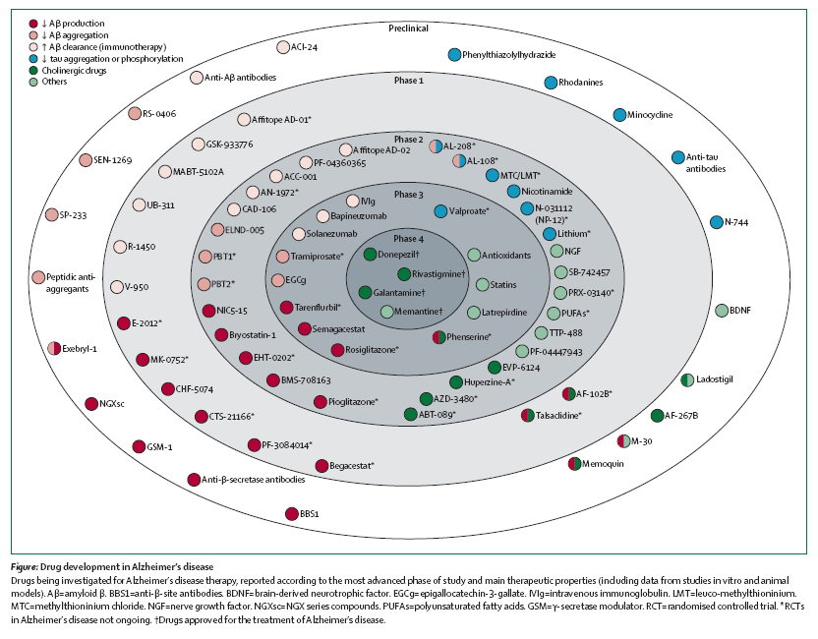
Siloed Exploration …
Mangialasche F et al. Lancet Neurol 2010; 9: 702–16

Slide 45

BARCELONA

Slide 46


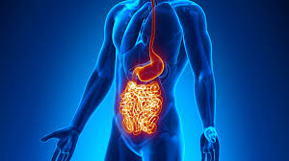

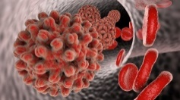
The Road Ahead
Transformation projects
Progress by individual drug developers
New constructs enabling
multiple drug developers
Janssen Crohn’s Platform
Janssen HBV Platform
EU-PEARL
EU-PEARL

Slide 47

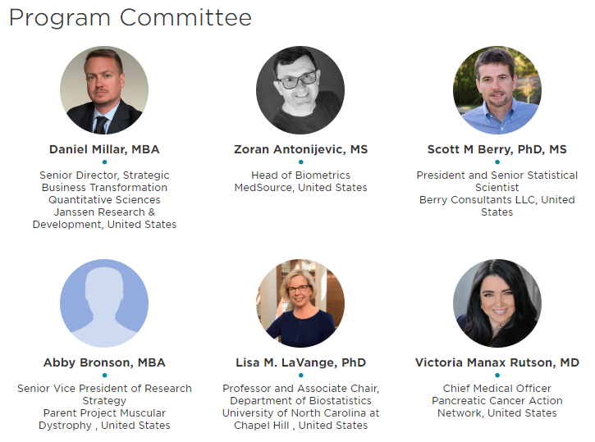
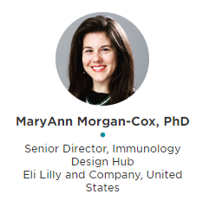
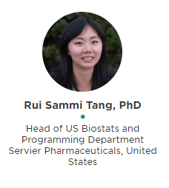
Master Protocol Workshop
October 29-30, 2019, Hyatt Regency Bethesda, MD

Slide 48
IMI EU-PEARL
(Patient-centric clinical trial platforms)
Launching in November
2019
Major Depressive Disorder
Nonalcoholic Steatohepatitis
(NASH)
IMI EU-PEARL (3.5 years)
Design and plan IRPs for four (4) indications
Connect multiple stakeholders: drug developers, academics, hospitals, patient advocates
Deliver a re-useable methodology for IRPs
Tuberculosis
Neurofibromatosis

Slide 49
Integrated Research Platforms
Real World Evidence &
Disease Registries
Platform Trials
Optimized Registration Pathway
Objective: RWE & Registries provide efficient access to:
Understanding natural progression of disease
Data useful to identify predictive clinical biomarkers
Access to cohorts of patients ready to be enrolled in clinical trials
Synthetic controls
Objective: Platform Trial (cross-company) including proof-of-concept (“learn”), Seamless Phase 2/3, and confirmatory for registration increase data generation efficiency:
Patient-centric approach: increase optimal allocation of patients to most promising treatments
Combination opportunity: enable efficient study of combinations across companies
Operational efficacy: increase site performance though standardization and decrease phase transition time
Objective: Optimize the registration pathways to achieve speed and safety³ including:
Faster patient access: covering both the regulatory and heath technology assessment (HTA) review process
Adaptive Pathways: file on early data (surrogate or phase 2); supplement with RWE post approval and simultaneous HTA/HA consultation
“Threshold Crossing⁴”: regulatory pathway for carefully selected products and indications in which RCTs are not feasible
Connected Healthcare System to enable Clinical Research
Objective: Health System infrastructure and regulation to enable clinical trials including pragmatic trials.

Slide 50

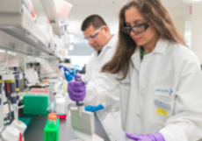




There is value for all stakeholders
Patients
Drug Developers
Regulators
Investigators
Randomization to most promising treatment option
Less probability to receive placebo/SOC
Time¹: answering questions more quickly; fail fast
Cost¹: shared controls
Quality: invested sites
Advance most promising therapies to patients most quickly
Create long-term research opportunity, enabling investment
Match most promising treatment option to each patient
1 Deloitte Insights, September 17, 2018, “Master Protocols: Shifting the drug development paradigm”

Slide 51

Most Important Change Strategy: Patients!
1 Deloitte Insights, September 17, 2018, “Master Protocols: Shifting the drug development paradigm”

Slide 52
Leveraging Master Protocols to Build Local Infrastructure and Technical Capacity

Slide 53
Presentation objectives
Describe current demographic and epidemiological changes in low- and middle-income countries (LMICs) and clinical research in global health
Describe current adoption of master protocols
Discuss how the framework of master protocols can build capacity and infrastructure in LMICs for global health

Slide 54
Growing global population
Trends and projected
population growth: 1950 - 2100
We have made tremendous progress in prevention and treatment of infectious and other communicable diseases for LMIC setting
The global population continues to increase, and growth rates vary greatly across regions
  7.7 billion (2019) → 8.5 billion (2030) → 9.7 billion (2050)
However, rapid population growth combined with demographic and epidemiological changes now present challenges for sustainable development
The UN, World Population Prospects 2019: https://population.un.org/wpp/
Notes:
https://population.un.org/wpp/Publications/Files/WPP2019_10KeyFindings.pdf

Slide 55
Rapid shift from communicable to noncommunicable diseases in LMICs
The disease burden continues to shift from communicable to noncommunicable diseases rapidly in LMICs
These countries, which have the highest population growth, are also the least prepared
Bollyky TJ et al. Health Aff 2017; 36(11):1866-75
Notes:
Health system capacity index - a score based on health service delivery, health work force, health information systems, access to essential medicines, health financing, and leadership/governance

Slide 56

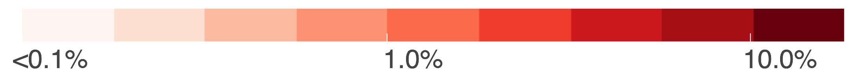
Current efforts for clinical trial research across the globe
% of clinical trials registered from 2010 to 2019
Since 2010, there have been more than 400,000 clinical trials that have been registered globally
Despite the burden of disease being most concentrated in LMICs, there is a major mismatch between clinical trial research efforts
WHO’s International Clinical Trials Registry Platform, http://apps.who.int/trialsearch/

Slide 57
Survey of LMIC trials: Maternal, newborn, and child health research
Questionable methodological quality
Post-hoc power calculations showed these trials had an average power of 23.5%
Average trial duration was ~3.1 years
The majority of trials (67%) investigated only 2 arms
Park JJH et al., JAMA 2019; 2(7)e197871
Notes:
Inefficient designs (i.e. fixed sample trial designs) are most common
Poor planning and considerations for trial location and analyses
Usually conducted for short-term only
Trials are usually conducted in an uncoordinated manner
Arguably, some of global health trials have been conducted without much consideration of local infrastructure and human resources of local staff in LMIC

Slide 58
Current adoption of master protocols

Slide 59
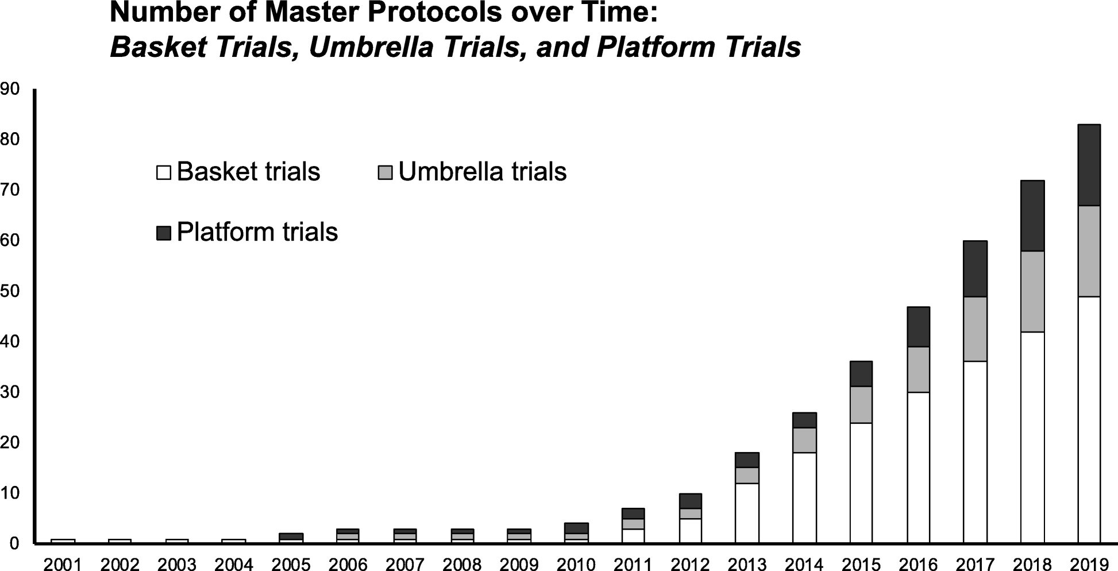
Rising popularity of master protocols
83 master protocols: 49 basket, 18 umbrella, and 16 platform trials
Park JJH et al., BMC Trials 2019; 20(1):1-10
Notes:
83 master protocols identified:
49 basket trials
18 umbrella trials
16 platform trials

Slide 60
Geographic distribution of master protocols
Park JJH et al., BMC Trials 2019; 20(1):1-10

Slide 61
Where are master protocols taking place?
The majority have taken place in the US (n = 44)
  Followed by other high-income countries, such as the UK: (n = 25) and France (n = 23)
No master protocols have been completed in low-income countries
  EBOLA (NCT02380625) trial had been proposed for West Africa (Guinea, Sierra Leone, and Liberia)

Slide 62
Master protocol framework:
Potential (under-rated) benefits
Separate to documented statistical efficiencies that master protocols could bring a conceptual shift toward flexible and scaled trial design, and at the same time, it can provide the following opportunities in LMICs and global health research:
  Improved staff retention and training
  Improved capacity for local research programs
  Improved reactivity to emerging health crises

Slide 63
Brain drain: Shortage of health care providers and researchers in LMICs
Clinicians and researchers often end up staying in high-income countries that they pursued their training in
Both high-quality training and research opportunities are keys to retaining and attracting local talent
Taylor AL et al., NEJM 2011 (365(25):2348-51

Slide 64
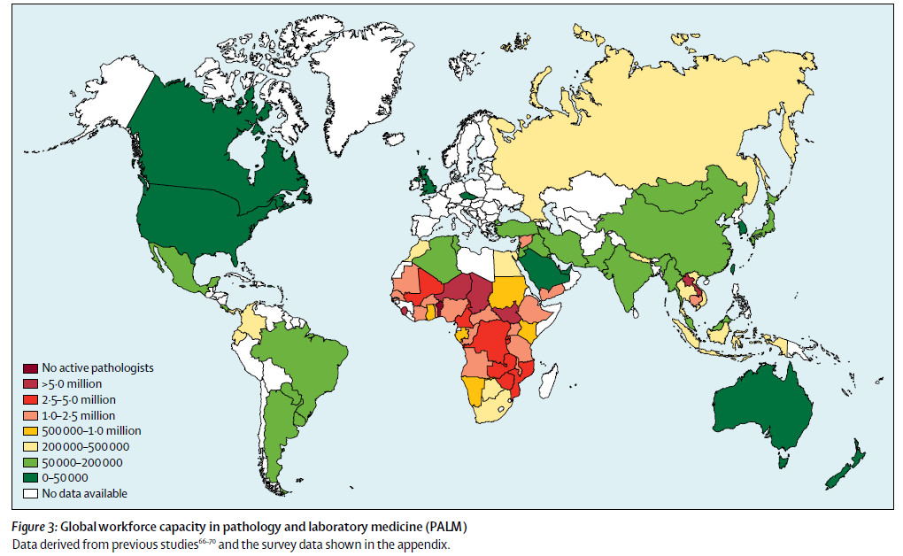
Infrastructure considerations for master protocols in LMICs
Master protocols frequently rely on advanced diagnostic methods, requiring appropriate logistic considerations for sample requirements (e.g. cold chain audit)
For isolated trial projects, the cost of these are prohibitive, and frequently result in outsourced laboratory and supplementary trial resources
Under a master protocol framework, centralized pathology and service provision can create economies of scale and centralize expertise, which could not only improve local infrastructure but also local capacity
Global Pathology and laboratory medicine (PALM) workforce capacity. Numbers are PALM staff per 1,000,000 individuals¹
Wilson et al. Lancet 2018; 391: 1927–38

Slide 65



Website details for UGHE: https://https://ughe.org/
Notes:
Jan 2019 Butaro Rwanda

Slide 66
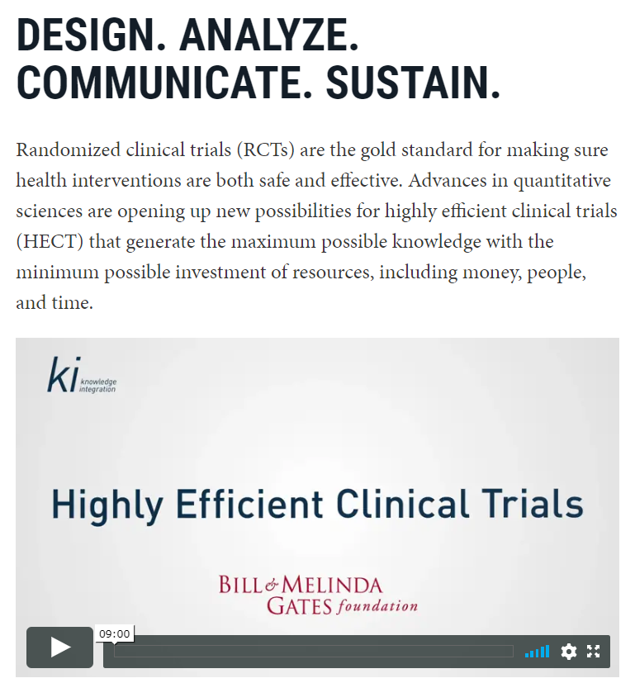
Donor support for improvement of trial methods, local capacity and infrastructure
The Bill and Melinda Gates Foundation (BMGF) has been instrumental in championing advanced clinical trial design methods in LMICs
The BMGF aims to leave a positive footprint by
  Supporting local capacity and infrastructure development
  Creating LMIC STEM jobs over time
  Boosting intra-African partnerships, and more
Website details for Gates Foundation: https://kiglobalhealth.org/hect/

Slide 67
Strategic considerations for master protocols in LMICs
There is a strong imperative to consider LMICs as part of a strategy to unify best practice in master protocols.
Outside of high unmet disease burden, LMICs have unique and diverse characteristics that necessitate highly tailored trial approaches in the most efficient and time responsive manner
  Not all countries and not all people are the same

Slide 68
jpark@mteksciences.com
802-777 West Broadway
Vancouver, BC
V5Z 1J5, Vancouver
+1 604 294 3823
@MTEKSciences
68
(C) 2019 MTEK Sciences Inc. All rights reserved

Slide 69
Group Discussion

Slide 70
Session II: Building Capacity for Innovation
Panelists:
Stacey Adam, FNIH
Mary Redman, Fred Hutchinson Cancer Center
Michelle Detry, Berry Consultants, LLC
Mika Newton, xCures
Ed Connor, I-ACT for Children

Slide 71
PRECISION ONCOLOGY NETWORK
Mika Newton, CEO
FALL 2019

Slide 72
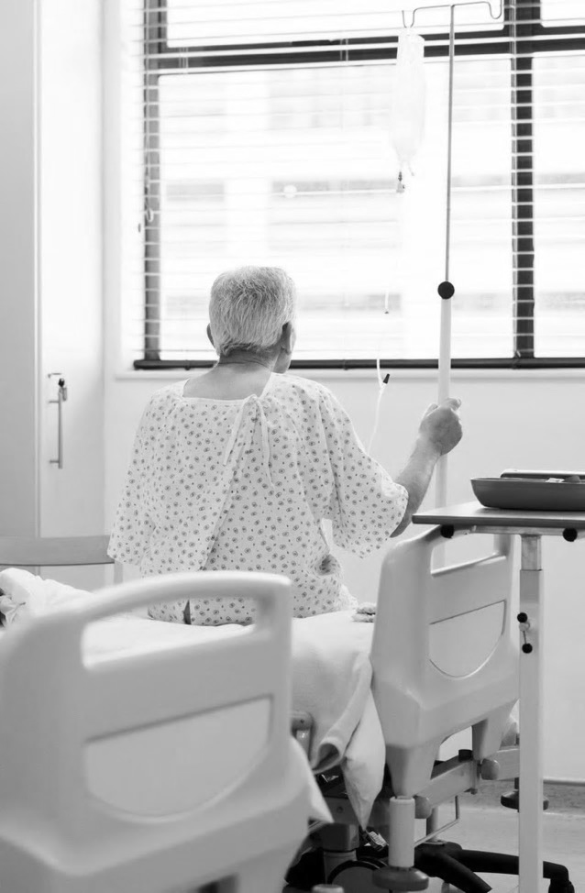
For Advanced Cancer Patients,
Getting the Best Care Is a Nightmare
No one knows the optimal way to treat any cancer,
many patients can’t get or pay for the drugs they need
and treatment outcomes vary widely
Each year thousands die unnecessarily

Slide 74




xCures: A perpetual trial that continuously learns from all patients, all physicians, all therapies, all the time through Creating value an AI-based precision oncology platform that finds novel treatment options, facilitates access, and coordinates across patients to maximize learning. (NCT03793088)
KOLs/VTBs
Rx
CT
A Common Platform Across
Clinical Trials
Physicians/
Health Networks
CT
Rx
Rx
AI Dynamically Allocates Patients and Drugs to Optimize Outcomes
Service Providers
Rx
CT
Insights Shared Across Ecosystem
Rx
Pharma
Rx
Rx
Rx
Rx
Rx
Rx
Rx
Rx
Faster, cheaper development of drugs and tests
Payers pay only for what works
Patients get the best outcomes
Payers
Rx

Slide 75

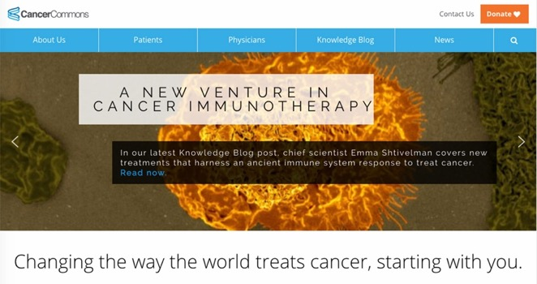
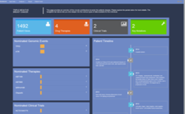



ASK Cancer Commons
RESPECTED NON-PROFIT
Network of world-class physicians and researchers
4,000+ patients who have benefitted from ASK
virtual tumor boards
Multiple peer reviewed publications
American Cancer Society collaborator
4000 patients, 40+ countries
Case
Referral
Patient
and
Physician
Cancer
Network
Partner
Virtual
Tumor
Board
Ranked
Options
for Care
Make
Decision
Capture
Outcome
Notes:
VTB Service but not scalable.

Slide 76







Cancer Commons + xCures
Globally
coordinate
treatment plans
across patients
Case
Referral
Patient
and
Physician
Cancer
Network
Partner
Virtual
Tumor
Board
Ranked
Options
for Care
Make
Decision
Capture
Outcome
Initial Options
Knowledge Base
(options, rationales and outcomes)

Slide 77


xCures Platform: Options, Access and Outcomes
LEARNING FROM ALL PATIENTS. ALL PHYSICIANS. ALL THERAPIES. ALL THE TIME.
SUPPORTING VIRTUAL TUMOR BOARDS
SERVICING PATIENTS
C
Trial enrollment
Expanded access
Reimbursement for approved drugs
O
Knowledge sharing
Decision support
Treatment planning
OPTIONS
ACCESS
O
R
D
I
N
A
OUTCOMES
T
E
TRACKING REAL WORLD EVIDENCE
Master protocol
Data registries

Slide 78



Value for All Stakeholders
Consults with VTB experts; Access to top drugs; Superior Outcomes
PATIENTS
Faster, cheaper trials → approvals, label expansions, compendia listings, Early signals. Salvage drugs abandoned for business reasons.
PHARMA
Improved outcomes. Patient referrals and retention. Access to novel
treatments. Knowledge sharing with peers.
PROVIDERS
Clinical data. Outcomes data. Rapid Investigator Initiated Studies.
RESEARCHERS
Optimize care, defray costs by moving patients into research, and pay only when drugs works. Trusted data for claims adjudication.
PAYERS
Notes:
Started with patients, but get that right, and create Value across the board. (and owning the patients = owning oncology).
Put patient value at center of the system and creates all kinds of new value.
Change the economics, making some things feasilble.
Have a side fund, trade insider information. Spin off Virtual Biotechs if warranted (CollabRx business model).
We create value across ecosystem, all aligned with patient. (by aligning with pt, we can create value across the ecosystem).
If we see signals, lots of ways to monetize. Selll successes to pharma and failures to the payers. (and comparative effectiveness to investors).
Publish papers -> compendia listings.

Slide 79

Institute for Advanced Clinical Trials for Children
Edward Connor, MD, MBE, FAAP
Chairman and Interim Chief Medical Officer
I-ACT for Children
An independent 501(c)3 public-private collaboration launched in 2017 to advance innovative medicines/device development and labeling to improve child health
Addressing the challenges and opportunities in pediatric clinical trials of new medicines/devices
Focus on innovation, efficiency, quality, child-health impact
Early and continuous cross-stakeholder stakeholder engagement, including patients/parents
Scope:
  Strategy/Planning including innovative trial design, feasibility, pediatric program development
  Infrastructure/Trials Execution – 60 pediatric centers, international reach, multidisciplinary experts
  Best Practices – trial readiness, harmonized processes, points of contact
  Thought Leadership – moving the field forward
Funded by membership, FDA U18 grant, donations/philanthropy

Slide 80

Institute for Advanced Clinical Trials for Children
Platform trials represent an important alternative to traditional product development for children and a high priority for I-ACT for Children
Increasing interest by regulators, biopharmaceutical companies, foundations, networks, etc.
Key success factors:
  Program that is “ready for prime time” (pipeline, natural history, endpoints, feasibility, etc.)
  Diverse stakeholder engagement and credible stakeholder value proposition
  Committed leadership and governance
  An entity to serve as master protocol “sponsor” and regulatory interface
  Trial network and infrastructure with regulatory-grade trials expertise and capabilities
  Seed funding and sustainability plan
“Two types of innovation are hallmarks of master protocols: the use of a trial network with infrastructure in place to streamline trial logistics, improve data quality, and facilitate data collection and sharing; and the use of a common protocol that incorporates innovative statistics“
Janet Woodcock, Lisa LaVange, NEJM

Slide 81


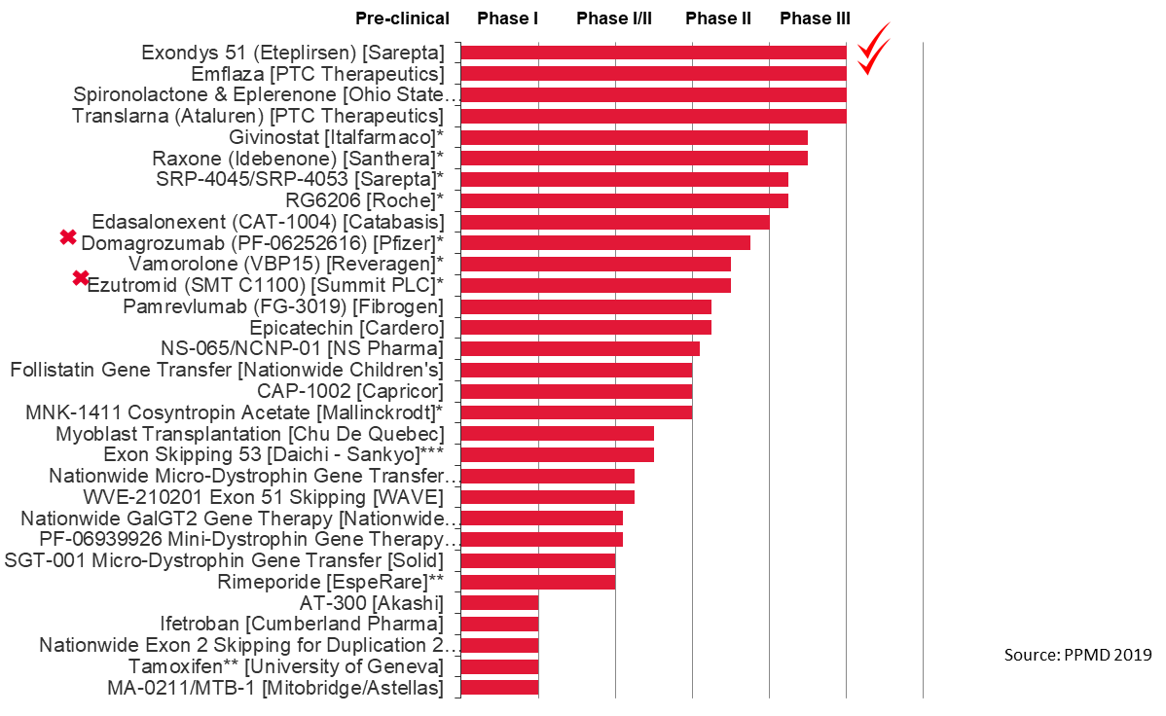
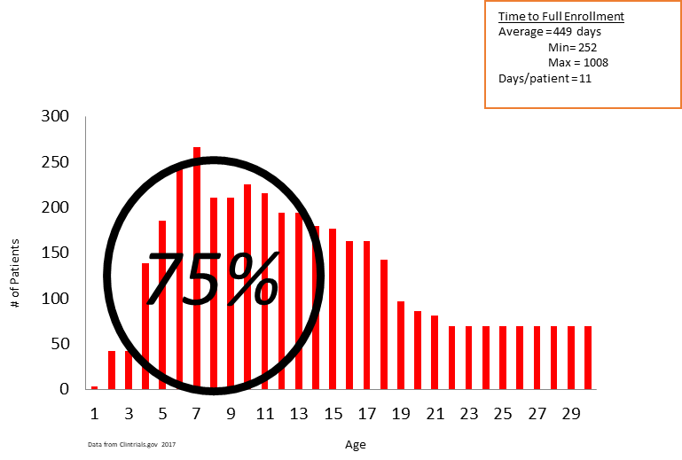
Duchenne Platform Trial
Concept:
  Parent Project Muscular Dystrophy (PPMD) drug development forum
  Critical Path Institute (C-Path) Duchenne Regulatory Science Consortium
  Berry Consultants: design, statistics, analysis planning
  I-ACT for Children: master protocol, roadmap, stakeholders meeting, consortium
Patients Needed by Age (N=3885)
41 studies, Ph 2+,

Slide 82
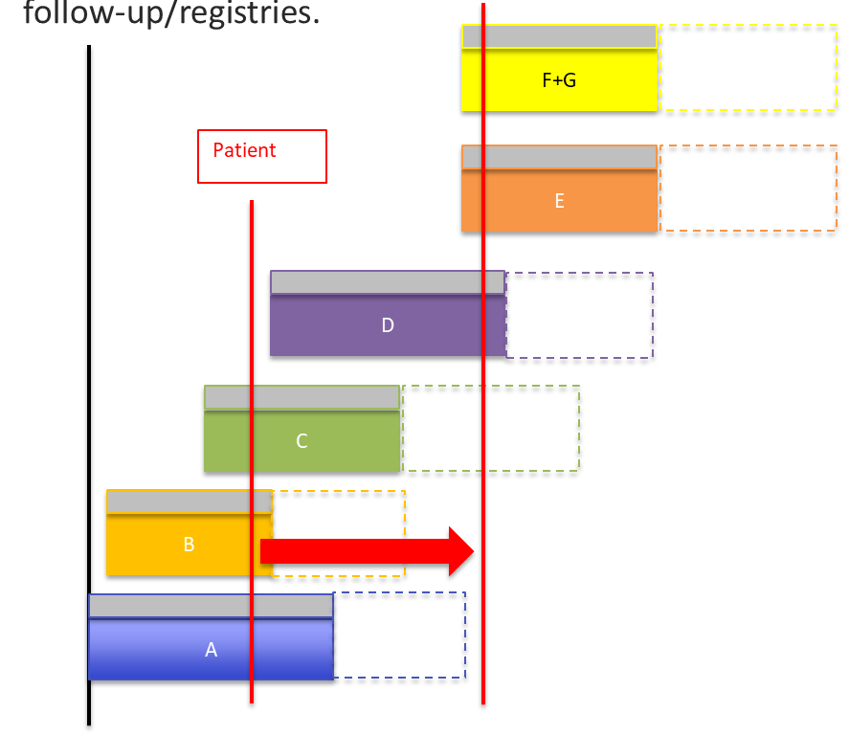
Platform Trial: DMD
Standard patient experience
Standard suite of endpoints
Savings in sample size
Limited placebo exposure
Adaptive
Wider patient inclusion
Standard futility analyses
Decrease time to “decision”
Trial ready sites
Centralized processes
Coordinated regulatory interface

Slide 83




I-ACT for Children: Platform Trial Catalyst
Concept: Idea and initial feasibility (ready for prime time?)
Consortium: Key stakeholders produce essential elements
Master Protocol
Business Plan
Operations Plan
Platform Trial Implementation
“Corporation”: Entity created to implement trial and hold IND

Slide 84

Summary
Platform trials represent an important innovative trial design methodology in the pediatric product development toolkit.
Platform strategy includes scientific, organizational, and financial elements
Plan for registrational use upfront
Don’t start something you can’t finish… Sustainability is essential.

Slide 85
Lunch

Slide 86
Breakout Session Instructions
October 22, 2019
Kimberly Fisher, CTTI
Notes:
NOTE: If your presentation is being recorded, this will be the beginning of the recording, so make it a clean introduction.
EXAMPLE:
Welcome everyone! My name is [insert introducer’s name/title] and it is my pleasure to introduce [insert presentation name].
Today’s presentation is hosted by the Clinical Trials Transformation Initiative, and the speakers today include [insert speaker(s) name/title]
[Insert prepared speaker(s) bios.]

Slide 87
Day 1 Instructions

Slide 88
Breakout Session Brainstorm Goals
Priortiize
ROADBLOCKS
Day 2
Brainstorm
TOOLS
Day 1
Identify Potential
STRATEGIES

Slide 89
Study Development Process
Pre-Planning
Planning
Execution
Notes:
Can include feedback loops around challenges and problem-solving approaches to get to the point of the cyclical, iterative nature of design

Slide 90
Challenges and Problem-Solving Approaches
Pre-Planning
Planning
Execution

Slide 91
Roadmap Goals
Demystify critical design & operational aspects of master protocol studies
Provide diverse stakeholders with problem solving approaches to address key roadblocks

Slide 92
What Makes a Good Strategy?
Targeted:
  Driven by a well-defined problem
  Responds to the needs of a specific stakeholder group
  Consider of less experienced groups
Flexible:
  Can respond to the cyclical, iterative nature of some roadblocks
  Scalability (can be applied at a small scale or a large scale)
Feasible:
  Target stakeholder group has the capacity to implement the strategy

Slide 93
Strategy Scope
Changing “Hearts and Minds”
Broad capacity building
Enterprise-
Level
NUTS AND BOLTS:
How do we get it done?
Study-
Level

Slide 94
Tool Scope
TOOL:
Forum for international regulatory agencies to discuss using master protocol studies in diverse therapeutic areas
Enterprise-
Level
TOOL:
Regulator Communications Toolkit
Study-
Level

Slide 95
Day 1 Breakout Sessions
Blue Group:
Pre-Planning
Yellow Group:
Planning
Green Group:
Execution
Facilitator:
Jane Perlmutter,
Gemini Group
CTTI Staff:
Annemarie Forrest
Room:
Crystal II
Facilitator:
Marianne Chase,
Mass General
CTTI Staff:
Kimberly Fisher
Room:
Crystal III
Facilitator:
Roger J. Lewis,
Berry Consultants, LLC
CTTI Staff:
Laura Shannon
Room:
Crystal IV

Slide 96
Breakout Session Recap: Day 1
10.22.2019
Kimberly Fisher, CTTI
Notes:
NOTE: If your presentation is being recorded, this will be the beginning of the recording, so make it a clean introduction.
EXAMPLE:
Welcome everyone! My name is [insert introducer’s name/title] and it is my pleasure to introduce [insert presentation name].
Today’s presentation is hosted by the Clinical Trials Transformation Initiative, and the speakers today include [insert speaker(s) name/title]
[Insert prepared speaker(s) bios.]

Slide 97
Pre-Planning Breakout Session 1
October 22nd, 2019
Jane Perlmutter, Gemini Group
Notes:
NOTE: If your presentation is being recorded, this will be the beginning of the recording, so make it a clean introduction.
EXAMPLE:
Welcome everyone! My name is [insert introducer’s name/title] and it is my pleasure to introduce [insert presentation name].
Today’s presentation is hosted by the Clinical Trials Transformation Initiative, and the speakers today include [insert speaker(s) name/title]
[Insert prepared speaker(s) bios.]

Slide 98
Strategy 1 – Mission clarity and creep
Prioritized roadblock:
  What is the problem?
    Mission must be clear and of a defined scope
  Which stakeholder groups are the most affected by this roadblock?
    Initiator of the master protocol
Example of effective problem-solving approach:
What strategic action should be taken to proactively address this roadblock?
  Identify the desired end-state and what you need to achieve desired end-state
  Identify value proposition r/t mission statement for each SH and then reconcile among SHs
  Be realistic about resources needed to complete these first steps
SH=Stakeholder
Notes:
When identifying mission, assumes unmet medical need, assumes there are resources available to complete these early preplanning steps.
Guides what type of MP should you use? Who are the right collaborators?
Mission statement should be clear enough that we know what we are funding in the next phase.

Slide 99
Strategy 2 – Leadership/building a team
Prioritized roadblock:
  What is the problem?
    An effective leadership team is critical for success
Example of effective problem-solving approach:
  articulation of necessary skill sets and expertise and stakeholders (passion, motivate others, time, fair, decision with incomplete info)
What strategic action should be taken to proactively address this roadblock?
  Identify and bring to table necessary contributors, understanding their specific skill sets and motivations to participate
Notes:
Leader should think about the overall success of the master protocol (needs of the program) rather than the benefit to any specific individual stakeholder
Must be able to get individual stakeholders to cede some control
Comfortable making uncomfortable (but perceived as fair) decisions – fair and transparent decision-making

Slide 100
Planning Breakout Session 1
October 22nd, 2019
Marianne Chase, Massachusetts General Hospital
Notes:
NOTE: If your presentation is being recorded, this will be the beginning of the recording, so make it a clean introduction.
EXAMPLE:
Welcome everyone! My name is [insert introducer’s name/title] and it is my pleasure to introduce [insert presentation name].
Today’s presentation is hosted by the Clinical Trials Transformation Initiative, and the speakers today include [insert speaker(s) name/title]
[Insert prepared speaker(s) bios.]

Slide 101
Planning Breakout Session 1 Objectives
Provide feedback on CTTI’s high-level roadmap
(will focus today’s conversation on Planning)
Prioritize key roadblocks
Develop strategies to address key roadblocks

Slide 102
Breakout Session Ground Rules
Listen actively and respectfully
Give everyone the opportunity to share their ideas
Recognize that there will be disagreement:
  To maximize the benefit of collaborating,
  you need to diverge before you converge
  Team members with minority perspectives should
  be given the opportunity to speak up
  Criticize ideas, not people

Slide 103
Breakout Session Introductions
Name, affiliation
What will change if we do not increase the use of master protocol studies in diverse therapeutic areas?

Slide 104
CTTI High-Level Roadmap:
Planning

Slide 105
Planning Deliverables: Design
Refine study hypothesis and objectives
For studies that use an adaptive trial design,
simulation-guided clinical trial design is required to
establish the operating characteristics of the trial
Develop plan for pre-planned adaptations

Slide 106
Planning Deliverables: Operations
Develop clinical trial management systems that are flexible and integrated (e.g., web-based randomization system
Establish implementation logistics for the statistical analysis plan:
  Ongoing data collection
  Timely implementation of pre-specified interim analysis
Budget and contracting
  Clarify:
    Who owns the data, especially data in the placebo arm.
      Rights to use or license
      Balance patient-centered considerations regarding data sharing and access with the need to preserve proprietary information.

Slide 107
Planning Deliverables: Operations
Develop site network:
  Assess fit, feasibility and training needs
Identify vendors:
  Assess fit, feasibility and training needs
Establish criteria and centralized process for investigational medical product selection
Develop governance structure

Slide 108
Planning Deliverables:
Multi-Stakeholder Engagement
Regulatory engagement
  FDA:
    Agency wants early and frequent interaction.
  International Regulatory Engagement
    Clarify differences in global regulatory approaches.
    Identify available guidance to help identify what these differences may be.
IRB engagement and education
Engagement of sponsors, disease experts and the patient community in decision-making processes related to protocol design and governance

Slide 109
Planning Roadblocks: Design
Reaching consensus on key design requirements requires significant time and engagement of multiple stakeholders:
  Alignment on key assumptions
  Evaluation of design features tested in statistical simulations.
  Ability to respond to and resolve competing pressures (e.g. time, budget, risk)
Impact of future “regimens”/ appendices can be difficult to identify early on, so may require future amendment to the master protocol

Slide 110
Planning Roadblocks: Operations
Establishing a qualified network of sites
Identifying vendors (central laboratories, pharmacies, etc.) with appropriate experience with master protocols
  Key considerations for a platform trial:
    Perpetual nature of platform trials can make it difficult to get accurate quotes
    Ability to process samples in a timeline (sometimes real-time) manner versus batching samples
Difficulty identifying a CRO with sufficient experience.
Funding can often be an impediment as the eventual cost of the trial is substantial.

Slide 111
Group Feedback
Key deliverables:
  What have we captured well?
  What should we expand upon?
Key roadmap:
  What have we captured well?
  What should we expand upon?

Slide 112
Prioritizing Roadblocks

Slide 113
Group Questions
Which roadblocks are the most disruptive to progress during the planning stage of a master protocol?
How do these roadblocks undermine successful trial execution?
How do different stakeholder groups (e.g., patients, providers, study sites, sponsors) experience this roadblock?

Slide 114
Strategy Development Group Exercise

Slide 115
Strategy Development
Discussion Prompts
Prioritize the roadblock
  What is the problem?
  Which stakeholder groups are the most effected by this roadblock?
How has your organization successfully addressed this problem?
What strategic action should be taken to proactively address this roadblock prior to study execution?

Slide 116
Report-Out Preparation

Slide 117
Are Our Strategies Study-Level or Enterprise-Level?
Study-
Level
Enterprise-
Level
NUTS
AND BOLTS:
How do we get
it done?
Changing
“Hearts and Minds”
Broad capacity building

Slide 118
Does Our Strategy Fit This Criteria?
Targeted:
  Driven by a well-defined problem
  Responds to the needs of a specific stakeholder group
  Consider of less experienced groups
Flexible:
  Can respond to the cyclical, iterative nature of some roadblocks
  Scalability (can be applied at a small scale or a large scale)
Feasible:
  Target stakeholder group has the capacity to implement the strategy
Notes:
Early adopter…

Slide 119
Small Group Report Out

Slide 120
Strategy 1
Prioritized roadblock:
  What is the problem? Reaching consensus on key design requirements requires significant time and engagement of multiple stakeholders.
Which stakeholder groups are the most affected by this roadblock? All stakeholder groups (e.g. patient advocacy groups, interventional arm owner, key opinion leaders) are impacted, it is critical the think through unique barriers to achieving consensus that are relevant to each stakeholder group
Example of effective problem-solving approach: Have a structured consensus-building process…one example is having an intensive face-to-face design strategy meeting that engages champions and key decision makers
  Multiple diseases, or multiple investigational products
What strategic action should be taken to proactively address this roadblock? Making sure key decision makers have appropriately gotten feedback from all relevant stakeholders, but note that a “design-by-committee” approach may not be feasible

Slide 121
Strategy 1
Prioritized roadblock:
  What is the problem?
    Identifying qualified vendors for the trial
  Which stakeholder groups are the most affected by this roadblock?
    Non-traditional drug developer (e.g. nonprofit)
Example of effective problem-solving approach:
  Create criteria for assessing vendor qualifications
  Need to balance utilizing preferred vendors with vendors who have master protocol experience
What strategic action should be taken to proactively address this roadblock?
  Consider RFI/RFP process

Slide 122
Study Execution Breakout Session 1
October 22, 2019
Roger J. Lewis, Berry Consultants, LLC

Slide 123
Planning Breakout Session 1 Objectives
Provide feedback on CTTI’s preliminary roadmap
(will focus today’s conversation on Planning)
Prioritize key roadblocks
Develop strategies to address key roadblocks

Slide 124
Breakout Session Ground Rules
Listen actively and respectfully
Give everyone the opportunity to share their ideas
Recognize that there will be disagreement:
  To maximize the benefit of collaborating,
  you need to diverge before you converge
  Team members with minority perspectives should
  be given the opportunity to speak up
  Criticize ideas, not people

Slide 125
Breakout Session Introductions
Name, affiliation
What will change if we do not increase the use of master protocol studies in diverse therapeutic areas?

Slide 126
CTTI High-Level Roadmap:
Study Execution

Slide 127
Deliverables: Design
Update weighted randomization probabilities
Conduct additional simulations to support decision making
Monitor accrual rates, subgroup prevalence, & other statistical assumptions

Slide 128
Deliverables: Operations
Maintain consistency between sub studies
Ensure appropriate tracking & communication b/w different databases
Constant tracking of data availability & quality to facilitate speed of data analysis
DMC needs to balance fidelity to the original design;
also continue to assess the scientific & ethical appropriateness of that design
Ongoing education & training of the sites on infrastructure
& data collection requirements
Notes:
Original slide text:
Maintain consistency between sub studies
Ensure appropriate tracking and communication between the different databases utilized for the trial
Constant maintenance and tracking of data availability and quality to facilitate speed of data analysis
Data monitoring committee needs to balance fidelity to the original design while continuing to assess the scientific and ethical appropriateness of that design
Ongoing education and training of the sites on the infrastructure and data collection requirements of the trial

Slide 129
Deliverables:
Multi-Stakeholder Collaboration
Continue to maintain & cultivate relationships with broad stakeholder groups
Articulate the value proposition of the trial to new potential partners & sponsors

Slide 130
Roadblocks: Design
Changes in standard of care
Changes in laboratory assay

Slide 131
Roadblocks: Operations
Data availability: balancing need for speed, with a need for quality
Information firewalls: who knows what when?
Limited flexibility within SOPs: produces structural and procedural barriers to supporting the successful execution of a master protocol trial

Slide 132
Roadblocks:
Multi-Stakeholder Engagement
Each new intervention added to the trial will re-introduce stakeholder engagement challenges experienced in planning stages
Publication of partial results and the impact on ongoing investigation

Slide 133
Group Feedback
What are the key deliverables that we should highlight in the roadmap?
  What have we captured well?
  What should we expand upon?
What are key roadblocks that we should highlight in the roadmap?
  What have we captured well?
  What should we expand upon?

Slide 134
Prioritizing Roadblocks

Slide 135
Group Questions
Which roadblocks are the most disruptive to a master protocol study’s progress at the planning stage?
How do these roadblocks undermine successful trial execution?
How do different stakeholder groups (e.g., patients, providers, study sites, sponsors) experience this roadblock?

Slide 136
Strategy Development Group Exercise

Slide 137
Strategy Development
Discussion Prompts
Prioritize the roadblock
  What is the problem?
  Which stakeholder groups are the most effected by this roadblock?
How has your organization successfully addressed this roadblock?
What action can we take to mitigate the impact of the roadblock?

Slide 138
Report-Out Preparation

Slide 139
Does Our Strategy Fit This Criteria?
Targeted:
  Driven by a well-defined problem
  Responds to the needs of a specific stakeholder group
  Consider of less experienced groups
Flexible:
  Can respond to the cyclical, iterative nature of some roadblocks
  Scalability (can be applied at a small scale or a large scale)
Feasible:
  Target stakeholder group has the capacity to implement the strategy
Notes:
Early adopter…

Slide 140
Are Our Strategies Study-Level or Enterprise-Level?
Study-
Level
Enterprise-
Level
NUTS
AND BOLTS:
How do we get
it done?
Changing
“Hearts and Minds”
Broad capacity building

Slide 141
Small Group Report Out

Slide 142
Strategy
Monitoring Reports
External Events
Decision-Making Body
All stakeholders
At least 1 independent
Approvals & Oversight

Slide 143
Large Group Discussion

Slide 144
Large Group Discussion Questions
What are the goals that CTTI should focus on that could advance the development of master protocol studies?
  Study-level goals
  Enterprise-level goals
What are the strategies to achieve these goals?

Slide 145
Notes:
Please consider connecting with us on any of these social platforms!

