Slide 1
Improving Qualification of Investigators
Once you’ve logged into WebEx, please select one of the following audio options:
Call Using Computer
I Will Call In (please enter the ID number provided by WebEx)
DO NOT SELECT the “Call Me” option.
This webinar is being recorded.
All participants are muted upon entry.
Once you are connected through WebEx, you can use the mute & unmute symbols that appear to the right of your name.
Questions will be taken following the presentation via the chat box. Please indicate that you have a question by typing in the chat box “To Everyone.”

Slide 2
Improving Qualification of Investigators
November 15, 2018

Slide 3
Disclaimer
The views and opinions expressed in this presentation are those of the individual presenter and do not necessarily reflect the views of the Clinical Trials Transformation Initiative.

Slide 4
Agenda
Introduction to CTTI
Pamela Tenaerts, CTTI
Investigator Qualification Project
Sabrina Comic-Savic, The Medicines Company
Project Recommendations & Tools
Jimmy Bechtel, Society for Clinical Research Sites
Kate Haratonik, Genentech—a member of the Roche Group
Discussion

Slide 5
An Introduction to CTTI
Pamela Tenaerts, CTTI

Slide 6
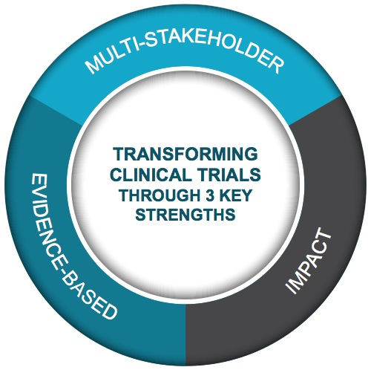

CTTI Strengths
Public-Private Partnership
Co-founded by Duke University & FDA
Involves all stakeholders
80+ members
MISSION: To develop and drive adoption of practices that will increase the quality and efficiency of clinical trials

Slide 7

CTTI Membership

Slide 8
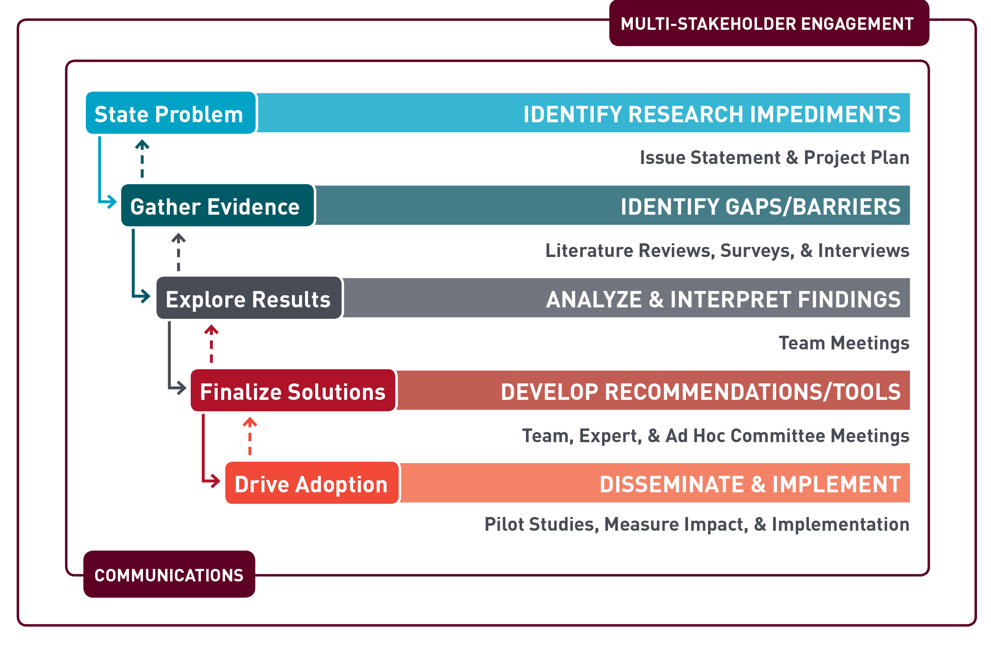
CTTI Methodology

Slide 9
Project Portfolio
Areas of Strategic Focus: | SYSTEMATIC EVIDENCE GENERATION | PATIENTS AS EQUAL PARTNERS | EFFICIENT & QUALITY TRIALS | PUBLIC HEALTH CONCERN | SAFE & ETHICAL TRIALS
Active Projects: | MCT Engaging Patients and Sites Real World Evidence State of Clinical Trials | Patient Groups & Clinical Trials | Investigator Qualification | ABDD HABP/VABP Studies
Complete Projects (now driving adoption): | Large Simple Trials MCT Decentralized Clinical Trials MCT Mobile Technologies MCT Novel Endpoints Registry Trials |  | GCP Training Investigator Community Monitoring Quality by Design Recruitment Site Metrics | ABDD Peds Trials ABDD Streamlining HABP/VABP Trials ABDD Unmet Need Long-Term Opioid Data | Single IRB, Single IRB Adv DMCs Informed Consent Pregnancy Testing IND Safety, IND Safety Adv SAE Reporting

Slide 10
Thank You!
Team Leaders | Team Members
Jimmy Betchel (SCRS) Sabrina Comic-Savic (The Medicines Company) Kristen Miller (FDA-OMP) Janette Panhuis (PHRI) Suzanne Pattee (FDA-DCTQ) Ronnie Todaro (Parkinson’s Foundation) | Christina Brennan (Northwell Health) Tina Chuck (Northwell Health) David Ciavarella (CR-BARD) Catherine Dillon (MUSC) Bridget Foltz (FDA-OGCP) Kathy Goldstein (Regeneron) Kate Haratonik (Genentech-Roche) Christine Hildebrand (Amici CR) Patricia Hurley (ASCO) Jim Kremidas (ACRP) Emily Lemons (PMG) Rob Mentz (Duke) Jean Mulinde (FDA-OSI) Natasha Phrsai (Northwell Health)
Project Managers
Jen Goldsack (CTTI), Kirsten Wareham (CTTI)
Social Science Lead
Teri Swezey (CTTI)
EC Champion
Dalvir Gill (TransCelerate)
As well as additional experts and leaders across the clinical trials enterprise,
including patients and other stakeholders

Slide 11
Investigator Qualification Project
Sabrina Comic-Savic, The Medicines Company

Slide 12
The Challenge and CTTI’s Solution
FDA regulations state that sponsors are responsible for “selecting investigators qualified by training and experience”
Challenge: A more efficient and effective means of identifying whether investigators and their delegates (site teams) are qualified is needed
New CTTI recommendations outline how to confirm that site teams are qualified while also reducing inefficiencies in training and better preparing for the quality conduct of clinical trials

Slide 13
Common Clinical Investigator Deficiencies*
Little evidence that GCP training alone sufficiently qualifies investigators
Most common deficiencies noted during investigator inspections are directly related to GCP principles:
Failure to follow the investigational plan/agreement and/or regulations
Inadequate accountability for the investigational product
Inadequate communication with the IRB
Inadequate recordkeeping
30 years of GCP training has not fixed these issues
* Clinical Investigator (CP 7348.811) deficiencies identified in FDA Form 483 issued at close of inspections.
https://www.fda.gov/downloads/ScienceResearch/SpecialTopics/RunningClinicalTrials/UCM604510.pdf

Slide 14
A Culture Change is Needed
Eliminate the distinction between “qualification” and “preparation”
A successful shift depends on:
Investigators and their delegates assuming greater ownership of their qualification
Sponsors and CROs accepting documentation of relevant education and experience as evidence of qualification
If investigators are appropriately prepared for a trial, then they are qualified to conduct it

Slide 15
What Does Investigator Success Look Like?
Investigator Qualification
Investigator Community
Quality by Design (QbD)
Study Design & Conduct to Facilitate Investigator Success
Qualification Beyond GCP Training
Successful Investigators
Necessary Support & Infrastructure

Slide 16
Recommendations & Tools
Kate Haratonik, Genentech—a member of the Roche Group
Jimmy Bechtel, Society for Clinical Research Sites

Slide 17
Recommendations Summary
Quality Conduct by Design
Expand qualification beyond GCP training
Identify the unique learning requirements of each trial
Take a targeted approach to being qualified
Improve Educational Programming
Create educational programming with adult learners in mind, taking into account individual study roles
Specific, actionable recommendations are provided to both 1) Sponsors and CROs, and 2) Investigators and their delegates

Slide 18
Expand Qualification Beyond GCP Training
Recognize the limits of GCP training; turn qualification from a “check-box-activity” to a valuable learning opportunity
GCP alone is unlikely to either:
Adequately prepare an inexperienced member of a site team, or
Add value to the practice of an experienced researcher

Slide 19
Expand Qualification Beyond GCP Training
For Sponsors and CROs | For Investigators and Their Delegates
Move away from repetitive GCP training as the one-size-fits-all approach to qualifying. Develop training that is tailored to your protocol and the members of your site teams. | Recognize that GCP training in isolation is insufficient to prepare for the quality conduct of a clinical trial Evaluate your site team’s preparedness to conduct clinical research before seeking selection as a trial site. Use CTTI’s framework of characteristics resource.

Slide 20
Identify Unique Learning Requirements
The knowledge, skills, and experience required site teams will vary with each trial
Different study phases, disease states, protocol designs, study participant populations, and clinical settings guide unique requirements

Slide 21
Identify Unique Learning Requirements
For Sponsors and CROs | For Investigators and Their Delegates
Provide the completed or draft protocol to potential site teams at the beginning of the site selection process. Invite feedback to address feasibility issues up front. Complete thorough pre-study visits. | Request the full protocol when you are contacted about a trial. Assess whether you/your delegates are adequately qualified. Discuss your assessment findings openly with the sponsor to close any gaps in preparedness.

Slide 22
Take A Targeted Approach
A targeted, risk-based approach to being qualified involves:
Identifying potential high risks in protocol execution, and
Focusing targeted, applied learning solutions toward these high-risk areas.
Risk analyses should consider:
Potential challenges associated with a given protocol, and
Reflect the most common deviations experienced by site teams on similar protocols.

Slide 23
Take A Targeted Approach
For Sponsors and CROs | For Investigators and Their Delegates
Critically evaluate the skills, knowledge, and experience of site teams before: site selection and formulation of learning requirements. Discuss your evaluation of the site openly with investigators. | Consider your performance on past protocols to develop policies, procedures, or educational programming to improve the conduct of future studies. Share your findings with sponsors and CROs during the site selection process to guide effective preparation of the site team.

Slide 24
Improve Educational Programming
Create training with adult learners in mind, taking into account individual study roles
Educational programming should focus on the learning requirements of the specific trial and address the gaps in knowledge and skills
Active learning encompasses a broad range of formal and informal approaches
Training is one type of learning that imparts information through a structured, learner-centered approach with measurable outcomes

Slide 25
Improve Educational Programming: Site-based learning activities may include:
Mentoring
Job-shadowing
Virtual or in-person knowledge-sharing networks
Mock run-throughs of study participant visits and protocol procedures

Slide 26
Improve Educational Programming
For Sponsors and CROs | For Investigators and Their Delegates
Recognize the value of non-traditional learning approaches. Accept documentation of (1) previous relevant training and (2) application of knowledge and skills as evidence of qualification. Define gaps in knowledge and skills. Create role- and protocol-specific education goals. Recognize that different site team members may benefit from different types of education. | Consider how to best meet your learning goals. Seek out educational offerings that meet content-specific learning goals and suit individual learning styles Encourage a mentoring program Document learning activities to serve as a record demonstrating your qualification for the conduct of clinical trials.

Slide 27
Resources and Tools
Framework of Characteristics of a Qualified Site Team: How Does Yours Measure Up?
Documenting Qualification: A Quick Reference Guide for Investigators & their Delegates
Documentation Template
Resources for Training & Learning (Appendix 1)
Mentoring & Knowledge-Sharing Examples (Appendix 2)

Slide 28
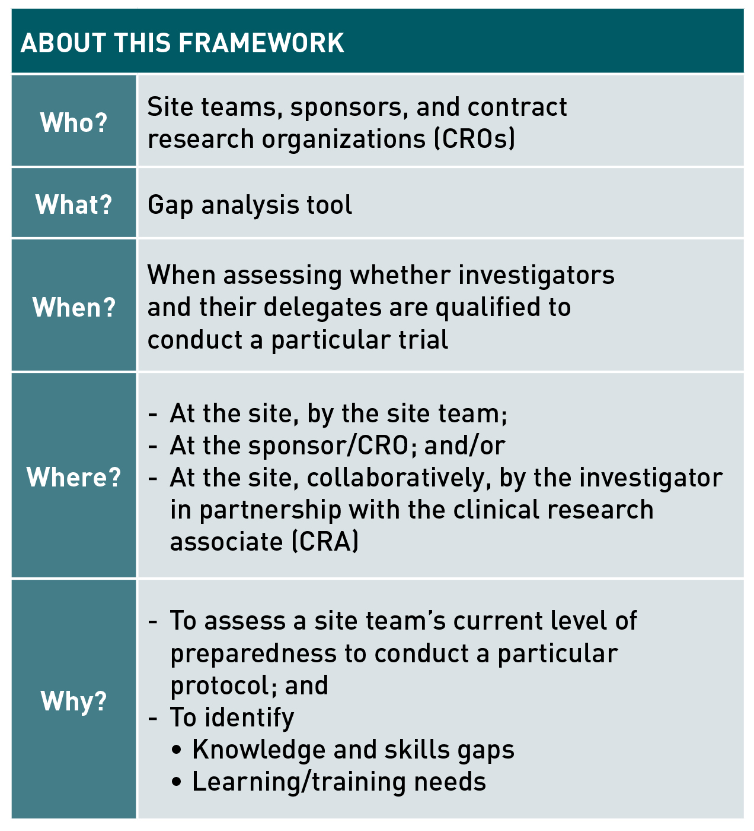
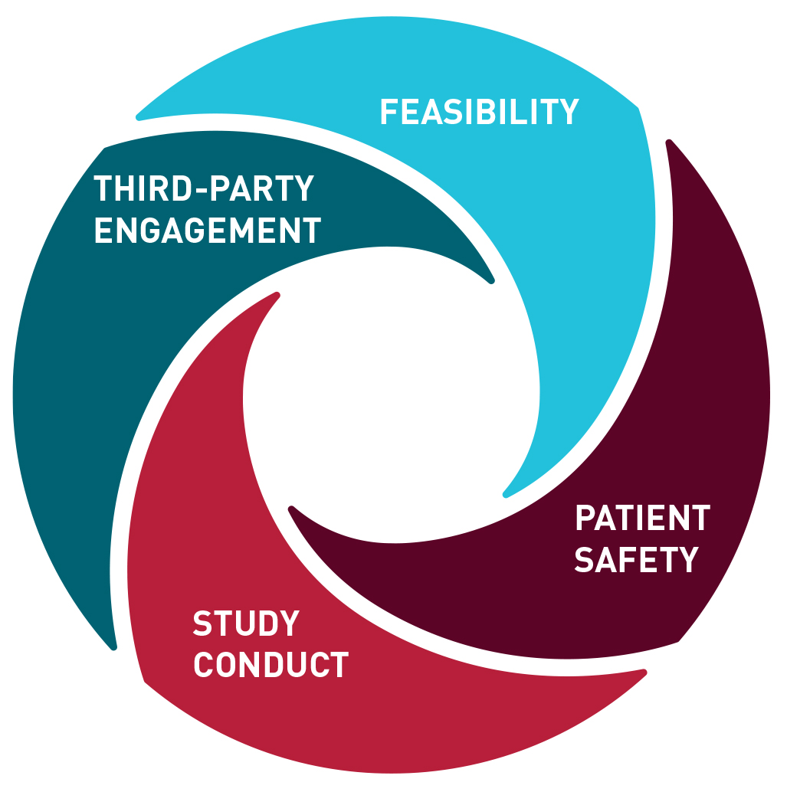
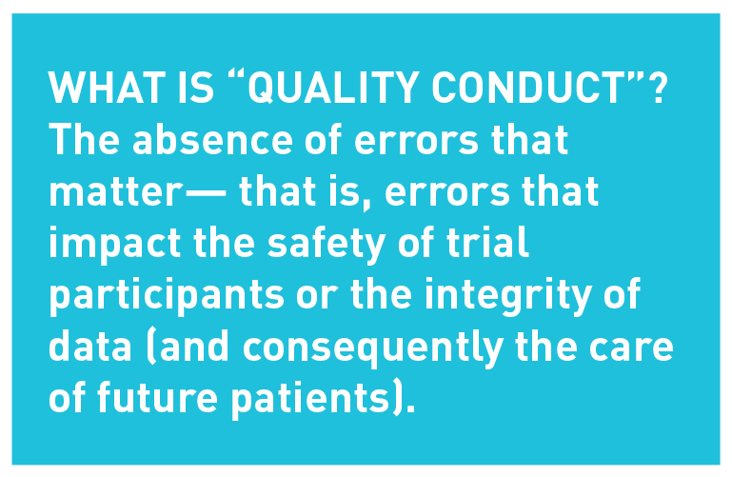
Framework of Characteristics of a Qualified Site Team

Slide 29
Documenting Qualification: A Quick Reference Guide
Sponsors, CROs, and site teams should assume greater control of qualification
Support the transfer of experience between trials while maintaining a record of qualification activities in a single document
This will allow sponsors, CROs, and site teams to
Focus on addressing protocol-specific gaps in preparedness
Improve study execution
Eliminate redundant training

Slide 30
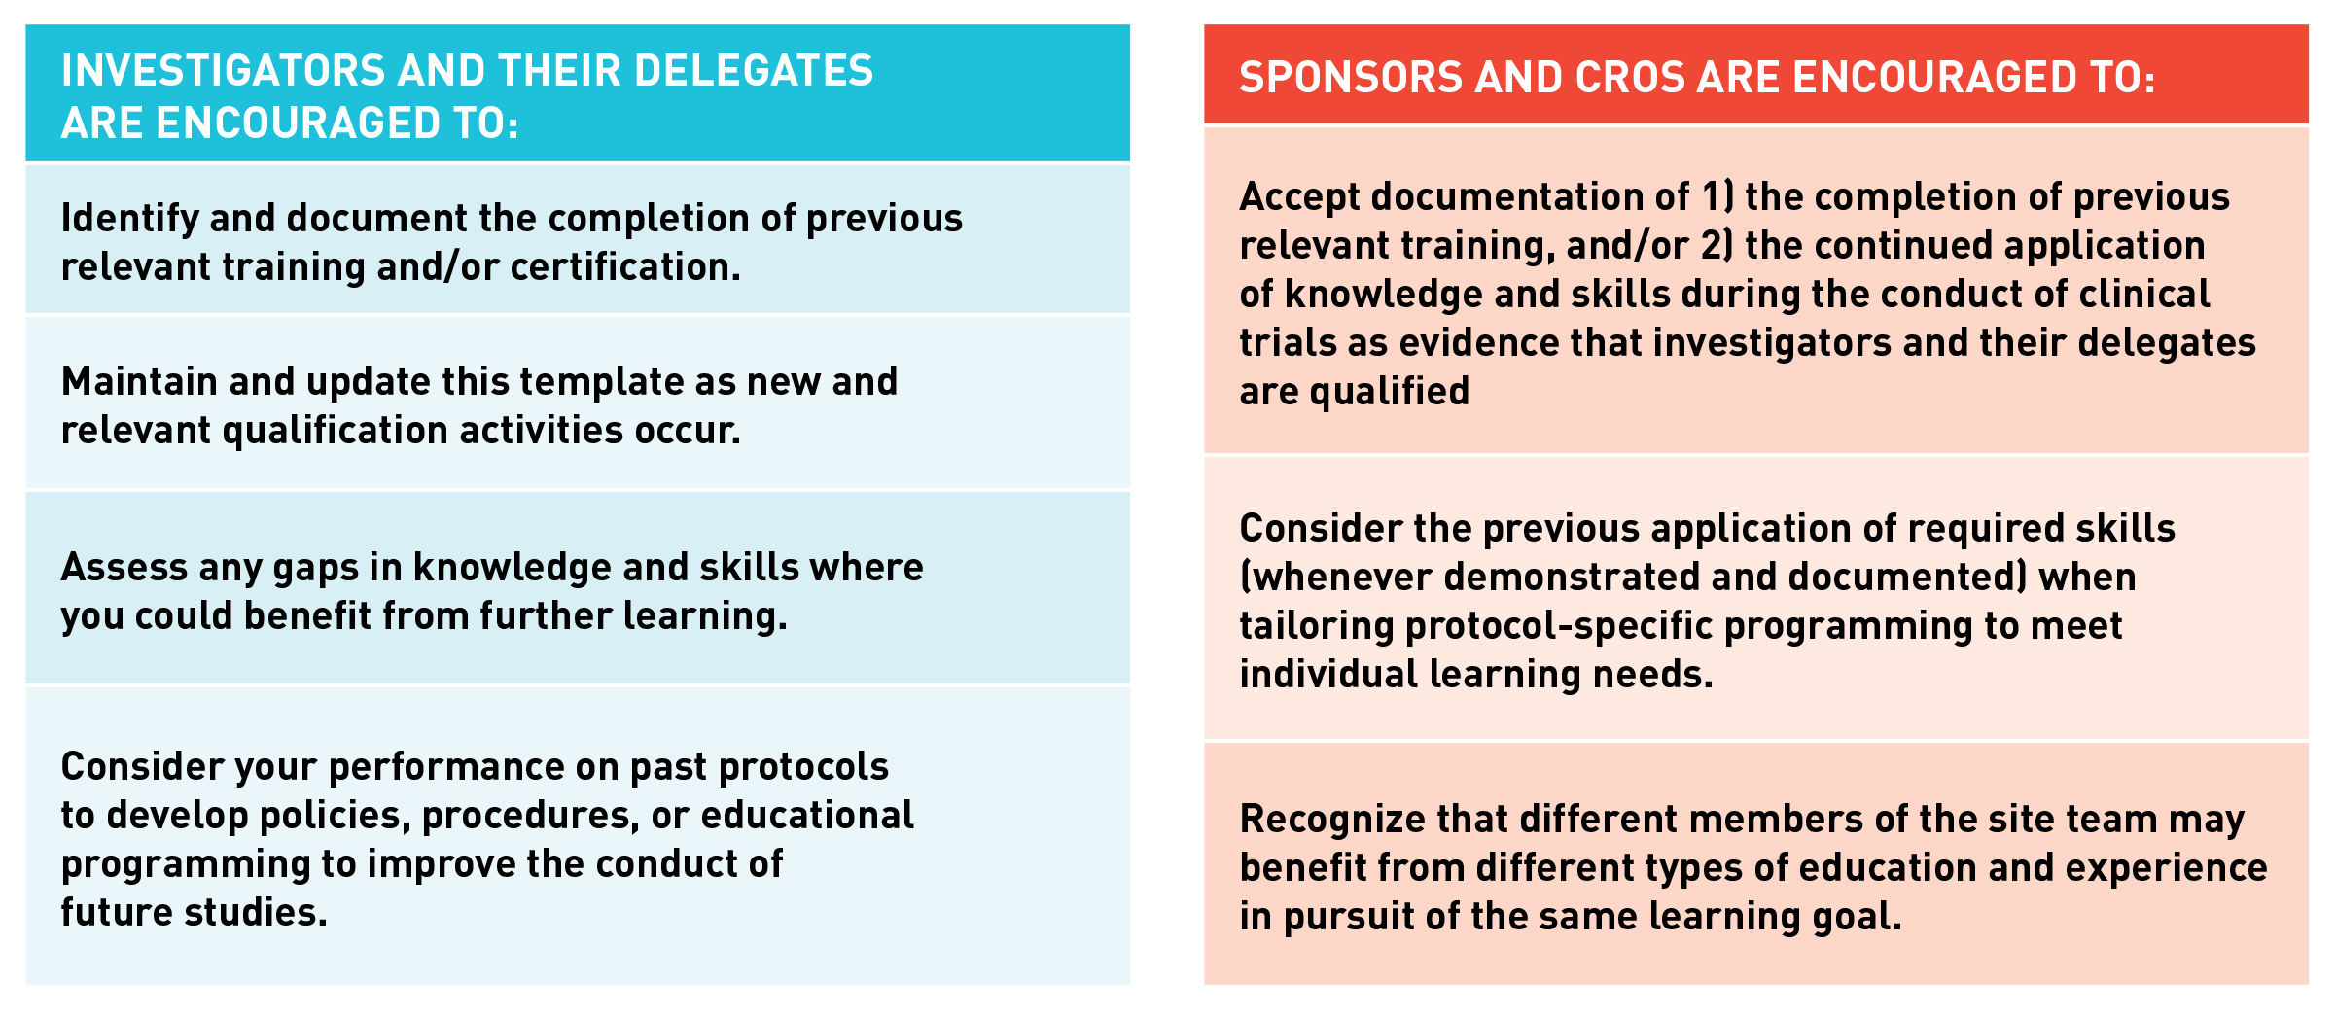
Documenting Qualification Template
Qualification activities are any relevant learning activities that develop your experience, knowledge, skills, or expertise

Slide 31
Resources for Training & Learning: Appendix 1
Inventory of training, learning, and certification opportunities for site teams
Over 100 opportunities listed
Free and paid opportunities
Online and in-person opportunities

Slide 32
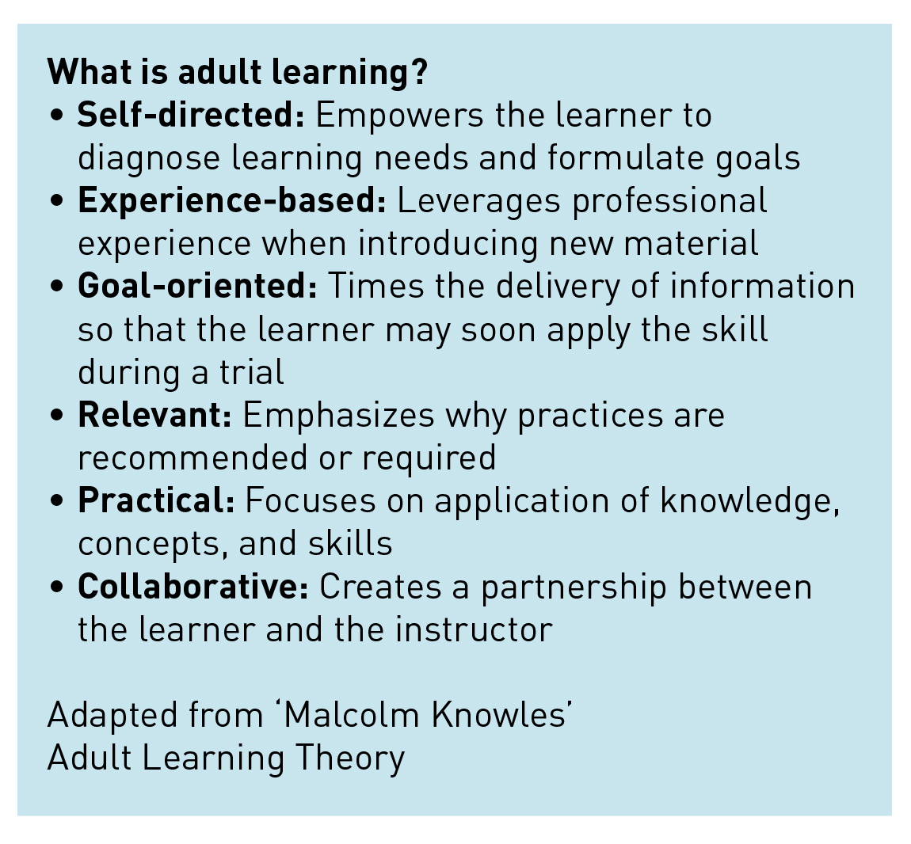
Mentoring & Knowledge-Sharing Examples: Appendix 2
List of existing mentoring programs and knowledge-sharing networks to illustrate how adult learning activities are being implemented in practice
Adult learning activities can help to address gaps in knowledge and skills through information exchange and peer support

Slide 33
Recommendations Summary
Move away from repetitive GCP training
A step toward targeted and effective educational programming
A shift in the perception of qualification activities
Recognition of previous training and experience
Identification of gaps in knowledge or skills
Improved understanding of how to apply GCP principles

Slide 34
Anticipated Impact
A culture of collaboration
Improved execution of study protocol
Fewer regulatory findings
Improved quality
Improved efficiency
Mentorship and knowledge-sharing platforms

Slide 35
Discussion

Slide 36
Annemarie Forrest: annemarie.forrest@duke.edu
Jimmy Bechtel jimmy.bechtel@myscrs.org
Sabrina Comic-Savic sabrina.comic savic@themedco.com
Kate Haratonik Haratonik.kate@gene.com

