Slide 1
Welcome
Once you’ve logged into WebEx, please select one of the following audio options:
  Call Using Computer
  I Will Call In
  DO NOT SELECT the “Call Me” option.
This webinar is being recorded.
All participants are muted upon entry.
Questions will be taken following the presentation. Please indicate that you have a question by typing in the chat box “To Host.”

Slide 2
Findings & Reflections from CTTI’s ICH E6 Renovation Work
March 19, 2020
Presenter’s Info
Notes:
NOTE: If your presentation is being recorded, this will be the beginning of the recording, so make it a clean introduction.
EXAMPLE:
Welcome everyone! My name is [insert introducer’s name/title] and it is my pleasure to introduce [insert presentation name].
Today’s presentation is hosted by the Clinical Trials Transformation Initiative, and the speakers today include [insert speaker(s) name/title]
[Insert prepared speaker(s) bios.]

Slide 3
Disclaimer
The views and opinions expressed in this presentation are those of the individual presenter and do not necessarily reflect the views of the Clinical Trials Transformation Initiative.

Slide 4
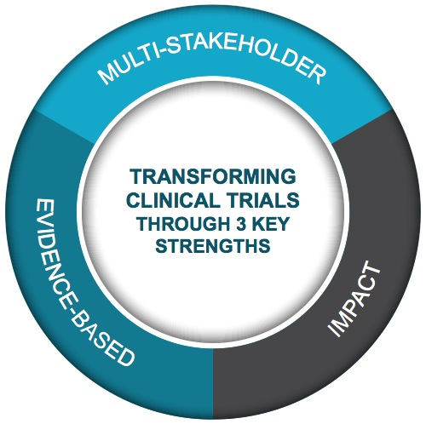

CTTI Strengths
Public-Private Partnership
Co-founded by Duke University & FDA
Involves all stakeholders
Approx. 80+ members
Participation of 400+ more orgs
MISSION: To develop and drive adoption of practices that will increase the quality and efficiency of clinical trials

Slide 5
About CTTI’s Work on Informing ICH E6
Renovation
Inform the appropriate renovation of ICH E6 in order to support the shared goal of improving clinical trials, internationally
Prior to the renovation, provide ICH with insights from stakeholders affected by ICH E6
Highlight the most essential issues and areas of greatest need for updates

Slide 6
Brief Agenda
Time | Topic | Presenter
12:05 p.m. | Introduction: ICH and ICH E6 Renovation | Fergus Sweeney Celia Witten
12:20 p.m. | Review of CTTI Findings | Amy Corneli
12:35 p.m. | Reflection on CTTI Findings | Pamela Gonzalez Dagmar Gortz
12:45 p.m. | Discussion and Q&A | Pamela Tenaerts
Please indicate that you have a question by typing in the chat box “To Host.”

Slide 7
Introduction to ICH
Fergus Sweeney, Head, Inspections, Human Medicines Pharmacovigilence and Committees, European Medicines Agency
Celia Witten, Deputy Director, Center for Biologics, US Food and Drug Administration

Slide 8
ICH-E6(R3)
Good Clinical Practice

Slide 9
Outline
E6(R3) External Outreach
Background on ICH
Overview of GCP renovation
  ICH E8 R1 revision
  ICH E6 R3 revision

Slide 10
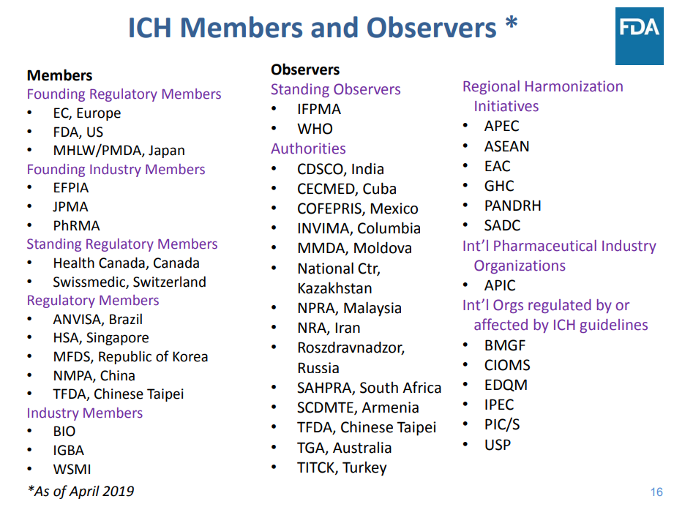

Slide 11
ICH guideline development steps
Reflection Paper – may be prepared prior to some guideline development
Guideline Proposal agreed and informal WG established
Concept paper and business plan adopted
Formal EWG established and Step 1 consensus building commences
Step 1 sign off by EWG on draft document
Step 2a sign off by ICH assembly Step 2b sign off by regulators on draft document
Step 3 Public consultation launched and post consultation revision
Step 4 final guideline adopted by ICH
Step 5 final guideline implementation and coming into force in each region

Slide 12
Background on ICH
ICH Guidelines fall into four categories:
  Quality
  Efficacy
  Safety
  Multidisciplinary
ICH E8 General Considerations on Clinical Studies and ICH E6 Guideline on Good Clinical Practice are both part of the E “Efficacy” family of guidelines

Slide 13
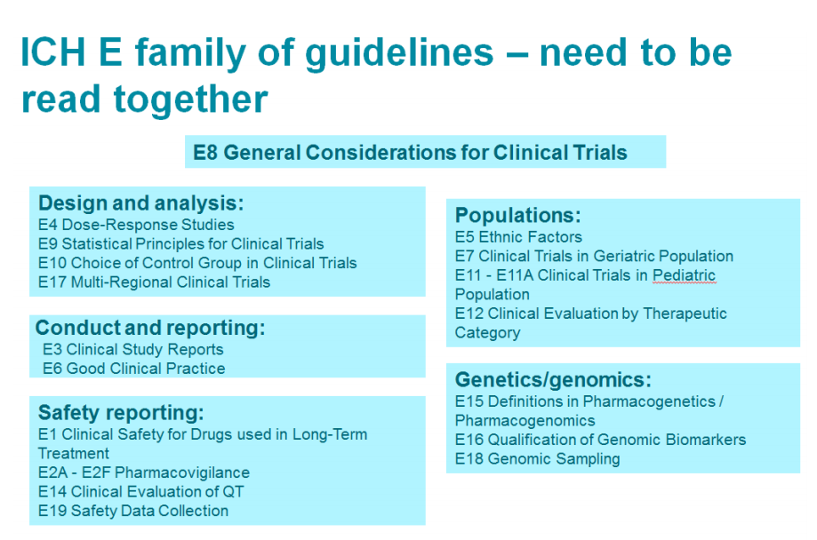

Slide 14
ICH E6 and E8 – A Brief History
E6: Good Clinical Practice (GCP) – finalized in 1996
  Describes the responsibilities and expectations of all stakeholders in the conduct of clinical trials.
  GCP covers aspects of monitoring, reporting, and archiving clinical trials
  Addenda for essential documents and investigator brochures
E6 (R2) – finalized in 2016
  Addendum to encourage implementation of improved and more efficient approaches, while continuing to ensure human subject protections
  Updated standards for electronic records

Slide 15
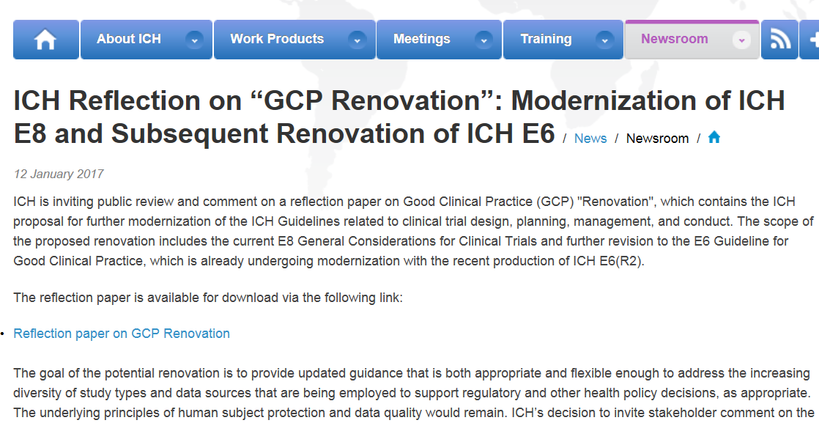
ICH E8 & E6
Connected Development

Slide 16
ICH Reflection on GCP Renovation
Step 1: Revision to ICH E8
  Goal is to address broader concerns about the principles of study design and planning for an appropriate level of data quality
  Provides comprehensive cross-referencing to the family of ICH guidance documents
Step 2: Renovation of ICH E6 GCP
  Goal is to address flexibility concerns with respect to a broader range of study types and data sources
  Retains the current focus on good clinical investigative site practices

Slide 17
ICH E6 and E8 – A Brief History
E8: General Considerations for Clinical Trials -- finalized in 1997
  Sets out general scientific principles for the conduct, performance and control of clinical trials
  Addresses a wide range of topics in trial design and executions
  Emphasizes the protection of human subjects in clinical trials
E8 (R1) – Draft issued for public comment in May 2019

Slide 18
E8 Fundamental design elements
Study population
Intervention
Control group
Response variable
Methods to reduce bias
Statistical analysis
Described in the protocol together with the study objectives, study type, and data sources which should be finalized before start of study (ICH E6)
E8 clinical trial design principles
E6 GCP clinical trial conduct principles

Slide 19
E8 key aspects linking to E6
Principles
  Quality
  Quality by Design
Designing quality into clinical trials
  Quality by design of clinical studies
  Critical to Quality Factors
  Risk proportionate approach
  Involvement of wide range of stakeholders in clinical trial design
  Examples of critical to quality factors

Slide 20
Conclusion
  This document focuses on designing quality into clinical studies, considering the diversity of clinical study designs and data sources used to support regulatory and other health policy decisions.
  The principles and approaches set out in this guideline, including those of quality by design, should inform the approach taken to the design, conduct, and reporting of clinical studies and the proportionality of control measures employed to ensure the integrity of the critical to quality factors.
This is a guideline that everyone involved in the conduct of clinical trials should read and understand.
The greatest challenge will be in Change Management – adjusting behaviors, attitudes – moving away from preconceived ideas and interests

Slide 21
E6 R3

Slide 22
Overview of E6(R3) Revision - Purpose
E6(R3) External Outreach
To develop a responsive GCP guideline
Provide flexibility
  Acknowledge the diversity of trial designs, data sources, and the different contexts in which clinical trials can be conducted
  Highlight that GCP principles can be satisfied in a variety of ways

Slide 23
Overview of E6(R3) Revision – Approach
E6(R3) External Outreach
A rewrite and reorganization of ICH-E6(R2)
  Principles document and Annexes
  Align with ICH-E8 as appropriate
  Bridge identified gaps within E6 and between E6 and relevant ICH guidances
Clear and concise scope
  Expectations should be fit for purpose
Focus on key concepts
  Quality by design and Risk-based approach
  Proportionality
  Critical to quality factors
  Other…

Slide 24
Preliminary Conceptual Representation of the Approach
Overarching principles that apply across the board
Annex-1
GCP for Interventional clinical trials
Additional considerations for non-traditional interventional clinical trials
Annex-2
The WG will continue to assess what should be included in Annex-1 and Annex-2
Annex-1
Reflects the concepts in E6(R2) (with updates and refinements as needed)

Slide 25
Overview of E6(R3) Revisions – Annex 1 and Annex 2
Annex 1 – Interventional Clinical Trials
  Considers principles as they relate to the use of unapproved or approved drugs in a controlled setting with prospective allocation of treatment to participants and collection of trial data
Annex 2 – Non-traditional Interventional Clinical Trials
  Considers principles as they relate to the use of non-traditional clinical trial designs such as pragmatic clinical trials and decentralized clinical trials, as well as those trials that incorporate real world data sources

Slide 26
Why are observational studies not included?
Although certain observational studies and data are being utilized to identify safety signals, regulatory organizations are still determining how to best utilize observational studies to support decisions on efficacy.
  Important issues such as determining appropriate methodologies to establish causal inference and to provide regulatory grade evidence are not fully elucidated for observational studies.
  Deliberations and planning are still needed to determine best way forward
Observational studies may have different considerations for the protection of human participants and for data collections compared to interventional trials.
  Interventional trials prospectively apply an intervention to participants in accordance with the protocol, whereas observational studies are often retrospective in nature and do not involve an intervention.
Certain elements, such GCP considerations for real-world data sources within the context of interventional clinical trials, are included under annex-2 from the current ICH-E6(R3) concept paper. The scope of Annex-2 will be further defined after Annex-1 has been developed.

Slide 27
Anticipated Approach
Simultaneous work on the principles AND Annex-1
Endorsement of Concept Paper –Nov - 2019
Step-4
Simultaneous work streams
Step-1 / 2
Principles
Principles + Annex 1 in Step-3
Feedback
Annex-2
Close coordination
Annex –1
Develop Updated Concept Paper for Annex 2
Annex 2 reaching Step-1
Approximately 24 months
Approximately 12-18 months

Slide 28
External Outreach
There are many stakeholders impacted by ICH-E6 GCP guidelines
Stakeholder outreach approaches are being considered by the EWG and ICH member organizations
The knowledge gained by learning from stakeholder experiences and viewpoints will further enrich EWG discussions

Slide 29
Progress
Business plan and concept paper finalized and endorsed
  EWG established
EWG discussions
  Principles of the guidance
  Scope and content of the guidance
  Stakeholder engagement activities

Slide 30
Thank You
E6(R3) External Outreach

Slide 31
Review of CTTI Findings
Amy Corneli
Social Science Lead, CTTI; Associate Professor, Department of Population Health Sciences, Duke University

Slide 32
Evidence Gathering Activities
Online survey
Qualitative, in-depth telephone interviews
Open-comment platform

Slide 33
Survey—Overview

Slide 34
Purpose
Identify areas of ICH E6 GCP that are and are not
in need of renovation
Identify a diverse group of stakeholders globally to invite for follow-up, in-depth interviews

Slide 35
Participants (n=327) reside in 39 countries
Europe and Central Asia
North America
60%
30%

Slide 36

Participants conduct research in
153 countries
Among the participants—
  70% conduct research in Europe & Central Asia
  52% in North America
  30% in East Asia and Pacific
  18% in Latin American and Caribbean
  15% in sub-Saharan Africa
  14% in South Asia
  13% in Middle East and North Africa

Slide 37

Participants’ Organizations and Roles
Represent a wide variety of organizational types
  40% hospital/medical center
  19% pharmaceutical biotechnology
  14% commercial contract research
Represent many research roles
  24% investigator
  20% quality assurance/quality control
  17% clinical operations
  14% study coordinator

Slide 38
Survey—Results

Slide 39
Top ICH E6 GCP principles needing renovation (25%—29%)
Implementing systems that assure quality
Medical care by qualified physicians/dentists
Confidentiality and privacy
Informed consent
Information documentation and storage
2.13
2.7
2.11
2.9
2.10

Slide 40
Sections and Topic Renovations
Needing the most renovation:
  Section 4: Investigator
  Section 5: Sponsor
Needing the least renovation:
  Section 7: Investigator Brochure
Topic most frequently mentioned as
needing renovation:
5.18 Monitoring (45%)

Slide 41
All Survey
Findings
CTTI has all survey findings available on the CTTI website: https://www.ctti-clinicaltrials.org/

Slide 42
Qualitative Interviews—Overview

Slide 43
Purpose
For stakeholders to share detailed information about their experiences with implementing
ICH E6 GCP and their renovation preferences
  What they hope the revision will achieve
  Most helpful aspects/sections and why
  Least helpful aspects/sections and why
  How the guidance could be improved

Slide 44
Participants
23 stakeholders
Reside in 10 countries, primarily in Europe (57%) and
North America (30%)
Conduct research in 124 countries
  91% in Europe and Central Asia
  78% in North America
  74% in East Asia and Pacific
  57% in Latin American and Caribbean
  57% in sub-Saharan Africa
  35% in South Asia
  39% in Middle East and North Africa

Slide 45
Interviews—Results
Note: We include significant and repeated concerns expressed by participants, if even not the intended purview of ICH, so that ICH is aware of the reality of the experiences of researchers, and can consider how best to address these concerns as part of the renovation.

Slide 46




Aspirations
Need Flexibility | Simplify | Make updates
Be transparent
and inclusive

Slide 47
Need Flexibility
Narratives focused on:
Being specific about the types of research for which
ICH E6 GCP is a requirement
Clarifying when ICH E6 GCP is optional
  Investigators select components as appropriate
Providing a framework for adapting the guidance to other types of research
  Identifying minimum requirements of GCP necessary
  for different types of trials
  Setting quality standards that encompass
  non-interventional and non-drug studies

Slide 48
Need Flexibility
Because ICH E6 GCP is viewed a global guideline,
research in lower and middle-income countries need flexibility (e.g., informed consent, vulnerable populations, orphaned children)

Slide 49

Need Flexibility
The introduction of GCP states
that the principles of GCP can be, as appropriate, applied to different types of research. So this precise
introductory phrase has guided,
at least in Europe, authorities and
ethical committees applying ICH GCP
to all different types of research, which are not even involving drugs, at all.
—Regulatory, non-profit

Slide 50
Simplify
Recommendation: Make ICH E6 GCP
more user-friendly
  Simplify GCP refresher training requirements
  Eliminate duplicative trainings currently required by sponsors
Concerns:
  Complexity of the guidelines → disincentive for
  new investigators, for small single-site trials, and
  for investigator-initiated studies
  Need to transition from perception of a “checklist” and policing tool for audits → spirit of GCP, guiding principles for research

Slide 51
Make Updates
Accommodate changes in research conduct
and technology
  Multisite and multimodality trials
  Informed consent (e.g., delayed consent, waiver of consent, opt-out consent)
  Advances in technology (e.g., paperless trials and remote data collection)
  New and enhanced study roles and responsibilities (e.g., monitor, sponsor liaison, study coordinator), including patients as stakeholders
Clarify terms and concepts (e.g., risk-based approach, quality tolerance limits)

Slide 52
Be Transparent and Inclusive
Include a wide variety of stakeholders
(e.g., patients, others) in the revision process
→ more operationally feasible
guidance
Be transparent in the creation of the renovation
  Process followed
  Rationale behind decisions
  Stakeholders who are involved and how selected
  Process for soliciting feedback
  How feedback was reviewed

Slide 53

Be Transparent and Inclusive
Who is writing [the renovation]?...
Who is it sitting around the table?
How they have been selected?…
There is a big need for transparency
about the constituents, their role, the representation.
—Academic Center, Study Coordinator

Slide 54
Helpful Overall
Globally agreed-upon guidance
  Provides research framework for countries with limited research guidelines, or where variation in regulations exists between countries
  Provides process for establishing a clear evidence base → ensures that trial data can support marketing applications

Slide 55
Helpful Overall
I have taken ICH E6 throughout my career as a quality professional, and now [working in] operations…the principles…each of the chapters, they're valuable. It's an absolutely perfect roadmap for me. I understand what regulators want, and where we're going to have to show evidence of their requirements...
—Academic Center, Clinical Operations

Slide 56
Helpful Sections
Section 2 (Principles of GCP) → describes fundamental concepts that all types of clinical research should strive for
Section 4 (Investigator) → provides clear guidance on investigator oversight and informed consent
Section 5 (Sponsor) → provides helpful guidelines for sponsor oversight; appreciate shift to a risk-based approach in R2
Section 8 (Essential Documents) → appreciate exhaustive document list and shorter core lists

Slide 57
Unhelpful Overall
Similar to aspirations → focused on uncertainty about whether or how the guidelines are intended to accommodate nonregulatory and/or nondrug trials

Slide 58
Unhelpful Sections
Most comments → Section 4 (Investigator) and Section 5 (Sponsor)
  Clarify description of responsibilities
  Clarify terms and alignment with other regulations
Expand guidance in Section 4 (Investigator)
  Example: Description of adequate resources →
    Incorporate more flexibility in staff member roles
    Address consequences of having inadequate resources

Slide 59
Unhelpful Sections
Clarify topics in Section 5 (Sponsor):
  Monitoring
  Quality management using a risk-based approach
  Trial management, data handling, and record keeping
Comments:
  Some inspections are based on R1
  Sponsors’ interpretation of ICH E6 GCP varies → over-resourcing risks

Slide 60
Unhelpful Sections
Clarify topics in Section 6 (Clinical Trial Protocols) →
  Guidance on protocol development is too vague
  Need direction on making protocols simpler and
  more feasible
  Include templates, definitions, and guidance on version changes
Specifics needed in Section 8 (Essential Documents) → Interpretation of GCP affects the types of essential documents collected

Slide 61
Unhelpful—Quality Tolerance Limits
There is a still a huge uncertainty within the industry what is meant with that [quality tolerance limits]. Therefore, it’s difficult otherwise to see what’s working and what’s not working because not many trials have been inspected according to the new guidelines, so you don’t get any real feedback already on what’s working well, what’s not working well.
—Pharma, QA/QC

Slide 62
Open Comment Opportunity
Purpose – Allow respondents to suggest line-by-line edits to the current guideline version
Participants – 36 respondents from North America (n=7), Europe (n=26), and Asia (n=3) who self-reported that they conduct research for which the findings will be used for regulatory purposes.
No data analysis was conducted; responses are reported verbatim in the report

Slide 63
Reflection on Findings
Pamela Gonzalez, Director of Research Operations & Conduct, Office of Clinical Research, University of Chicago Medicine
Dagmar Gortz, Director, External Engagement & Business Insights, BioResearch Quality & Compliance, Governance & Operations Management, Janssen

Slide 64
Discussion
Moderator: Pamela Tenaerts
Please indicate that you have a question by typing in the chat box “To Everyone.”

