Slide 1
The Fastest Path to Effective COVID-19 Treatments: Using Master Protocol Studies
January 13, 2021

Slide 2
Housekeeping
This webinar is being recorded and will be posted to the CTTI website
All participants are muted upon entry
Questions can be entered in the chat box during the webinar
There will be a discussion that includes audience questions, at the end of each session

Slide 3
Welcome & Agenda
Pamela Tenaerts, CTTI

Slide 4
Agenda
Welcoming Remarks
Opening Comments
Current State of COVID Clinical Trials: A Call to Action
Practical Solutions to Setting Up Master Protocol Sites
Increasing Participant Enrollment in Master Protocols
Lessons for the Future
Closing Comments

Slide 5
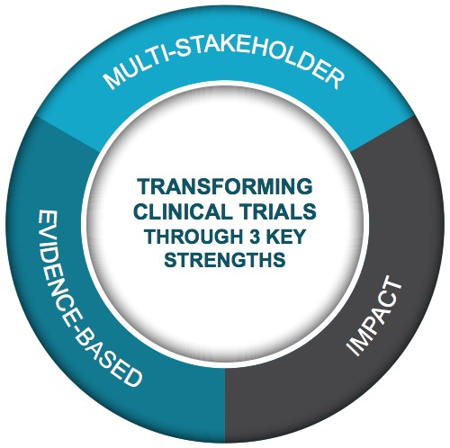
Multi-stakeholder,
public-private partnership
co-founded by Duke University & FDA
Participation of 500+ more orgs and + 80 member organizations
MISSION: To develop and drive adoption of practices that will increase the quality and efficiency of clinical trials

Slide 6
Overview of COVID-19 Efforts
Resources Created
Work Underway
After the Pandemic
For Ongoing Trials
Playbook of Best Practices
Webinars:
Conduct of Ongoing Trials in COVID
Switching to Remote & Virtual Visits
For COVID-19 Trials
Daily ClinicalTrials.gov download
Webinars:
Designing High-Quality Trials
Engaging Minority Patients
Master Protocol Summit
Lessons learned relative to transforming trials
COVID-19 treatment trial report
Maintaining the transformation
Analysis of clinical trial ecosystem changes
Transforming Trials 2030
https://www.ctti-clinicaltrials.org/projects/clinical-trials-issues-related-covid-19

Slide 7
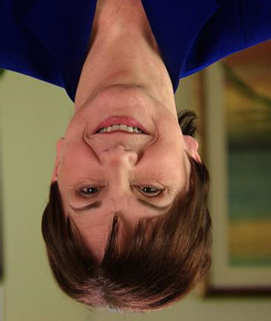
Opening Comments
Janet Woodcock, Operation Warp Speed

Slide 8
Current State of COVID Clinical Trials: A Call to Action
Robert Califf, Verily and Google Health

Slide 9
Power of Coordination
Results for: Azithromycin, Dexamethasone,
Hydroxychloroquine, & Lopinavir-Ritonavir
Source: January 4, 2021 Collaborators’ Meeting
https://www.recoverytrial.net/files/recovery-collaborators-meeting-2021-01-04.pdf

Slide 10
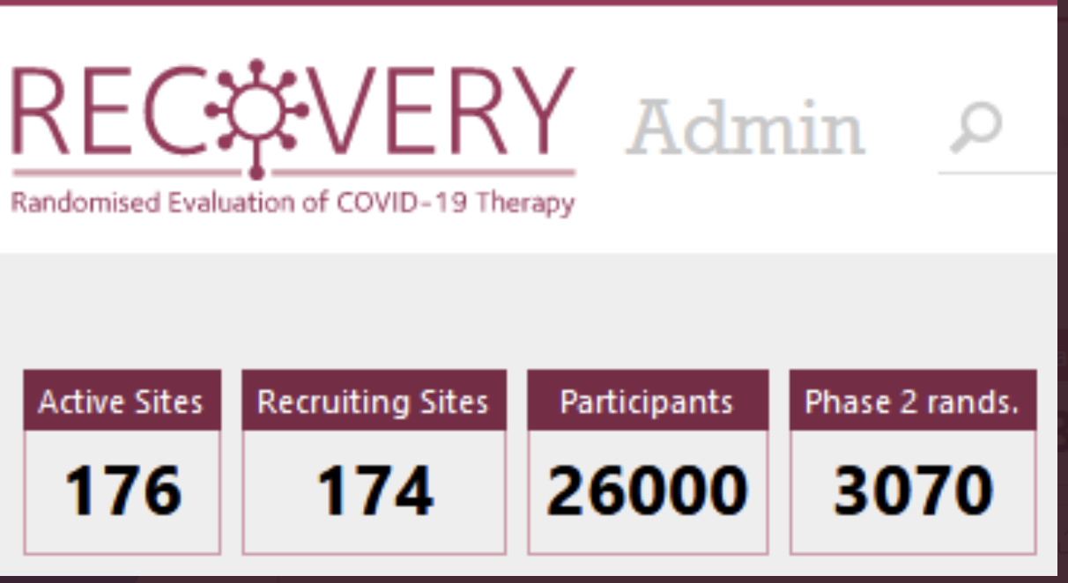
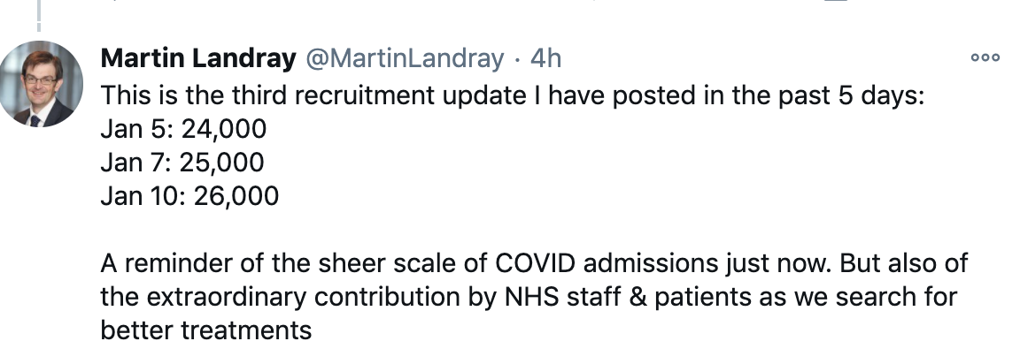

Slide 11
State of COVID-19 Clinical Trials

Slide 12
ClinicalTrials.gov: COVID-19 Clinical Trials
4039 COVID-19 Studies registered as of Dec. 1, 2020
2300 Interventional Studies
658 > = to 1 U.S. Site
558 Purpose Treatment or Prevention
*excluding 12 withdrawn
Data source: CTTI’s database for Aggregate Analysis of ClinicalTrials,gov (AACT) (https://aact.ctti-clinicaltrials.org/).

Slide 13
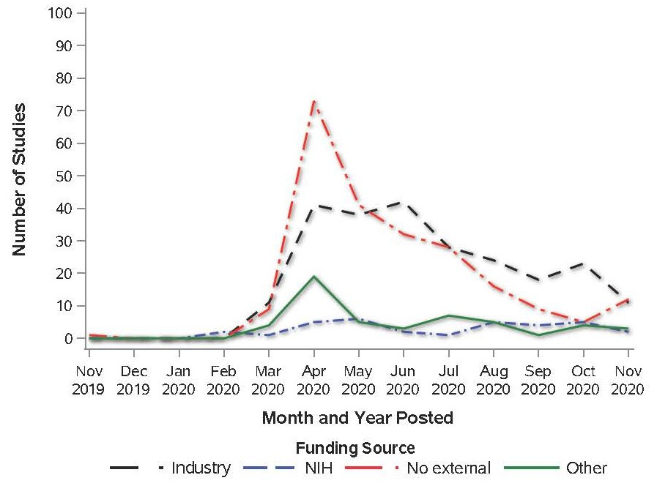
U.S. COVID-19 Prevention or Treatment Trials on ClinicalTrials.gov, by Funder Type
Adapted from graph originally reported at https://califf001.medium.com/complete-rapid-reporting-of-clinical-trials-a-necessary-component-of-the-pandemic-response-aa158eb1a1cb

Slide 14
Study Recruitment Status
 | Funder Type
 | Industry N=242 | NIH N=35 | No external N=228 | Other N=53
 | n/N (%)
Not yet recruiting | 28/242 (11.6%) | 3/35 (8.6%) | 35/228 (15.4%) | 9/53 (17.0%)
Recruiting & Enrolling by Invitation | 172/242 (71.1%) | 24/35 (68.6%) | 149/228 (65.4%) | 34/53 (64.2%)
Active, not recruiting | 29/242 (12.0%) | 4/35 (11.4%) | 23/228 (10.1%) | 5/53 (9.4%)
Completed, Suspended, or Terminated | 13/242 (5.3%) | 4/35 (11.4%) | 21/228 (9.2%) | 5/53 (9.4%)

Slide 15
Number and Location of Study Sites
 | All studies N=558 | Industry N=242 | NIH N=35 | No external N=228 | Other N=53
Number of sites
Mean +/- SD | 9.86 +/- 25.30 | 17.15 +/- 34.91 | 17.34 +/- 23.08 | 1.53 +/- 2.30 | 7.49 +/- 15.49
Median (Q1, Q3) | 1.00 (1.00, 6.00) | 4.00 (1.00, 13.00) | 5.00 (1.00, 22.00) | 1.00 (1.00, 1.00) | 1.00 (1.00, 6.00)
Multi-site study, n(%) | 247(44.3%) | 158(65.3%) | 23(65.7%) | 43(18.9%) | 23(43.4%)
Locations of study sites, n (%)
US only | 492 (88.2) | 190 (78.5%) | 29 (82.9%) | 226 (99.1%) | 47 (88.7%)
US and Non-US | 66 (11.8%) | 52 (21.5%) | 6 (17.1%) | 2 (0.9%) | 6 (11.3%)

Slide 16
U.S. Sites: Selected COVID Treatment Master Protocols
 | APR 2020 | MAY 2020 | JUN 2020 | JUL 2020 | AUG 2020 | SEP 2020 | OCT 2020
REMAP-COVID |  |  |  |  |  |  |  | 30 | 9 | 44
I-SPY COVID |  |  |  |  |  |  |  | 15 | 30* | 50-100
ACTIV-2 |  |  |  |  |  |  |  | 90 | 107 | 160
ACTIV-3 |  |  |  |  |  |  |  | 30 | 2 | 118
ACTIV-4A |  |  |  |  |  |  |  | 45 | 111 | 155
ACTIV-4B |  |  |  |  |  |  |  | 10 | ~50 | 200
ACTIV-5 |  |  |  |  |  |  |  | 0 | 0 | 200
ACTIV-1 |  |  |  |  |  |  |  | 9 | 16 | 25
 | Month MP started |  |  |  |  |  |  | Active sites | In process sites | Total planned
Site numbers as of first week in Jan

Slide 17
Enrollment by Funder
 | All studies N=558 | Industry N=242 | NIH N=35 | No external N=228 | Other N=53
Enrollment, n (%)
0-49 | 155 (27.8%) | 70 (28.9%) | 4 (11.4%) | 71 (31.1%) | 10 (18.9%)
50-99 | 100 (17.9%) | 45 (18.6%) | 5 (14.3%) | 47 (20.6%) | 3 (5.7%)
100-249 | 125 (22.4%) | 47 (19.4%) | 8 (22.9%) | 59 (25.9%) | 11 (20.8%)
250-499 | 60 (10.8%) | 32 (13.2%) | 4 (11.4%) | 17 (7.5%) | 7 (13.2%)
500+ | 118 (21.1%) | 48 (19.8%) | 14 (40.0%) | 34 (14.9%) | 22 (41.5%)

Slide 18
U.S. Enrollment: Selected COVID Treatment Master Protocols
 | APR | MAY | JUN | JUL | AUG | SEP | OCT | NOV | DEC | JAN
REMAP-COVID |  |  |  |  |  |  |  |  | 340 | 1660
I-SPY COVID |  |  |  |  |  |  |  |  | 580 | 420
ACTIV-2 |  |  |  |  |  |  |  |  | 1003* | 4247*
ACTIV-3 |  |  |  |  |  |  |  |  | 441 | 1809
ACTIV-4A |  |  |  |  |  |  |  |  | *613 | *2387
ACTIV-4B |  |  |  |  |  |  |  |  | 74 | 6926
ACTIV-5 |  |  |  |  |  |  |  |  | 41 | 259
ACTIV-1 |  |  |  |  |  |  |  |  | 161 | 1351
 | Month MP started |  |  |  |  |  |  |  | 2020 enrolled | Still planned
Enrollment numbers as of first week in Jan
*ACTIV 2 and ACTIV 4A = US + non-US

Slide 19
Repurposed Therapeutics Trials
We at FDA constructed a data lake with all registered therapeutic trials globally excluding traditional medicines
2610 trials of repurposed agents as of 12/20 registered globally
We evaluated if they had a randomized design and if the planned study power met arbitrary but highly reasonable and conservative estimates for adequate power
Only 5% of experimental trial arms met these criteria; same with trials conducted at least in part in US
Situation is actually worse as many trials had poor enrollment
Almost all definitive data have come from platform trials or company-sponsored trials
From Janet Woodcock, FDA/OWS

Slide 20
COVID-19 Repurposed Therapeutics Effort
Few trials designed to change standard of care in pandemic
Screening platform trials are a reasonable approach—look for big effects, get to answer quickly
But most trials duplicative (snapshot, numbers change over time)
Agent Number of adequate trial arms Other trial arms
Conv plasma 7 194
HIG 0 37
Immunomod 27 679
HCQ/CQ etc 9 213
Direct antiviral 24 232
From Janet Woodcock FDA/OWS

Slide 21
Intervention Sub-Types
 | All studies N=558 | Industry N=242 | NIH N=35 | No external N=228 | Other N=53
 | n (%) |  | n/N (%) | n/N (%) | n/N (%)
Antivirals | 95 (17.0%) | 26 (10.7%) | 13 (37.1%) | 41 (18.0%) | 15 (28.3%)
Immunomodulators | 146 (26.2%) | 92 (38.0%) | 15 (42.9%) | 33 (14.5%) | 6 (11.3%)
Steroids | 5 (0.9%) | 0 (0.0%) | 1 (2.9%) | 3 (1.3%) | 1 (1.9%)
SARS-CoV-2 Neutralizing Antibodies | 14 (2.5%) | 12 (5.0%) | 2 (5.7%) | 0 (0.0%) | 0 (0.0%)
Other neutralizing antibody | 51 (9.1%) | 5 (2.1%) | 5 (14.3%) | 37 (16.2%) | 4 (7.5%)
Cell/gene | 27 (4.8%) | 18 (7.4%) | 2 (5.7%) | 7 (3.1%) | 0 (0.0%)
Antithrombotic | 30 (5.4%) | 9 (3.7%) | 2 (5.7%) | 16 (7.0%) | 3 (5.7%)
Vaccine | 17 (3.0%) | 15 (6.2%) | 2 (5.7%) | 0 (0.0%) | 0 (0.0%)
Other | 180 (32.3%) | 43 (17.8%) | 3 (8.6%) | 100 (43.9%) | 34 (64.2%)
Combination | 6 (1.1%) | 3 (1.2%) | 0 (0.0%) | 3 (1.3%) | 0 (0.0%)

Slide 22
Duplication – Five Most Common Interventions
Intervention | # of Studies, % US studies | % Multisite | Median (Q1, Q3) # of sites | No external funder, n(%)
Hydroxychloroquine | 50 (9%) | 22/50 (44.0%) | 1 (1, 4) | 31/50 (62.0%)
Convalescent plasma | 43 (7.7%) | 18/43 (41.9%) | 1 (1, 4) | 34/43 (79.1%)
Remdesivir | 19 (3.4%) | 17/19 (89.5%) | 15 (10, 64) | 1/19 (5.3%)
Azithromycin | 19 (3.4%) | 9/19 (47.4%) | 1 (1, 4) | 11/19 (57.9%)
Tocilizumab | 12 (2.2%) | 7/12 (58.3%) | 4 (1, 64) | 5/12 (41.7%)

Slide 23
Master Protocols in U.S.
 |  | Funder Type
 | All studies N=558 | Industry N=242 | NIH N=35 | No external N=228 | Other N=53
Master protocol, n/N (%) | 14/558 (2.5%) | 3/242 (1.2%) | 6/35 (17.1%) | 0/228 (0.0%) | 5/53 (9.4%)

Slide 24
Survey to inform: The Fastest Path to Effective COVID-19 Treatments: Using Master Protocol Studies
January 13, 2021

Slide 25
CTTI Request for Experiences
Inform meeting topics
CTTI collected feedback Dec. 28, 2020 to Jan. 13, 2021
Survey distributed via:
Email to CTTI member organizations and public contacts
Posts on Twitter and LinkedIn
Encouraged trade, media, and other organizations to share
25 Target respondents – individuals executing COVID-19 treatment master protocol trials in the U.S.

Slide 26
What best represents your stakeholder perspective? (n=22)
Clinical Investigator/Site 2
Academia 2
Pharma 7
CRO 5
Government 4
Biotech 1
Other 1
Not represented: device/IRB/Legal/Patient/Healthcare Delivery

Slide 27
What are your biggest challenges to setting up new COVID treatment master protocol trial sites? (n=18)
Allowed to choose 3

Slide 28
Strategies to Successfully Start Up Sites (n=16)
STAFFING
Reallocate
Supplement
Training
FEASIBILITY
Streamline Protocol
Single point of contact site management
CONTRACTING
Being flexible
Take it or leave it
Leverage existing contracts
IRB
Expedited
Select sites based on timely review
TRIAL BUDGET
Increase Budgets

Slide 29
What are your biggest challenges to enrolling participants into COVID treatment master protocol trials? (n=10)
Allowed to choose 3

Slide 30
Strategies to Successfully Enroll Participants (n=9) nAllppt.com
PROTOCOL DESIGN
Amendments
Streamline protocol
CO-ENROLLMENT
SITES
Communication
New sites
Domestically
Non-US
CONSENT
Simplify

Slide 31
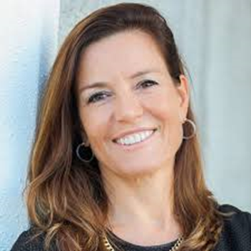
Practical Solutions to Setting Up Master Protocol Sites
Derek Angus: REMAP-COVID
Laura Esserman: I-SPY-COVID
Manizhe Payton: ACTIV-2
Pamela Tenaerts: Moderator, CTTI

Slide 32
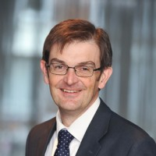
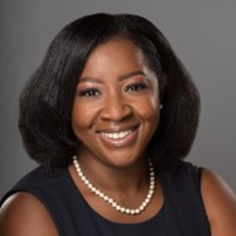
Increasing Participant Enrollment in Master Protocols
Kousick Biswas: Veterans Health Administration
Dan Cooper:
UC Irvine
Martin Landray:
RECOVERY Trial
Esther Krofah: Moderator, FasterCures,
a Center of the Milken Institute

Slide 33
Lessons for the Future
Samuel Brown: Intermountain Health System
Adrian Hernandez: PCORnet
Saye Khoo:
AGILE
Mark McClellan: Moderator, Margolis Center for Health Policy

Slide 34
Closing Comments

Slide 35
Additional COVID-19 Resources
Daily ClinicalTrials.gov COVID trials download
Webinars: Designing High-Quality Trials, Engaging Minority Patients
Master Protocol Summit
Articles of Interest
Duke-Margolis Paper Details Strategies to Treat COVID-19
Master Protocols to Study Multiple Therapies, Multiple Diseases, or Both (The New England Journal of Medicine)
Complete, Rapid Reporting of Clinical Trials: A Necessary Component of the Pandemic Response (Medium)
Master Protocol COVID Treatment Resources
Accelerating COVID-19 Therapeutic Interventions and Vaccines (ACTIV)
I-SPY COVID Trial
​​​​​RECOVERY - Randomised Evaluation of COVID-19 Therapy
REMAP-CAP: A Randomised, Embedded, Multi-factorial, Adaptive Platform Trial for Community-Acquired Pneumonia

Slide 36
Sign up for CTTI’s e-newsletter and follow us on Twitter or LinkedIn
to hear more about our ongoing COVID-19 efforts,
as well as our Transforming Trials 2030 initiative.

