Slide 1
Accelerating the Appropriate Use of Mobile Technology in Clinical Trials through Novel Endpoint Recommendations
June 26, 2017

Slide 2
Agenda
Introduction to CTTI
  Pamela Tenaerts, CTTI
Mobile Clinical Trials Novel Endpoints Project
  Martin Landray, University of Oxford
Project Recommendations & Tools
  Marc Walton, Janssen
Panel
  Moderator: Martin Landray, University of Oxford
  Panelists:
    Leonard Sacks, FDA
    Wendy Snyder, Amgen
    Rob Wilson, Actigraph
    Lauren Bataille, Michael J. Fox Foundation

Slide 3
An Introduction to CTTI
Pamela Tenaerts, CTTI

Slide 4
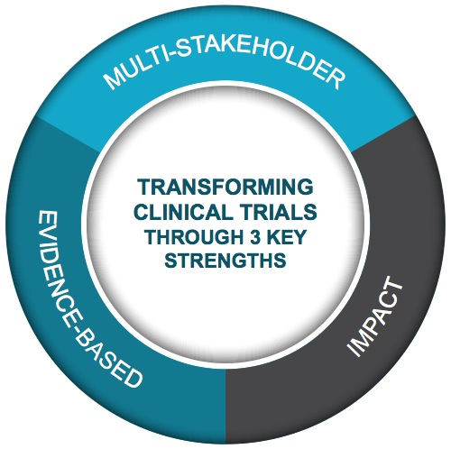

CTTI Strengths
Public-Private Partnership
Co-founded by Duke University & FDA
Involves all stakeholders
80+ members
MISSION: To develop and drive adoption of practices that will increase the quality and efficiency of clinical trials

Slide 5

CTTI Membership
Notes:
*June 6, 2017 version

Slide 6
CTTI Methodology

Slide 7
PROJECT PORTFOLIO
May 2017
Areas of Strategic Focus: | SYSTEMATIC EVIDENCE GENERATION | PATIENTS AS EQUAL PARTNERS | EFFICIENT & QUALITY TRIALS | PUBLIC HEALTH CONCERN | SAFE & ETHICAL TRIALS
Active Projects: | MCT Legal & Regulatory MCT Mobile Devices MCT Novel Endpoints MCT Stakeholder Perceptions Registry Trials State of Clinical Trials | Patient Groups & Clinical Trials | Investigator Community Investigator Qualification | ABDD HABP/VABP Studies | Pregnancy Testing
Complete Projects: | Large Simple Trials |  | GCP Training Monitoring Quality by Design Recruitment Site Metrics | ABDD Peds Trials ABDD Streamlining HABP/VABP Trials ABDD Unmet Need Long-Term Opioid Data | Central IRB Central IRB Advancement DMCs Informed Consent IND Safety IND Safety Advancement SAE Reporting

Slide 8
The MCT Novel Endpoints Project Team
Team Leaders | Team Members | Project Manager
Lauren Bataille (MJFF) Rob DiCicco (GSK) Cheryl Grandinetti (FDA) Will Herrington (Oxford) Martin Landray (Oxford) Kaveeta Vasisht (FDA) | Ashish Narayan (Northwell) Elektra Papodopoulous (FDA) Theresa Strong (FPWR) Komathi Stem (monARC Bionetworks) Ken Skodacek (FDA) Nirav 'Rav' Sheth (MicroMedicine) Marc Walton (Janssen) | Jen Goldsack (CTTI)
 |  | Social Science Lead
 |  | Brian Perry (CTTI)
 |  | EC Champion
 |  | John Alexander (Duke)

Slide 9
MCT Novel Endpoints Project
Martin Landray, University of Oxford

Slide 10
Mobile Clinical Trials (MCT) Program
PURPOSE:
Develop evidence-based recommendations that affect the widespread adoption and use of mobile technology in clinical trials
ANTICIPATED IMPACT:
Increase the number of clinical trials appropriately leveraging mobile technology
4 PROJECTS
Novel
Endpoints
Mobile
Devices
Stakeholder
Perceptions
Legal &
Regulatory Issues
*Scope: FDA-regulated clinical trials after the time of initial research volunteer consent

Slide 11
Project Definition of Novel Endpoints
New endpoints that have not previously been possible to assess
Existing endpoints that can be measured in new and possibly better ways

Slide 12
The Case for Technology-Derived Novel Endpoints
Address unmet need for high quality endpoints
    Where measures don’t exist at all
    Where existing measures may be deemed inadequate
Complement existing measures
    Novel endpoints are unique in their ability to objectively capture data about patients outside of the clinic in the context of their activities of daily living

Slide 13
Recommendations and Tools
Recommendations for selecting, developing and incorporating novel endpoints using mobile technology for use in clinical trials
Novel endpoint development benefit framework
Selection tool to support decisions between viable novel endpoints for development
Guide to interacting with FDA regarding novel endpoint development

Slide 14
Recommendations and Tools
Flowchart and companion detailed description of novel endpoint development
Four use cases of tangible examples
  Parkinson’s disease
  Diabetes
  Heart failure
  Duchenne’s muscular dystrophy

Slide 15
Recommendations & Tools
Marc Walton, Janssen

Slide 16
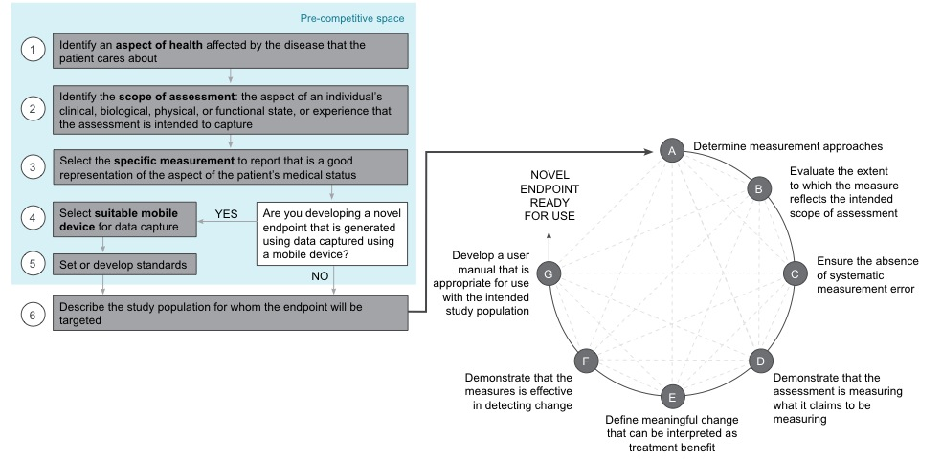
Steps for Novel Endpoint Development

Slide 17
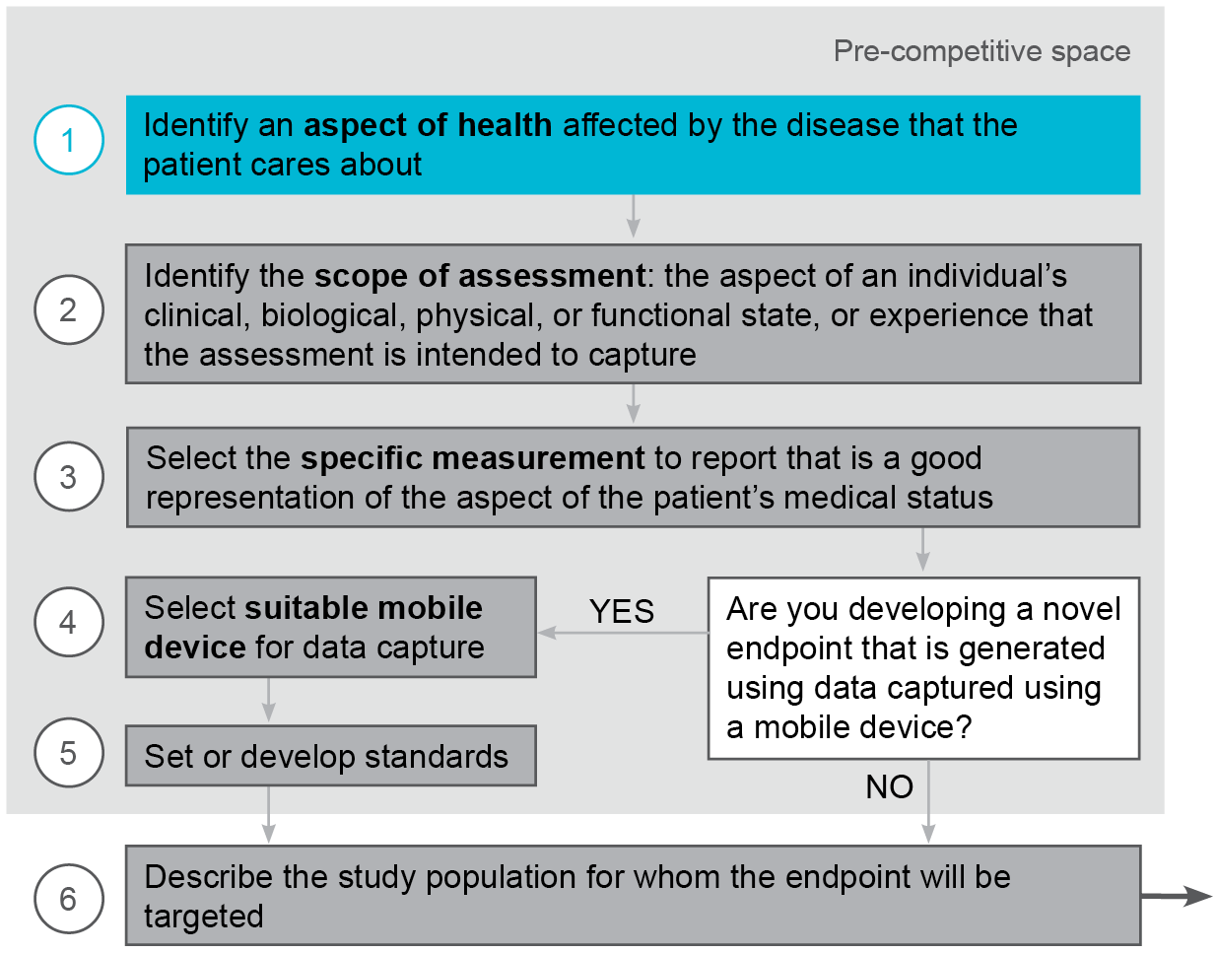
Steps for Novel Endpoint Development

Slide 18
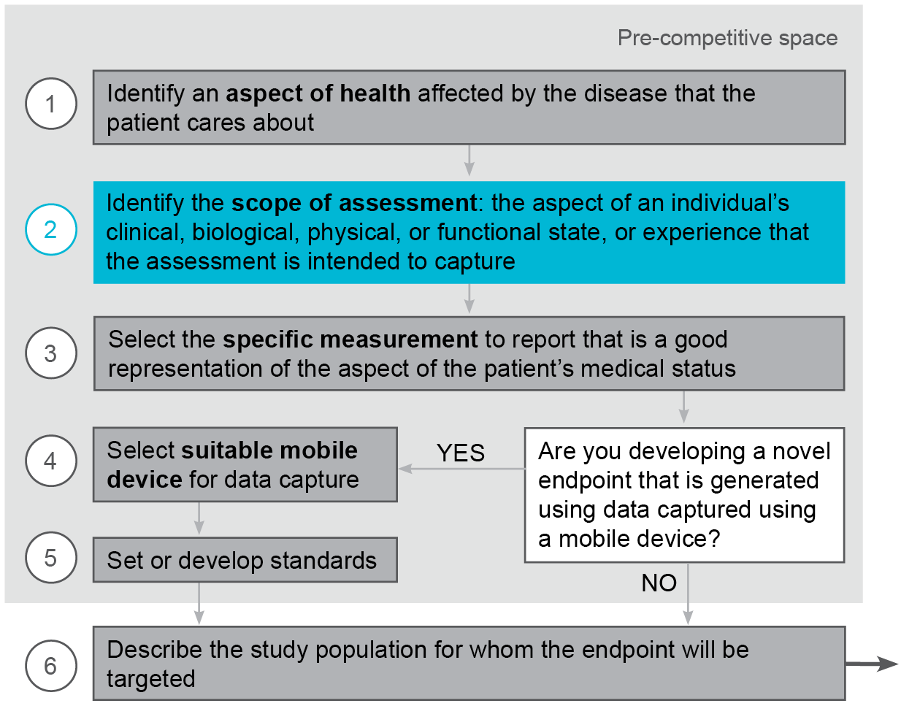
Steps for Novel Endpoint Development

Slide 19
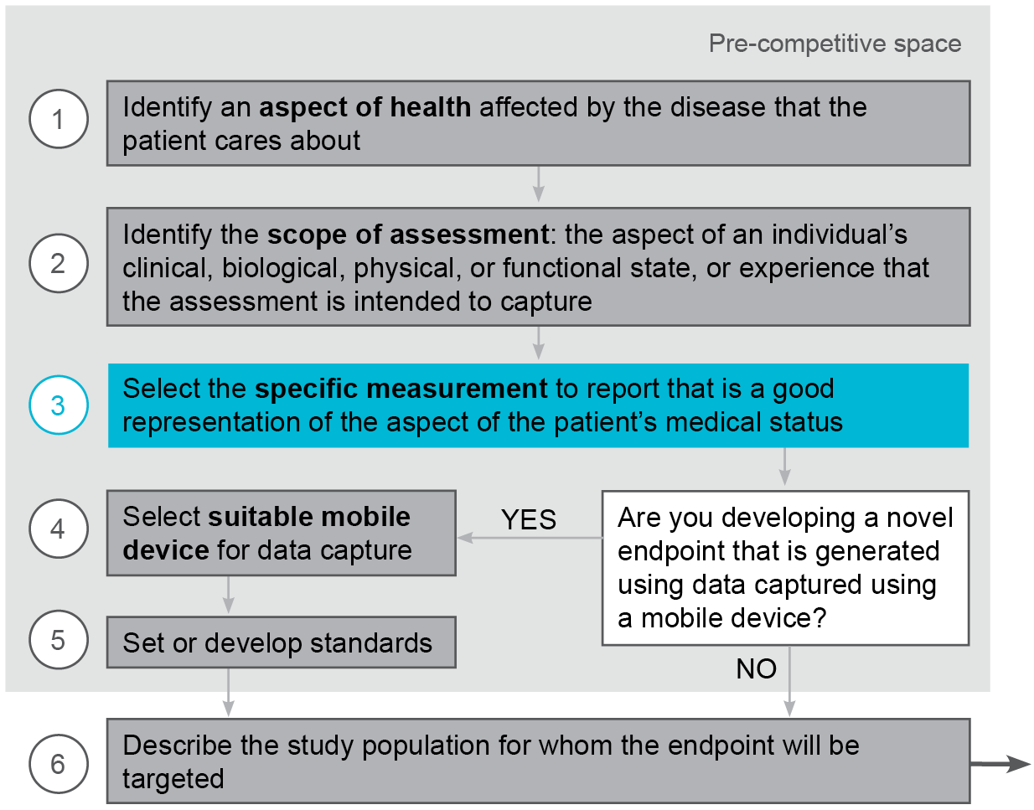
Steps for Novel Endpoint Development

Slide 20
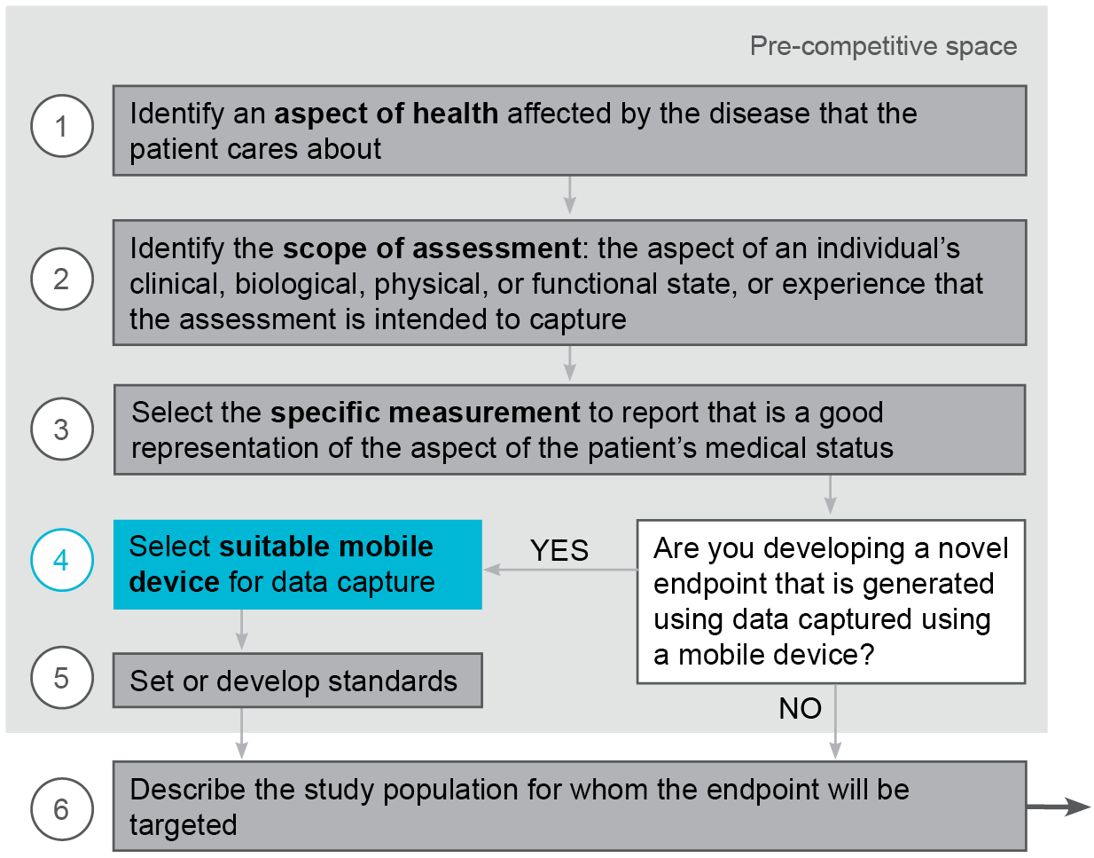
Steps for Novel Endpoint Development

Slide 21
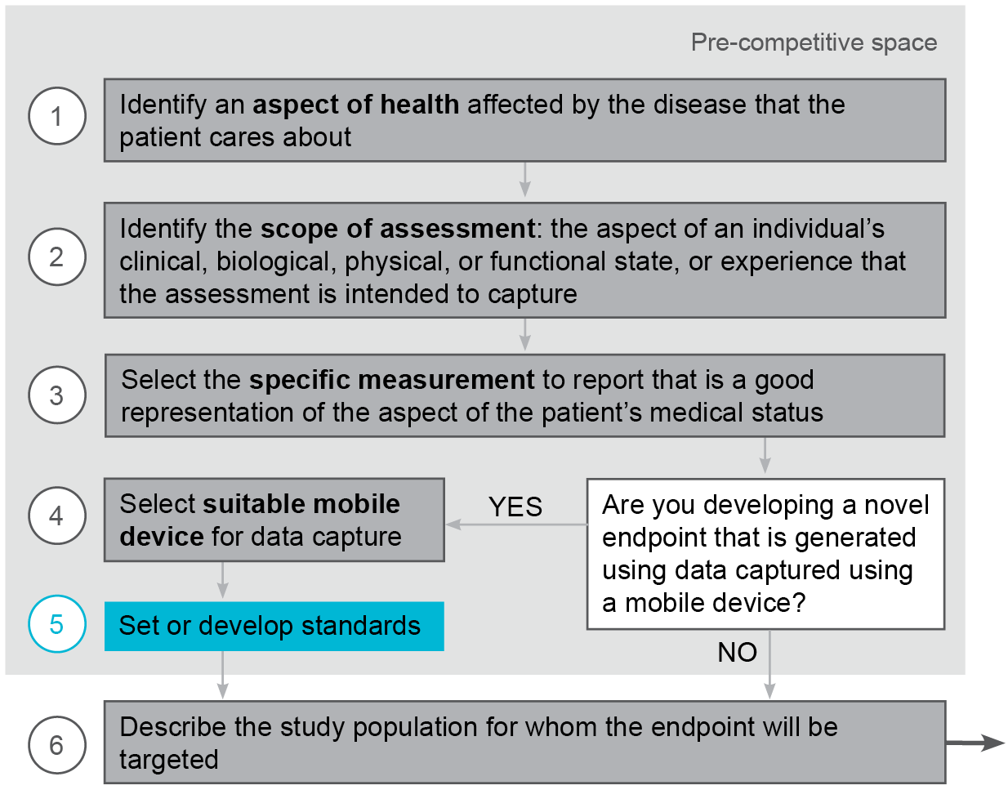
Steps for Novel Endpoint Development

Slide 22
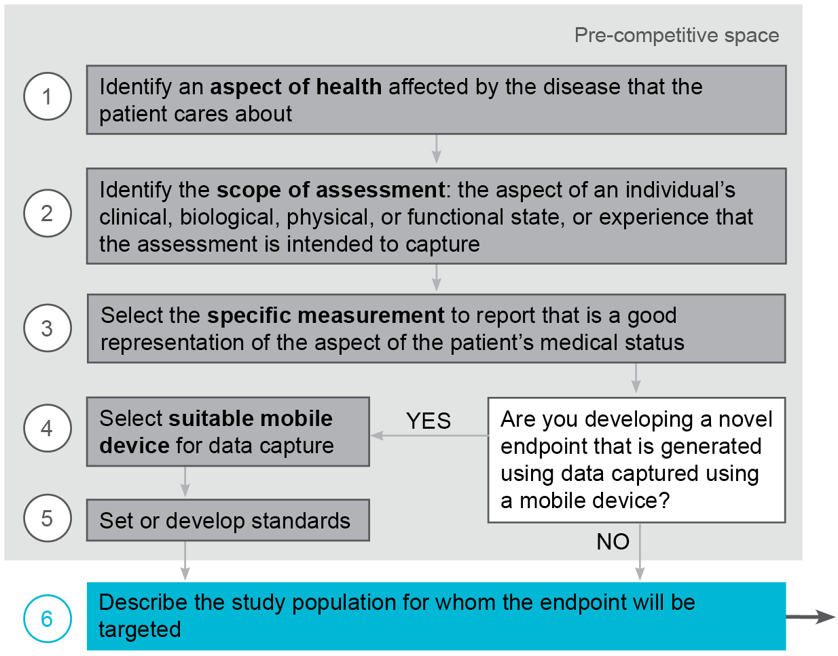
Steps for Novel Endpoint Development

Slide 23
Steps for Novel Endpoint Development

Slide 24
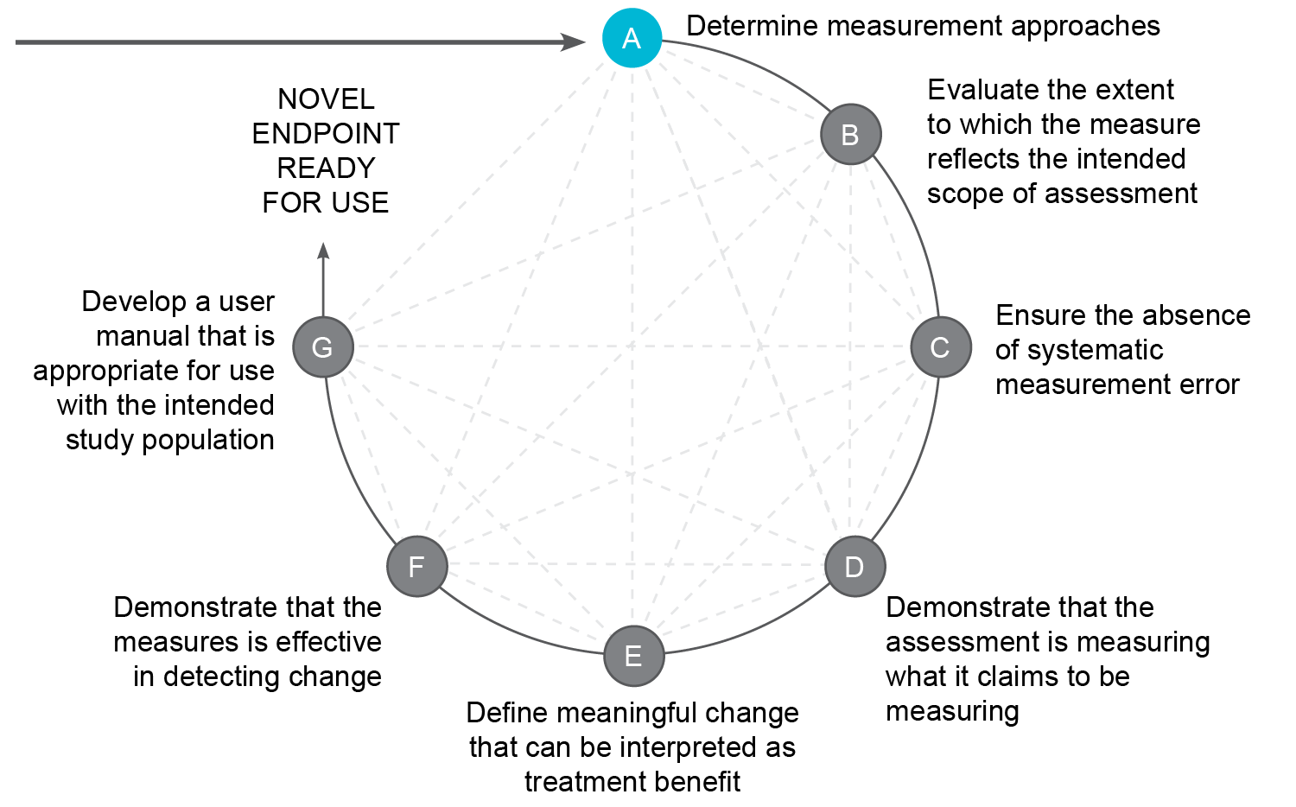
Steps for Novel Endpoint Development

Slide 25
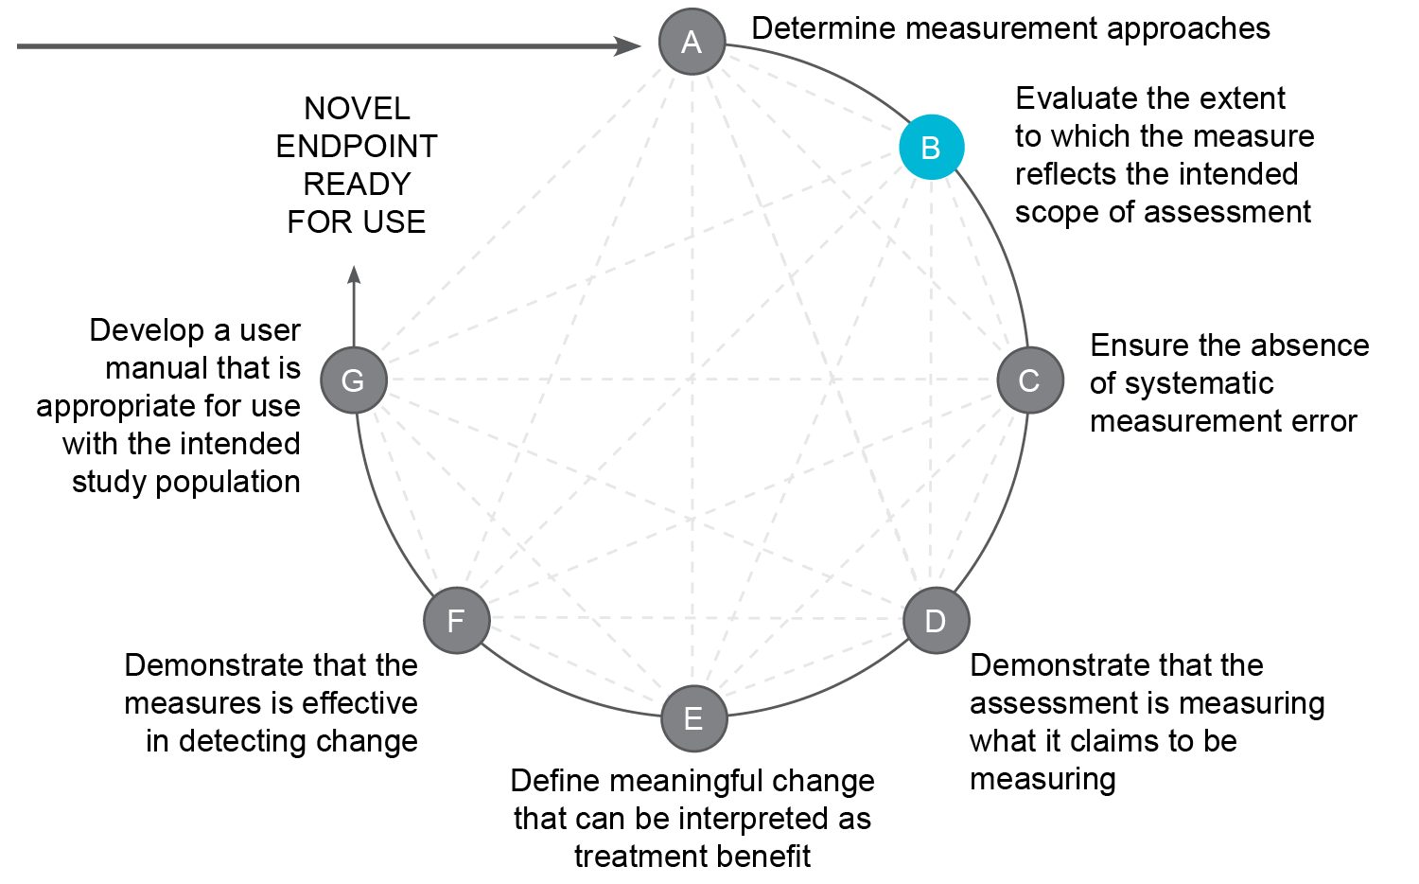
Steps for Novel Endpoint Development

Slide 26
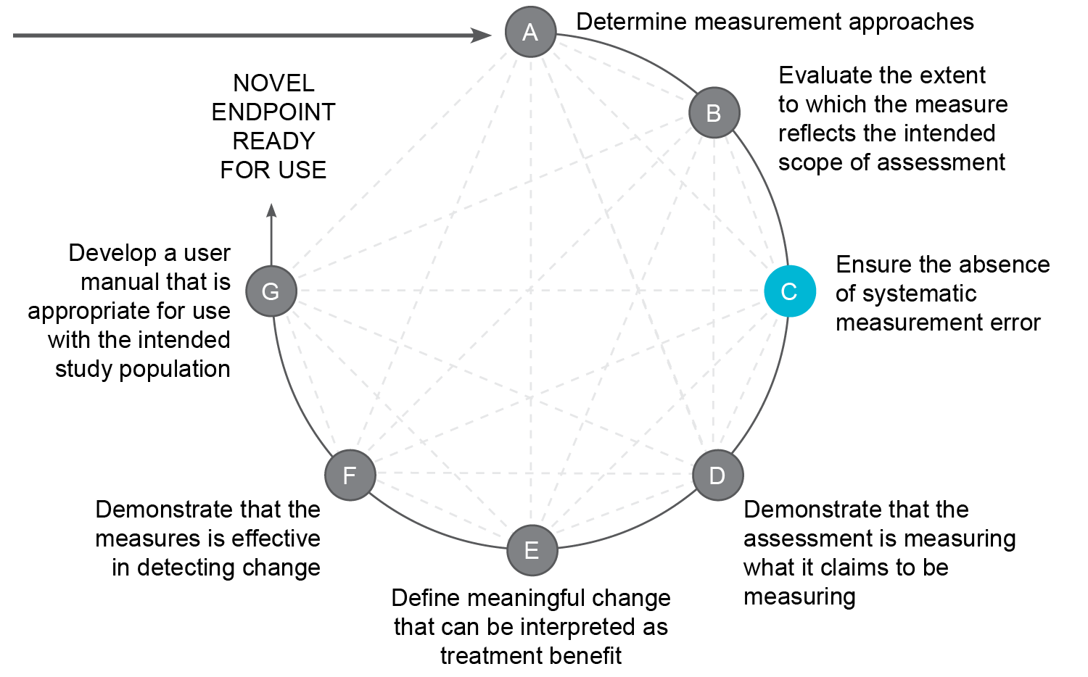
Steps for Novel Endpoint Development

Slide 27
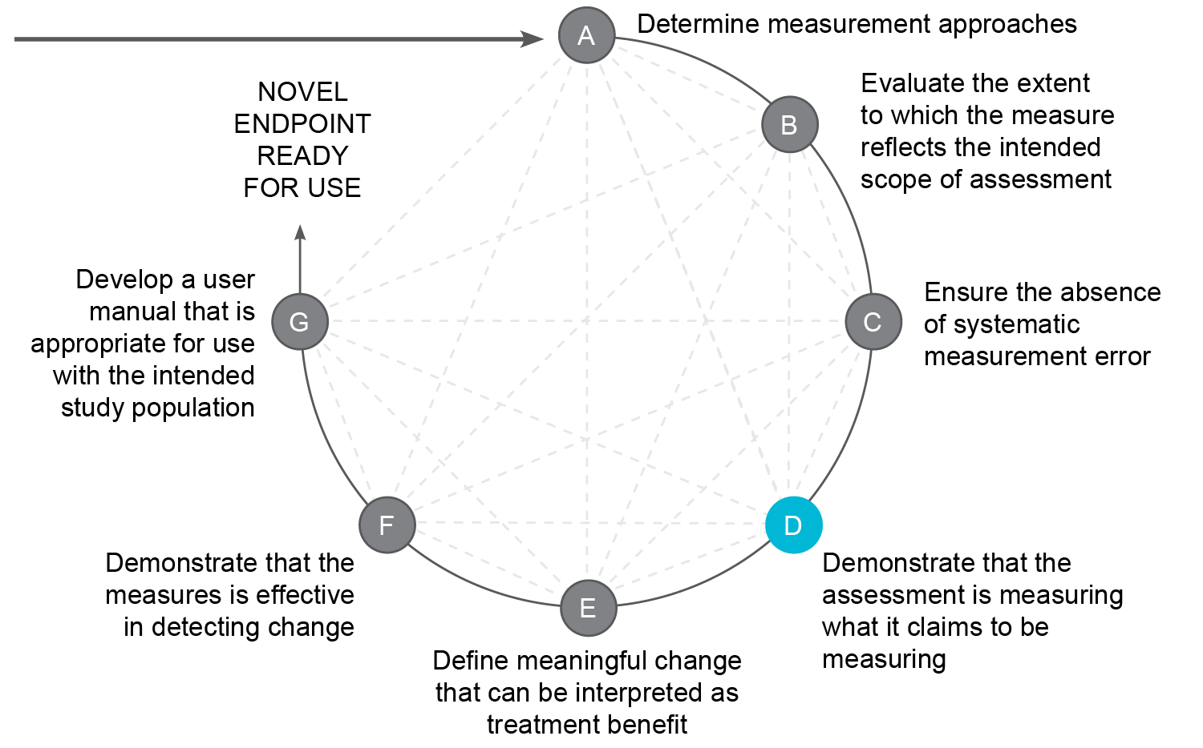
Steps for Novel Endpoint Development

Slide 28
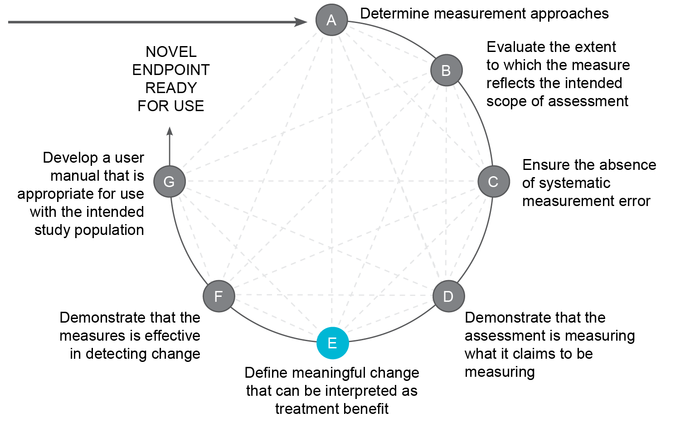
Steps for Novel Endpoint Development

Slide 29
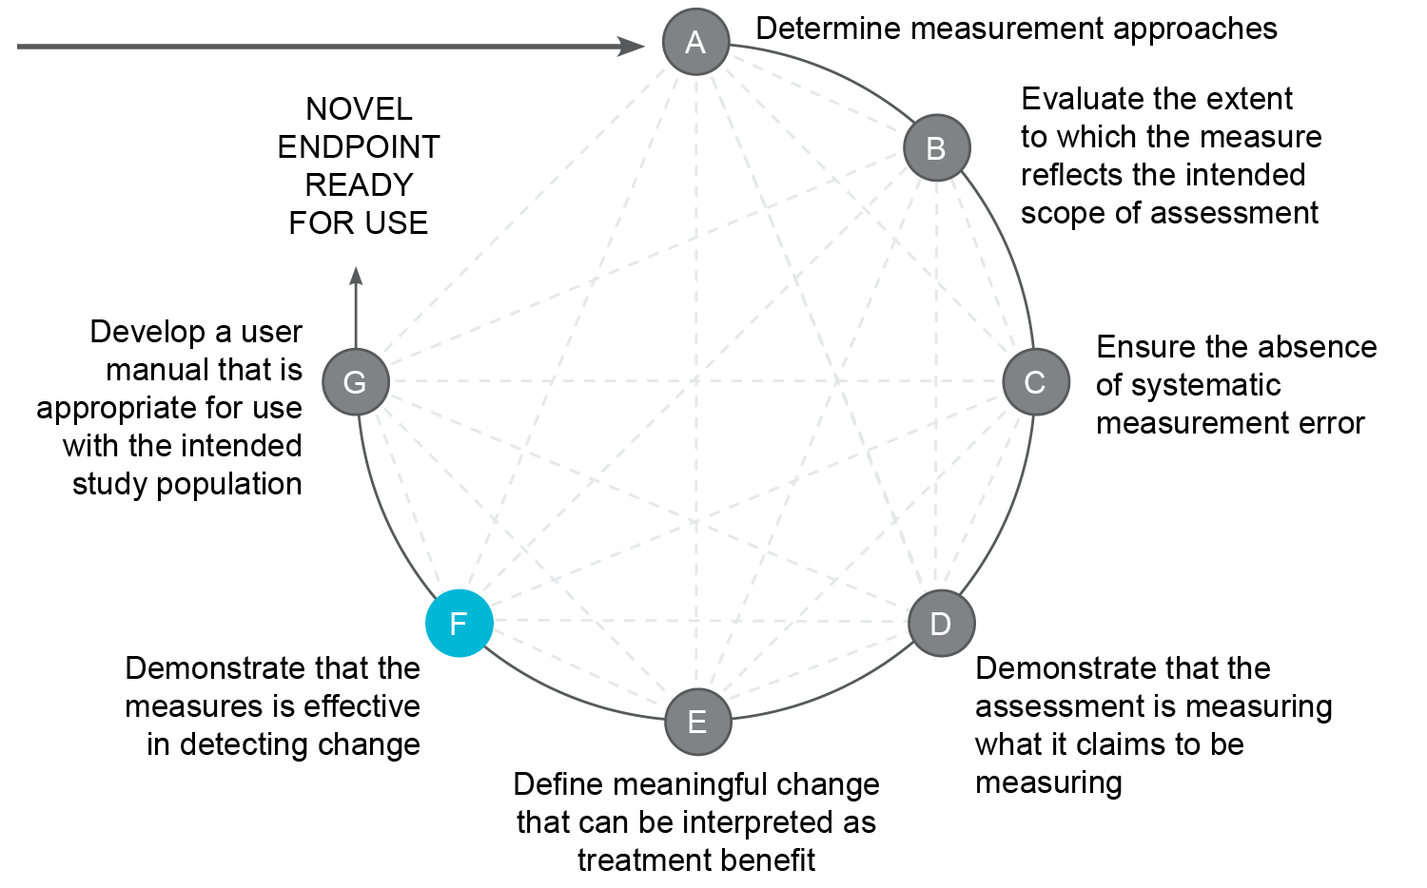
Steps for Novel Endpoint Development

Slide 30
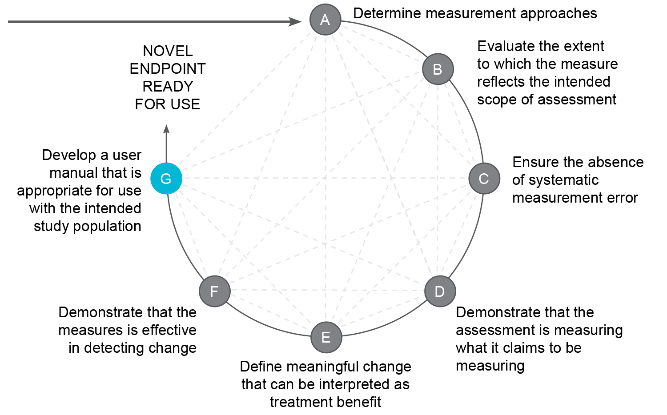
Steps for Novel Endpoint Development

Slide 31
Implementing the Development Pathway
High level pathway is supported by a detailed tool providing for each step detailed descriptions, suggested approaches, considerations and links to tangible examples within our use cases

Slide 32
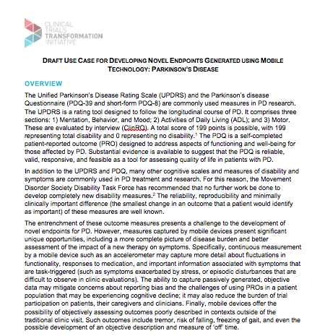
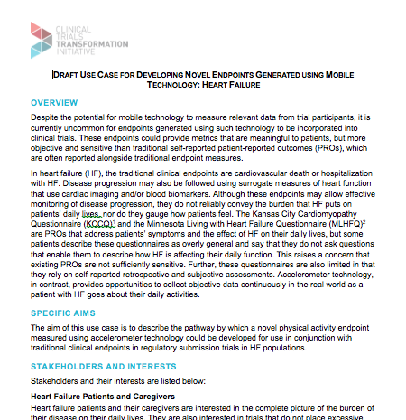
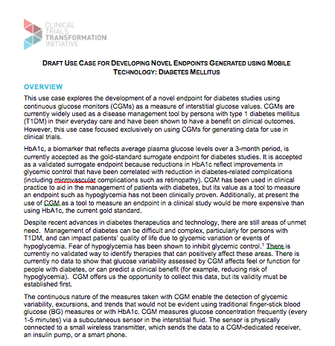
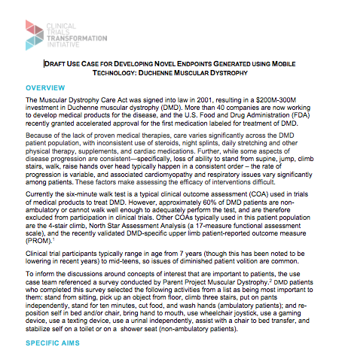
4 Use Cases
Parkinson’s Disease | Heart Failure | Diabetes | Duchenne’s Muscular Dystrophy

Slide 33
Recommendations: summary
Optimize novel endpoint selection
  Focus on measures that are meaningful to patients
  Select the device after selecting an outcome assessment
  Use a systematic approach to identify key novel endpoints
Approach novel endpoint development process practically
  Foster collaboration among key stakeholders
  Create technical standards for mobile technology-derived assessments
  Engage regulators throughout the process
  Include novel endpoints as exploratory endpoints in existing clinical trials and observational cohort studies
  Critically position novel endpoints in interventional trials

Slide 34
Benefits of Developing Novel Endpoints
BENEFITS
 | SHORT-TERM | MEDIUM-TERM | LONG-TERM
Patient Centricity | Development of high-quality, patient-centric, mobile technology-derived endpoints | Greater use of endpoints that matter to patients in clinical trials Reduced participation burden (patient and caregiver) in clinical trials Fewer barriers to trial participation Larger, more inclusive, and more generalizable trials | Increase in clinical trials that yield more complete information on how therapies affect aspects of disease most important to patients Increase in clinical trials that yield better information to inform regulatory and labeling claims as well as subsequent reimbursement decisions Increase in participation and retention of patients in clinical trials through the development and selection of measures that matter to patients
Efficacy | Inclusion of mobile technology-derived endpoints in early-phase trials and in postmarket surveillance | Improved predictability rates for advancement from phase II to phase III trials Increased efficiency of postmarket surveillance | Increase in number of potentially successful treatments taken forward for testing in phase III trials, particularly in high-risk therapeutic areas
Efficiency | Generation of data needed by payers to make coverage determinations during clinical trials | Prevention of delays in coverage, payment, and use decisions | Prevention of delays in patient access to therapies
*The term “clinical trial” is used here to refer to studies done to support regulatory approval for marketing.
Source: Clinical Trials Transformation Initiative’s Mobile Clinical Trials – Novel Endpoints Project

Slide 35
In Summary
The CTTI MCT Novel Endpoints Team has developed action-oriented recommendations and tools to support the development of valuable mobile tech derived novel endpoints
  Now available on the CTTI website:
  http://www.ctti-clinicaltrials.org/our-work/digital-health-trials/developing-novel-endpoints/
These recommendations and tools make technology derived novel endpoint development feasible
Key takeaways
  Use the steps we have outlined
  Select endpoints wisely
  Collaborate
  Engage FDA
  Position novel endpoints appropriately

Slide 36
Driving Adoption of Recommendations
Moderator: Martin Landray, University of Oxford
Panelists: Leonard Sacks, FDA
    Lauren Bataille, Michael J. Fox Foundation
      Wendy Snyder, Amgen
    Rob Wilson, Actigraph

Slide 37
C-Path CAMD survey

Slide 38
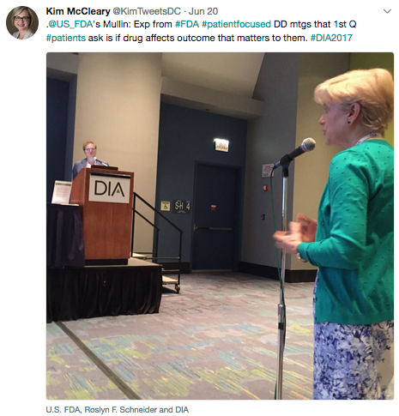

Slide 39
Discussion

Slide 40
Martin Landray martin.landray@bdi.ox.ac.uk
Marc Walton mwalton9@ITS.JNJ.com
Jen Goldsack jennifer.goldsack@duke.edu

